Slide 1
01 / THE PROBLEM
An ambulance is two minutes away
and still cannot find the door.
Indian addresses describe a neighbourhood. They do not locate a door.
DigiLease
Built on India Post's DIGIPIN

Slide 2
02 / FOUNDATION
India already built the answer
India Post · 27 May 2025 · Apache 2.0
Built with IIT Hyderabad and ISRO NRSC.
Ten characters name every 3.8 m square in India.
DIGIPIN
4P3 KCJ6 T8P
One 3.8 m square. Offline-derivable. No lookup table.
Not a company's format. India's own, open source, free for anyone to build on.

Slide 3
03 / THE GAP
But you still cannot share it safely
ROADMAP
India Post's roadmap, DHRUVA, describes a consent-based address system.
TODAY
The converter exists. The consent layer does not.
THIS BUILD
That is exactly what we built.

Slide 4
04 / DIGILEASE
LIVE — open the site
An address you can hand over,
and take back.
One link per person
Expires
Revocable
Works offline
One card for the door. Many links out of it — each one yours to end.

Slide 5
05 / CREATE
LIVE — /new
Make a card
01
Drop a pin
Move the pin onto your actual door. The DIGIPIN updates live underneath it.
02
Add the landmark
The marker a rider actually sees from the road. Blue gate.
03
Add a photo
One photo of the gate, kept in a private bucket.
The server computes the DIGIPIN. A code sent from the browser is never trusted.

Slide 6
06 / CONSENT
LIVE — create a share
One link per person
Label it. Choose how long it lasts.
Every receiver gets their own link, so you always know who opened which one — and ending one never touches the others.
ACTIVE SHARE
Flipkart Delivery
Expires in 72 hours
/s/9f3c4a2b
Opened 3 times · Last opened 19:37 · Ends automatically at 23 Sep 19:37

Slide 7
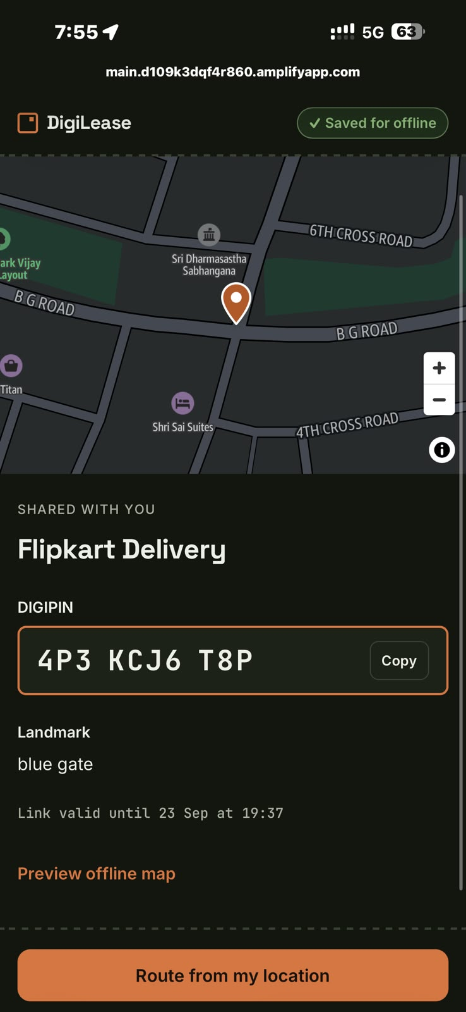
07 / THE RECEIVER
What the receiver sees
No app. No account.
The link opens in whatever browser they already have.
The door, the landmark, the DIGIPIN.
Copyable code, the gate photo, the marker they will see.
Saved for offline, automatically.
Cached on the first open, before they leave home.

Slide 8
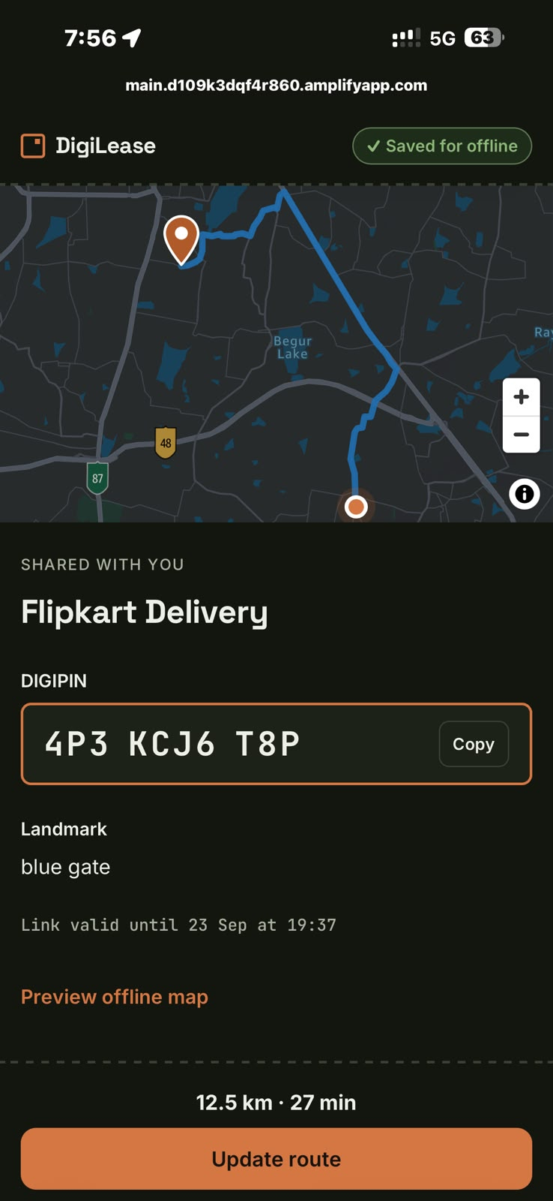
08 / ROUTE
Route to the door
12.5 km
to the door
27 min
estimated
Routed to the exact 3.8 m square, not to the locality. Amazon Location Routes v2, called from Lambda.

Slide 9
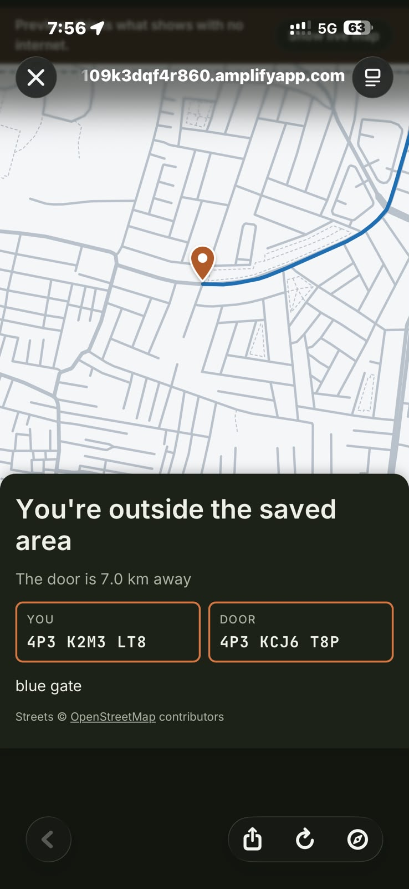
09 / OFFLINE
Then the signal drops.
Still works.
Streets, the route, their own position, and the distance to the door.
YOU
4P3 K2M3 LT8
DOOR
4P3 KCJ6 T8P
7.0 km away, with no network.
Streets © OpenStreetMap contributors

Slide 10
10 / REVOCATION
LIVE — hold to revoke
And you can take it back
Share
→
View
→
Revoke
→
Dead link
LINK STATUS
Link ended
The receiver's page dies on the next refresh. Nothing to uninstall, nothing to ask for back. The whole consent loop fits on one screen.

Slide 11
11 / ARCHITECTURE
Eight AWS services, one SAM template
Browser
API Gateway
Lambda
DynamoDB + S3
Location Service
→
→
→
→
FRONTEND
React 19 + Vite. AWS Amplify Hosting, CDN-delivered single-page app.
API
API Gateway HTTP API. Cognito JWT authorizer on every owner route, CORS locked to the deployed origin.
COMPUTE
One Lambda, Node 22. Computes the DIGIPIN server-side, validates every input at the boundary.
DATA
DynamoDB: Cards, Shares (GSI byCard), access log, TTL on expired shares.
STORAGE
S3 private bucket. Door photos behind 5-minute pre-signed URLs; cached street data per card.
MAPS
Amazon Location. Vector tiles via a restricted browser key, political-view=IND; Routes v2 from Lambda.
OPS
CloudWatch logs. One AWS SAM template, one command to deploy.
REGION
ap-south-1, Mumbai.

Slide 12
12 / HOW IT WORKS OFFLINE
Offline, in one line
01
Lambda fetches the streets around the door once from OpenStreetMap.
02
Stores that slice in Amazon S3.
03
The receiver's browser caches it on first open.
04
A service worker serves it with no network at all.
One fetch per card. Not per visitor.
Which is why it costs almost nothing to run, and why it still works in a basement.

Slide 13
13 / WHAT WE LEARNED
Two silent failures
AWS SAM
SAM silently drops your CORS config if you build AllowOrigins with an !If — and sam validate still passes. The API came up with no CORS, and no error anywhere.
MAPLIBRE + VITE
MapLibre's worker breaks under Vite's pre-bundling. The map style never finishes loading, and nothing is thrown.
Both cost us hours. Both are written down in the repo now.

Slide 14
14 / DIGILEASE
DigiLease
An address you can hand over, and take back.
main.d109k3dqf4r860.amplifyapp.com
Built on India Post's DIGIPIN · Apache 2.0

