Slide 1
W02D1 – SQL Intro
Instructor: Jeremy Eng
Credit: Eric Elmoznino

Slide 2

Introduction
Instructor: Dr. Jeremy Eng (engj@saskpolytech.ca)
Lead Cloud Applications and Data Instructor at Sask Polytech
Born and raised in Saskatoon, Saskatchewan
PhD in Statistics
Research Areas:
Big data simulations involving Monte Carlo techniques
Developing and applying machine learning techniques to model COVID-19 spread in Saskatchewan and Canada (PMCMC)
Microsoft Certified Trainer
LinkedIn: https://www.linkedin.com/in/jeremy-eng-sk/

Slide 3
Outline
Introduction
Types of Data
SQL
Database Schemas
RDBMS Landscape
SQL Demo/Exercises

Slide 4
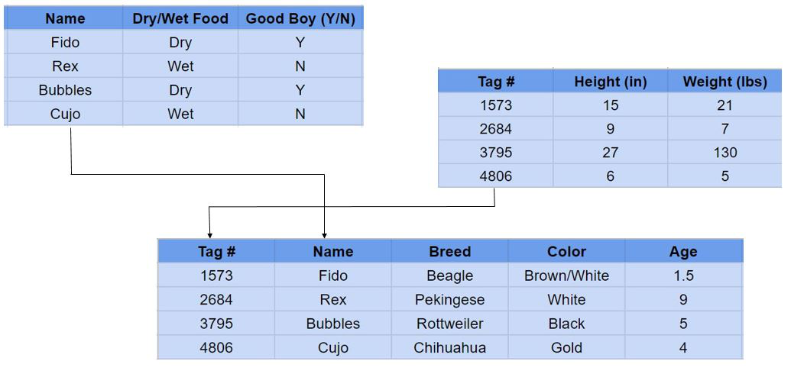
Introduction
Almost all companies/organizations store their data in some form of a database.
3 main types of data:
Structured
Tabular (rows/columns)
Relational

Slide 5
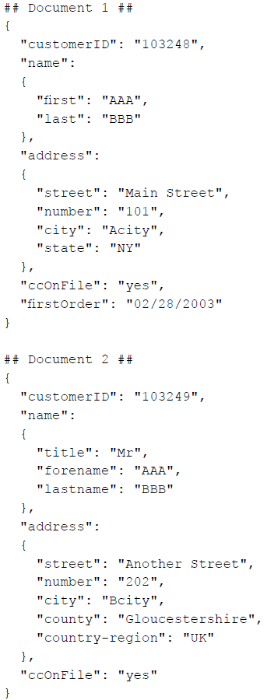
Introduction
Almost all companies/organizations store their data in some form of a database.
3 main types of data:
Structured
Tabular (rows/columns)
Relational
Semi-structured
Key-value stores (JSON), graph databases

Slide 6
Introduction
Almost all companies/organizations store their data in some form of a database.
3 main types of data:
Structured
Tabular (rows/columns)
Relational
Semi-structured
Key-value stores (JSON), graph databases
Unstructured
Audio, video, binary data

Slide 7
Introduction
Almost all companies/organizations store their data in some form of a database.
3 main types of data:
Structured
Tabular (rows/columns)
Relational
Semi-structured
Key-value stores (JSON), graph databases
Unstructured
Audio, video, binary data
SQL databases are used to store structured data (relational data)
Notes:
SQL: Structured
NoSQL: Semi/un-structured
Flexibility

Slide 8
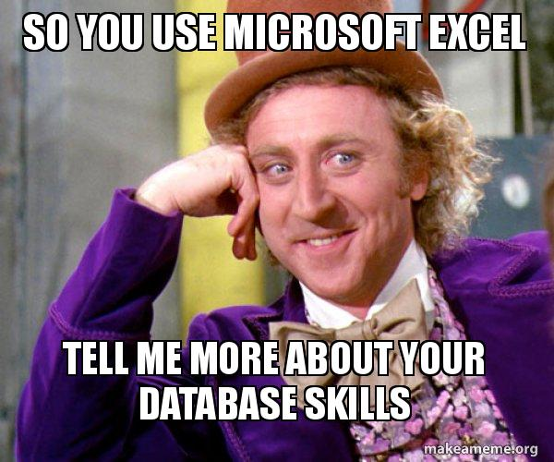
Introduction: Why Use Databases?
Databases enforce strict structure and relationships (clean data)
Ensures all data transactions are correct.
ACID properties
Can store massive amounts of data
Efficient data retrieval
Centralized, secure, robust
Integration availability with other software tools (e.g. Python)
Bad example: Excel spreadsheets
Notes:
ACID
Atomicity: All changes to data are performed as if they are a single operation. That is, all the changes are performed, or none of them are.
E.g.: In an application that transfers funds from one account to another, the atomicity property ensures that, if a debit is made successfully from one account, the corresponding credit is made to the other account.
Consistency: Data is in a consistent state when a transaction starts and when it ends.
E.g.: In an application that transfers funds from one account to another, the consistency property ensures that the total value of funds in both the accounts is the same at the start and end of each transaction.
Isolation: The intermediate state of a transaction is invisible to other transactions. As a result, transactions that run concurrently appear to be serialized.
E.g. In an application that transfers funds from one account to another, the isolation property ensures that another transaction sees the transferred funds in one account or the other, but not in both, nor in neither.
Durability: After a transaction successfully completes, changes to data persist and are not undone, even in the event of a system failure.
E.g. In an application that transfers funds from one account to another, the durability property ensures that the changes made to each account will not be reversed.
The advantages come into clear focus when you think about how quickly things would get out of hand if a company attempted to manage data with Excel.
Consistency (e.g. number types vs. string types appearing in the same column).
Size. Lack of efficiency. Not well organized, basically have to use a single massive table.
Speed. Operations like filtering, grouping, arithmetic are all slow and difficult to do. Bad for retrieval and manipulation.
Decentralized. Everyone starts making their own copy, who knows which is the true master file anymore.
Concurrency.
Google Spreadsheets can handle those, but run into other issues.
Excel has some integration with Python, but your Excel sheet has to be very specifically formatted. Easy for it not to work.

Slide 9
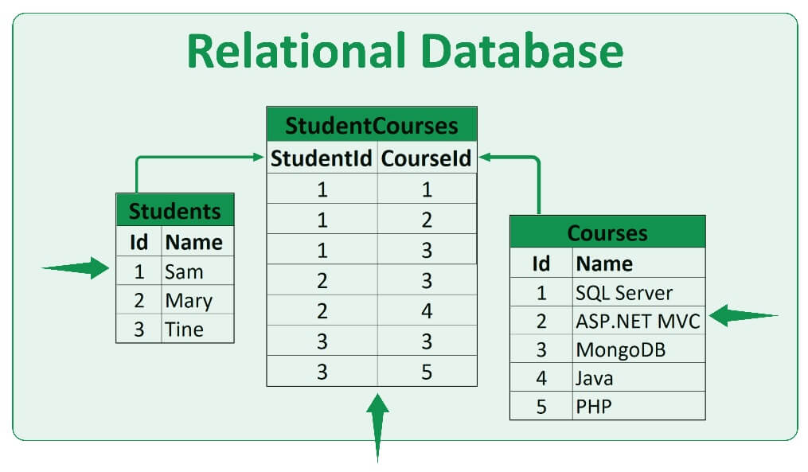
Why SQL?
Most common form of relational database management system (RDBMS)
Relations created via Primary/Foreign keys
Save space by using multiple tables
Use queries to get only the data you want.
Can calculate summary statistics on groups/subsets of data.
Mentioned in most data science job postings.
Focus on data retrieval, not definition/manipulation/control.

Slide 10
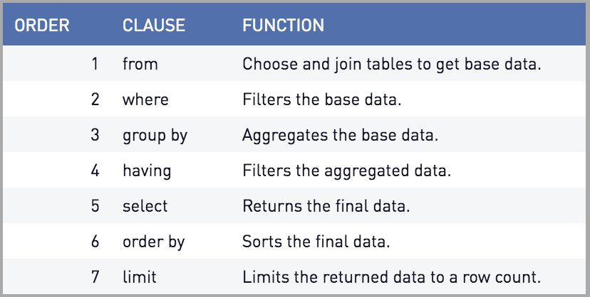
Challenges with SQL
Declarative language (SQL) vs imperative (Python)
Order of operations
Long, nested queries with many variable names
vs. imperative programming where good programs break logic up into multiple steps
Many things happening concurrently in a single SQL statement, order not explicit
vs. imperative programming where code executes line-by-line
Debugging is more difficult due to the above
Can help to break a complex query down into steps and test those out first. Incremental approach to writing the query
To review the fundamentals: https://www.w3schools.com/sql/
Notes:
Declarative optimization.

Slide 11
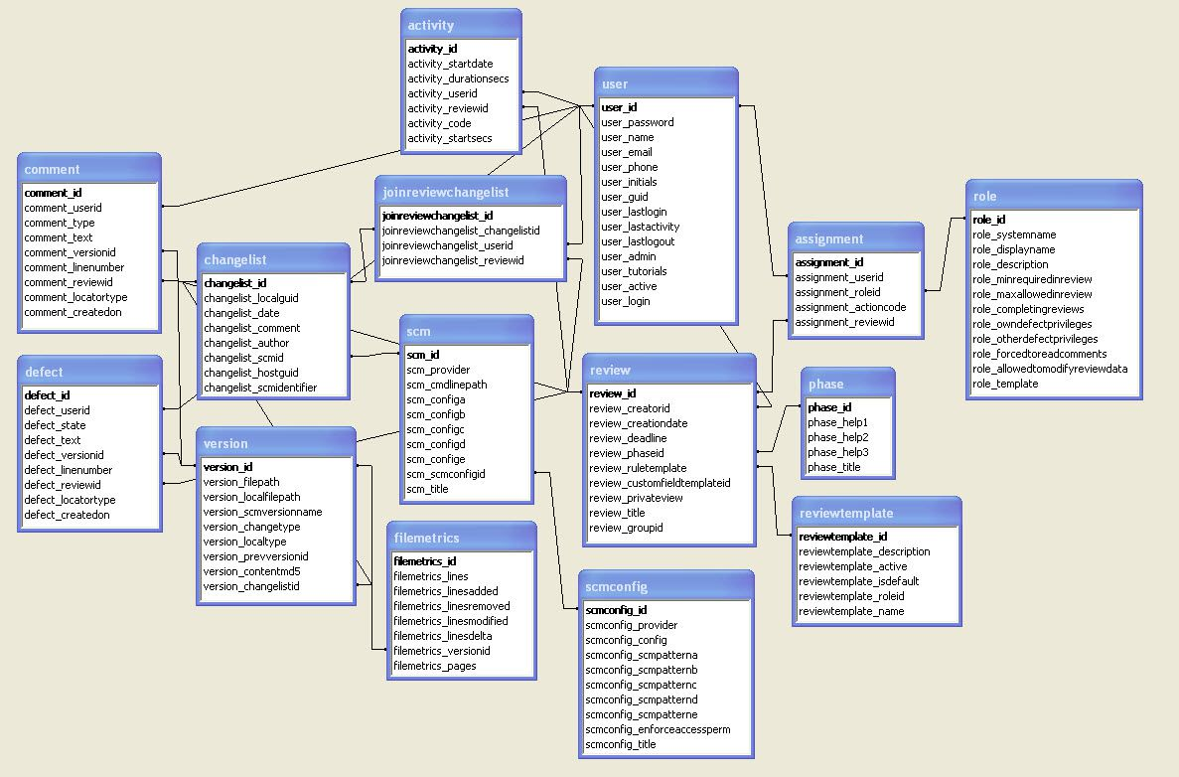
Database Schemas
How many tables should we create? What should be stored in each table? How are the different tables related?
Arguably the most difficult part of relational databases is designing the schema
Less of a concern for data scientist (data engineer/database administrator)
Important to understand the schema (structure) to know how to write queries (e.g. what tables to join).
Common designs:
Star schema
Snowflake schema
Notes:
More of a data engineer/database admin job

Slide 12
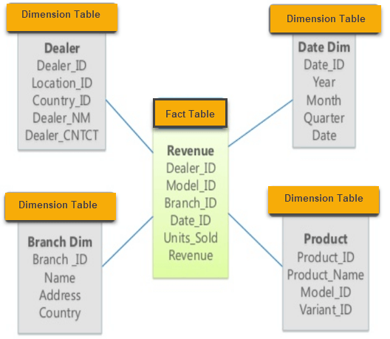
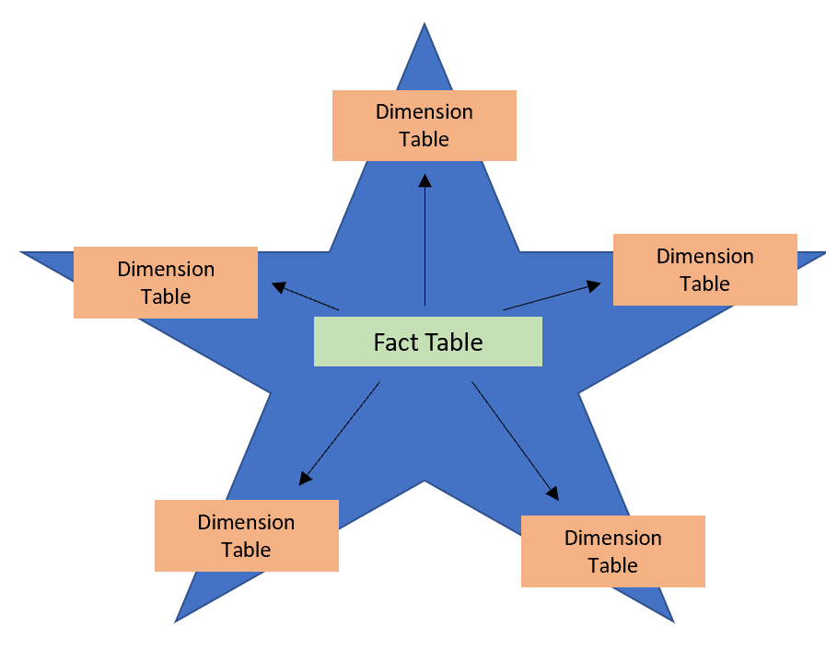
Star Schema
Fact tables vs Dimension tables
Fact tables: Contain events / transactions / observations. Updated often—lots of rows, less columns.
Dimension tables: Contain attributes about a single “concept” (column) in the fact table. Rarely updated—fewer rows.
Fact Tables contain foreign keys, dimension tables contain primary keys.
Dimension tables are not related to each other.
Usually filter/group on items in dimension tables.
Notes:
Fact table examples: sales orders, stock balances, exchange rates, temperatures
Dimension table examples: products, people, places

Slide 13
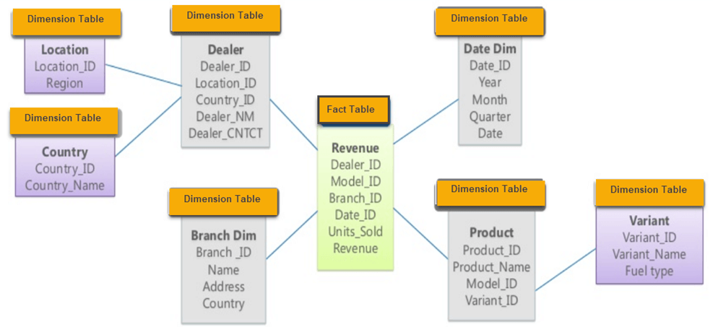
Snowflake Schema
Nested version of the Star Schema
Dimension tables can contain foreign keys
Dimension items can be complex concepts.
More tables, but less duplication.
Concepts of Normalization:
Eliminate repeating groups in individual tables.
Create a separate table for each set of related data.
Identify each set of related data with a primary key.

Slide 14
RDBMS Landscape
SQL is a programming language, but there are many different flavours of SQL (versions).
Basic SQL statements are the same, but different custom statements.
Closed source (i.e. paid)
Vendors: Oracle, SQL Server (Microsoft), IBM DB2, Microsoft Access - local small databases
Could come with integrations and services that make things easier
Open source (i.e. free)
MySQL, PostgreSQL, SQLite, MariaDB
Good developer community makes these great options
This website offers a good comparison of open source systems options.
Notes:
Microsoft: VS Code, C sharp, MS source control (like github).

Slide 15
SQLite and PostgreSQL (Postgres)
SQLite is great to learn SQL
Don’t have to set up a server with users.
Stored locally as a file (can be used by desktop applications)
Not actually used in companies/orgs with multiple users
E.g. no concurrency
Postgres is open source which makes it easy to upgrade or extend
High compliance to the SQL standard
Easily runs on Windows, Mac OS X, and almost all Linux distributions
MySQL would be a good choice too (less compliance to SQL standard)
Can run locally or connect remotely.
Notes:
We will mainly use SQLite and Postgres

Slide 16
SQL Demo
Notes:
We will mainly use SQLite and Postgres

