Slide 1
W08D4 – NLP II
Instructor: Jeremy Eng
Credit: Eric Elmoznino

Slide 2

Introduction
Instructor: Dr. Jeremy Eng (engj@saskpolytech.ca)
Lead Cloud Applications and Data Instructor at Sask Polytech
Born and raised in Saskatoon, Saskatchewan
PhD in Statistics
Research Areas:
Big data simulations involving Monte Carlo techniques
Developing and applying machine learning techniques to model COVID-19 spread in Saskatchewan and Canada (PMCMC)
Microsoft Certified Trainer
LinkedIn: https://www.linkedin.com/in/jeremy-eng-sk/

Slide 3
Outline
Sentiment analysis
What is sentiment analysis?
Different types of sentiment analysis
Use cases
Demo
Topic modeling
What is topic modeling?
Use cases
Latent Dirichlet Allocation
Demo

Slide 4
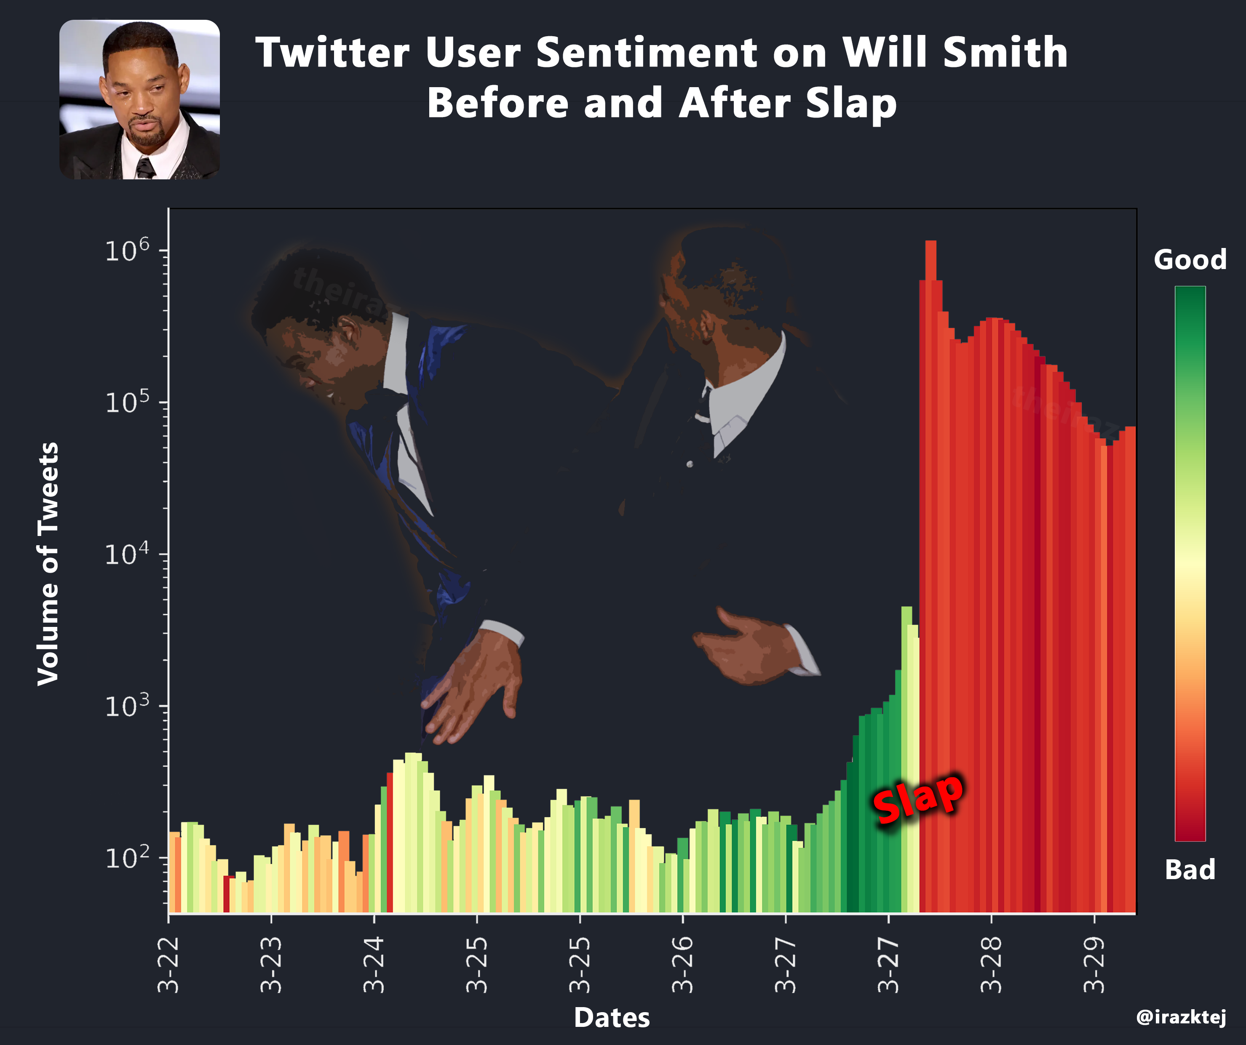
Sentiment Analysis
Notes:
Sentiment analysis: determining the opinion or attitude of some given text (subjective).

Slide 5
Sentiment Analysis
Sentiment analysis: determining the opinion or attitude of some given text (subjective).
Supervised or unsupervised.
Binary classification, multi-class classification, regression, etc.
Aka: Opinion Mining, Sentiment Mining, or Subjectivity Analysis.
Useful in marketing, customer service, social media, psychology.
Example—”The Batman” review:
“I'll admit I raised an eyebrow when I saw that Pattinson was cast, but I eat my words, he was awesome, and hopefully will play the part a few more times. This film blew me away, exciting, fast paced, surprisingly gritty, and genuinely had an awesome story.”
Result: Positive or negative? Positive, negative, or neutral? Scale from -1 to 1?
What are some key factors?
Challenges?
Sarcasm, both +/- words, (long range) negation, syntax, writing style.
Notes:
Faster than reading through every review, social media post, document, etc.
Focus on supervised sentiment
+/- words (e.g., decent)

Slide 6
Sentiment Analysis: Use Case Examples
Marketing
Immediate feedback on a new product via social media
Brand monitoring: reviews, blogs, news, forums
Market research: what is popular/not popular?
Automated customer service actions
Chat bot vs when to send to human.
Market predictions
Stock prediction
Psychology
Suicide prevention
Notes:
What would the (supervised) training data consist of?
For NLP, you usually need a LARGE training data set (corpus)

Slide 7
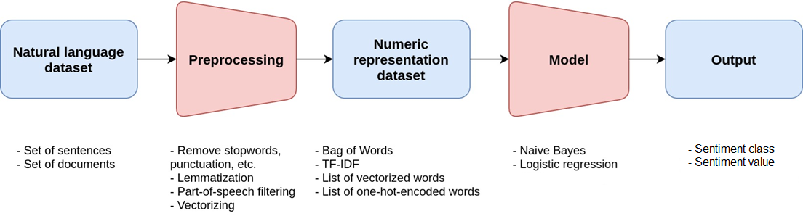
Sentiment Analysis: Full Process
Notes:
Stopwords are the English words which does not add much meaning to a sentence. They can safely be ignored without sacrificing the meaning of the sentence.
Lemmatization is the process of grouping together the inflected forms of a word so they can be analyzed as a single item. (running, ran, runner, etc.)
Part-of-speech filtering: Nouns, verbs, adjectives, adverbs, etc.
Vectorizing: converting words/phrases → vectors of real numbers
Bag of words: words and how often they occur
TF-IDF (term frequency-inverse document frequency): a statistical measure that evaluates how relevant a word is to a document in a collection of documents.
Word vectorization: words/phrases → vectors of real numbers
One-hot-encoded words: Every word which are part of the given text data are written in the form of vectors, constituting only of 1 and 0 . Each word is written or encoded as one hot vector, with each one hot vector being unique.

Slide 8
Sentiment Analysis: Machine Learning Models
For sentiment classes:
Naïve Bayes
Logistic Regression
Random Forest
Support Vector Machines
Classification models!
For sentiment values:
Regression models!
Neural Networks

Slide 9
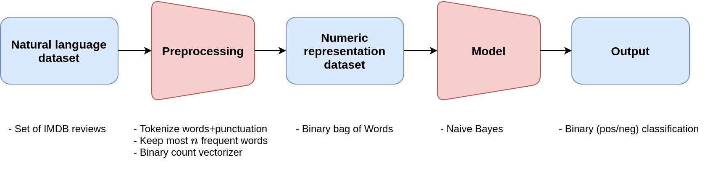
Sentiment Analysis: Demo

Slide 10
Topic Modeling
Given a set of documents, I want to identify topics that best describe them.
Ex: All of your emails.
Ex: News articles from 2021.
Unsupervised learning
Could label and do supervised, but would no longer be considered topic modeling.
Also, a lot of work (reading).
What previous ML technique is this similar to?
Challenges?
Multiple word meanings (e.g. model)
Topic mixtures (multiple topics in a single document)
Very training dataset dependent (global vs local news articles)
Domain knowledge
Must determine actual topic “name” afterwards
Hyperparameter representing number of topics
Notes:
Topics of emails: Lighthouse/education, dog/cat, shopping,
Topics of 2021 news articles: covid, Joe Biden, GME meme stock, supply chain problems
Similar to clustering

Slide 11
Topic Modeling: Use Case Examples
Tagging documents
Organizing company documents
Organizing scientific papers
Marketing
Kinds of things people are saying about your brand
Recommendations based on reading (or listening) history
Data collection
Legal discovery
Search engines
Label webpages with topics (used by Google)

Slide 12
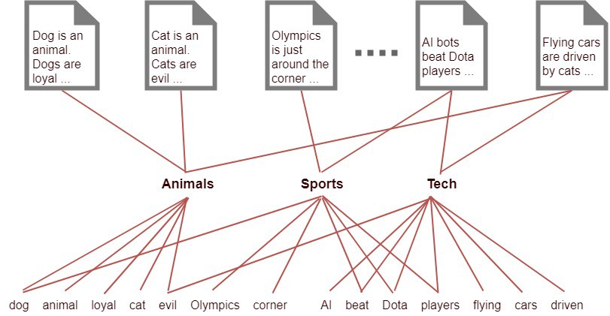
Topic Modeling: Latent Dirichlet Allocation (LDA)
Overview
Each document is described by a distribution of topics.
Each topic is described by a distribution of words.
Given some document, what is the most probable distribution of topics that generated it?
Hierarchical Bayesian model (three-level):
p(topics|document) ∝ p(document|topics)p(topics)
Unsupervised
Notes:
LDA in dimensionality reduction refers to linear discriminant analysis
Latent = not observed

Slide 13
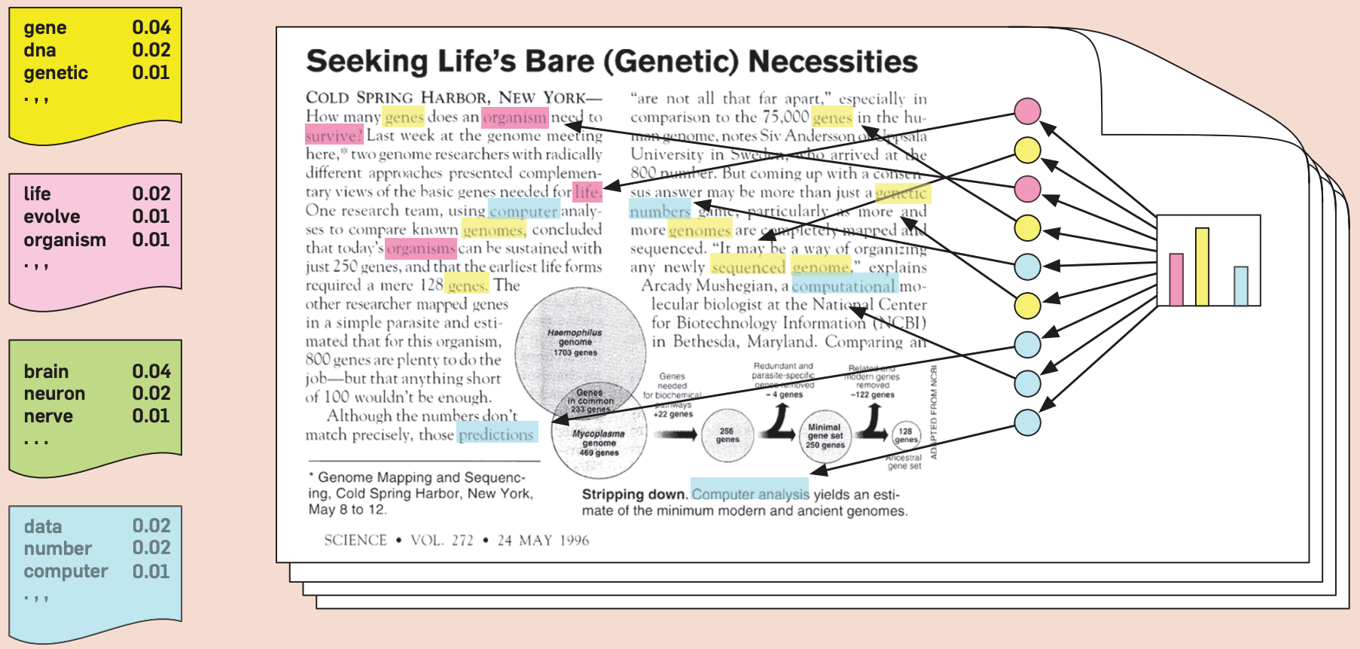
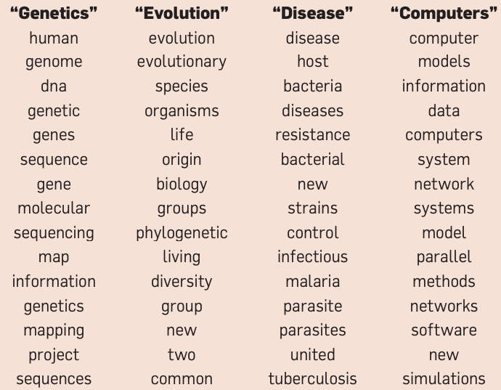
Topic Modeling: LDA Assumed Generative Process
Each document is described by a distribution of topics.
Each topic is described by a distribution of words.
Notes:
Assumed generative procedure:
Sample topic (from dist’n)
Sample word from topic (from dist’n)
Want to learn:
Words in each topic
Word dist’n (for each topic)
Topic dist’n (for each document)

Slide 14
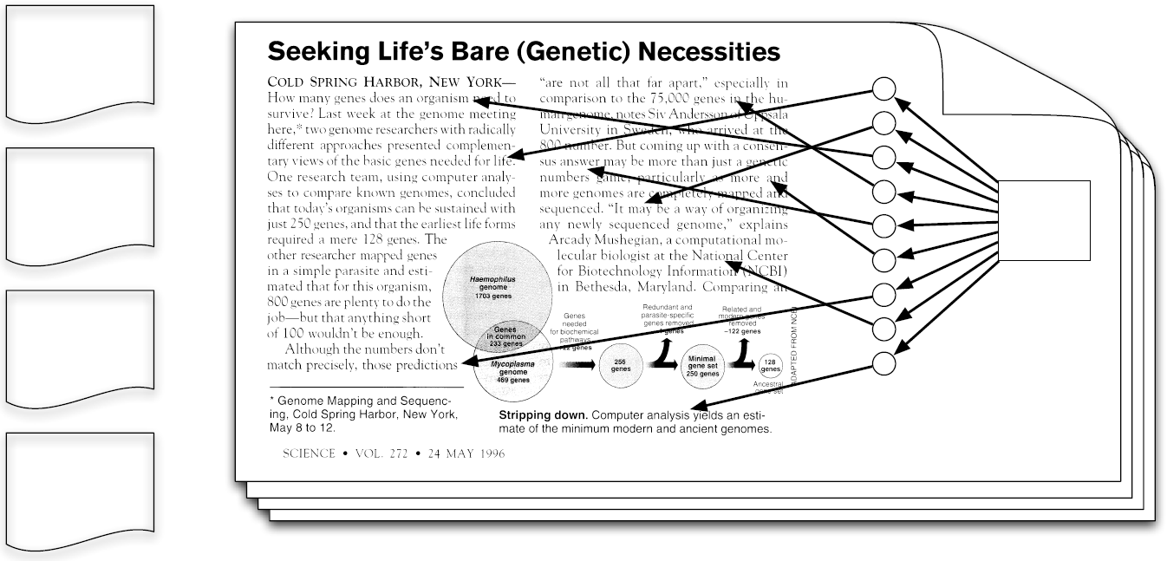
Topic Modeling: LDA Assumed Generative Process
Each document is described by a distribution of topics.
Each topic is described by a distribution of words.
Notes:
This is what we start with

Slide 15
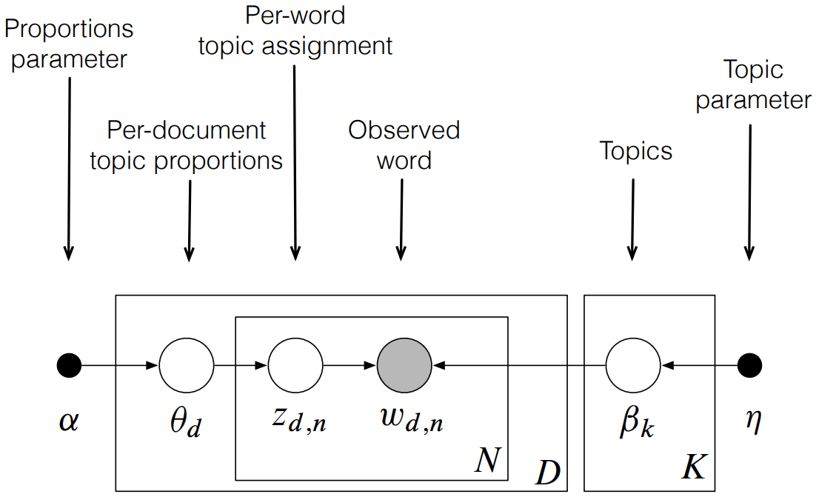
Topic Modeling: LDA Graphical Model
D documents, N words, K topics
Hyperparameters: α, η, K
β_{k} = word proportions in topic K (depends on η)
θ_{d} = topic proportions in document d (depends on α)
z_{d,n} = assigned topic for word n in document d
Nodes = Random Variables
Shaded = observed
Unshaded = latent
Arrows show dependence
Plates = replication
Notes:
Hyperparameters:
α = Controls how many topics are in each document (few or many)
η = Represents how many words are in each topic (few or many)
We want to infer:
β_{k} = word proportions in topic K (depends on η)
θ_{d} = topic proportions in document d (depends on α)
z_{d,n} = assigned topic for word n in document d
Many ways to perform this inference.

Slide 16
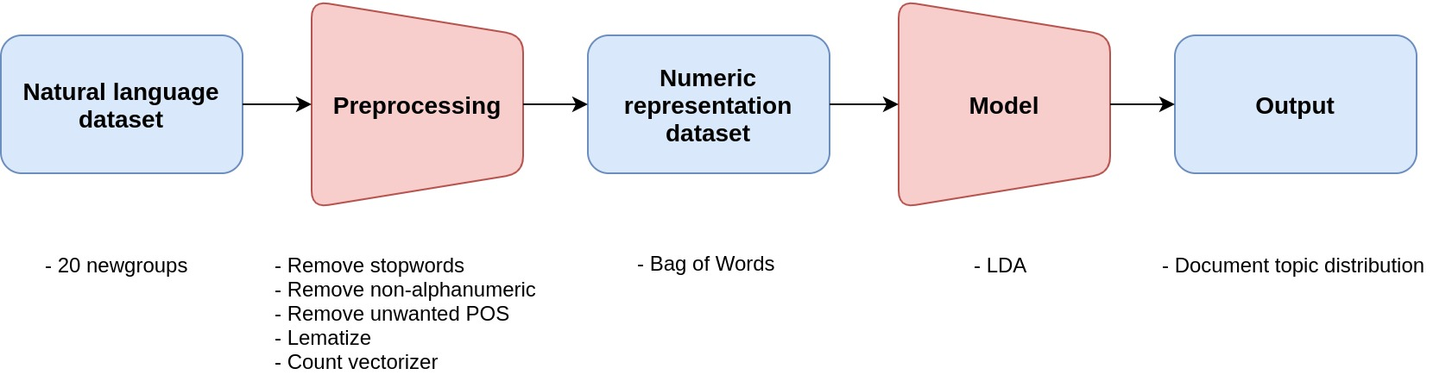
Topic Modeling: Demo

