Slide 1
COVID-19 Trends and Death Rates Analysis in the United States
Student Name: Vinayak Vemula
CSIT 553: Exploratory Data Analysis and Visualization

Slide 2
Project Overview
Objective: Analyze COVID-19 case trends and mortality across US states.
Techniques used: EDA, Aggregation, Map Visualizations, Interactive Time Series.
Understand geographical and time-based patterns in COVID-19 spread.

Slide 3
Dataset Description
Dataset: COVID-19 Data Repository by Johns Hopkins University (CSSE)
Source: https://github.com/CSSEGISandData/COVID-19
Fields Used: Province_State, Lat, Long_, Date-wise cumulative Cases and Deaths.

Slide 4
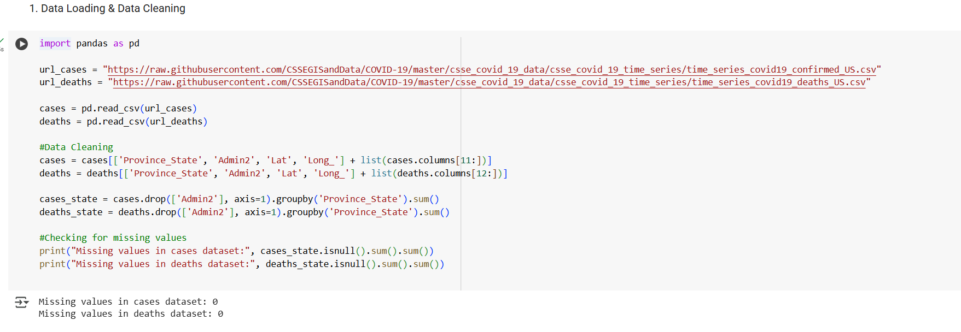
Data Loading & Cleaning
Loaded two CSV files: Confirmed Cases and Deaths in the USA.
Selected essential columns (State, Lat, Long, Dates).
Grouped by State.
Checked for missing values (minimal).

Slide 5
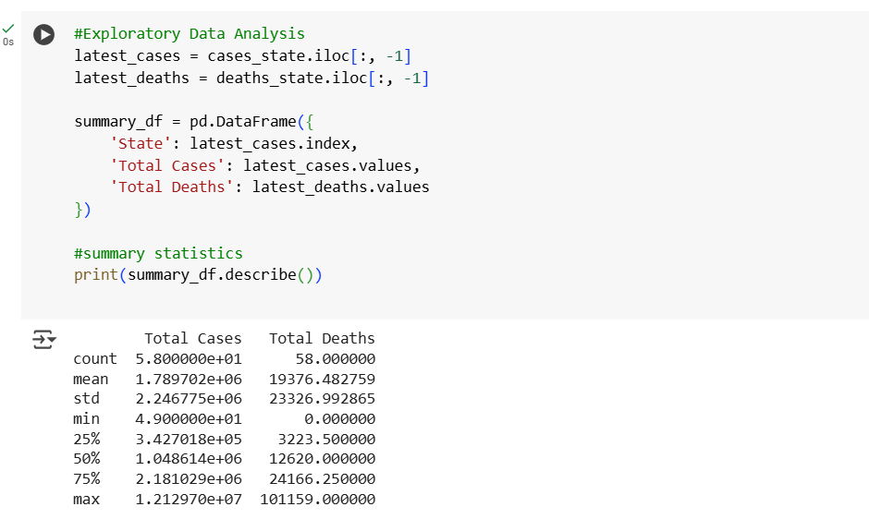
Descriptive Statistics (EDA)
Total Cases and Deaths summarized per state.
Descriptive stats: Mean, Min, Max, Standard Deviation.
California, Texas among highest cases.

Slide 6
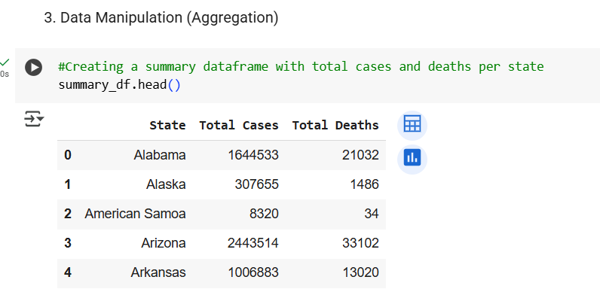
Data Aggregation
Aggregated total cases and deaths at the State level.
Simplified county-level data into state summaries.

Slide 7
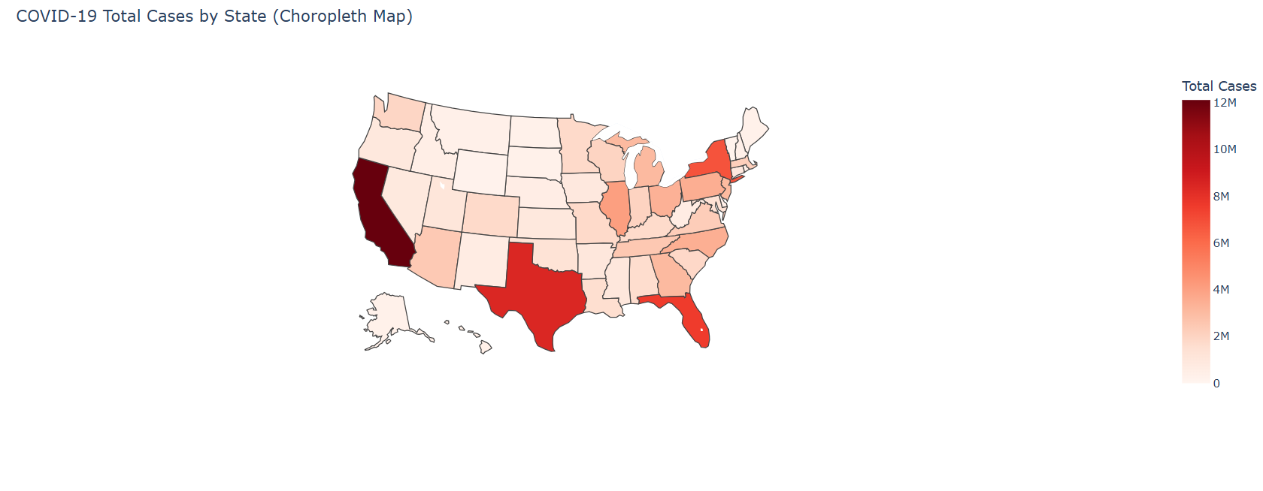
Map Visualization 1: Choropleth Map
Visualization: Total Cases by State.
Method: Plotly Choropleth Map.
(Insert Choropleth Map Screenshot)
Insight: Higher cases in CA, TX, FL, NY.

Slide 8
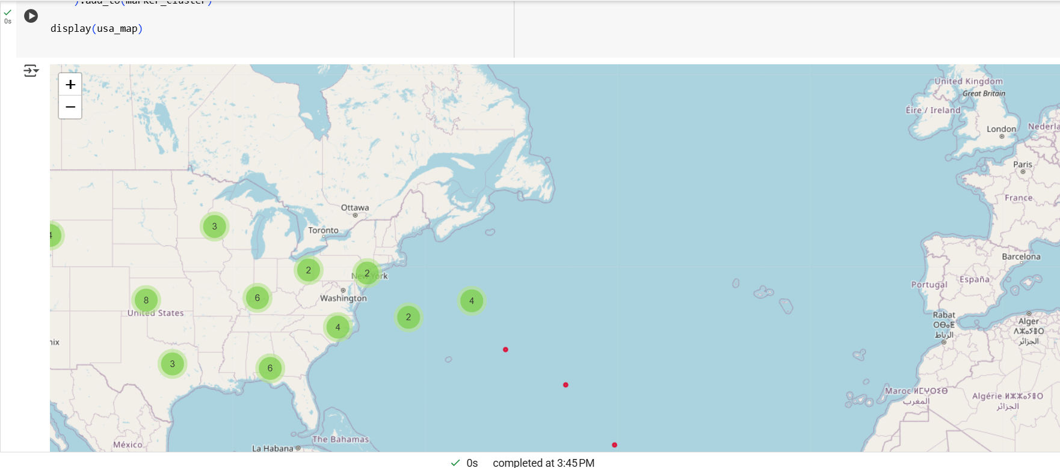
Map Visualization 2: Bubble Map
Visualization: Total Deaths by State.
Method: Folium Bubble Map with Marker Clusters.
(Insert Bubble Map Screenshot)
Insight: Death clusters in NY, CA, TX.

Slide 9
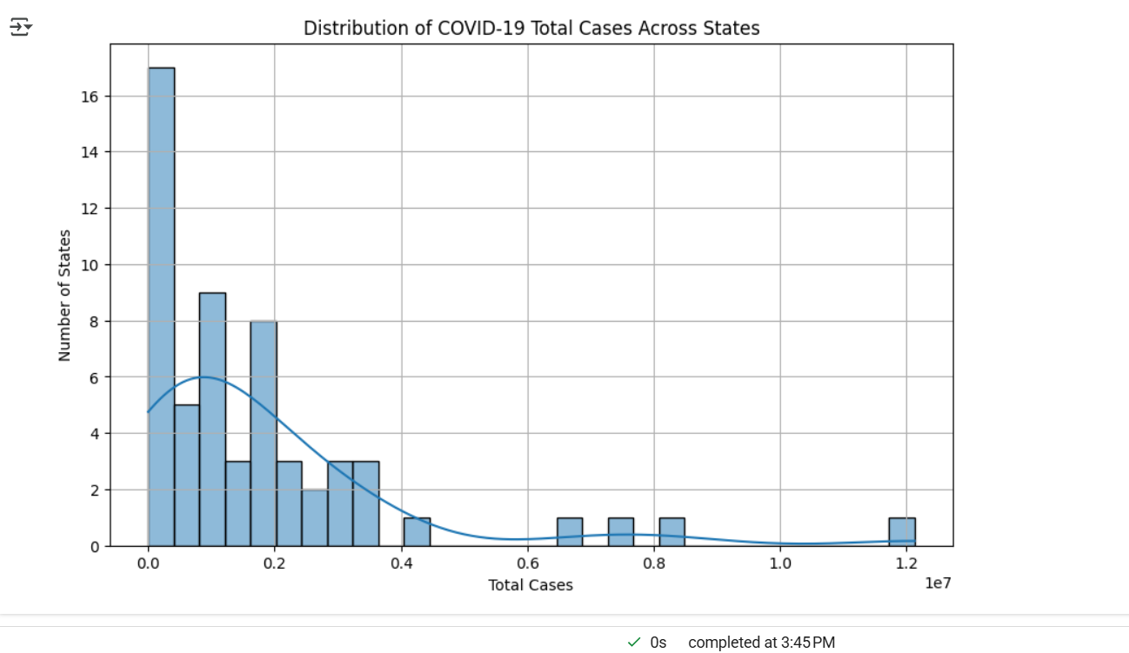
Aggregation Visualization 1: Histogram
Visualization: Distribution of Total Cases.
Method: Seaborn Histogram.
(Insert Histogram Screenshot)
Insight: Most states have < 1 million cases.

Slide 10
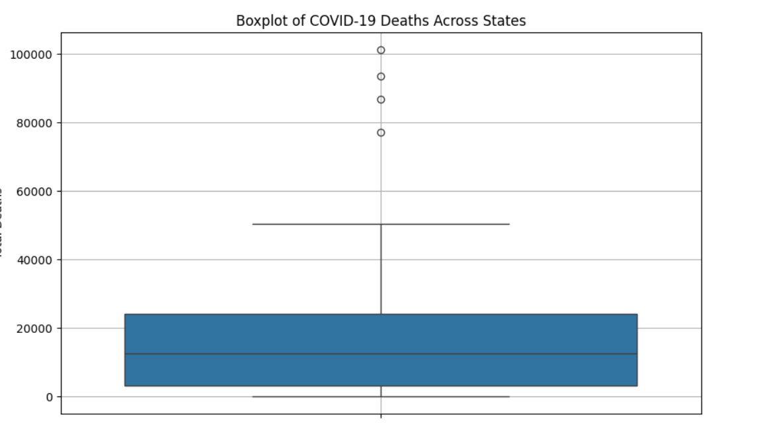
Aggregation Visualization 2: Boxplot
Visualization: Spread of Deaths across States.
Method: Seaborn Boxplot.
(Insert Boxplot Screenshot)
Insight: Few states are outliers with very high deaths.

Slide 11
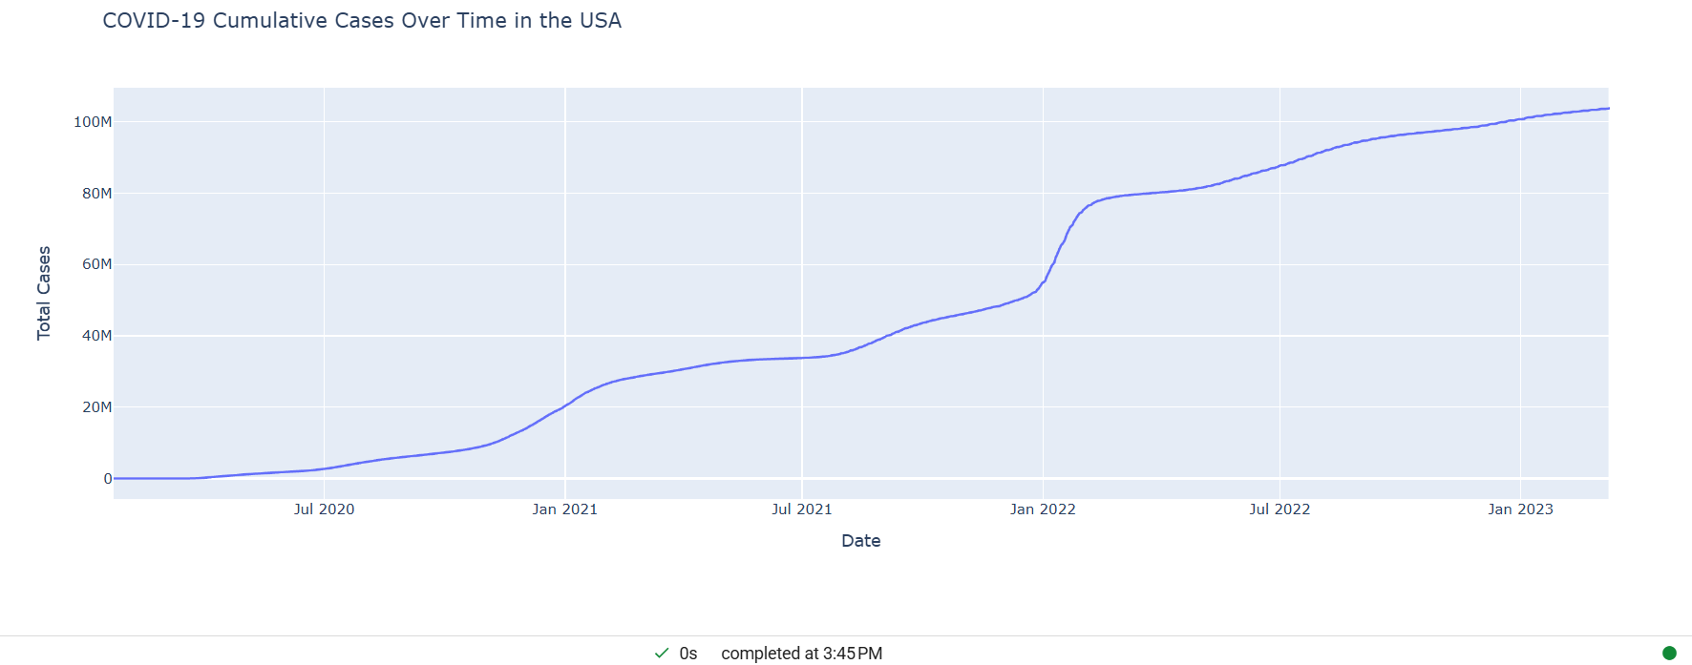
Interactive Visualization: Time Series
Visualization: Cases Cumulative Over Time.
Method: Plotly Interactive Line Chart.
(Insert Time Series Plot Screenshot)
Insight: Exponential rise in 2020; stabilizing later.

Slide 12
Conclusion
States like CA, TX, and FL recorded the highest cases.
COVID-19 death rates were unevenly distributed.
Time series shows early exponential outbreak phase.
Visualizations helped explore spatial and temporal patterns.

Slide 13
Demo Execution
All codes executed successfully.
Live Choropleth and Bubble Maps displayed.
Interactive Time Series graph working.
LINK: https://colab.research.google.com/drive/1bunuFX7nS75BQgY2eW1W0fcvrBYHLFq6?usp=chrome_ntp

Slide 14
References
Dataset: COVID-19 Data Repository by Johns Hopkins University (CSSE)
https://github.com/CSSEGISandData/COVID-19
Plotly, Folium, Seaborn Libraries for visualization.

