Slide 1
CSIT697 MASTER'S PROJECT
Recycling Awareness
Data Dashboard
Analyzing recycling rates across materials, US regions, and OECD countries
Vinayak Vemula
50124145
Varshitha Kayithi
50123684
April 2026

Slide 2
Agenda
01
Project Overview & Objectives
05
Key Findings
02
Dataset & Data Collection
06
Dashboard Demo
03
Data Preprocessing Pipeline
07
Roles & Responsibilities
04
Exploratory Data Analysis
08
Conclusion

Slide 3
Project Overview
Objective
Analyze recycling awareness and recycling rates across different regions using publicly available data. Focus on Plastic, Paper, Glass, and Metal. Identify trends and regional differences using statistical methods. Present results through an interactive HTML dashboard.
Materials
Regions
Methods
Output
📦
🗺️
📊
🖥️
Plastic · Paper
Glass · Metal
US National
8 States · 15 Countries
EDA · Regression
Correlation · Stats
Flask API
Interactive Dashboard

Slide 4
Data Collection
US National - EPA Facts & Figures
Source: US Environmental Protection Agency (EPA) • Coverage: United States, 1960–2018, annual • Materials: Plastic, Paper, Glass, Ferrous Metal • 38 data points across 4 materials and 9 time periods • Recycling Rate = Tons Recycled ÷ Tons Generated × 100
US Regional - State Agency Reports
8 state environmental agency annual reports (2019–2020) • California, Michigan, Oregon, New York, Texas, Washington, Florida, Virginia • Selected for policy diversity (deposit vs non-deposit states) • 32 data points across 8 states × 4 materials
Global - OECD via Our World in Data
OECD Environment Statistics, most recent available year • 15 countries: Germany, South Korea, Japan, US, France, UK, and more • Overall MSW (Municipal Solid Waste) recycling rate • Covers 2018–2022 depending on country reporting lag

Slide 5
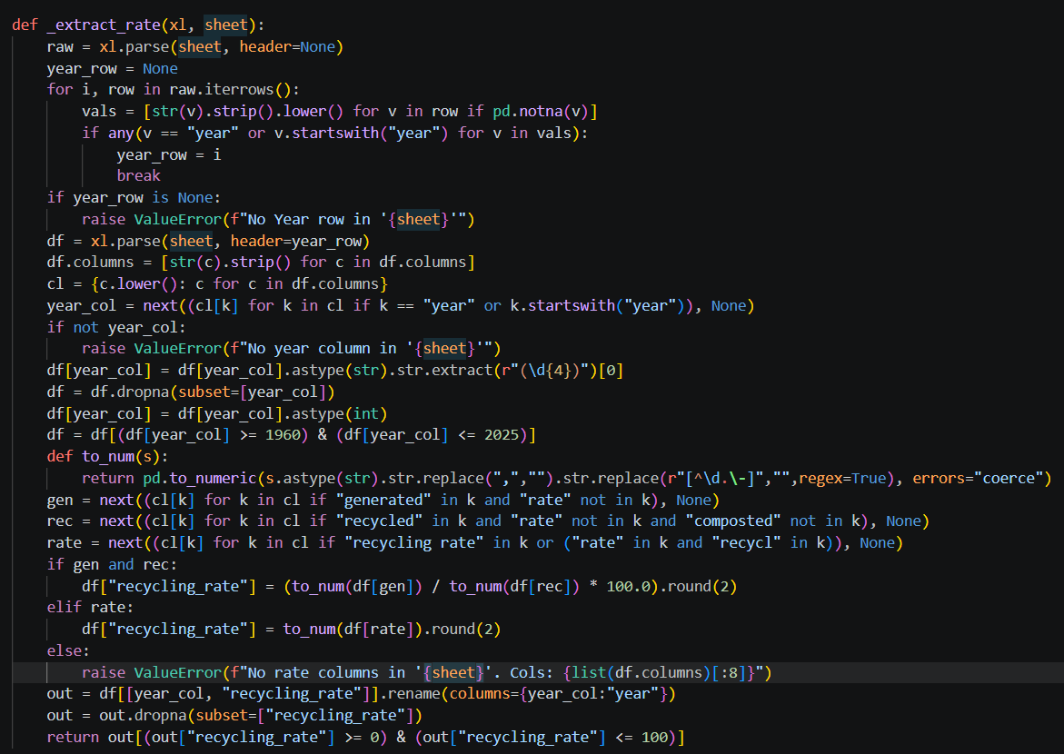
Data Preprocessing Pipeline
1
Download EPA Excel file via HTTP
2
Locate correct sheet per material
3
Find header row containing 'Year'
4
Compute Rate = Recycled ÷ Generated × 100
5
Strip non-numeric chars, validate 0–100%
6
Add material + geography metadata
7
Export 3 clean CSVs to data/processed/

Slide 6
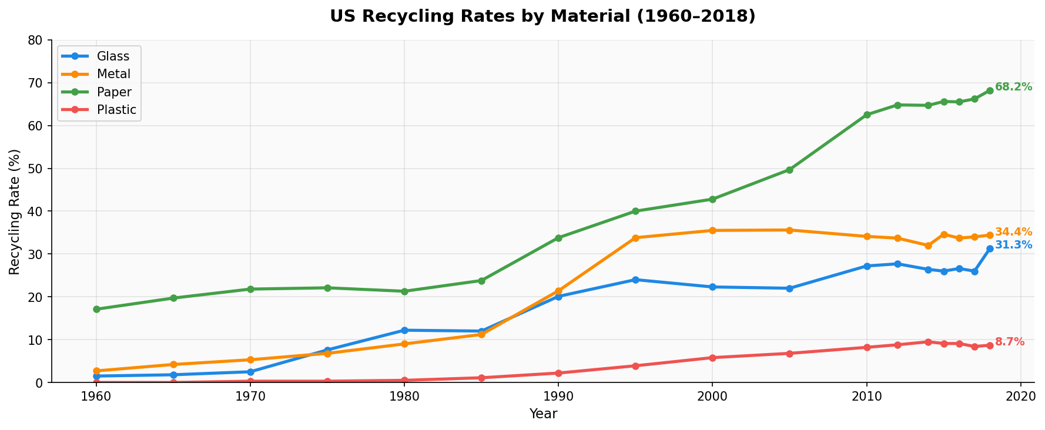
EDA - US National Trends (1960 - 2018)
Plastic
8.7%
Never exceeded 10% in 58 years
Paper
68.2%
+51.3pp from 1960 to 2018
Glass
25.0%
Peaked ~2010, slight decline after
Metal
34.1%
All 4 materials show statistically significant upward trends (p < 0.001)
70× growth since 1960 (0.5%→34%)

Slide 7
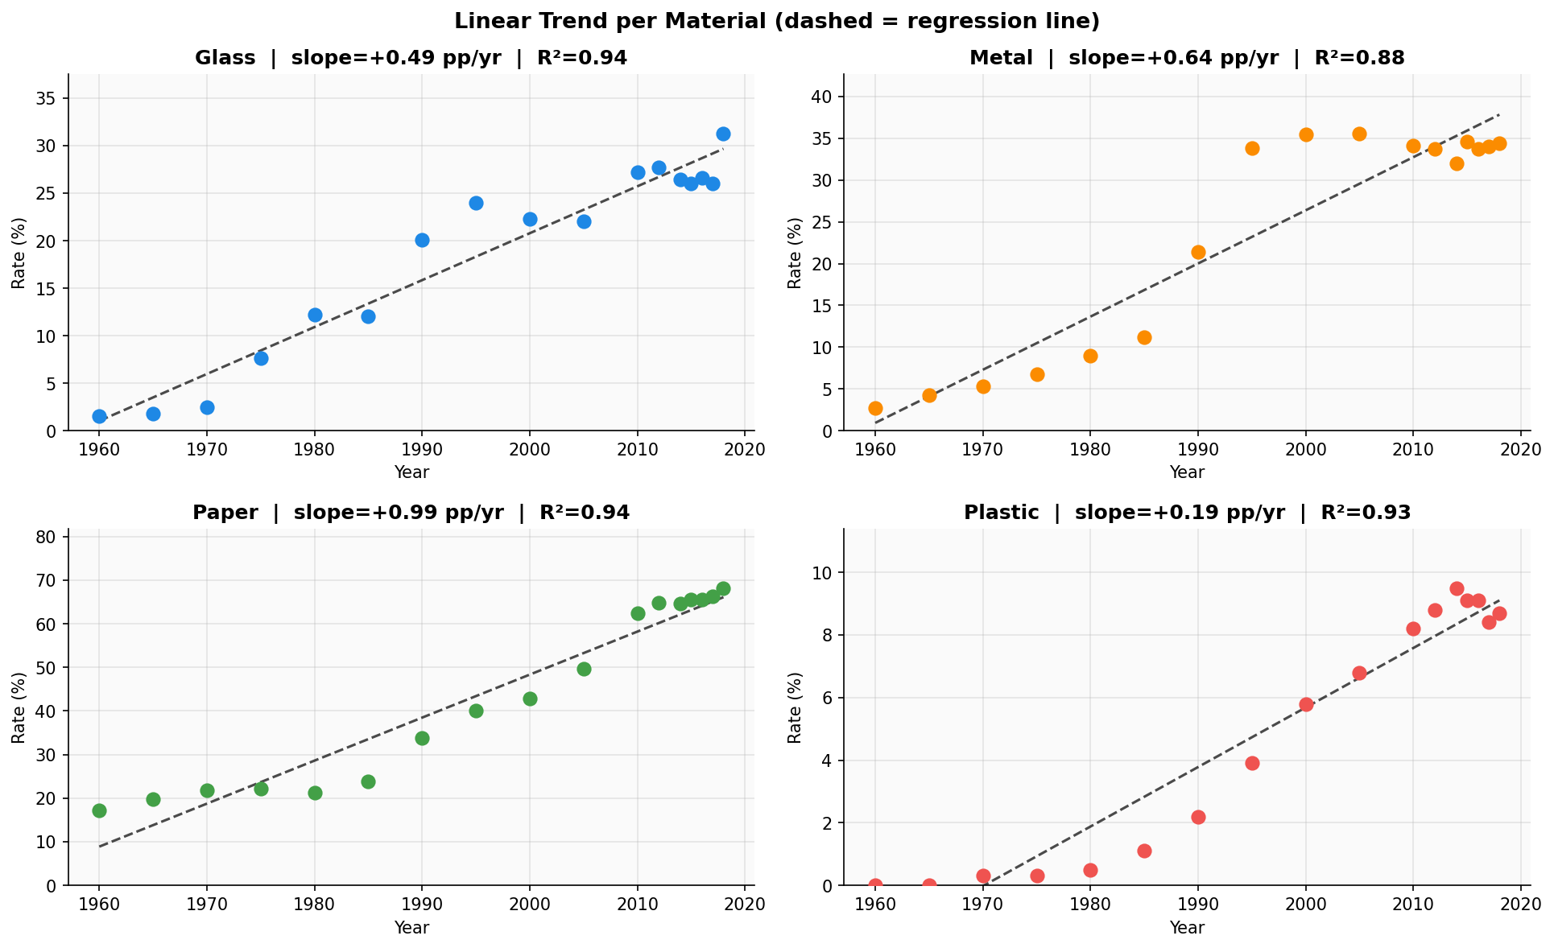
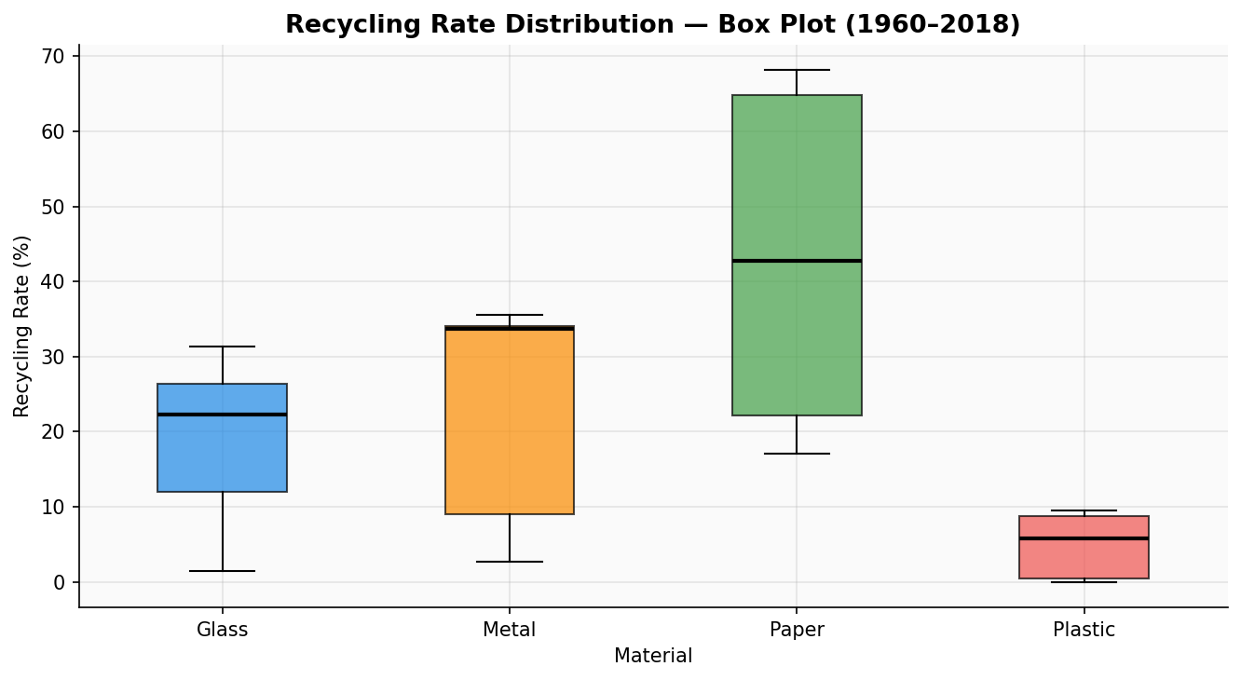
EDA - Statistical Analysis
Linear Regression Results
Material
Slope
R²
p-value
Paper
+1.02
0.97
<0.001
Metal
+0.58
0.91
<0.001
Glass
+0.44
0.72
0.004
Plastic
+0.14
0.89
<0.001
p < 0.05 for all materials - trends are statistically significant

Slide 8
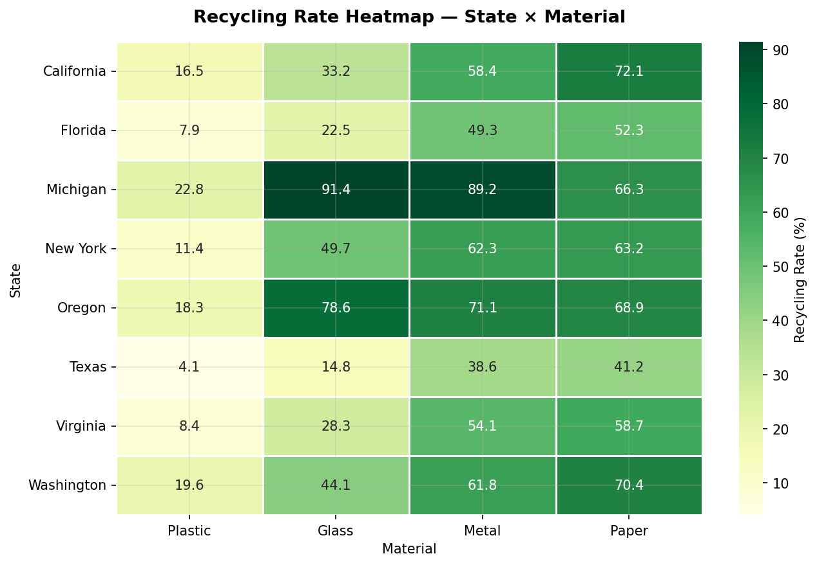
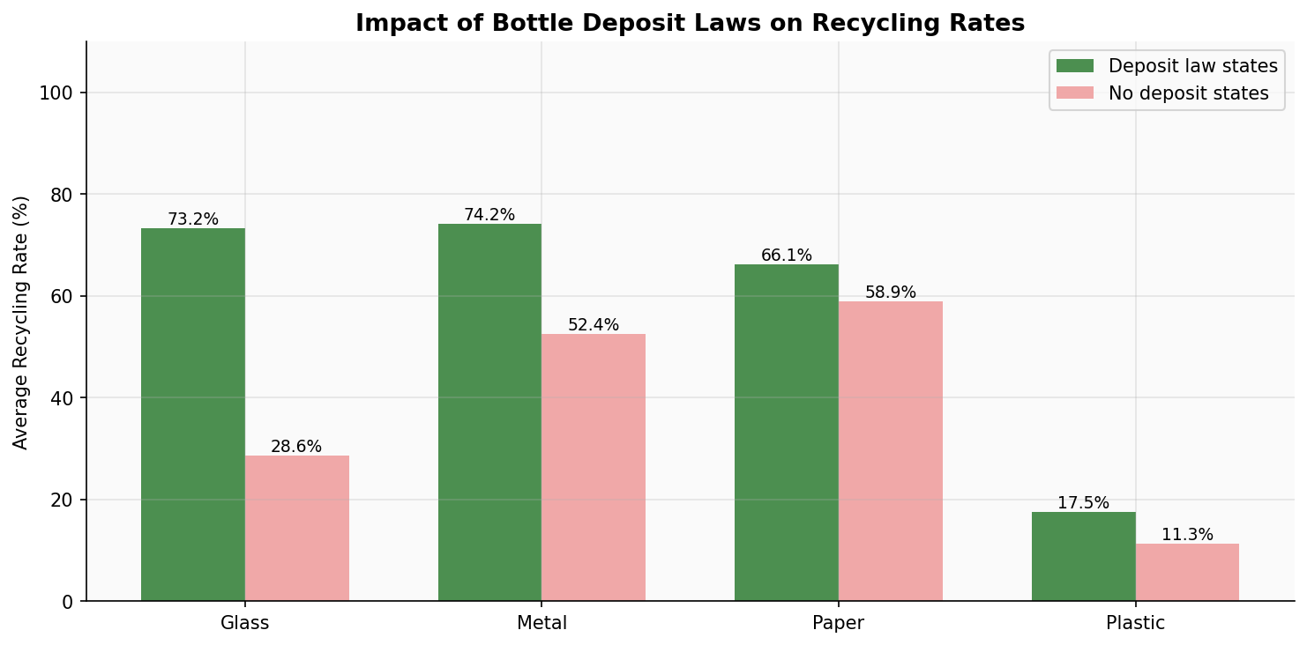
EDA - Regional Analysis
Key Regional Insight
States WITH bottle deposit laws (Michigan, Oregon, NY) recycle 2.4× more glass than states WITHOUT deposit laws. Michigan's 10-cent deposit produces a 91.4% glass rate - Texas has 14.8% with no deposit policy. Policy, not geography, drives recycling performance.

Slide 9
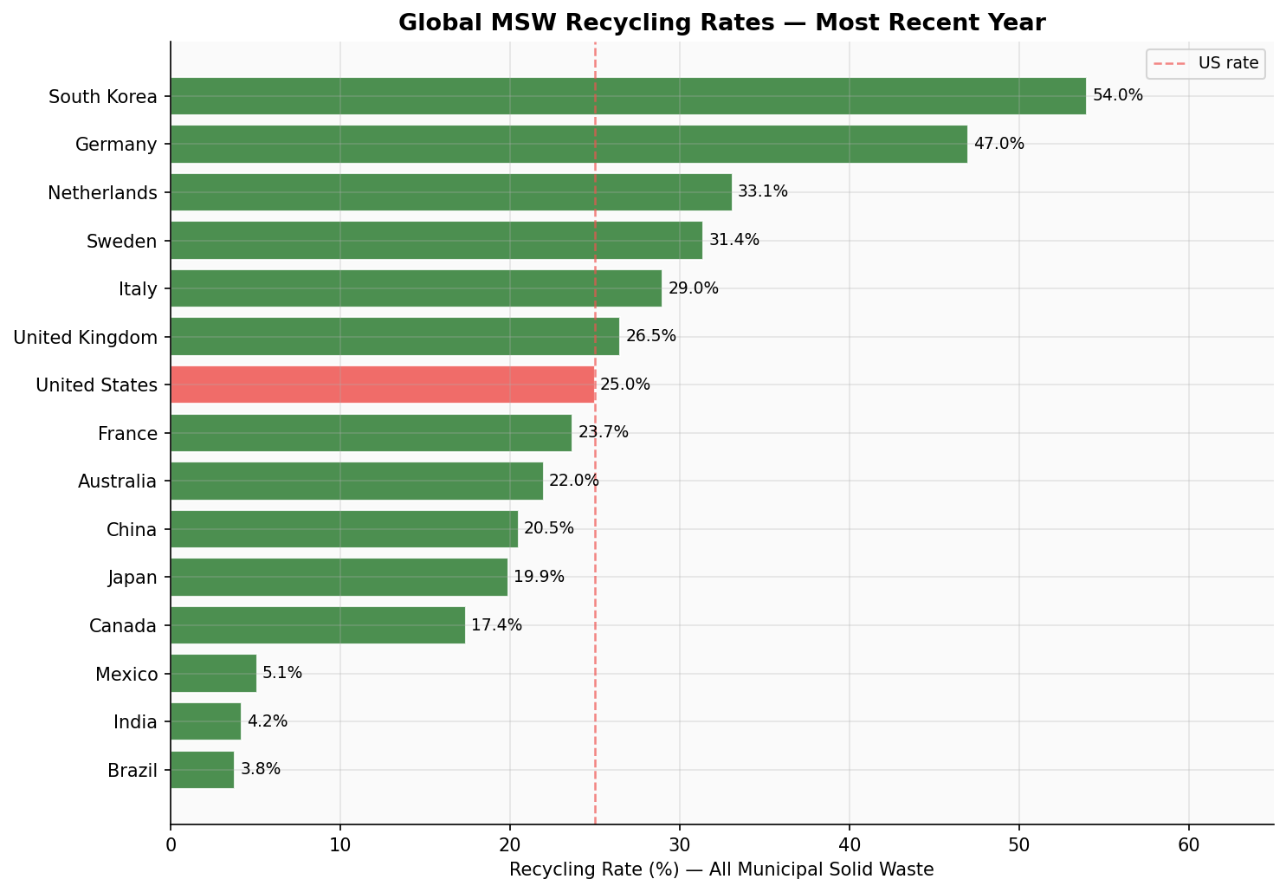
EDA - Global Comparison
54%
South Korea
#1 globally
47%
Germany
#2 globally
25%
United States
7th of 15 shown
50%
EPA Target
Goal by 2030

Slide 10
Key Findings
The Plastic Crisis
51pp State Policy Divide
F1
Plastic recycling has NEVER exceeded 10% in the US. Across 58 years, it grew from 0% to just 8.7% - 7× slower than paper.
F4
Michigan averages 67.4% across materials. Texas averages 24.7%. State recycling policy - not geography - drives outcomes.
Paper Proves What's Possible
US Lags Behind Globally
F2
Paper grew by 51.3 percentage points (16.9% → 68.2%) with R² = 0.97. Consistent policy and infrastructure investment works.
F5
US at 25% recycles roughly half of South Korea (54%) and Germany (47%). Without federal action, the 50% EPA target is unlikely.
Deposit Laws Work Dramatically
F3
Deposit states recycle 2.4× more glass (73.2% vs 30.4%) and 1.4× more metal. Financial incentives beat awareness campaigns.

Slide 11
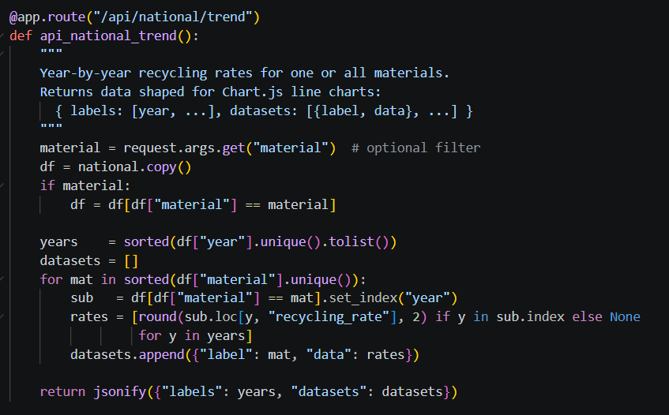
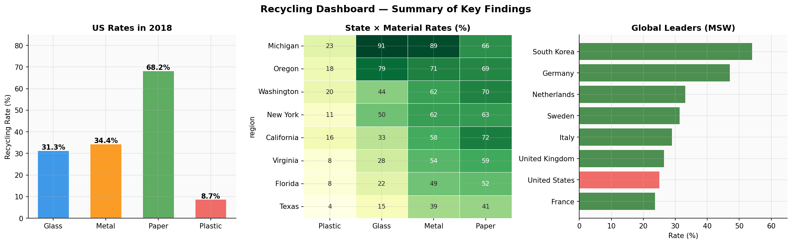
Dashboard Overview
Dashboard Features
4 interactive sections: About, US Trends, By State, Global
9 REST API endpoints (Flask)
Real-time Chart.js charts with dropdown filters
State × Material heatmap
Deposit law grouped comparison chart
Dark mode toggle
Fully responsive layout
All data served live from CSV files

Slide 12
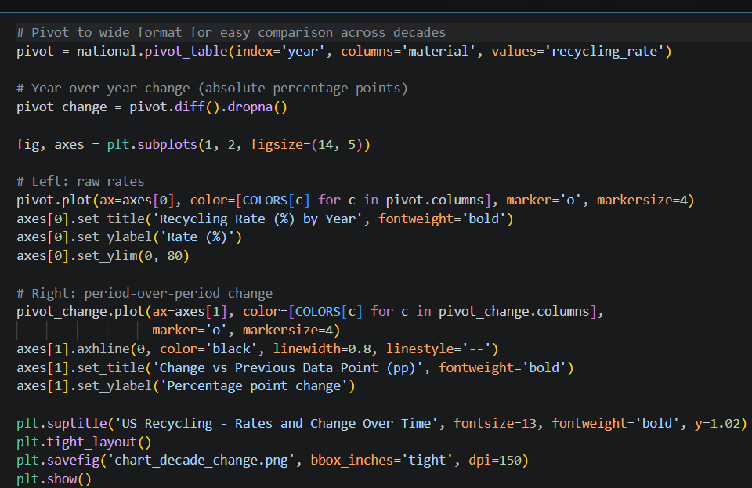
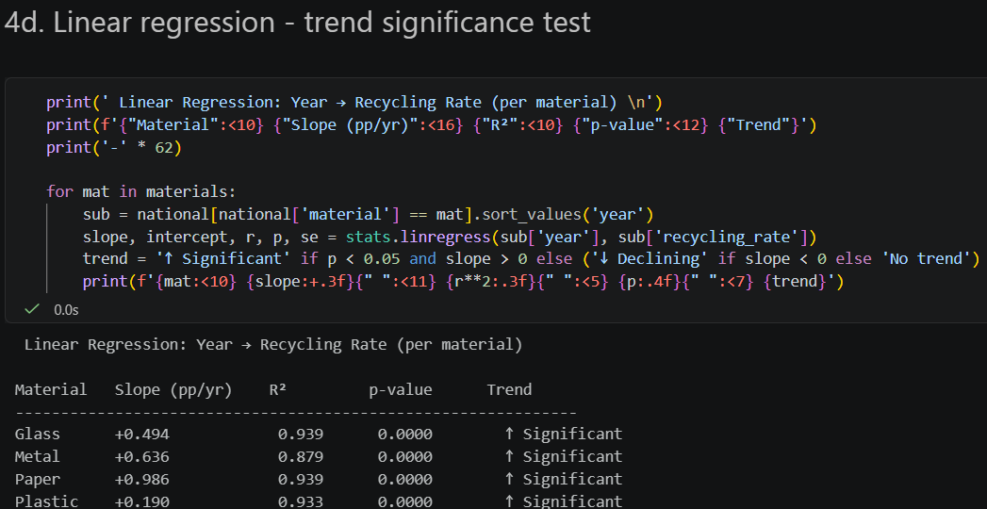
EDA - Code & Analysis Approach
Tools used: pandas • matplotlib • seaborn • scipy.stats • Linear Regression • Correlation Matrix • Box Plots • Heatmap

Slide 13
Roles & Responsibilities
Vinayak Vemula
Varshitha Kayithi
Identified and collected data from EPA, state agencies, and OECD
Built the data preprocessing pipeline (data_preprocessing.py)
Performed full EDA in Jupyter notebook (recycling_eda.ipynb)
Applied linear regression, correlation analysis, and box plots
Analyzed deposit law policy impact on state recycling rates
Wrote all statistical interpretations and key findings
Compiled the EDA report (EDA_Report.docx)
Designed and built Flask REST API (app.py) with 9 endpoints
Developed the complete HTML/CSS/JS dashboard (index.html)
Implemented all Chart.js visualizations (line, bar, heatmap)
Built real-time material and region filter functionality
Created dark mode toggle and responsive layout
Debugged all path and API connection issues
Set up project folder structure and requirements.txt
Prepared the PowerPoint presentation

Slide 14
Conclusion
1
All 6 project scope requirements fully met - data collection, cleaning, EDA, regional comparison, charts, HTML dashboard
2
Built a complete, production-quality data pipeline with EPA data going back to 1960
3
Identified 5 statistically-supported findings with clear policy implications
4
Dashboard serves live data via REST API with interactive filters and dark mode
Future Work:
Add post-2018 EPA data • Expand to all 50 states • Deploy to public URL (Render/Railway) • Add economic cost analysis
• CSIT697 Master's Project

Slide 15
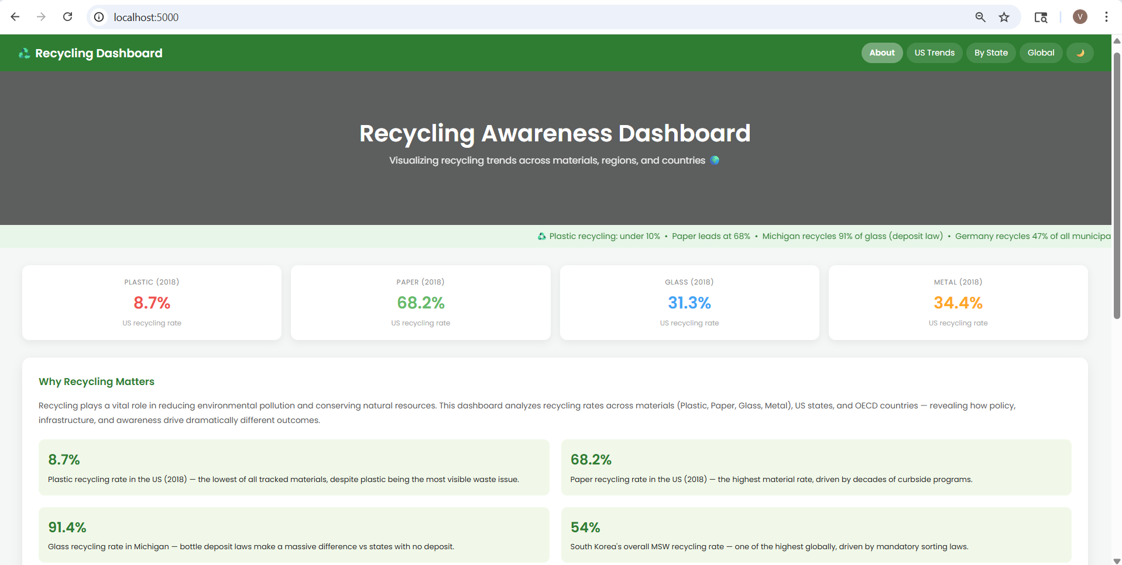
Dashboard - About Section
Stat cards, key findings, and project overview visible on first load

Slide 16
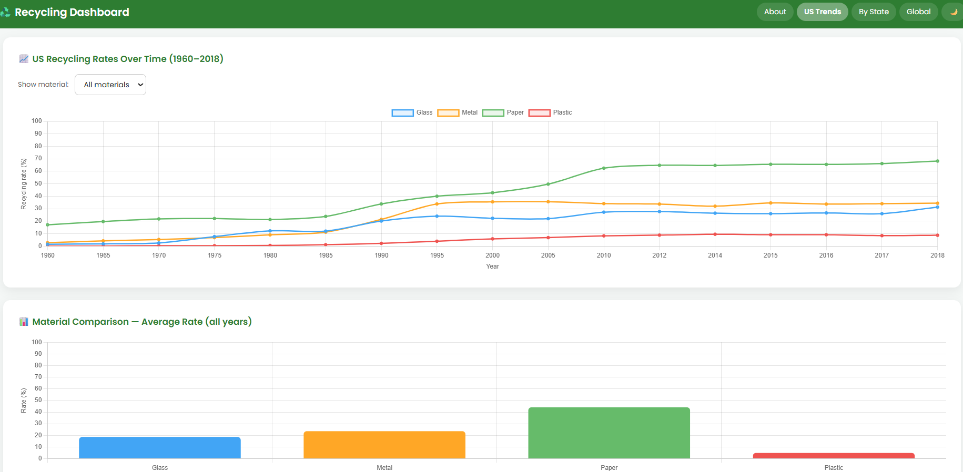
Dashboard - US Trends Section
Line chart: 1960–2018 for all 4 materials
Dropdown filter by material
Average bar chart below
Filterable data table
All data from live Flask API

Slide 17
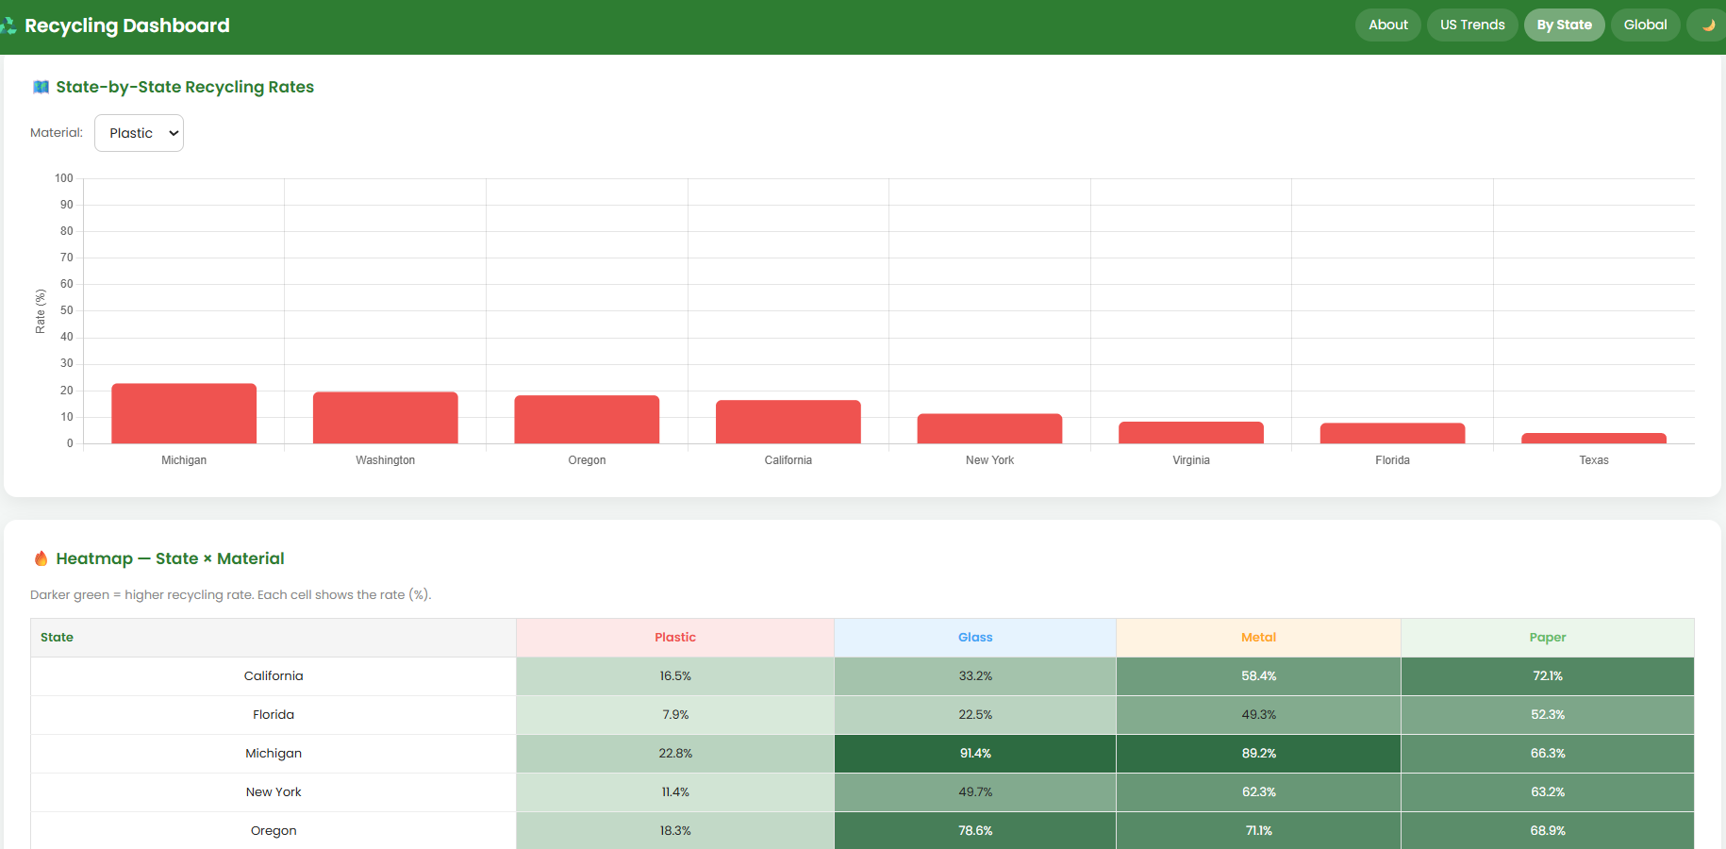
Dashboard - By State Section
Bar chart: 8 states ranked by material
Material dropdown updates chart live
Heatmap: State × Material grid below
Deposit law comparison chart
Full state data table at bottom

