Slide 1

Exploratory Data Analysis of U.S. Accidents
CSIT 553 – Project 2
Student Names: Joana Dervishaj
Vinayak Vemula
Vishwanath Bhupathi
Lam Nguyen

Slide 2
Project Description
This project analyzes fatal motor vehicle crashes in the U.S. using 2022 data from the Fatality Analysis Reporting System (FARS). The dataset includes detailed information on over 39,000 incidents.
Each record includes details like time, location, number of people and vehicles, and conditions such as weather and lighting—helping identify factors behind fatal crashes.
The goal is to uncover trends and risks through visual tools like maps and interactive charts, supporting safety efforts and informed decision-making.

Slide 3
Project Objectives
Analyze the temporal and spatial distribution of fatal traffic accidents.
Create geographic maps and aggregated charts to visualize crash data.
Use interactive plots to explore the data in depth.
Identify correlations between time, weather, location, and crash severity.

Slide 4
Dataset Overview
Data comes from the FARS 2022 report on fatal traffic crashes in the U.S.
Contains over 39,000 records with details on time, location, and conditions.
Features include: time, location, vehicle types, weather, lighting, and number of fatalities.
Cleaned to remove missing or incorrect coordinates for accurate mapping.

Slide 5
Bubble Map
Shows 5,000 fatal crashes across the U.S. using location data.
Each bubble’s position is based on GPS, with size or color reflecting severity or weather.
Hover details show state, hour, day of week, and weather condition.
Map created using Plotly with Mapbox and styled as an open street map.

Slide 6
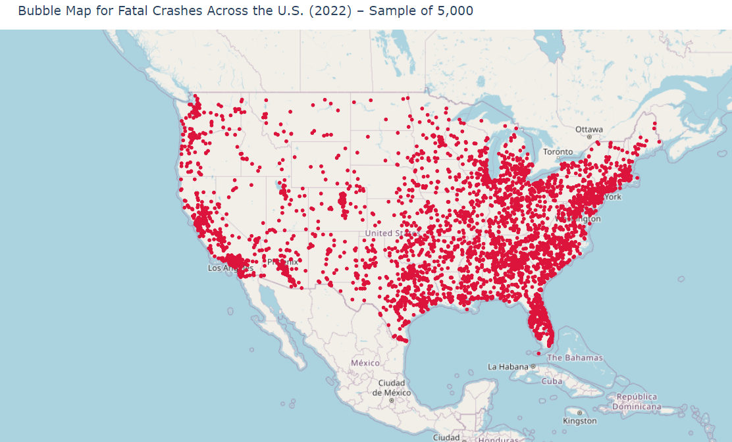

Slide 7
Choropleth Maps:
1. Fatal Crashes by
State
Visualizes the number of fatal crashes across U.S. states using color intensity.
Darker shades represent states with higher numbers of fatal crashes.
Helps identify regions with the highest crash frequency.

Slide 8
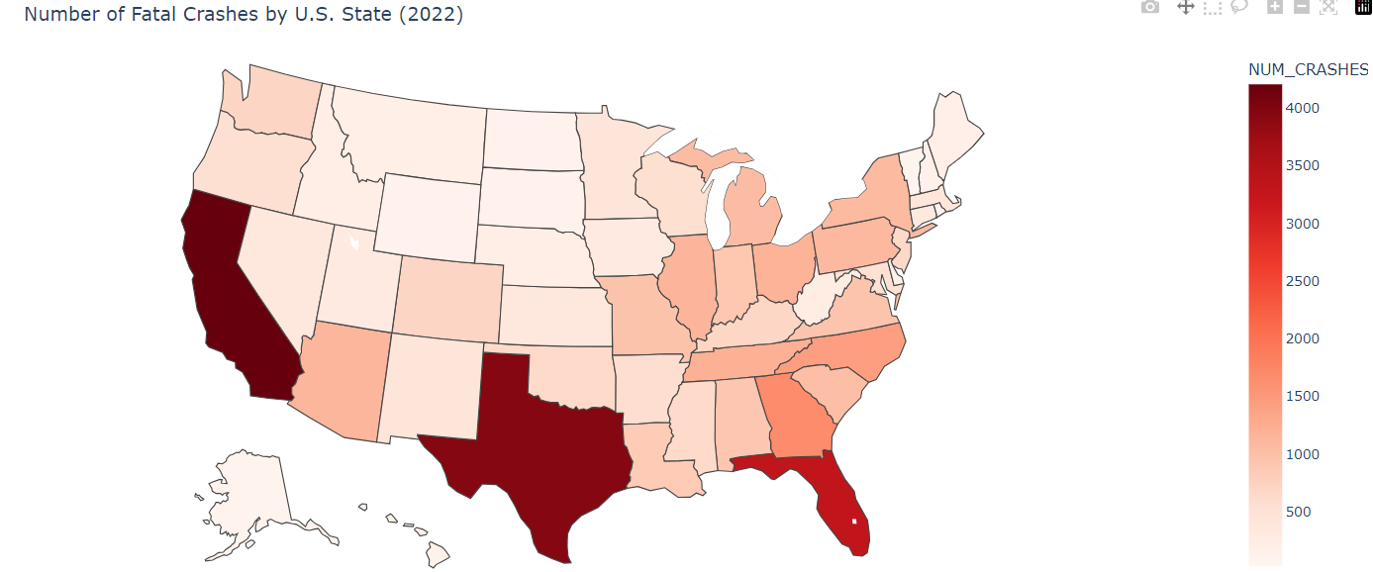

Slide 9
2. Crashes & Fatalities per 100K
Two maps:
(1) Crashes per 100K people
(2) Fatalities per 100K people.
Adjusting for population highlights risk levels more fairly.
Useful for comparing states regardless of size.

Slide 10
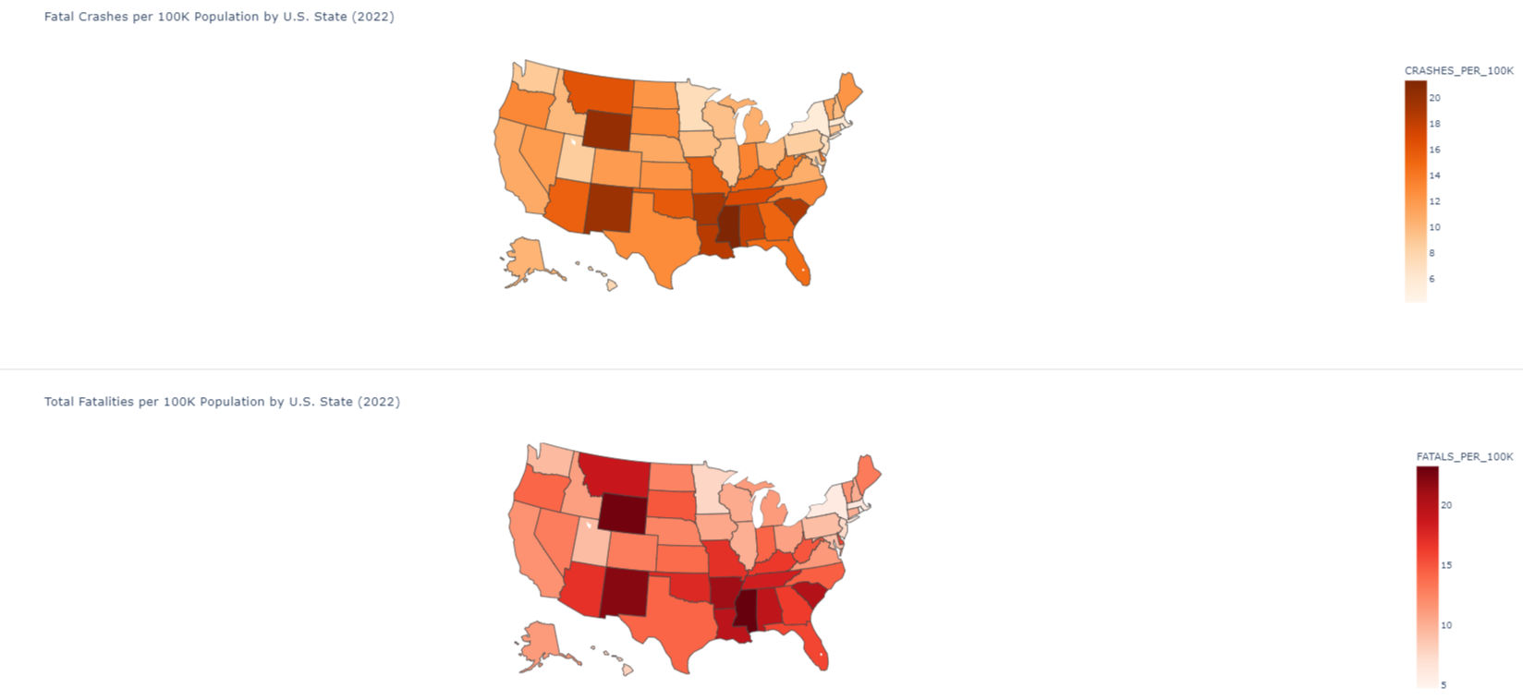

Slide 11
Histogram Maps:
1. Hourly Crashes by Day
Shows number of crashes by hour, broken down by day of the week.
Highlights peak hours for fatal accidents, like evening rush.
Color-coded bars make weekday patterns easy to compare.

Slide 12
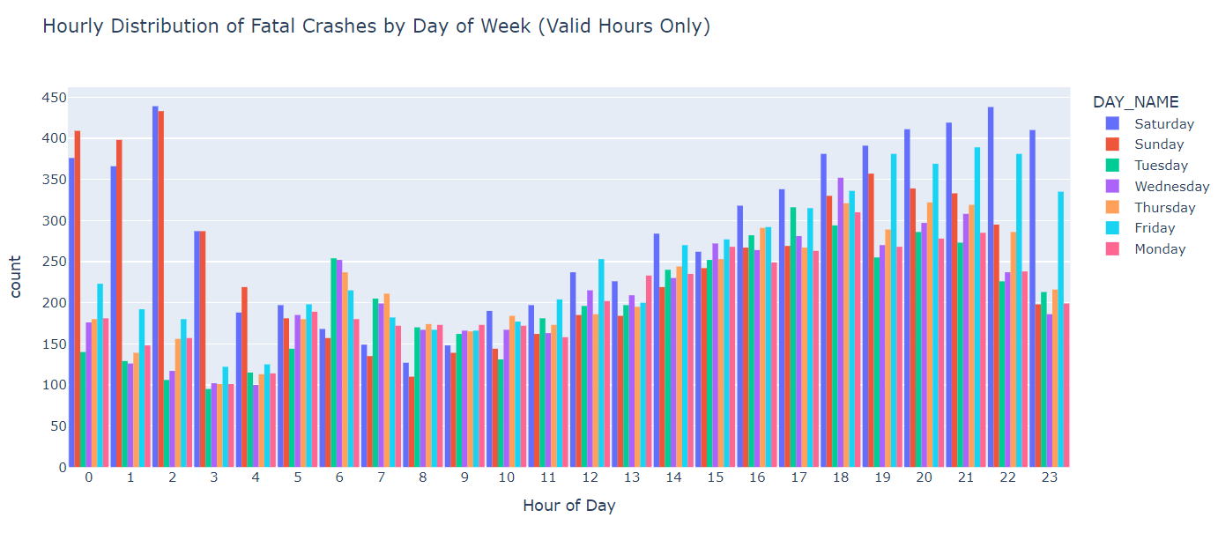

Slide 13
2. Weekday vs
Weekend Crashes
Bar chart separating crash counts by hour for weekdays and weekends.
Shows different patterns between workdays and leisure days.
Clear grouping helps identify when roads are most dangerous.

Slide 14
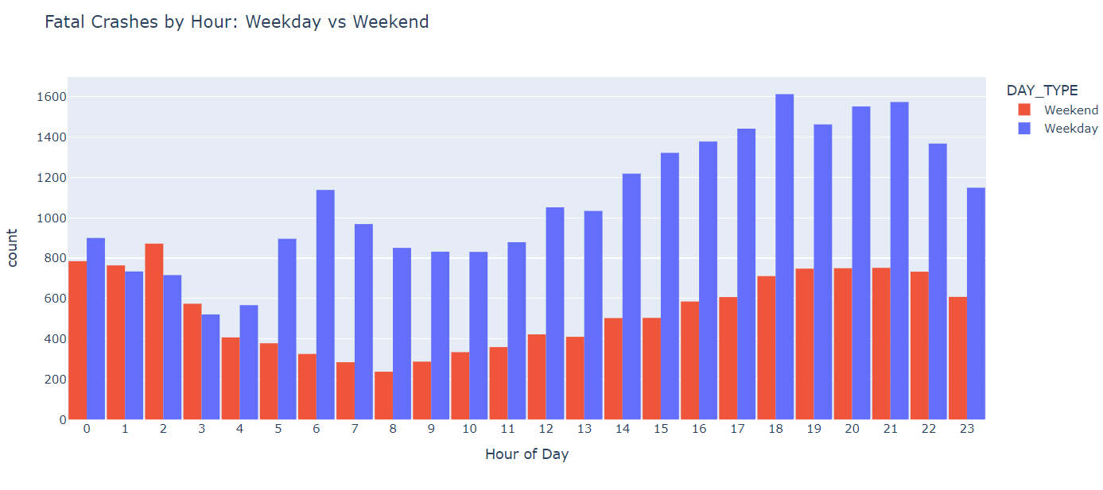

Slide 15
Box Plot
Displays the distribution of fatalities per crash under different weather conditions.
Useful to understand how adverse weather impacts crash severity.
Box plots show distribution, with outliers and medians.

Slide 16
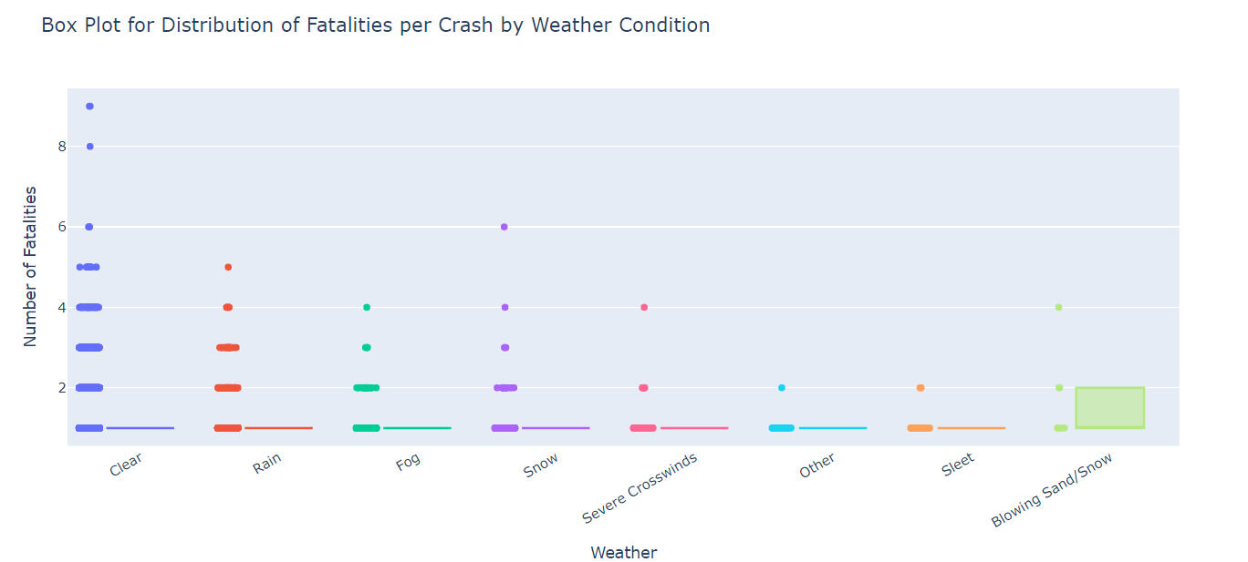

Slide 17
Heat Map
Heatmap showing concentration of fatal crashes in the U.S.
Identifies high-risk areas where crashes are concentrated.
Brighter areas indicate higher crash density.
Useful for spotting high-risk regions visually.

Slide 18
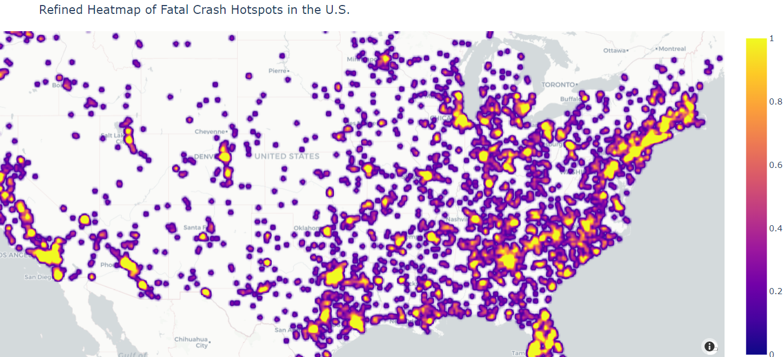

Slide 19
Time-Series
Line plot showing number of crashes by each hour of the day.
Interactive with scrubbing and zooming enabled.
Reveals overall crash trends over the day.

Slide 20
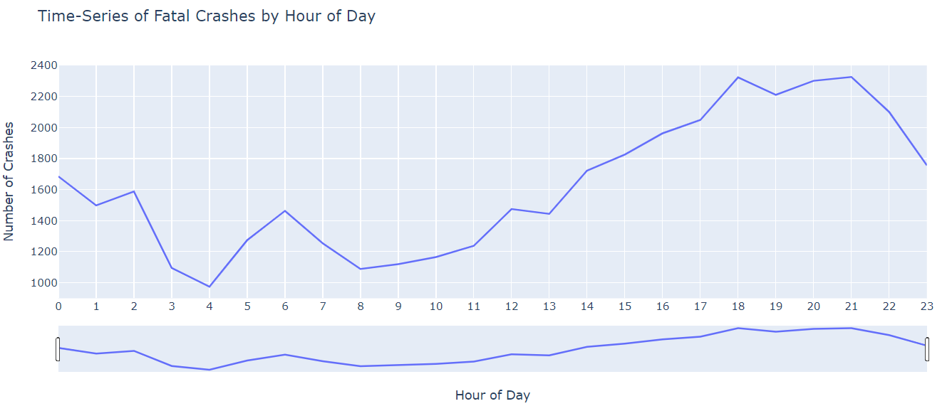

Slide 21
Bubble Map
Bubble map with crashes color-coded by weather conditions.
Bubble size represents number of fatalities at that location.

Slide 22
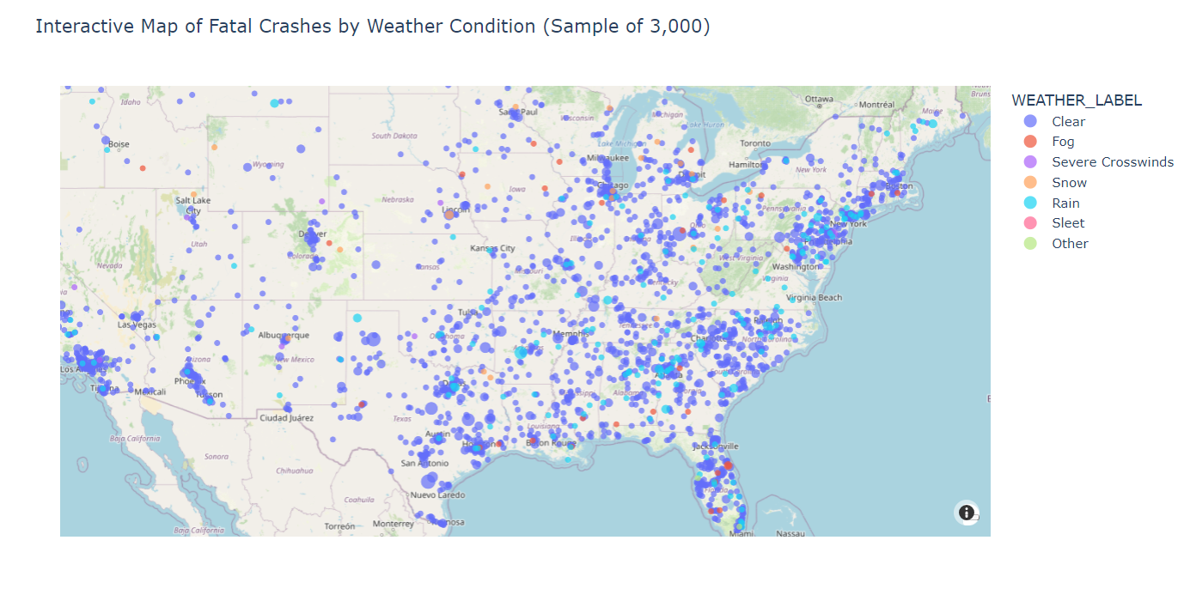

Slide 23
Scatter Plot
Scatterplot showing fatalities at different hours, colored by weather.
Shows how weather conditions may affect severity over time.
Helps compare patterns between clear and adverse conditions.

Slide 24
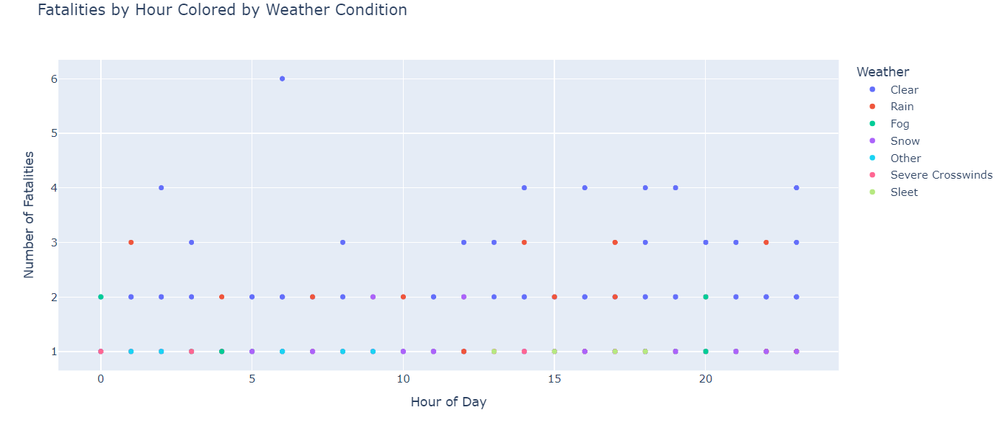

Slide 25
Bar Chart
Grouped bar chart displaying crash count per day under top 4 weather conditions.
Reveals interaction between weekday and weather effects.
Makes it easy to compare which days are riskier in bad weather.
Highlights the interaction between daily trends and conditions.

Slide 26
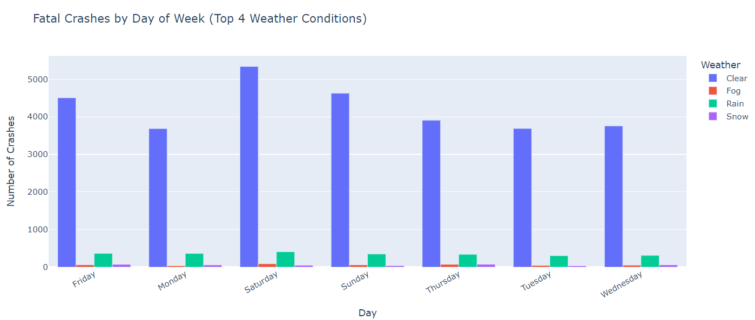

Slide 27
Demo Overview
All code implemented in a Jupyter Notebook using Python.
Libraries: pandas, plotly, seaborn, mapbox.
Dataset cleaned and visualizations generated live.
Interactive maps and plots demonstrate real-time exploration of crash patterns.
Python Code Link: https://shorturl.at/jqPms

Slide 28
Conclusion
Evening hours (5–8 PM) are the most dangerous.
Poor lighting and adverse weather conditions increase fatality severity.
States like Texas and California show highest raw crash numbers.
Visualizations provide actionable insights for traffic safety planning.

Slide 29
Q & A
Thank you for your attention!
We welcome your questions and feedback.

