Slide 1

Global Economic Trends Analysis Using World Bank Data
CSIT 553 Exploratory Data Analysis and Visualization
Joana Dervishaj
Vinayak Vemula
Vishwanath Bhupathi
Lam Nguyen

Slide 2
Project Description
This project analyzes the Special Data Dissemination Standard (SDDS) dataset from the International Monetary Fund (IMF), focusing on reporting delays across various countries.
SDDS is a framework ensuring countries report economic and financial data in a timely and transparent manner.

Slide 3
Project objective
Analyze global economic trends using World Bank Data.
Perform Exploratory Data Analysis (EDA).
Utilize Data Wrangling and Data Aggregation.
Design and implement data visualizations.
Derive data-driven conclusions.

Slide 4
DATASET DESCRIPTION
The dataset tracks the availability and timeliness of data reported by countries under the SDDS framework.
The SDDS is an initiative aimed at enhancing the availability of timely and comprehensive economic data for countries around the world.
The dataset measures how often and how promptly these countries report their data to the IMF
Links: https://datacatalog.worldbank.org/search/dataset/0037740/Quarterly-External-Debt-Statistics-SDDS

Slide 5
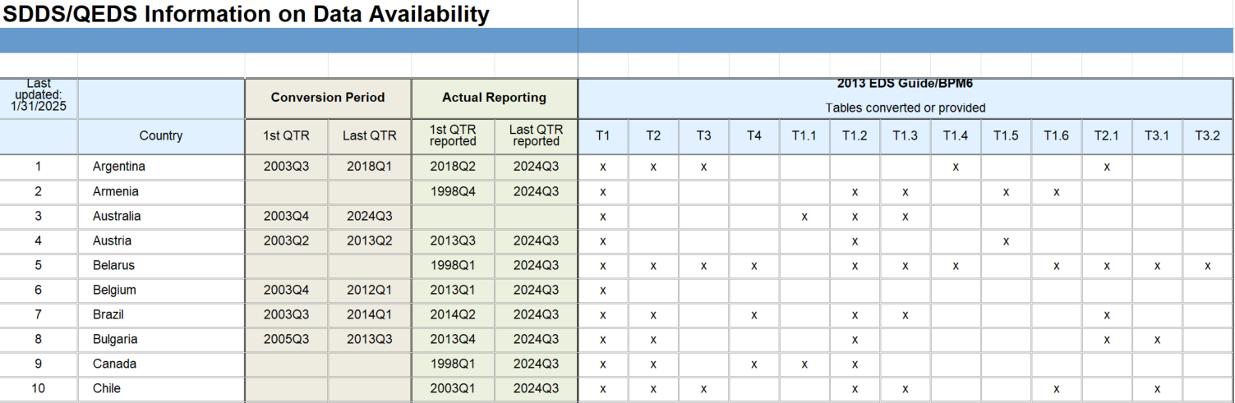
DATASET Content
The first ten rows of dataset:

Slide 6
DATASET Content
Contents (Columns):
Index: Numerical identifier for each entry.
Country: The name of the country that the data pertains to.
1st_QTR: The starting quarter of the period for which the data is available Last_QTR: The ending quarter of the period for which the data is available.
First_QTR_Reported: The actual first quarter in which the data was reported to the IMF.
Last_QTR_Reported: The actual last quarter in which the data was reported.
T1, T2, T3, T4, ...: Columns representing different tables of data that countries report under the SDDS. A value of x means that data was reported for that specific table during the quarter, while NaN means it was not.

Slide 7
KEY FOCUS OF PROJECT
Data Cleaning & Preprocessing
Descriptive Statistics & Trend Analysis
Comparative Analysis
Data Wrangling
Data Aggregation
Data Visualization
Insight Generation

Slide 8
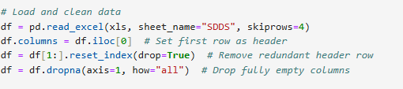
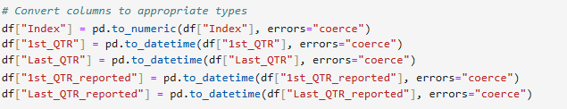

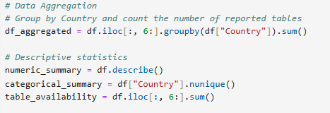
exploratory DATA ANALYSIS
The exploratory data analysis
(EDA) involved :
Data Loading : loading a dataset from the World Bank,
Data Cleaning : steps such as renaming columns, removing empty columns, and converting data types for consistency., Handle Missing dates were filled with the earliest available date, and 'x' indicators were transformed into Boolean values for easier analysis.
Data Analysis using descriptive statistics: Descriptive statistics were calculated to summarize numeric data, and categorical analysis revealed the number of unique countries in the dataset.
Data wrangling techniques were applied to calculate reporting delays, and data aggregation summarized the number of reported tables by country.

Slide 9
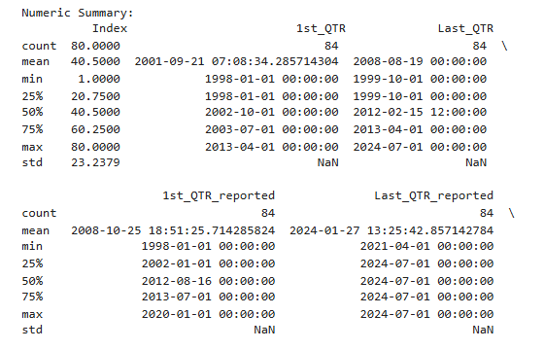
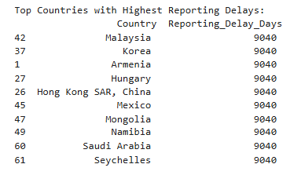
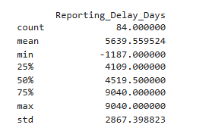
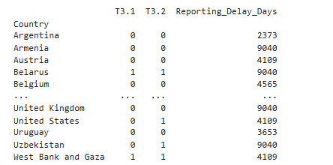
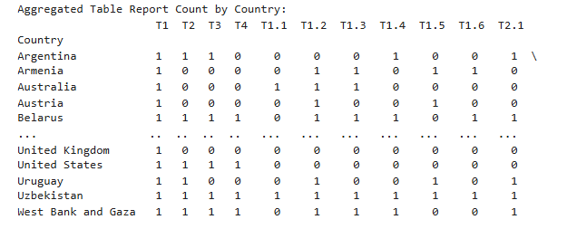
Output

Slide 10
Data Visualization
Bar Chart
Area Chart
Diverging Heat map

Slide 11
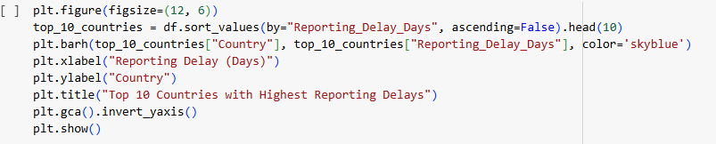
Data Visualization By Bar chart
Bar Chart: Visualizes the top 10 countries with the highest reporting delays

Slide 12
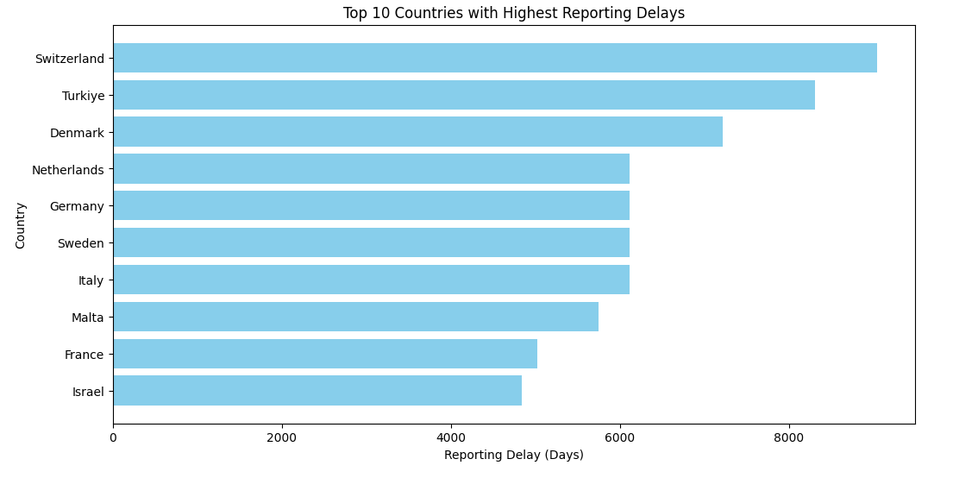
Data Visualization By Bar chart
Bar Chart: Visualizes the top 10 countries with the highest reporting delays

Slide 13
Data Visualization by Area chart
Area Chart: Displays the trend of average reporting delays over time, highlighting patterns and variations.
The average reporting delay over time is visualized using an area chart.
The x-axis represents time (quarterly), and the y-axis represents the average reporting delay.
The area chart fills the space under the line plot with a light blue color.
The title of the chart: "Trend of Reporting Delays Over Time".

Slide 14
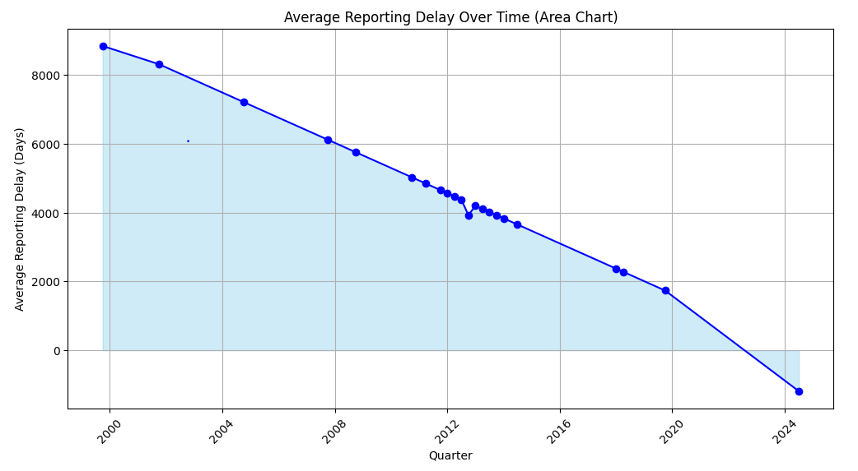
Area Chart: Displays the trend of average reporting delays over time, highlighting patterns and variations.

Slide 15
Data Visualization By Heat map
The Heat map will display the correlation between each of the reported tables (T1, T2, etc.) and the reporting delays.
If there’s a positive correlation, it means that as the number of tables reported increases, the delay tends to also increase. Conversely, a negative correlation indicates that reporting more tables could be associated with less delay.
The values on the Heat map range from -1 to 1, where:
1: Perfect positive correlation.
-1: Perfect negative correlation.
0: No correlation.

Slide 16
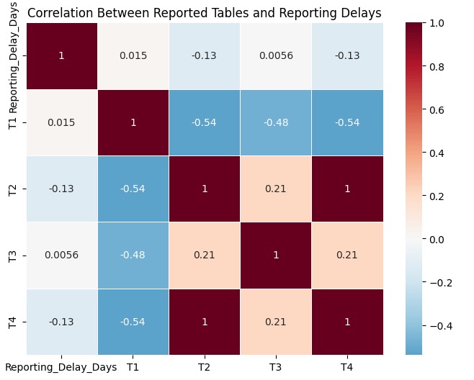
Data Visualization By Heat map
Diverging Heatmap: Correlation between reported tables and reporting delays

Slide 17
Snapshots of code
Python code link: https://colab.research.google.com/drive/1iB6kreDfuQN36AHMxJaA_12tMdcBIm32#scrollTo=df1feb0f

Slide 18
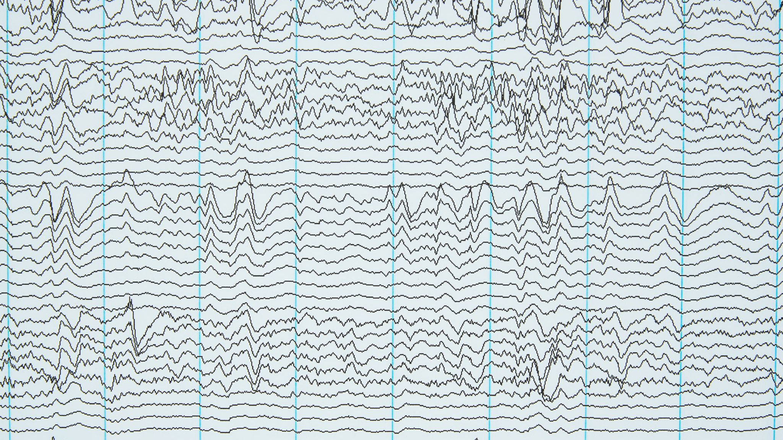
Conclusion
The analysis revealed significant reporting delays across multiple countries, with some nations experiencing notably higher delays.
The trend analysis indicated fluctuations in average reporting delays over time, suggesting potential seasonal or systemic patterns.
The correlation heatmap showed limited correlation between the number of reported tables and reporting delays, indicating delays may be influenced by other factors.
Overall, the findings emphasize the need for improved reporting processes to ensure timely data availability.

