Slide 1

BOOK RECOMMENDATION SYSTEM
- Presented by Team 6
Notes:
NOTE:
To change the image on this slide, select the picture and delete it. Then click the Pictures icon in the placeholder to insert your own image.

Slide 2

Team Members
Anjali
Hitesh Arun
Jaydip
Sabina
Sandhya
Sateesh
Vimala

Slide 3
Objective
Recommender system plays an important role in simplifying what to choose according to one’s taste and preference.
The Main objective is to extract features from given data set and use them to make a Book recommender system to recommend relevant books to users.
Summary of Data
The whole dataset is divided into 3 csv files comprising of books, users and ratings data separately.
Dataset | Rows | Columns
Books | 271360 | 3
User | 278858 | 3
Ratings | 1149780 | 3

Slide 4
Project Workflow
Data Collection
Import the Data
Data Pre-processing – Cleaning, Imputation & Treating missing values, outliers.
Exploratory Data Analysis (EDA)
Merging the datasets
Built 2 Popularity Based Model – Top Rated user wise, Top Rated location wise
Built 2 Collaborative Based Model – Item & User based filtering
Model Evaluation
Challenges
Conclusion
Model Deployment using Streamlit API
Future Scope

Slide 5
Packages Used
Pandas
Numpy
Regular Expression (re)
Matplotlib
Seaborn
Scipy
Collections
Sklearn
Ipython
Pickle
Streamlit

Slide 6
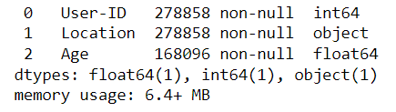
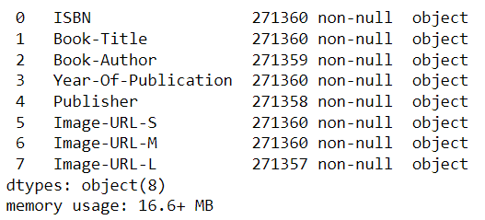
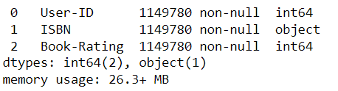
Data Overview
Users dataset
Books dataset
Ratings dataset

Slide 7
ANALYZING ALL THREE DATASET
There are almost no duplicate value’s in all 3 dataset’s.
But we have negligible null values in books dataset for 3 columns. We will try to impute values from internet.
We have almost 40% null values in ratings datasets for age column.
DATA CLEANING
We have successfully replaced the incorrect value with correct values for specific columns.
We have noticed, there was some values in year of publication columns which is 0 & future years.
We have successfully, imputed the missing values from Internet for links in Image column.
We have discovered, there were some values in specific columns which is swapped & does not belong to a specific column, and treated it.

Slide 8
IMPUTING DATA
In users dataset, for Nan values, we will impute with median as its neutral in presence of outlier & also the median for state & country is close to the age of 32 years.
In Books dataset, after replacing the extreme outlier values with mode year (2002) the distribution seems to be fairly symmetrical.
As we can see, there are no null values nor any duplicate or missing values to be imputed in ratings dataset.

Slide 9
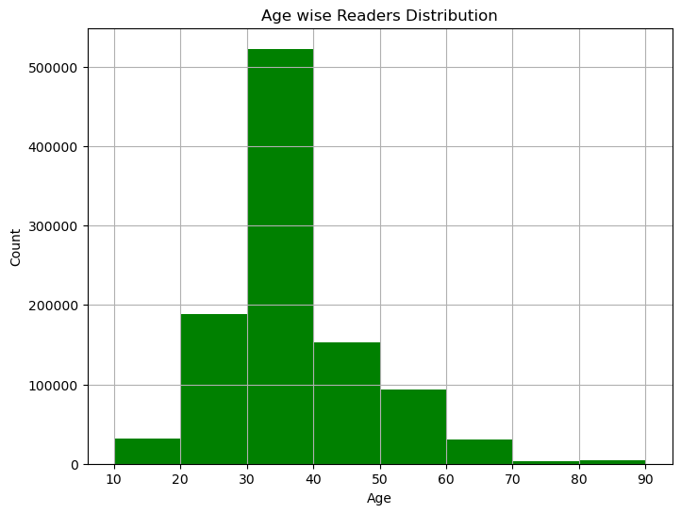
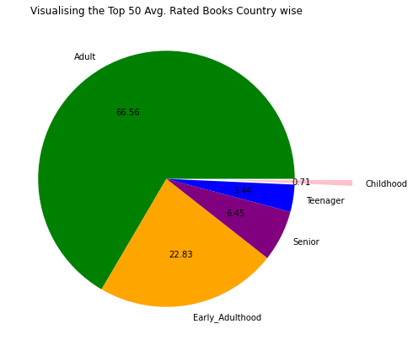
VISUALISING USERS DATA

Slide 10
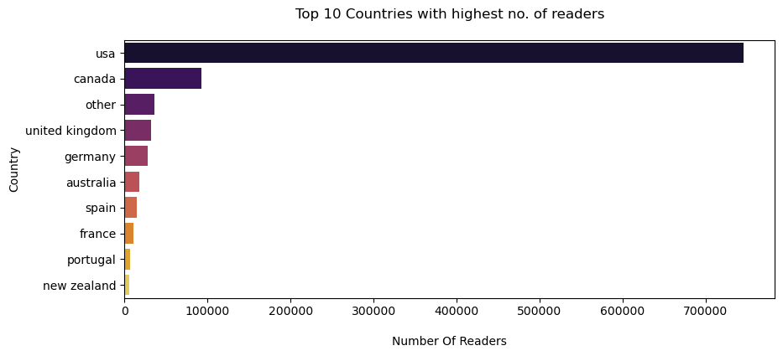
VISUALISING USERS DATA

Slide 11
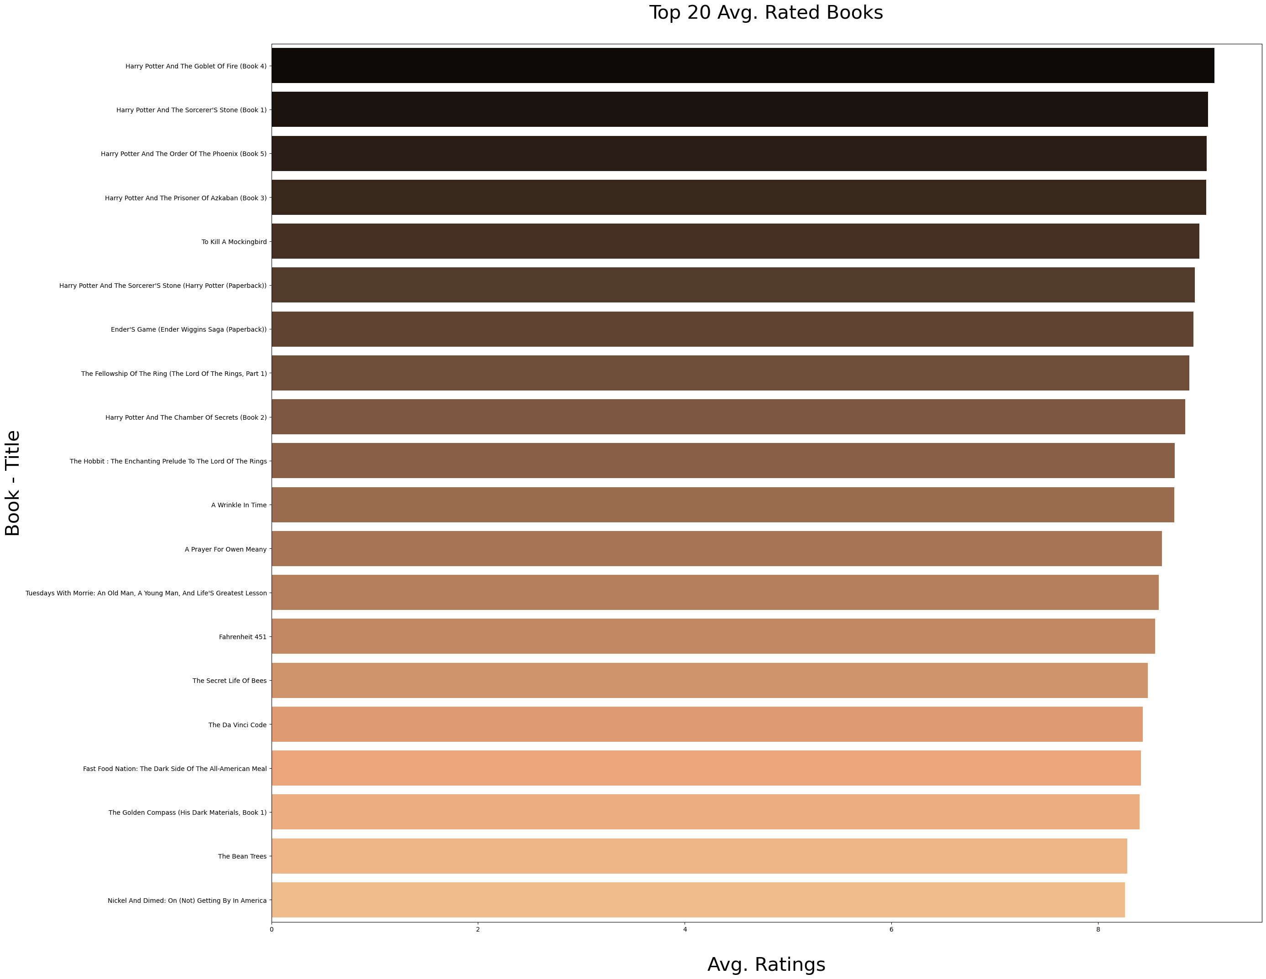
VISUALISING BOOKS DATA

Slide 12
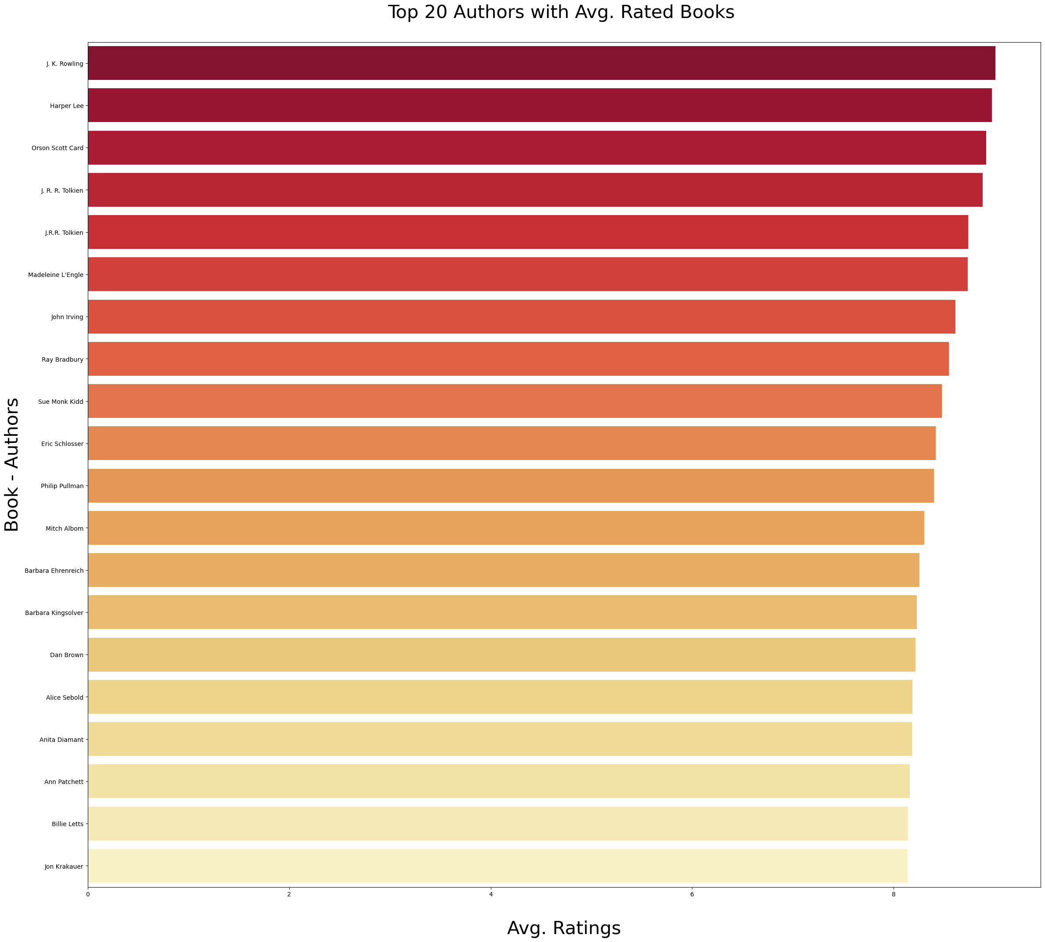
VISUALISING BOOKS DATA

Slide 13
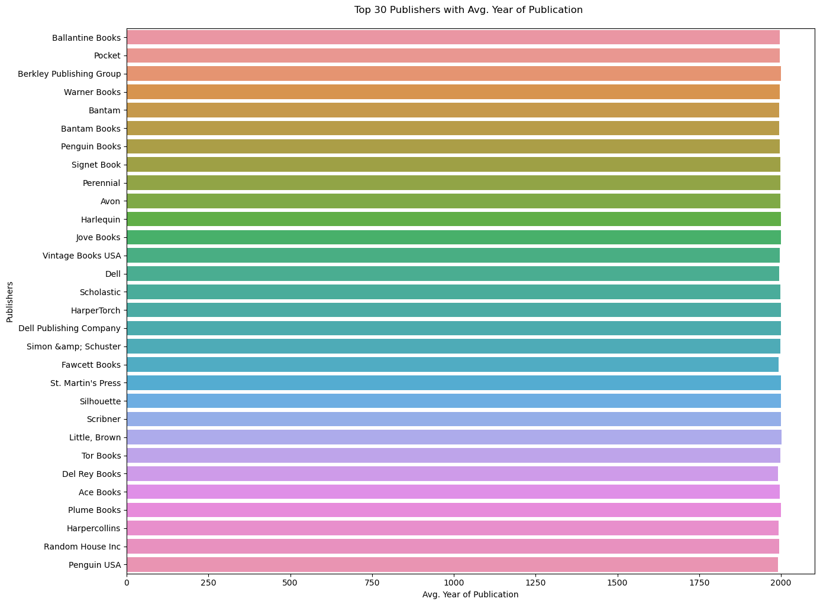
VISUALISING BOOKS DATA

Slide 14
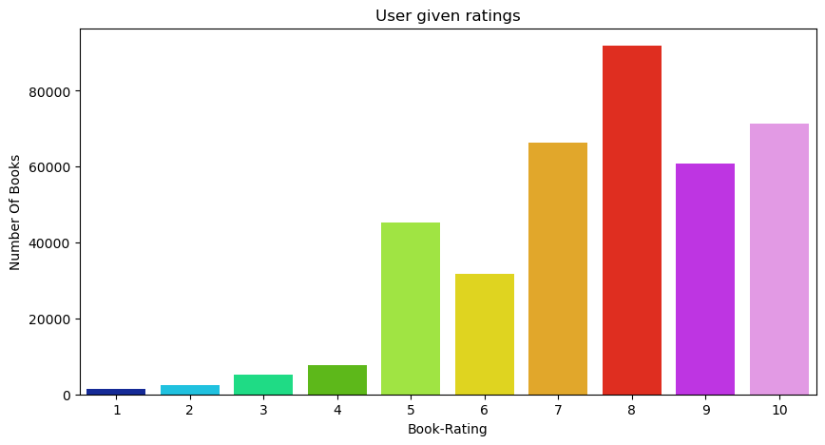
VISUALISING RATINGS DATA

Slide 15
INSIGHTS FROM EDA
Harry Potter and the goblet of Fire is the most rated Book of all time. J.K Rowling is the is the top rated author.
Ballentine Books has published most number of books.
More than 50% readers have either not read nor rated the books which appears to be 0 in ratings. Top ratings given by maximum users are 8.
From our analysis, only one model is not sufficient for recommending books based on popularity. As there are very few top popular common books found between countries.
Hence, we built 2 popularity models based on highest average ratings and location wise top rated books.
And we also built Collaborative Filtering model using on user similarity matrix with Pearson Correlation.

Slide 16
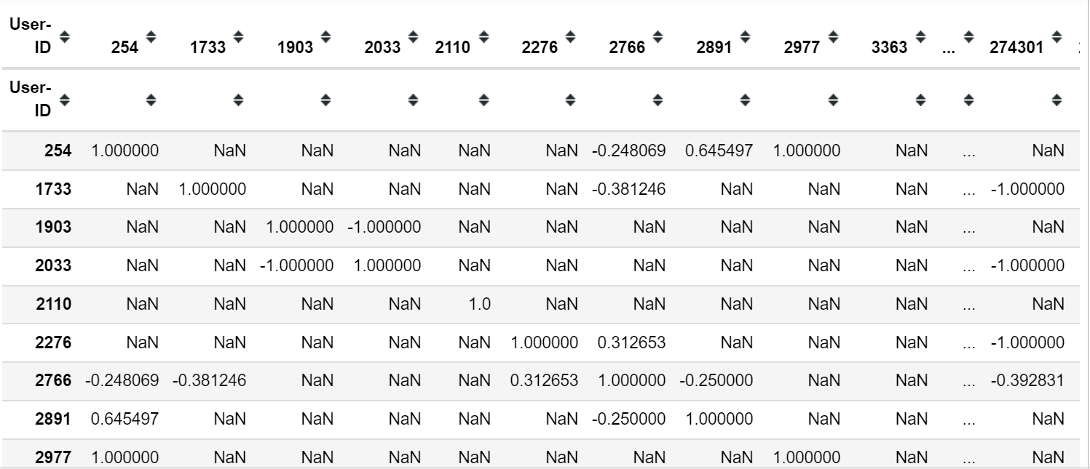
MODEL BUILDING
User - User based Collaborative Filtering:
User-User collaborative filtering is one kind of recommendation method which looks for similar users based on the items users have already liked or positively interacted with.
Using Pearson’s Correlation Coefficient for User based filtering.

Slide 17
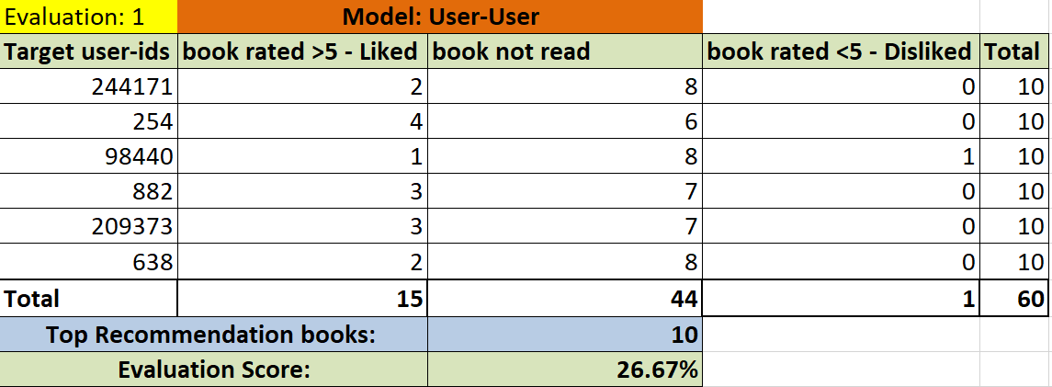
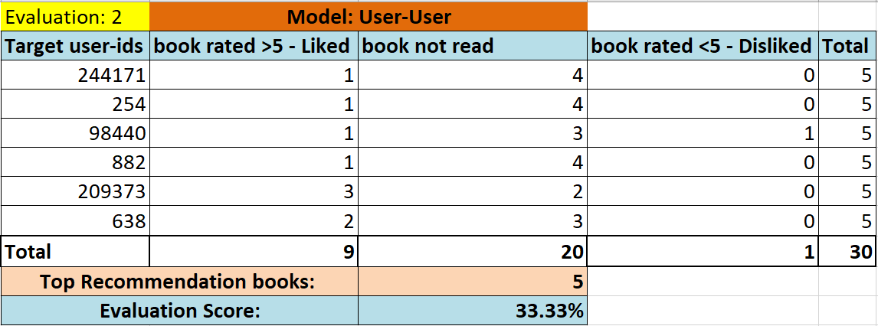
MODEL EVALUATION

Slide 18
CHALLENGES
Handling of sparsity was a major challenge as well since the user interactions were not present for the majority of the books.
Understanding the metric for evaluation was a challenge as well.
Since the data consisted of text data, data cleaning was a major challenge in features like Location etc.
Decision making on missing value imputations and outlier treatment was quite challenging as well.

Slide 19
CONCLUSION
In EDA, the Top-10 most rated books were essentially novels. Books like The Lovely Bone and The Secret Life of Bees were very well perceived.
Majority of the readers were of the age bracket 20–45 and most of them came from North American and European countries namely USA, Canada, UK, Germany and Spain.
If we look at the ratings distribution, most of the books have high ratings with maximum books being rated 8. Ratings below 5 are few in number.
Author with the most books was Agatha Christie, William Shakespeare and Stephen King.
For modelling, it was observed that for model based collaborative filtering was working better with Pearson’s Correlation than Cosine Similarity technique .
Amongst the memory based approach, user-user CF performed better than item-item CF because of lower computation requirements.

Slide 20

MODEL DEPLOYMENT
Streamlit API: https://ddatarep27-book-recommendation-system--dr-book-recommend-ks1fvl.streamlit.app/

Slide 21
FUTURE SCOPE
Should given more information regarding the books dataset, namely features like Genre, Description etc.,
We could implement a content-filtering based recommendation system and compare the results with the existing collaborative-filtering based system.
We would like to explore various clustering approaches for clustering the users based on Age, Location etc., and then implement voting algorithms to recommend items to the user depending on the cluster into which it belongs.

