Slide 1

RPA DEVELOPER VIRTUAL INTERNSHIP
by
V SARVAGNA
224G1A3397
Department of Computer Science and Engineering (AI & ML)
Srinivasa Ramanujan Institute of Technology
(Affiliated to JNTUA & Approved by AICTE) (Accredited by NAAC with ‘A’ Grade & Accredited by NBA (EEE, ECE & CSE)
Rotarypuram Village, B K Samudram Mandal, Ananthapuramu – 515701.
2024 - 2025

Slide 2
CONTENTS
Introduction
RPA Editions
Stages
Methodologies
RPA Components
RPA Tools
Future of RPA
Certification
References

Slide 3
INTRODUCTION
Robotics Process Automation (RPA) is a useful and widely emerging technology in the business world nowadays.
RPA,which uses various software robots to perform business-oriented tasks. Previously, in many organizations, the large volume of data was handled by the humans themselves.
Also, software robots are easy to integrate into any system according to the requirements and provide results that are comparatively quick and accurate as done by humans.
How does it work?
RPA observes the repeated actions performed by users then the automation is done on those tasks directly in the GUI.
Thus, RPA works on the business’s existing applications and handles routine tasks like E-Mail invoice processing, report maintenance and generation, data extraction, access to websites, and many more.

Slide 4
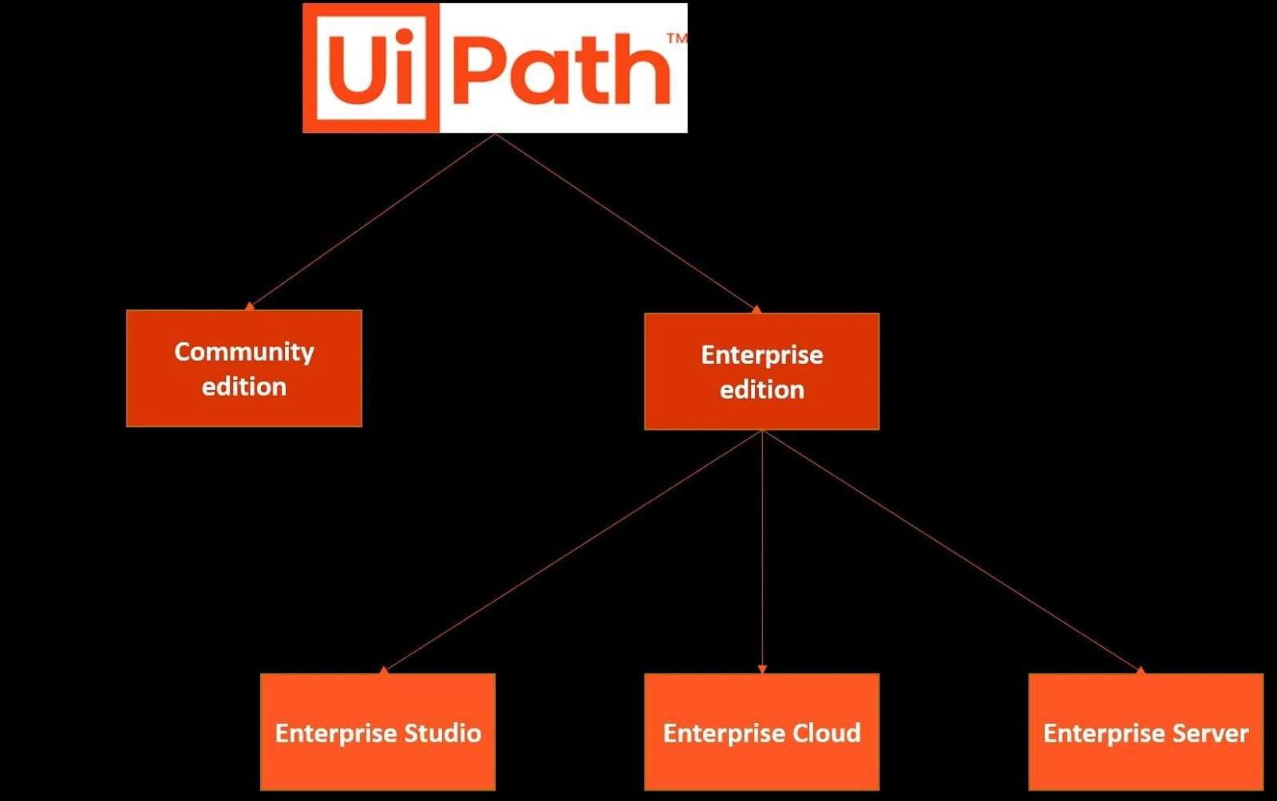
EDITIONS
EDITIONS:
Community Edition-
This Edition is for individual developers, small teams, education, and training purpose who are just starting on their automation journey.
The Community Account enables individuals and small and medium-sized business purposes. while large businesses only evaluate their sustainability for internal business requirements and non-profit business purposes.

Slide 5
EDITION CONTD…
2.Enterprise Edition:
The UiPath Enterprise edition offers advanced features for large-scale automation, It also provides flexible deployment options,advanced authentication management, and scalable architecture .
Enterprise studio: It is a comprehensive tool for automating business processes through RPA. It provides a visual workflow designer, advanced automation capabilities, and integration with various systems and applications.
Enterprise Cloud: Cloud-based platform that enables organizations to automate business processes using RPA. Deployment of the entire RPA enterprise platform for any size business.
Enterprise Server: It is a centralized management platform for automating business processes using Robotic Process Automation (RPA). Ensure secure and controlled automation environments

Slide 6
RPA STAGES
The RPA (Robotic Process Automation) development stages:
Process Identification & Analysis
Designing
Development
Testing
Deployment
Maintenance
Continuous Improvement

Slide 7
METHODOLOGIES
RPA Development Methodologies:
Agile:- Develop automation scripts in short iterations (2-4 weeks)- Prioritize processes based on business value and complexity- Collaborate for continuous feedback- Emphasize testing and validation in each iteration
Waterfall:- Linear and sequential approach- Predictive and plan-driven- Emphasizes thorough planning and documentation- Divides development into distinct phases (requirements, design, development, testing, deployment)
Hybrid:- Combines elements of Agile and Waterfall- Balances flexibility and structure- Adapts to changing requirements while maintaining some predictability- Uses Agile for development and Waterfall for planning and deployment

Slide 8

RPA COMPONENTS
In Robotic Process Automation (RPA), attended and unattended components refer to the modes of automation execution:
Attended Automation:
Human-in-the-loop
Robot assists human user
Executes tasks on user's machine
User intervenes when needed
Suitable for:
- Customer-facing processes
- Tasks requiring human judgment
- Exceptions handling
- Real-time data entry

Slide 9
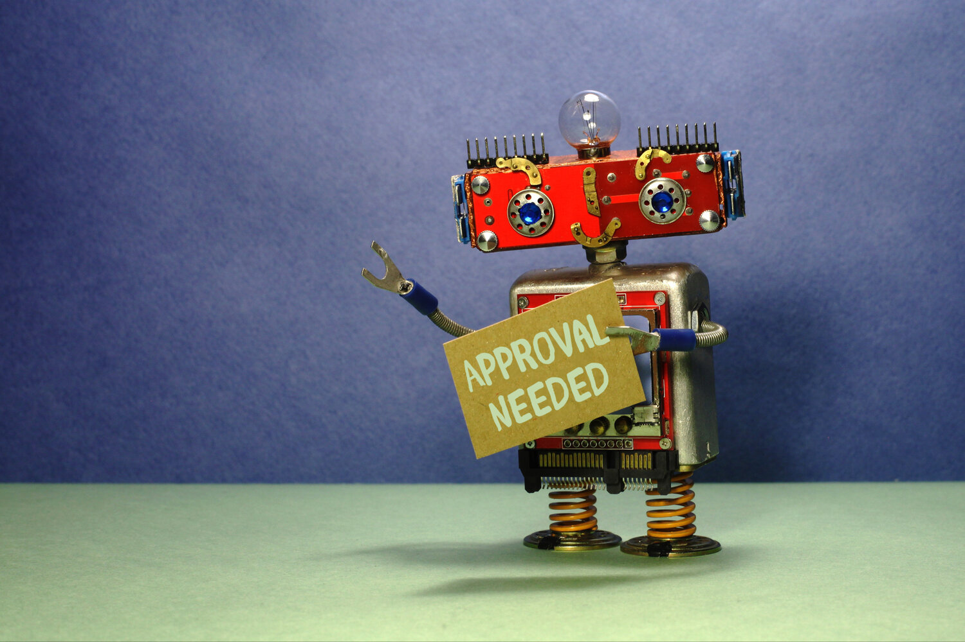
RPA TYPES CONTD…
Unattended Automation:
Autonomous execution
Robot works independently
Executes tasks on server or virtual machine
No human intervention required
Suitable for:
- Back-office processes
- High-volume data processing
- Repetitive tasks
- Batch processing

Slide 10
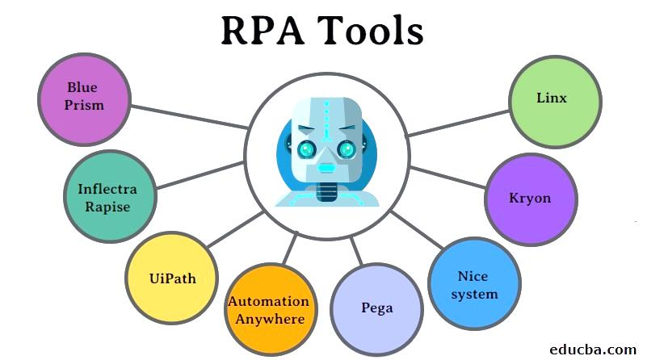
TOOLS

Slide 11
FUTURE OF RPA
The future of RPA holds immense potential for growth, innovation, and transformation.
As automation continues to evolve, organizations must embrace these changes to stay competitive.
Some of the benefits:
Enhanced efficiency and productivity
Improved accuracy and compliance
Faster time-to-market and agility
Better decision-making with data insights
Balancing automation with human touch
Continued innovation in automation tools
Emphasis on change management and adoption

Slide 12

EXAMPLE
EMAIL AUTOMATION:
Email Automation with Studio in RPA involves using software robots to automate email-related tasks, such as:
Reading and processing emails
Extracting data from emails
Sending automated responses
Forwarding emails
Creating and updating tasks or records

Slide 13
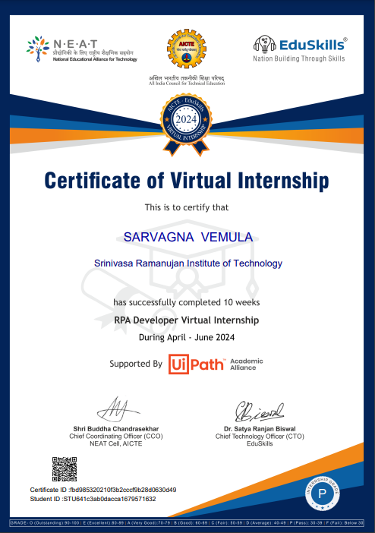
CERTIFICATION

Slide 14
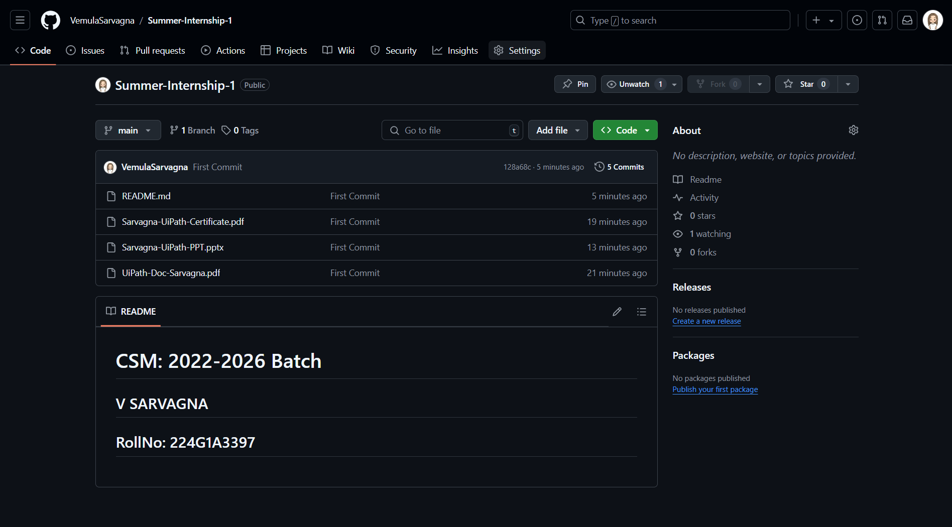
GIT HUB DASHBOARD
GitHub Repository Link: https://github.com/VemulaSarvagna/SummerInternship-1

Slide 15
REFERENCE
https://www.geeksforgeeks.org/robotics-process-automation-an-introduction/
https://academy.uipath.com/learning-plans/rpa-developer-foundation

Slide 16
THANKYOU!!

