Slide 1



AtliQ Hardwares
SQL Project Challenge
Consumer Goods Ad-hoc Insights

Slide 2
Objectives
About Company
AtliQ Hardware (fictitious corporation) is one of the major computer hardware manufacturers in India, with a strong presence in other nations.
Context
The management noticed that they do not get enough insights to make quick and smart data-informed decisions.
Planned to expand the data analytics team by adding junior data analysts.
Problem
There are 10 ad-hoc requests for which the company needs insights.
Approach
Run a SQL query to answer these requests. Convert it into visualizations and present the Insights to the top-level management.

Slide 3
AtliQ product’s
PC
Note Book
Gaming Laptop
Business Laptop
Personal Laptop
Desktop
Business laptop
Personal Desktop
N&S
Network
Wi-Fi Extender
Storage
External SSD
USB Flash Drive
DIVISION
SEGMENT
CATEGORY
P&A
Peripherals
Graphic card
Internal HDD
Processors
Accessories
Batteries
Keyboard
Mouse
Mother Board

Slide 4
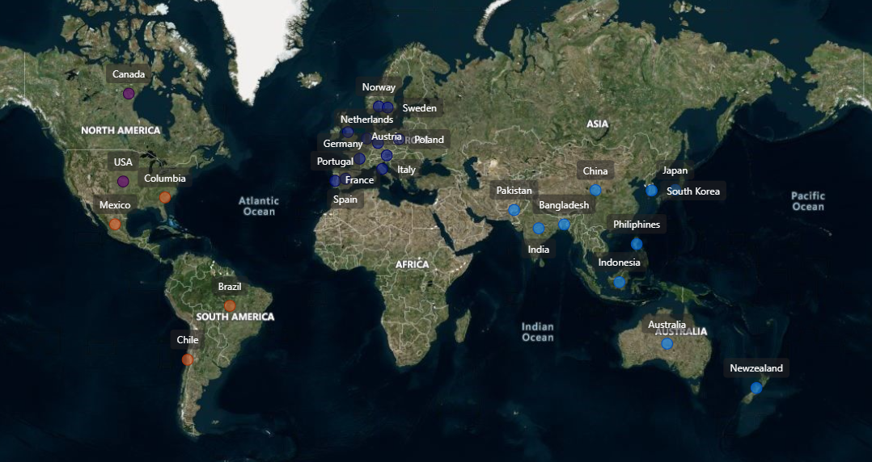
AtliQ Business - Markets
REGIONS
NA
LATAM
EU
APAC

Slide 5
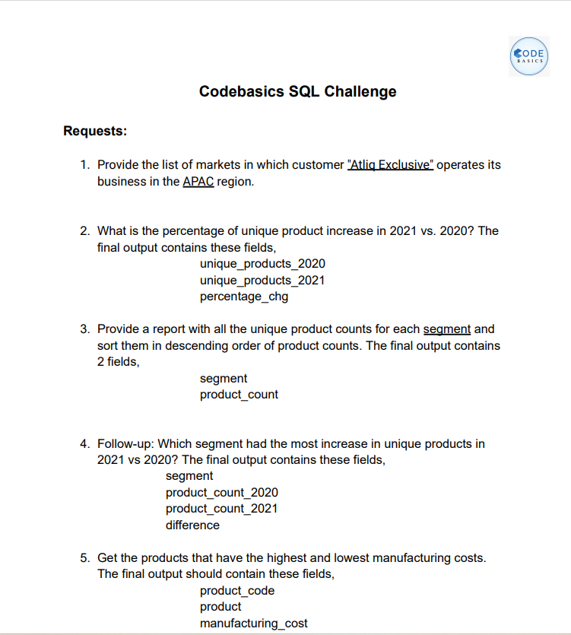
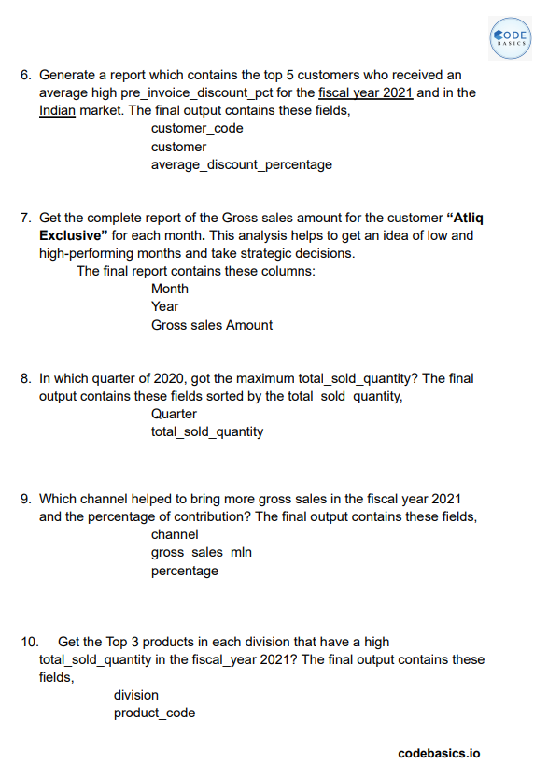
AD-HOC REQUEST’S

Slide 6
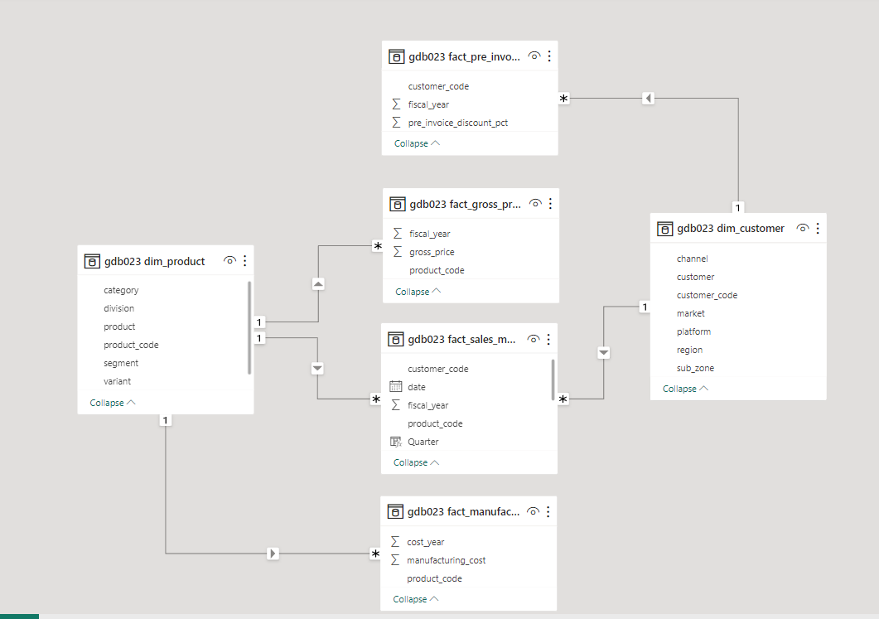

DATA MODEL
ATLIQ’S FISCAL YEAR
Input data is for FY 2020 and FY 2021.
FY2020-SEP 2019-AUG 2020
FY2021-SEP 2020-AUG-2021
TOOLS:
SQL:QUERIES EXECUTION
POWER BI:VISUALISATION

Slide 7

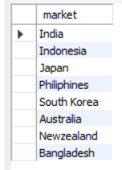
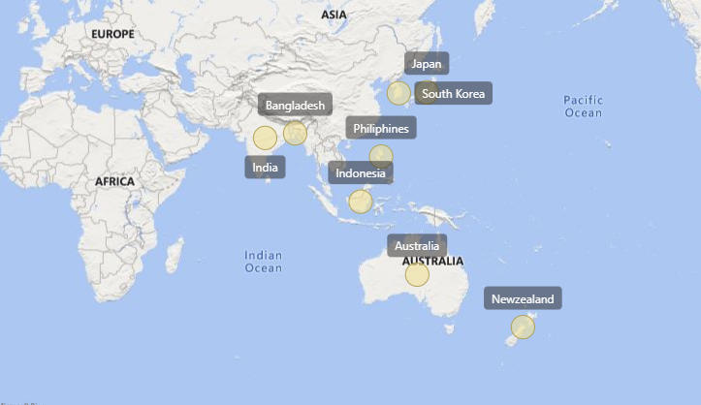
REQUEST-1
Provide the list of markets in which customer AtliQ Exclusive" operates its business in the APAC region.
OUTPUT
AtliQ Exclusive operates its business in the Asia Pacific region, encompassing eight countries: Australia, Bangladesh, India, Indonesia, Japan, New Zealand, the Philippines, and South Korea.

Slide 8
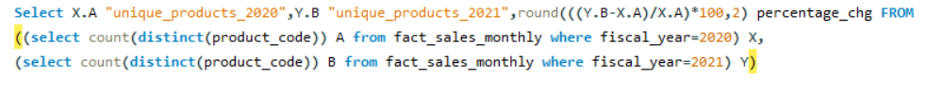
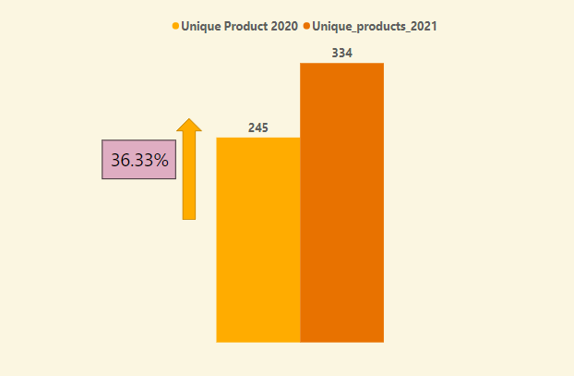

REQUEST-2
OUTPUT
What is the percentage of unique product increase in 2021 vs. 2020? The final output contains these fields.
unique_products_2020
unique_products_2021
Percentage chg
AtliQ Hardware soared from 245 unique products in FY2020 to an astounding 334 in FY2021, marking a remarkable 36.33% growth. Embracing customer demands, their dedication to innovation sets the stage for a promising future.

Slide 9
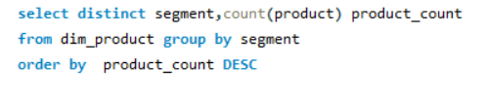
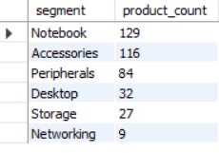
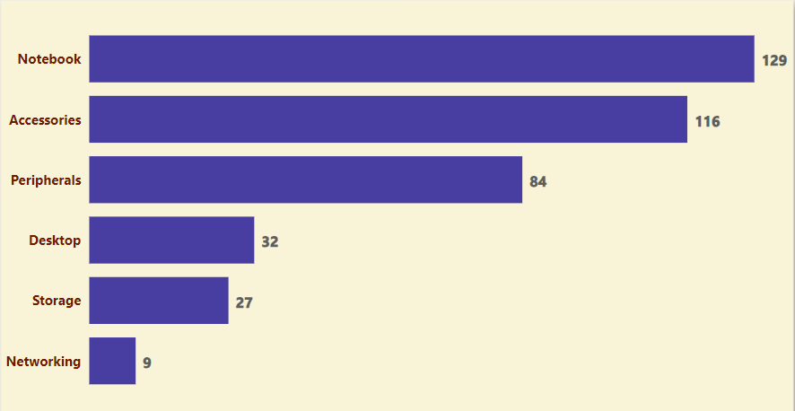
REQUEST-3
Provide a report with all the unique product counts for each segment and sort them in descending order of product counts. The final output contains 2 fields,
segment
Product_Count
OUTPUT
AtliQ Hardware excels in 6 unique product segments: Notebook, Accessories, Peripherals, Desktop, Storage, and Networking. Notably, the Notebook segment produces the highest variety, while the Networking segment offers the lowest, showcasing a diverse product range

Slide 10
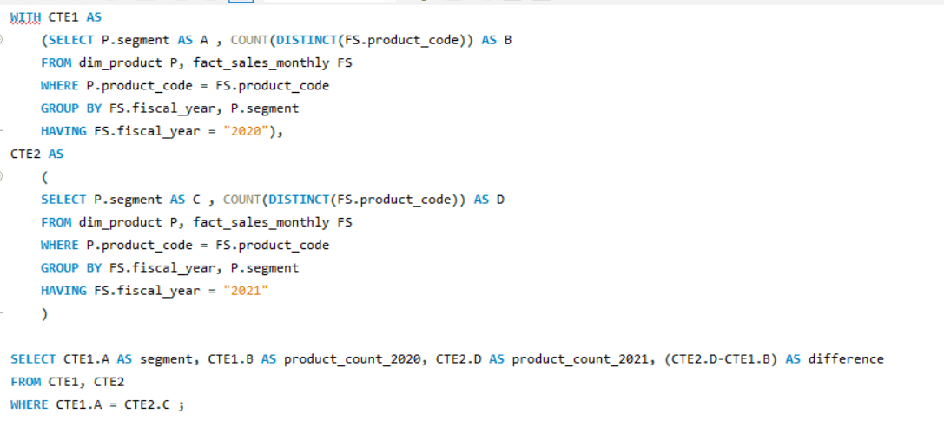
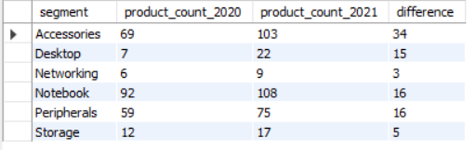
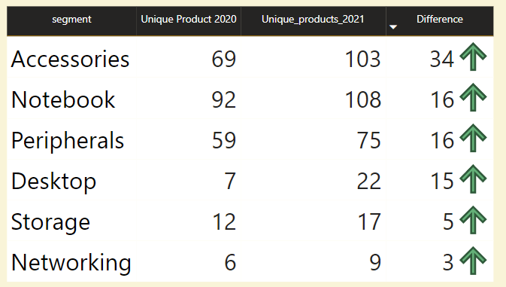
Request-4
Which segment had the most increase in unique products in 2021 vs 2020? The final output contains these fields, segment product count_2020 product count_
2021 difference
OUTPUT

Slide 11
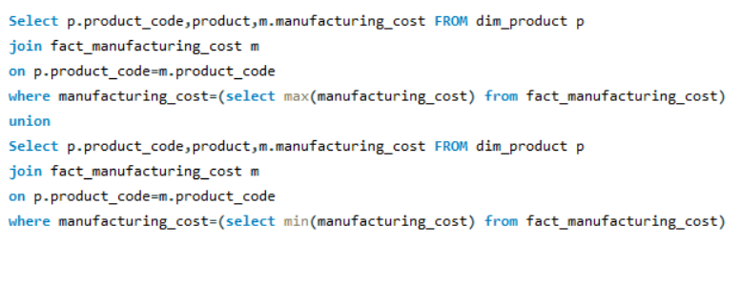

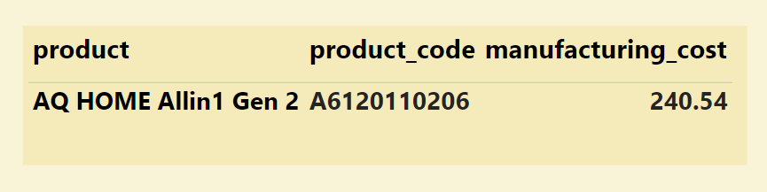

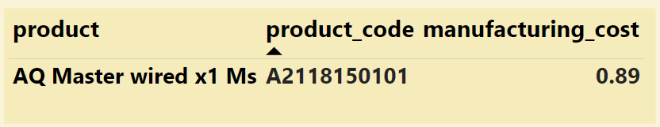

REQUEST-5
Get the products that have the highest and lowest manufacturing Costs. The final output should contain these fields, Product code, Product manufacturing cost
OUTPUT
HIGHER MANUFACTURING COST
LOWER MANUFACTURING COST

Slide 12
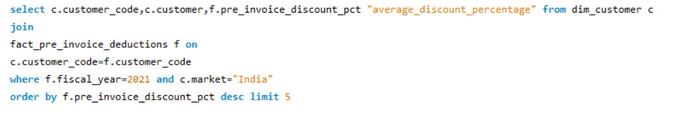
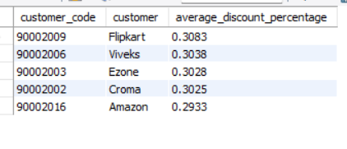
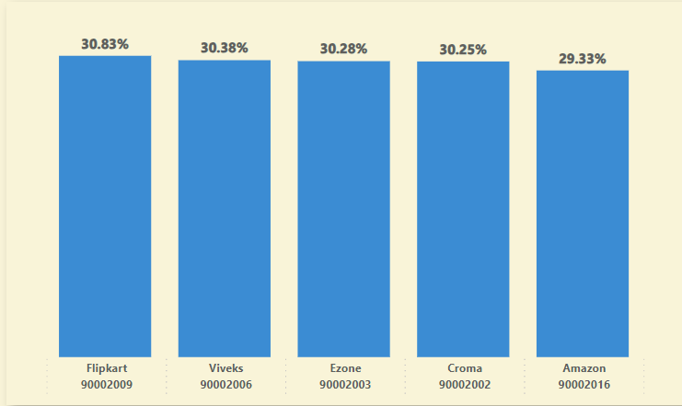
REQUEST-6
Generate a report which contains the top 5 customers who received an average high pre invoice discount % for the fiscal year 2021 and in the Indian market. The final output contains these fields,
customer code,
Customer,
Average discount percentage
OUTPUT
In FY2021, the top 5 customers in the Indian market has received nearly same pre-invoice discount percentages, listed in descending order, were: Flipkart (30.83%), Viveks (30.38%), Ezone (30.28%), Croma (30.25%), and Amazon (29.33%)

Slide 13
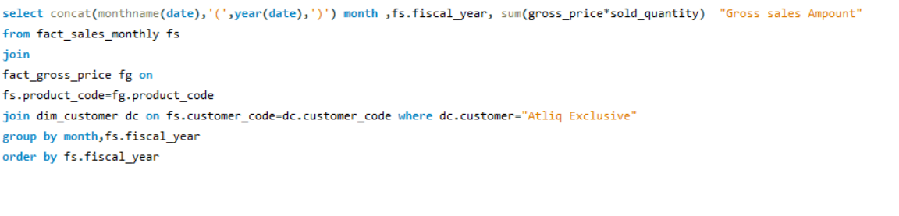
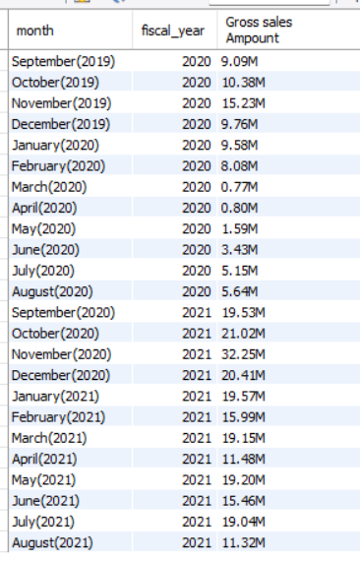
REQUEST-7
Get the complete report of the Gross sales amount for the customer AtliQ Exclusive for each month. This analysis helps to get an idea of low and high-performing months and take strategic decisions. The final report contains these columns:
Month
Year
Gross sales Amount
OUTPUT

Slide 14
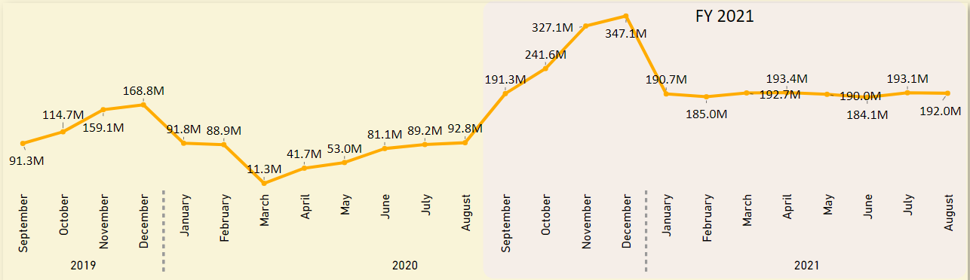
For AtliQ Exclusive, December 2020 recorded the highest sales, while March 2020 had the lowest gross sales due to the impact of COVID-19. Fortunately, sales rebounded swiftly after August, reaching the highest levels in November, marking a positive trend over the past two years

Slide 15
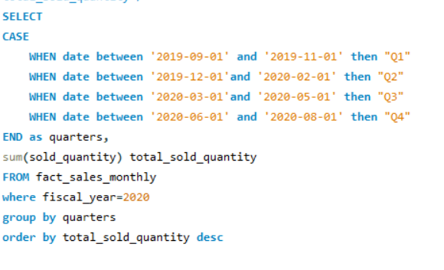
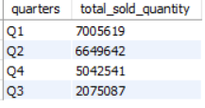
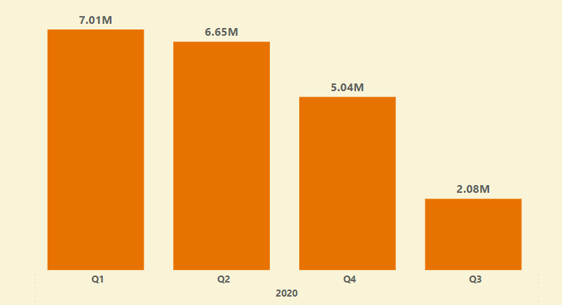
Request-8
In which quarter of 2020, got the maximum total sold quantity? The final output contains these fields sorted by the total_sold_quantity, Quarter total_sold_quantity
OUTPUT
In FY2020, AtliQ Hardware achieved its highest product sales of approximately 7.01 million in Q1 and the lowest of about 2.08 million in Q3. The decline during Q3 could be attributed to the impact of the COVID-19 pandemic, which peaked from March to May 2020.

Slide 16
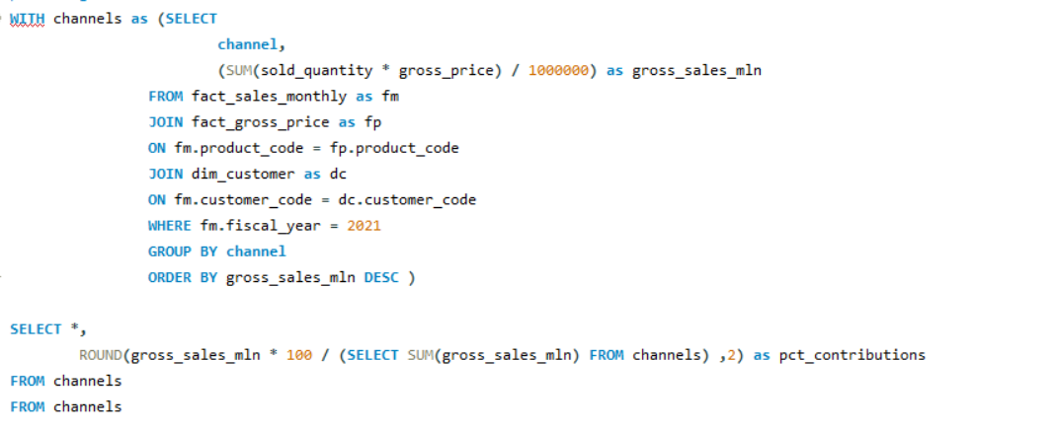
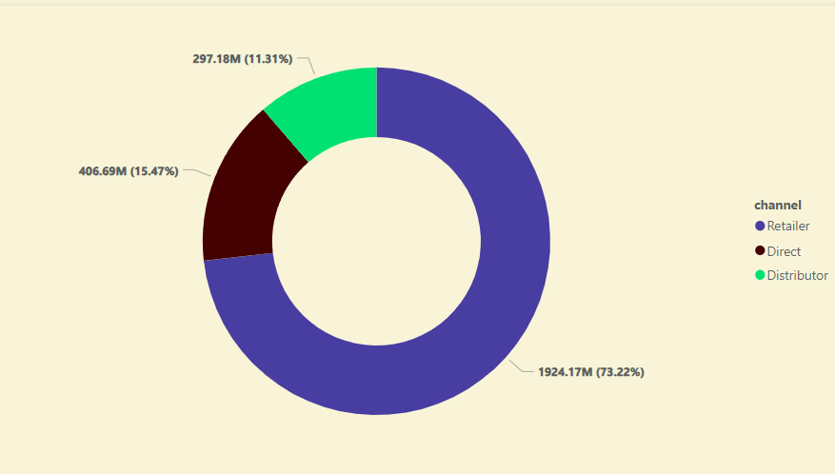
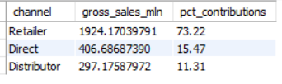
Request-9
Which channel helped to bring more gross sales in the fiscal year 2021 and the percentage of contribution? The final output contains these fields, channel gross_sales_mln percentage
OUTPUT
In FY2021, the Retailer channel proved most successful, generating approximately 73.23% of the total revenue, around 1924.17 million. Conversely, the Distributor channel had the lowest contribution, accounting for only 11.3% of the overall revenue, approximately 297.18 million.

Slide 17
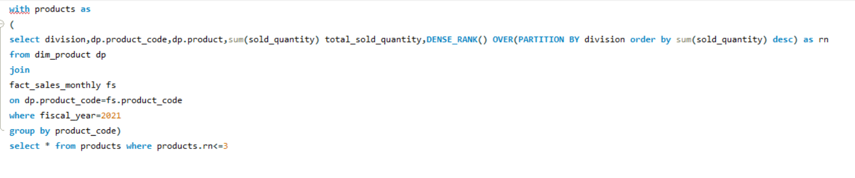
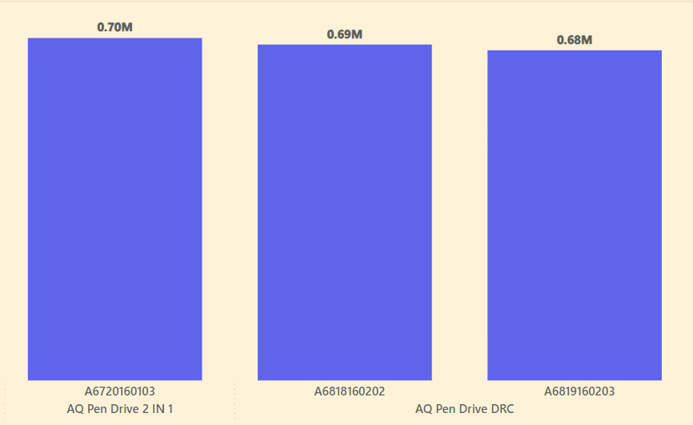
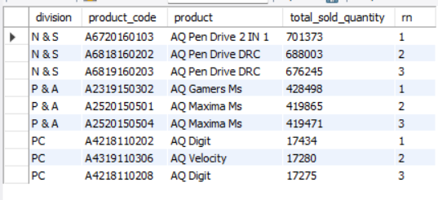
Request-10
Get the Top 3 products in each division that have a high total sold quantity in the fiscal year 2021? The final output contains these fields,
division
Product code
product
Total sold quantity
Rank order
N&S DIVISION
1
2
3

Slide 18
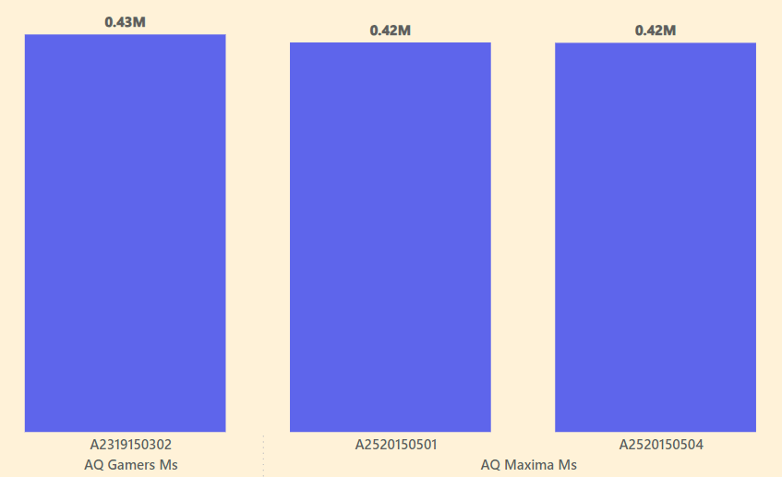
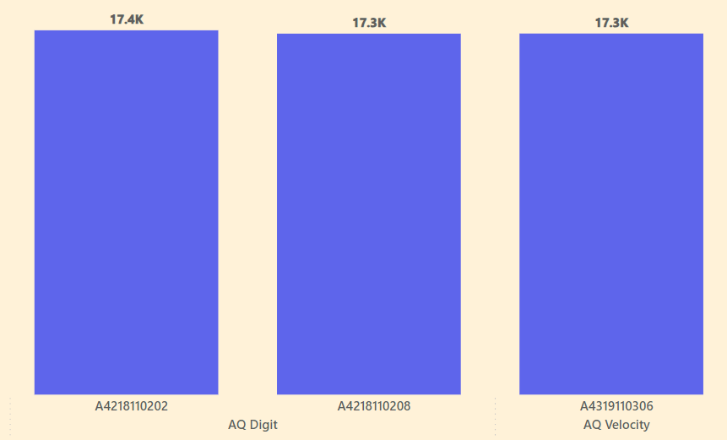
P&A DIVISION
PC DIVISION
1
2
3
1
2
3

