Slide 1
SENTIMENT ANALYSIS
CAPSTONE PROJECT
Presented By:
1. Student Name : Vemuri Anjali
2.College Name : SRK Institute Of Technology
3.Department:Computer Science And Engineering With
Specialization Data Science

Slide 2
OUTLINE
Problem Statement (Should not include solution)
Proposed System/Solution
System Development Approach (Technology Used)
Algorithm & Deployment
Result
Conclusion
Future Scope
References

Slide 3
PROBLEM STATEMENT
Example: Develop a Sentiment Analysis model to classify Restaurant
Reviews as Positive or Negative. With the rapid growth of
Online platforms for sharing opinions and reviews, restaurants often
Rely on the customer feedback to improve their services and attract
New customers. Analysing the sentiment of these reviews can provide
Valuable insights into customer satisfaction.

Slide 4
PROPOSED SOLUTION
Create a sentiment Analysis model to classify restaurant reviews as positive or negative which involves several steps like data collection, data preprocessing, algorithm, deployment, evaluation. The solution will consist of the following components:
Data Collection :
  Collect the labeled dataset on customer reviews.
  The dataset should include text reviews along with their corresponding sentiments i.e. Either positive or negative
Data Preprocessing :
  Text Cleaning : Remove all the special characters, blank spaces and stop words.
  Tokenization : Split text into individual words or tokens.
  Lower Case : Convert all the text to the lower case(e.g. "Good" to "good") to ensure uniformity.
  Lemmatization : Reduce the words to their base form (e.g. "jumping" to "jump") to ensure consistency
Machine Learning Algorithm:
  Implement a machine learning algorithm, such as Naive Bayes to classify reviews into sentiment categories by leveraging probabilistic calculations.
  The algorithm involves preprocessing the text data, training the model on labeled data, classifying new reviews and evaluating the model's.

Slide 5
Deployment:
  Deploy in translating machine learning models from development into actionable , real-world applications.
  Deploy the solution on a scalable and reliable platform, involves several tasks, from setting up the infrastructure to ensuring the system can handle requests efficiently and securely.
Evaluation:
  Assess the model's performance using appropriate metrics such as F1 Score, precision, recall or other relevant metrics.
  Result:

Slide 6
SYSTEM APPROACH
The "System Approach" section outlines the overall strategy and methodology for developing and implementing the Sentiment Analysis on Customer Review System. Here's a suggested structure for this section:
System requirements :
The system requirements involves WIFI processor, Windows10 OS, Jupyter Notebook, Anaconda software.
Library required to build the model :
The libraries required to build the model consists of the libraries such as pandas, matplotlib, seaborn, scikit-learn and many other relevant libraries

Slide 7
ALGORITHM & DEPLOYMENT
In the Algorithm section, describe the machine learning algorithm for sentiment analysis on customer review. Here's an example structure for this section:
Algorithm Selection:
  Provide a brief overview of the chosen algorithm (e.g., Naive Bayes, Support Vector Machines(SVM), Logistic Regression) and justify its selection based on the problem statement and data characteristics.
Data Input:
  Specify the input features used by the algorithm, such Review, Likes and any other relevant factors.
Training Process:
  Explain how the algorithm is trained using historical data. Highlight any specific considerations or techniques employed, such as cross-validation or hyperparameter tuning. Train a Machine Learning model on the extracted features to predict sentiment(positive or negative)
Prediction Process:
  Detail how the trained algorithm makes predictions for sentiment. Discuss any real-time data inputs considered during the prediction phase. once the model is trained and evaluated, it can be used to predict sentiment for new, unseen reviews.

Slide 8
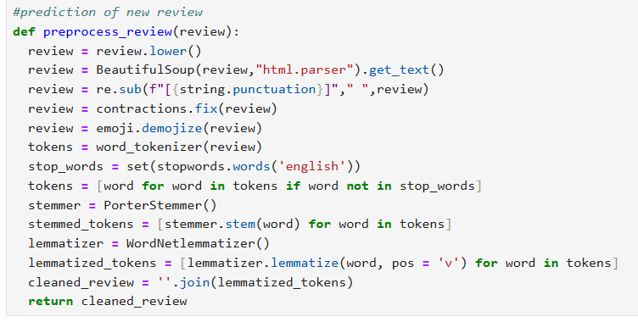
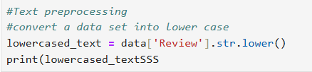
RESULT
Sentiment Analysis model ensures that the text data is preprocessed effectively. the sentiment analysis project sucessfully delivered a roboust model for accurately categorizing sentiment in textual reviews. The model is trained and evaluated properly, and it can provide accurate sentiment predictions for new reviews.

Slide 9
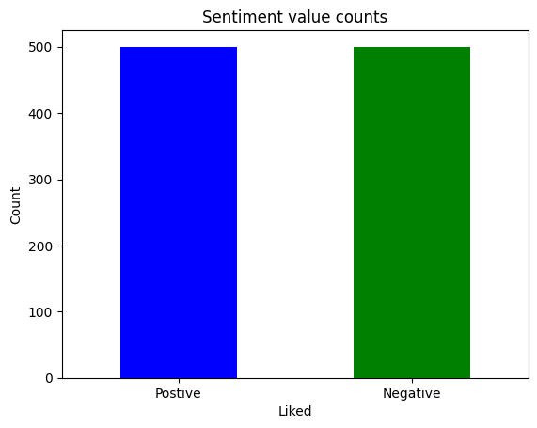
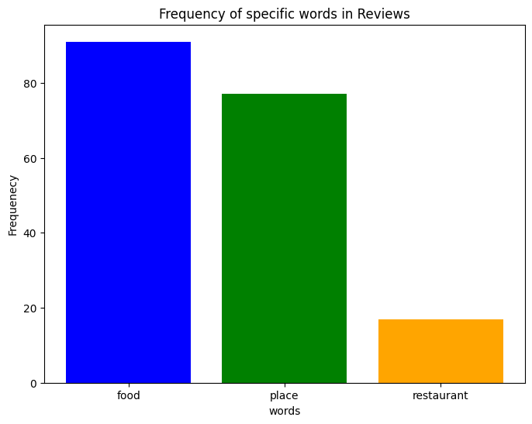
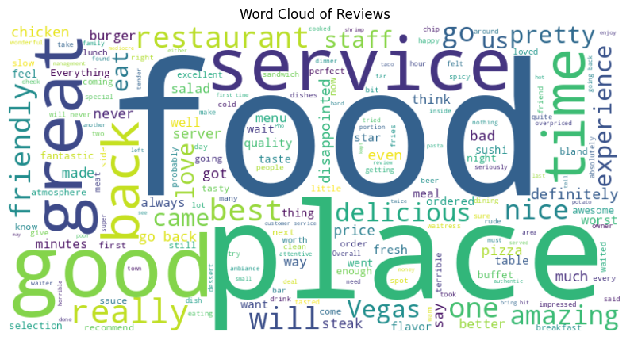

Slide 10
CONCLUSION
Developing a sentiment analysis model involves several steps, from data collection to prediction. It ensures that data is preprocessed effectively. It ensures that the model is trained and the model can be use to predict sentiment for new and unseen reviews.

Slide 11
FUTURE SCOPE
Sentiment Analysis is geared towards creating more intelligent, accurate, and context-aware systems that can provide deeper insights and more personalized experience across various applications. It has a significant impact in NLP, Machine Learning, Customer feedback and experience, Market Research and Competitive Analysis, Advanced preprocessing Techniques, Handling imbalanced data, HyperParameter Tunning, Featured Engineering.

Slide 12
REFERENCES
For Sentiment Analysis there are several relevant sources, research papers, and articles that were instrumental in developing the proposed solution. This could include tools and libraries for sentiment analysis, machine learning algorithms, datasets and best practices in data preprocessing and model evaluation.

Slide 13
THANK YOU

