Slide 1
ForecastinQ: Intelligent Sales Forecasting & Inventory Management
Infosys Springboard Virtual Internship 7.0 – Milestone-2 Review

Slide 2
The Problem & Our Vision
Business Challenge
ForecastinQ Vision
Stockouts lose revenue; overstocking ties up capital. Retailers need real-time visibility and intelligent forecasting.
A data-driven commerce platform that transforms inventory from a cost center into a competitive advantage.
Milestone-2 Focus
Building the core inventory operations engine with live database connectivity and intelligent filtering.

Slide 3
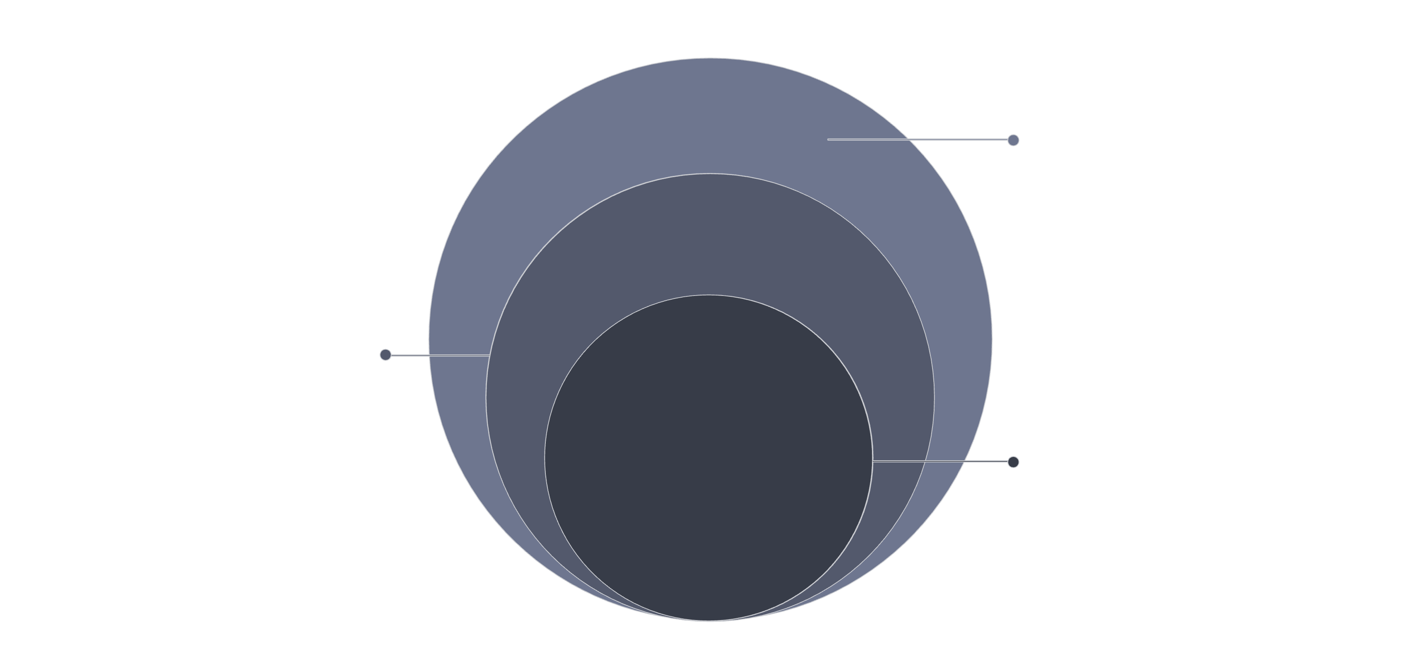
System Architecture & Data Pipeline
Full-Stack Architecture Overview
Data Layer
SQLite DB with live sync and secure access
Backend Layer
Node.js/Express REST API and business logic
Frontend Layer
React UI, responsive dashboard, real-time filtering
Integration: Seamless data flow between all layers with proper error handling.

Slide 4
Milestone-2 Objectives & Key Deliverables
Core Inventory Operations, Database Integration & Catalog Architecture
1
2
3
Transition from Static Layout to Active Database Connectivity
Catalog Health & Data Integrity
Security Standards & Best Practices
Implement parameterized queries, secure SQL binding, and validation rules
Defeat SQL injection, enforce input validation, and secure API endpoints
Move from hardcoded data to live SQLite synchronization
4
5
Modular Architecture
Performance & Optimization
Build reusable components and clean separation of concerns for scalability
Ensure fast query execution, efficient pagination, and responsive UI

Slide 5
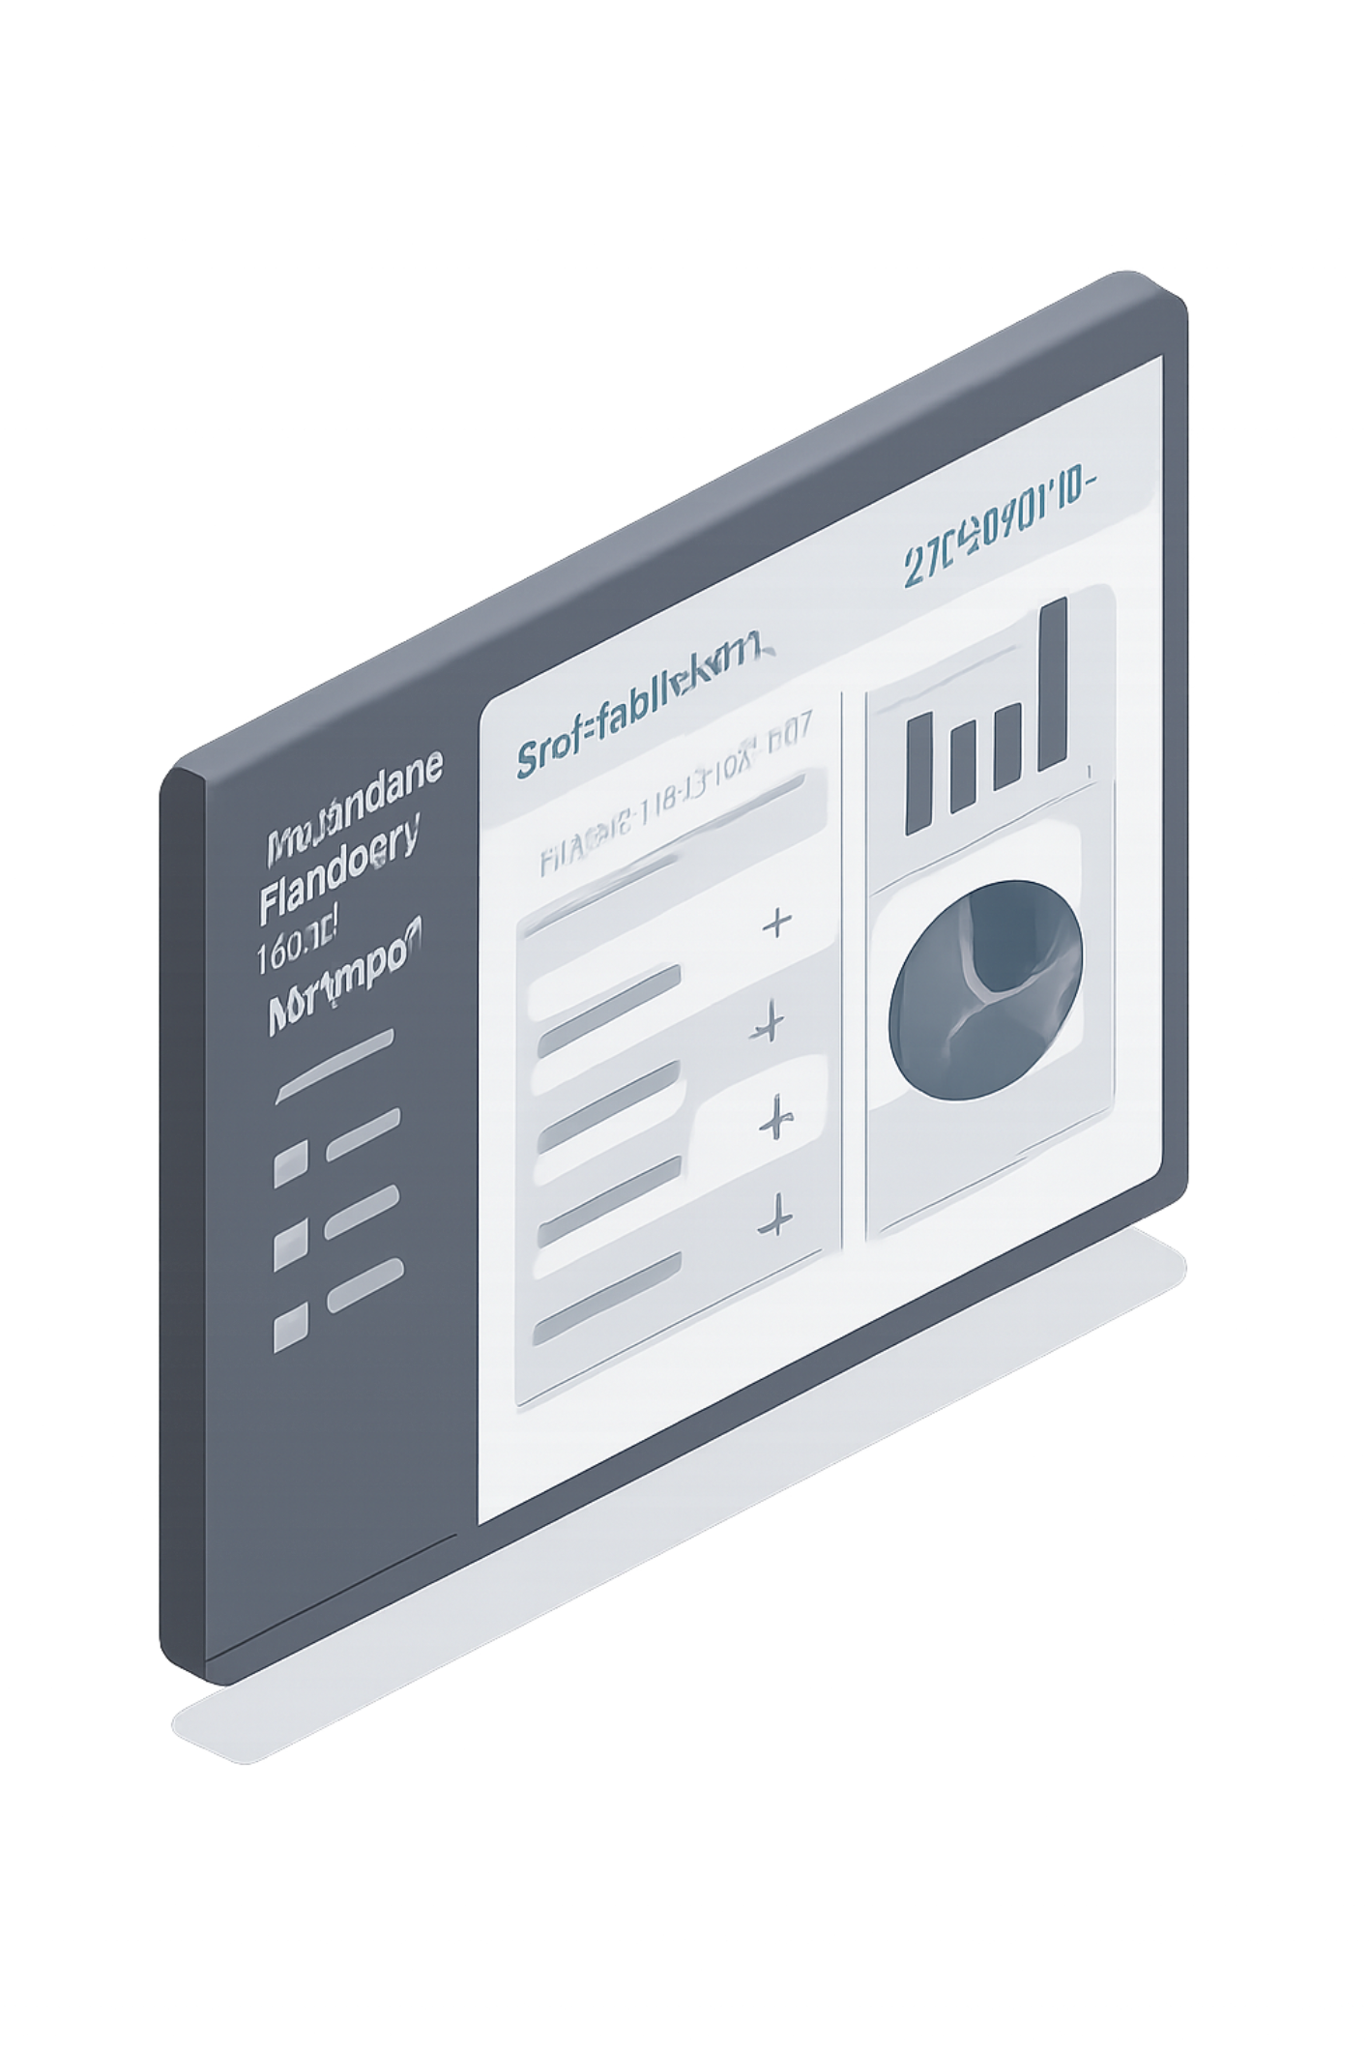
Executive Dashboard & Live Inventory Valuation
Real-Time Inventory Overview
Our executive dashboard provides an immediate, comprehensive snapshot of inventory health and financial performance, enabling proactive decision-making.
₹96,73,400
Total Inventory Valuation
18
Total Products
10
Active Brands
3
Critical Alerts
low stock items requiring immediate attention
Key Feature: Brand quick filters for instant category navigation.
APPAREL
ELECTRONICS
HOME GOODS
BOOKS

Slide 6
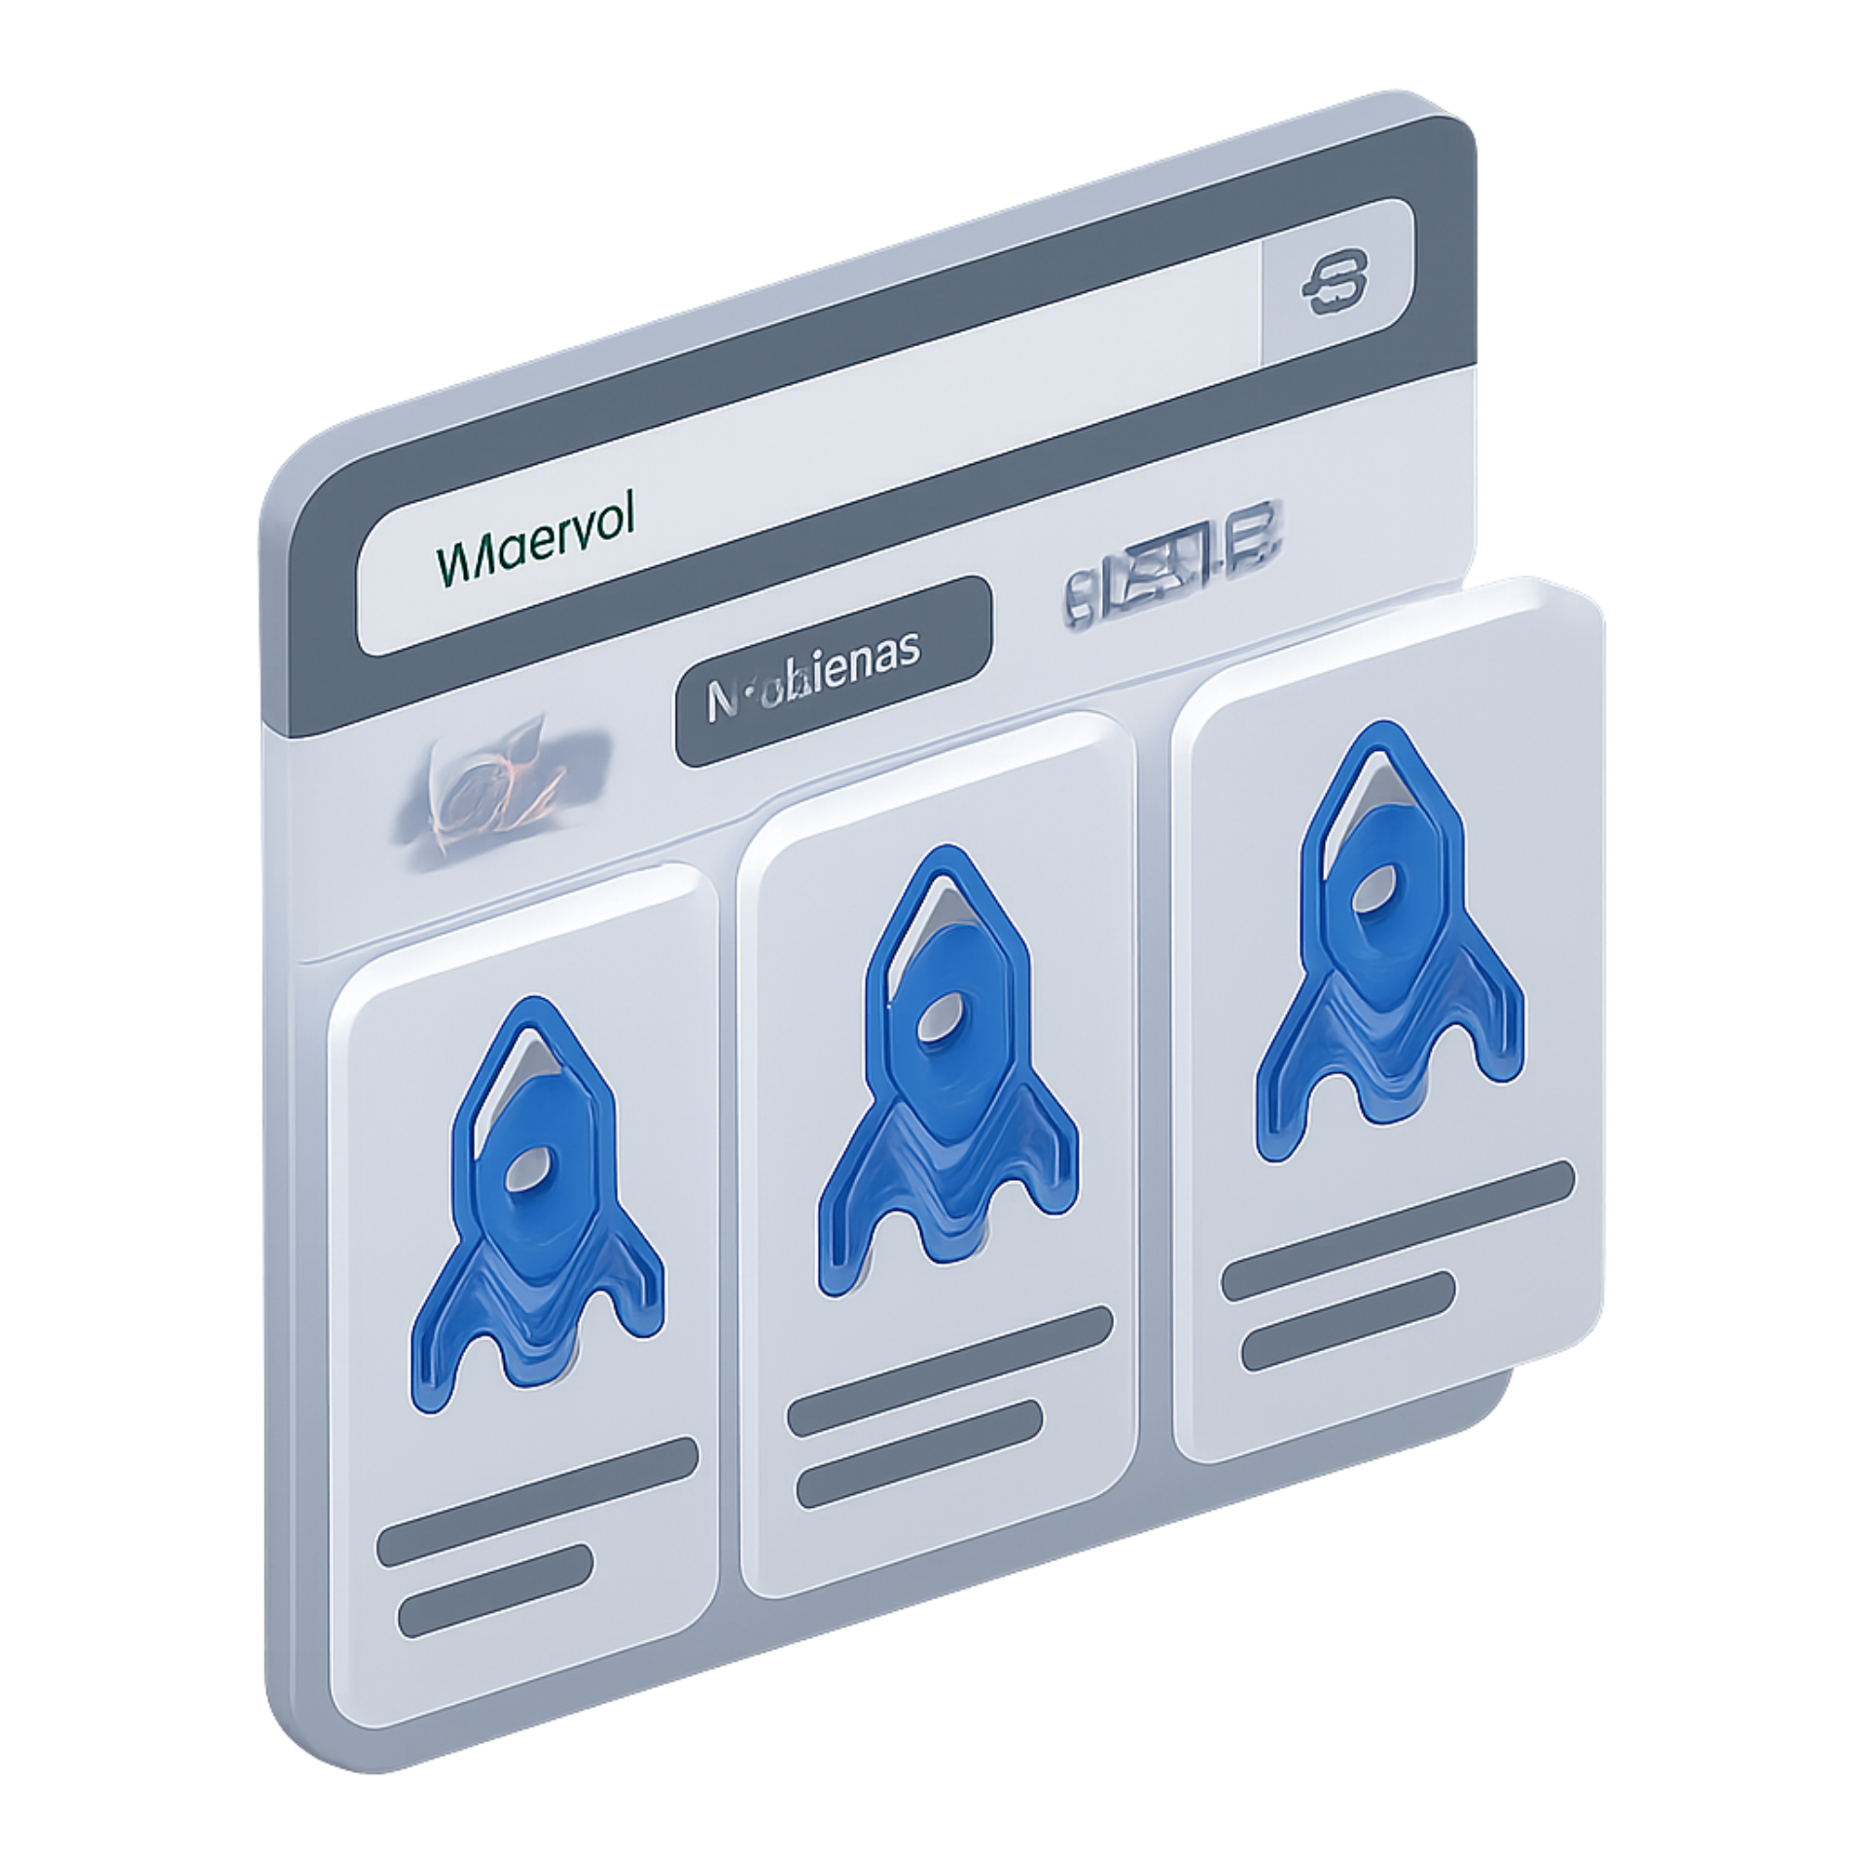
Product Catalog & Intelligent Filtering
Smart Search & Multi-Parameter Filtering
Multi-Parameter Filtering
Filter by Category + Brand simultaneously for precise product discovery
Instant Text Search
Real-time search across product names, SKUs, and descriptions
Live SQLite Sync
Database updates reflected instantly in the UI without page refresh
User Experience
Clean, intuitive interface with visual feedback and filter state persistence

Slide 7

Backend Engineering & Security (Catalog Health)
Secure SQL & Parameterized Query Architecture
Vulnerable Pattern (SQL Injection Risk)
Secure Pattern (Parameterized Query)
const user_input = "'; DROP TABLE users; --";
const query = "SELECT * FROM products WHERE name = '" + user_input + "'";
// SQL becomes: SELECT * FROM products WHERE name = ''; DROP TABLE users; --'
// This can lead to data loss or unauthorized access.
const user_input = "Electronics"; // User input
const query = "SELECT * FROM products WHERE name = ?";
db.run(query, [user_input], (err) => {
// user_input is treated as data, not executable code, preventing injection.
});
Parameterized Query Security
Input Validation
Use WHERE p.brand = ? syntax to defeat SQL injection attacks
Strict validation on all user inputs before database queries
Pagination Query Coexistence
Best Practices
Efficient pagination logic that works seamlessly with filtering and search
Prepared statements, input sanitization, and error handling
Security is paramount: Adopting parameterized queries and rigorous input validation safeguards our application against critical vulnerabilities like SQL injection, protecting both data integrity and user trust.

Slide 8





Smart Restocking & Threshold Automation
Intelligent Inventory Management
Stock vs. Min Level Logic
Automatic alerts when inventory falls below minimum thresholds
Automated Reorder Quantity Recommendation
System calculates optimal reorder quantities based on sales velocity and lead time
Brand Deep-Links
Quick navigation to all products from a specific brand for bulk operations
Threshold Configuration
Customizable min/max levels per product category
Reorder Workflow
Streamlined process from alert to purchase order generation

Slide 9
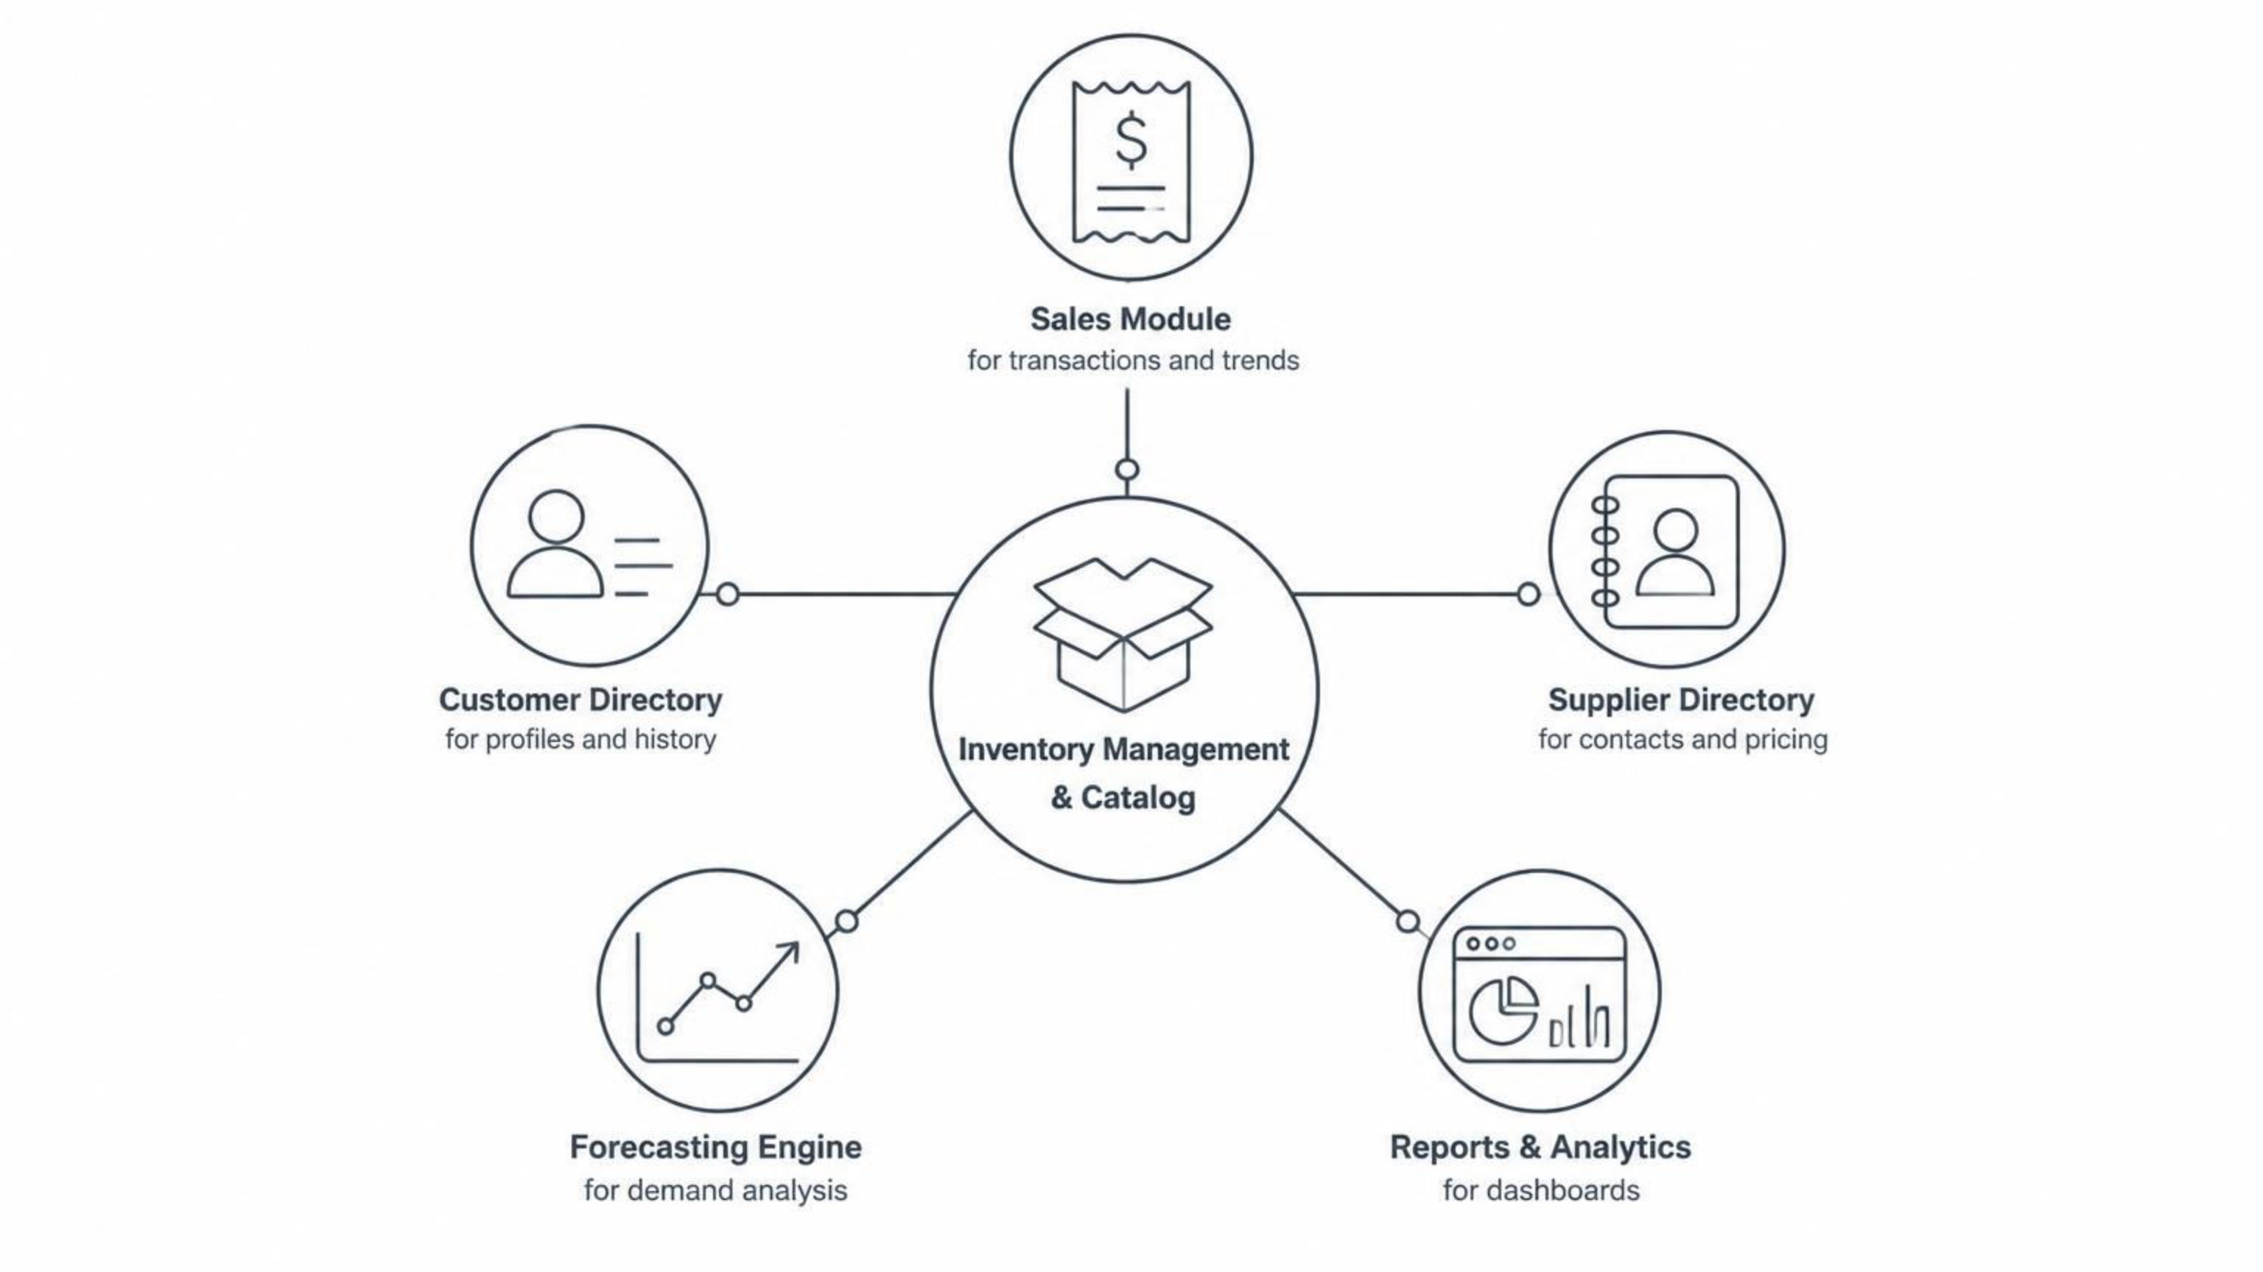
Commerce & Intelligence Architecture (Upcoming Modules)
Roadmap: Integrated Commerce Platform
Our platform is built on a modular architecture, with a robust core managing inventory and catalog data, around which future intelligent commerce modules will be integrated.
Core (Completed)
Upcoming Modules
Inventory Management & Catalog
Sales Module – Track transactions, revenue, and sales trends
Customer Directory – Manage customer profiles, purchase history, and preferences
Supplier Directory – Maintain supplier contacts, lead times, and pricing
Forecasting Engine – ML-powered demand forecasting and trend analysis
Reports & Analytics – Comprehensive dashboards and business intelligence

Slide 10
Key Takeaways & Next Steps
Milestone-2 Learnings
Milestone-3 Roadmap
Full-stack development with React, Node.js, and SQLite
Security best practices: parameterized queries and input validation
Database design and optimization for real-time data synchronization
Building scalable, modular architecture for enterprise applications
ML Forecasting Models – Implement machine learning for demand prediction
Predictive Analytics – Advanced trend analysis and anomaly detection
Sales & Customer Modules – Expand platform with transaction and customer management
Performance Optimization – Scale to handle larger datasets and concurrent users
We are committed to evolving ForecastinQ into a comprehensive, intelligent commerce platform, transforming inventory management into a strategic advantage for businesses.

