Slide 1

Milestone 3: Sales, Notifications & Reports
Infosys Springboard Virtual Internship — Technical Deep Dive

Slide 2



What's New in Milestone 3
Sales Module
Notifications System
Reports Module
Create sales with multiple line items and automatically track stock changes across related tables.
Low-stock alerts and system notifications with read/unread status, surfaced via the topbar bell icon.
Generate filtered data reports and export directly to CSV — a new data delivery workflow.

Slide 3
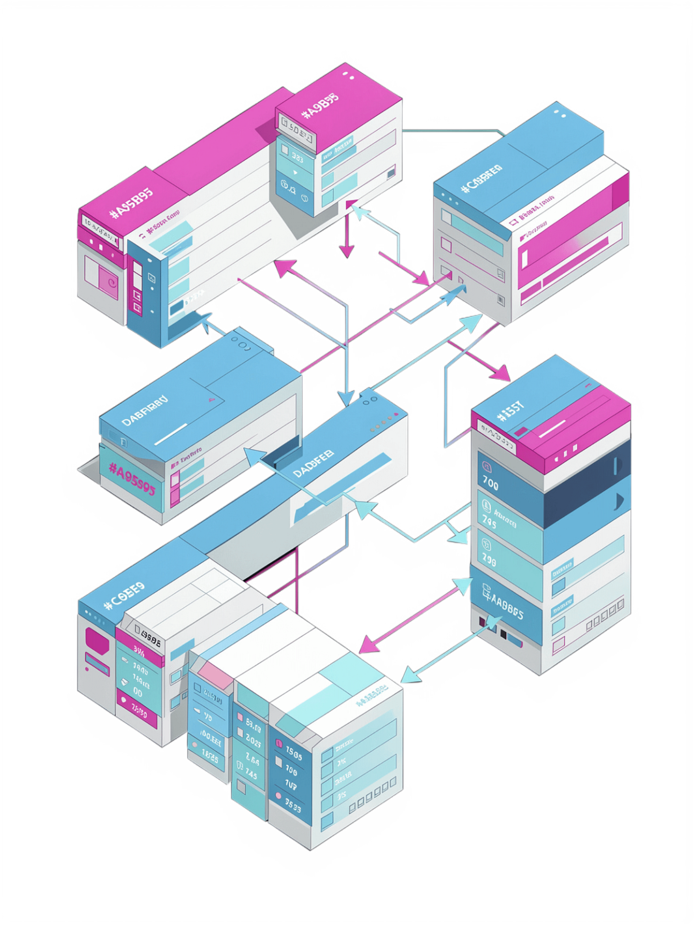
Multi-Table Transactions: The Sales Blueprint
One Form, Two Tables
Transaction Pattern
A single form submission orchestrates writes across two tables simultaneously — sales and sales_items — within one request lifecycle.
One INSERT into the sales table to create the sale record
Multiple INSERTs into sales_items for each line item
First hands-on experience with transactional database operations

Slide 4
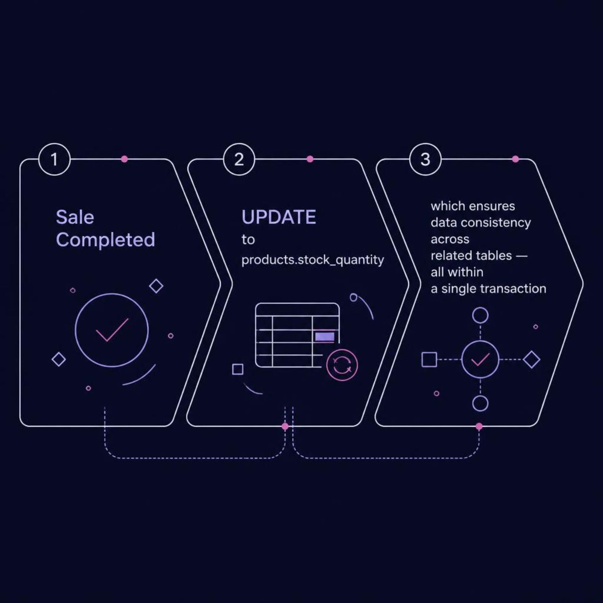

Stock Management Integration
Atomic Inventory Updates
Completing a sale automatically decrements products.stock_quantity — the inventory update happens within the same transaction as the sale insert.
Wrapping both operations in one transaction guarantees data consistency. If either step fails, the entire operation rolls back.

Slide 5
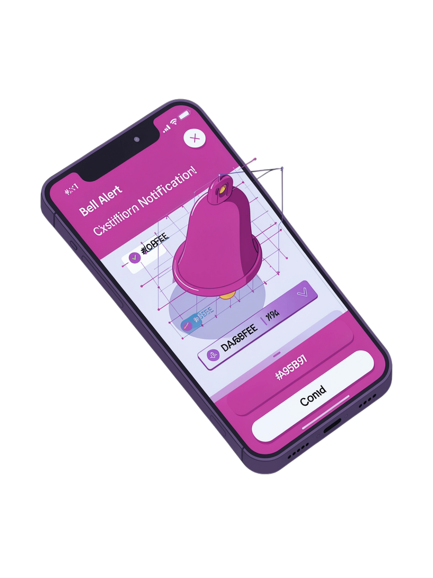



Notifications Architecture
Read / Unread Tracking
Each notification record carries a status flag, letting users distinguish new alerts from acknowledged ones at a glance.
Topbar Bell Icon
utils.get_unread_notifications() is called on every page load, driving the live unread count displayed in the navigation bar.
Automatic Low-Stock Alerts
When inventory falls below the defined minimum threshold, a notification is triggered automatically — no manual intervention required.

Slide 6
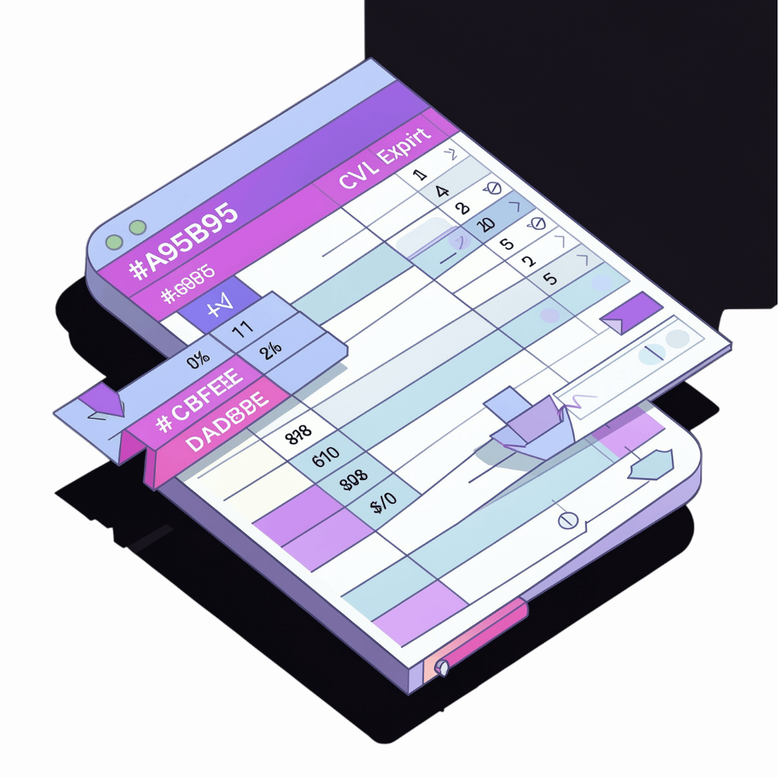
Reports & CSV Export
Two Delivery Modes
The Reports module supports two distinct output formats depending on the user's intent.
HTML View: Reports page renders filtered data directly in the browser for interactive review
CSV Export: The reports.export route streams a CSV file directly to the browser for download
This pattern introduces an important concept: the same underlying data query can power multiple response types — HTML rendering vs. file streaming.

Slide 7
Folder Structure Expansion
New Blueprints
New Template Folders
Three new Flask blueprint files extend the application's modular core:
Matching template directories keep views co-located with their blueprints:
blueprints/sales.py NEW
blueprints/notifications.py NEW
blueprints/reports.py NEW
templates/sales/ NEW
templates/notifications/ NEW
templates/reports/ NEW
The modular architecture established in Milestones 1–2 is fully preserved and extended.

Slide 8

Key Learning Tasks
1
Add a New Sale Status
Implement a refunded status and propagate it consistently across the sales list, dashboard KPIs, and the reports view.
2
Extend Low-Stock Notifications
Ensure low-stock alerts trigger automatically whenever stock falls below the minimum — not just on manual checks.
3
Date-Range Filtering with CSV Export
Implement start/end date filters on the Reports page and confirm the CSV export respects the same filter parameters.

Slide 9

Milestone 3 Checklist
Verify each deliverable before marking Milestone 3 complete:
Create sales with multiple line items
Stock quantity decreases after a completed sale
Notifications list shows relevant low-stock alerts
Reports page renders filtered data correctly
CSV export downloads from the reports.export route
Dashboard "View All" (Sales) link is functional
All six checks passing? You've completed Milestone 3. Well done.

