Slide 1
GIT
Built for developers
Vemuri Sindhura
Assistant Professor
VR Siddhartha Engineering College

Slide 2
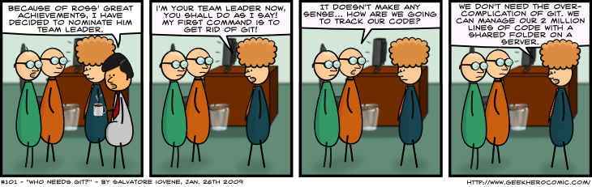
Who needs GIT

Slide 3
What is VCS?
Tracks the history of changes as people and teams collaborate to work on projects together.
As the project evolves major focus has to be done to find out:
1. The changes made
2. Who made the changes
3. Date & Time of change
4. Reason for changes

Slide 4
Centralized VCS
Pull down any changes other people have made from the central server.
Make your changes, and make sure they work properly.
Commit your changes to the central server, so other programmers can see them.

Slide 5
Distributed VCS
Do not necessarily rely on a central server to store all the versions of a project’s files.
Instead, every developer “clones” a copy of a repository and has the full history of the project on their own hard drive.
This copy (or “clone”) has all of the metadata of the original.

Slide 6
Advantage over Centralized VCS
Performing actions are extremely fast because the tool only needs to access the hard drive, not a remote server.
Any operation can be done without internet connection.
Each programmer has a full copy of the project repository, they can share changes with one or two other people at a time if they want to get some feedback before showing the changes to everyone.

Slide 7
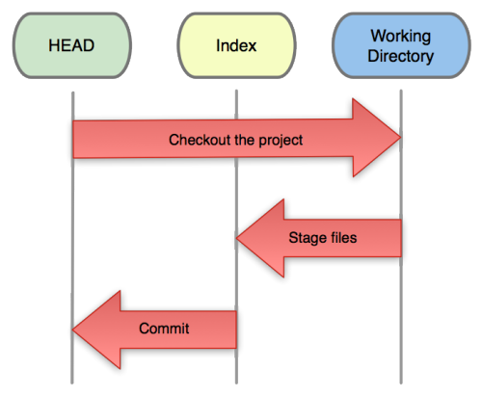
Getting Started
Three trees of Git
Head → last commit snapshot, next parent
Index → Proposed next commit snapshot
Working directory → Sandbox

Slide 8
WORKSTATION SETUP
To setup command line GIT access simply go to git-scm.com/downloads where you’ll find the required downloads for your OS.
After everything is set up and you have “git” in your PATH environment variable, then the first thing you have to do is to config git with your name and email:

Slide 9



Slide 10
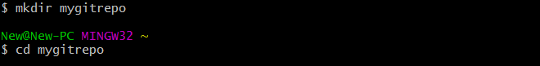

CREATE A NEW GIT REPOSITORY
Create a new directory where the git repository will live and cd into it:

Slide 11
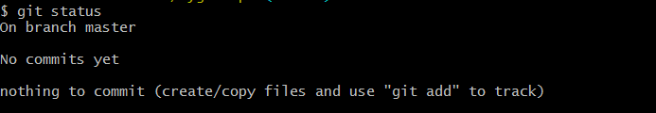
Check the current status of GIT repository

Slide 12
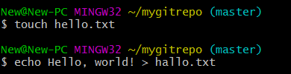

CREATE AND COMMIT A NEW FILE
The touch command is the easiest way to create new, empty files.
echo command is used along with > to add the data into a particular file.

Slide 13
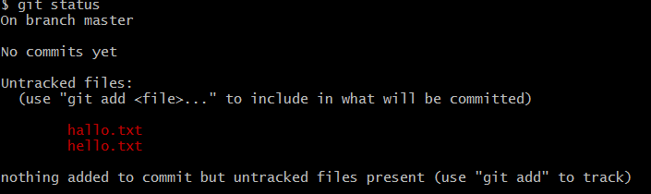
Again checking for status reveals:

Slide 14

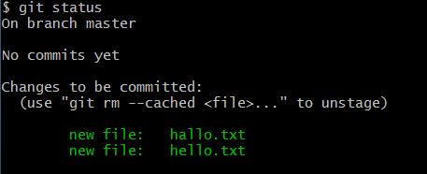
To “register” the file for committing we need to add it to git using
Status now indicates that the files are ready to be committed

Slide 15

After the commit operation

Slide 16
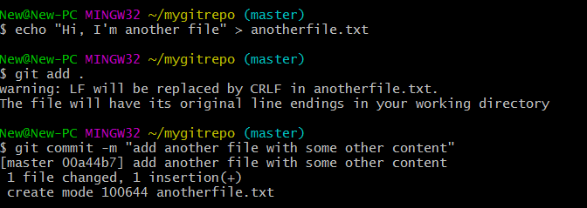
Adding another file to repository

Slide 17
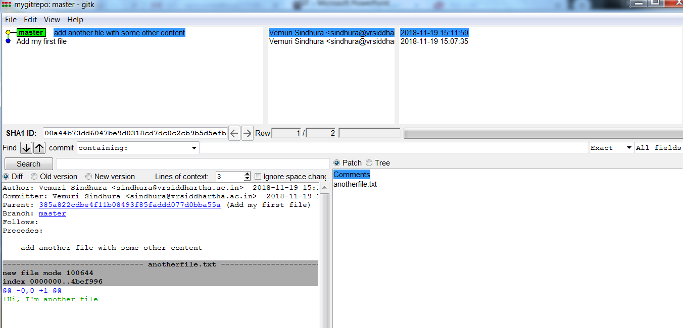
Visualized Master history in GIT GUI

Slide 18
CREATE A (FEATURE)BRANCH
GIT makes no technical distinction between the master branch and feature branches, so developers can edit, stage, and commit changes to a feature branch.
In addition, feature branches can (and should) be pushed to the central repository.

Slide 19



Create a new feature branch
Executing
The * in front of master indicates that we’re currently on that branch. Lets switch to my-feature-branch instead:

Slide 20
What’s different to other VCS is that there is only one working directory.
All of your branches live in the same one and there is not a separate folder for each branch you create.
Instead, when you switch between branches, Git will replace the content of your working directory to reflect the one in the branch you’re switching to.

Slide 21
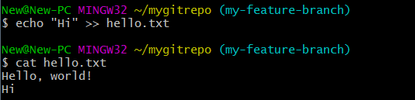
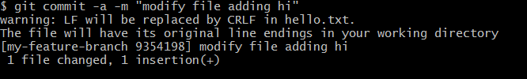
Lets modify one of our existing files
And then commit the changes to new branch

Slide 22
git commit -a -m to add and commit a modification in one step.
This works only on files that have already been added to the git repo before.
New files won’t be added this way and need an explicit git add as seen before.

Slide 23

What about our tree?

Slide 24
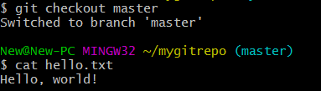
Now master remained where it was and we moved forward with my-feature-branch.
Lets switch back to master and modify the same file there as well.

Slide 25

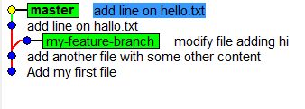
Lets change and commit it on master as well
Our tree now visualizes the branch

Slide 26
POLISHING FEATURE BRANCH COMMITS
We can create our own, personal feature branch and are allowed to do as much commits as we want.
But once you’re ready to merge back to master you should polish your commit history. This is done with the rebase command like this:

Slide 27

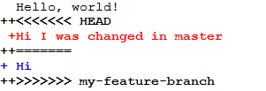
MERGING AND RESOLVING CONFLICTS
The next step would be to merge our feature branch back into master. This is done by using the merge command

Slide 28

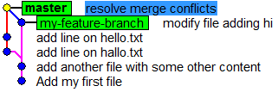
Resolving the merge conflicts and merging it
The tree reflects our merge.

Slide 29
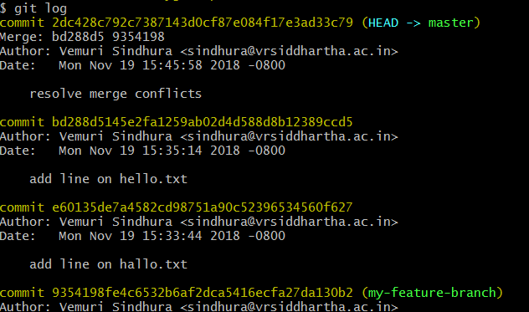
JUMP TO CERTAIN COMMIT
For example, we wish to jump to a particular commit.
Use git log command to get SHA identifiers which uniquely identify each node in a tree

Slide 30
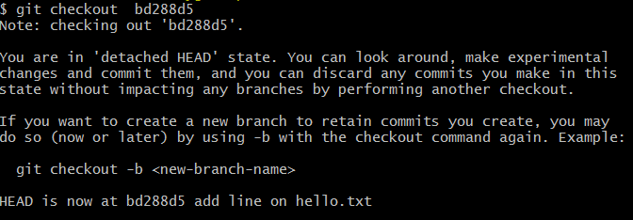
Take one of the identifiers (also if it isn’t the whole one, it doesn’t matter) and jump to that node by using the checkout command.
Detached head means “head” is no more pointing to a branch “label” but instead to a specific commit in the tree.

Slide 31
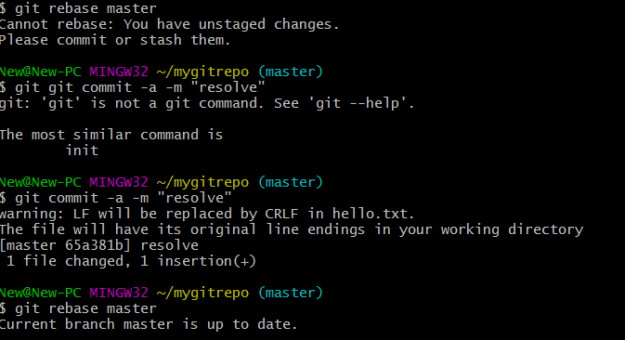
REBASE
Rebase is another way to integrate changes from one branch to another. Rebase compresses all the changes into a single “patch.” Then it integrates the patch onto the target branch.

Slide 32
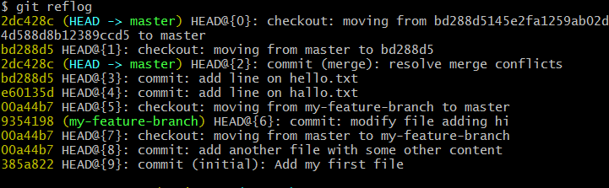
GIT reflog
git reflog doesn’t last forever. Git will periodically clean up objects which are “unreachable.” Don’t expect to find months-old commits lying around in the reflog forever.
Your reflog is yours and yours alone. You can’t use git reflog to restore another developer’s un-pushed commits.

Slide 33

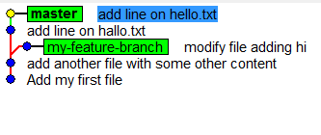
RESET HARD
Jumping back is nice, but what if we want to undo everything back to the state before the merge of the feature branch? It is as easy as
“git reset --hard <tag/branch/commit id>”

Slide 34
Using “revert” to rollback changes the nice way
The git revert command is a forward-moving undo operation that offers a safe method of undoing changes.
Instead of deleting or orphaning commits in the commit history, a revert will create a new commit that inverses the changes specified.
Git revert is a safer alternative to git reset in regards to losing work.
For instance consider you want to rollback a commit with ID 41b8684
“git revert 41b8684”

Slide 35
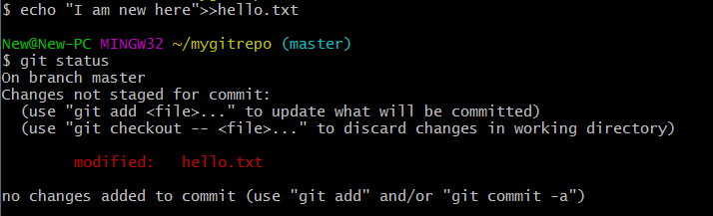
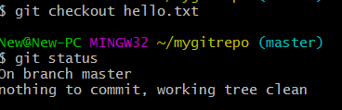
Assume you modified a file. Executing git status would result in
Performing check out will not allow us to undo any changes.

Slide 36

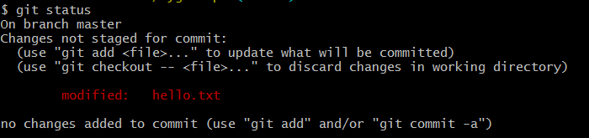
“reset” our current pointer to HEAD which is the top of our current branch.

Slide 37
We’re now again in the state when we have local changes not yet staged for a commit and can therefore use the checkout command to discard them.
A quicker way of doing so is to use the
command which will do an un-staging + checkout in one command.

Slide 38
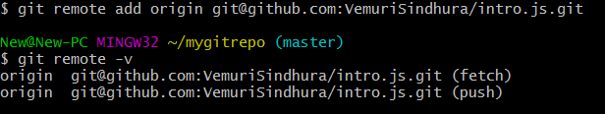
SHARING/SYNCHING YOUR REPOSITORY
Ultimately we want to share our code, normally by synching it to a central repository. For doing so, we have to add a remote.

Slide 39
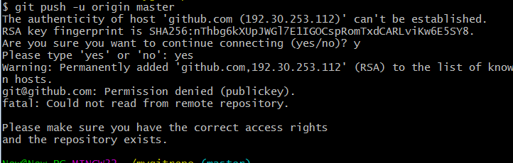
Publish our local branch master to the remote repository. This is done like

Slide 40
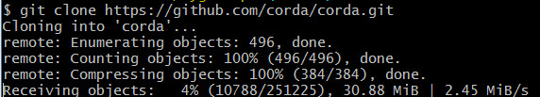
CLONING
git cloneis a Git command line utility which is used to target an existing repository and create a clone, or copy of the target repository.

Slide 41
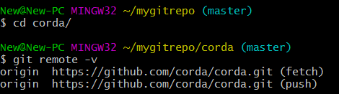
This will create a folder (in this case) named “intro.js” and if we enter it.
Check for the remotes we see that the according tracking information of the remote repository is already set up

Slide 42
