Slide 1
House Price-Prediction
Piyush Sharma(102216044)
Jasmine Garg(102216072)

Slide 2
Introduction
Accurately predicting house prices is a critical challenge in the real estate industry, with significant implications for buyers, sellers, and investors. This project aims to develop a data-driven model that estimates house prices based on key influencing factors such as number of bedrooms, bathrooms, area , etc. By leveraging advanced analytical methods, the objective is to identify the most impactful variables and build a reliable prediction tool. This work not only supports informed decision-making but also contributes to understanding the complex dynamics of real estate markets.

Slide 3
Literature Review
Trends
Research on house price prediction has gained momentum due to the increasing availability of large-scale housing datasets and advancements in data analytics tools.
Initial studies relied heavily on simple statistical methods like linear regression, focusing on small datasets with limited variables.
With technological advancements, machine learning and artificial intelligence (AI) have become prominent in addressing the nonlinear and complex relationships between housing features and prices.
Methods
In older times there was linear dataset available and one can use linear regression method.
In recent times due to progress in ML field we can integrate non-linear and complex dataset to find the required price prediction.
In this project we have used 2 of those models like Random-Forest and XGBoost(Extreme Gradient Boost).
Factors
Area-the area of house, i.e. increase in area, increase in price.
Bedrooms-No. of bedrooms in a house also affects its price.
Stories-increase in floors of house directly affects its price
Parking-it’s availability or not affects the price
Main-road-house’s connectivity to main road is also an important feature in determining its price

Slide 4
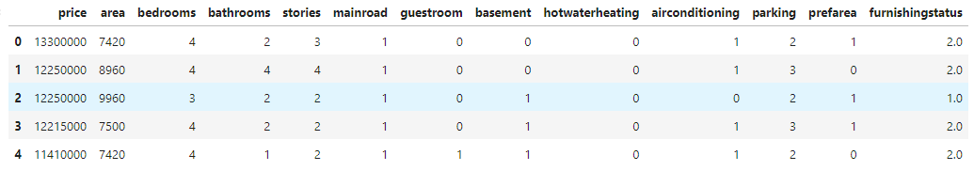
Methodology
Data Collection-
Used an online available dataset present on Kaggle to train, validate and train the model on all 3 models used. In this dataset we have various features like area, bedrooms, stories, parking, furnished or not.
These features help us to predict the price of house.
Dataset

Slide 5
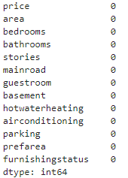
Data Preprocessing-
Used isnull().sum() to find the number of missing frequencies, if present, else we can start with the application of model.
Data Splitting-
Data that we used is split into three parts one for Training(70%), one for Validating(20%) and the remaining one for Testing(10%), by using snippet X_train, X_test, y_train, y_test = train_test_split(X, y, test_size=0.3, random_state=42).
No. of missing frequencies sum

Slide 6
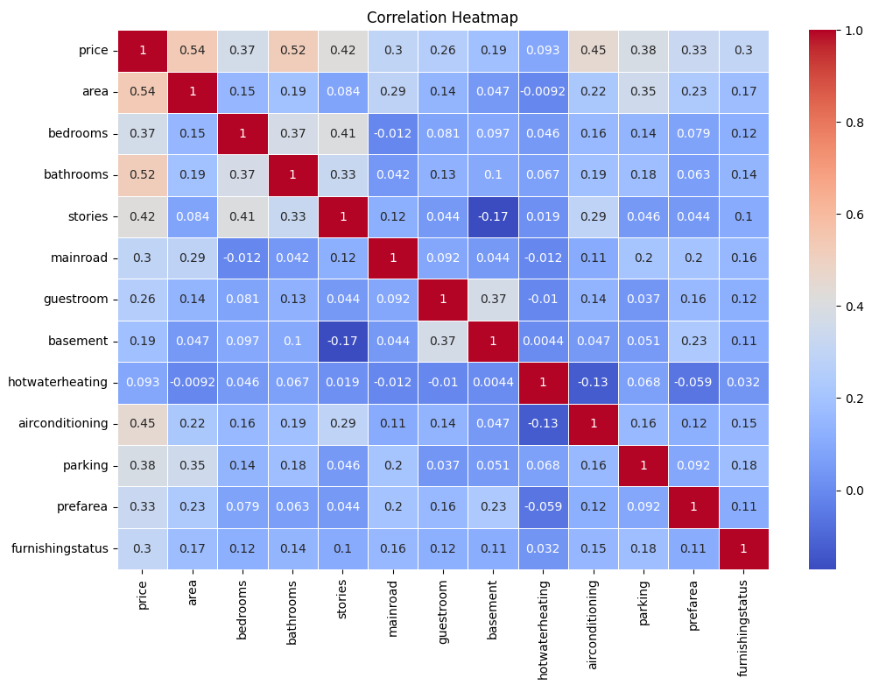
Feature Selection-
Created Correlation Heatmap (more closer to 1, more and plot of price with other all features to select features required for the high accuracy in prediction of price for house.
Correlation Heatmap

Slide 7
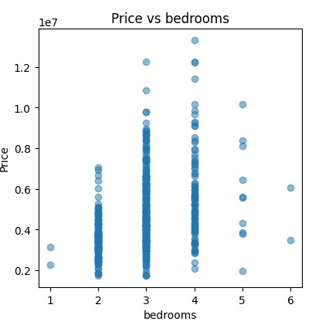
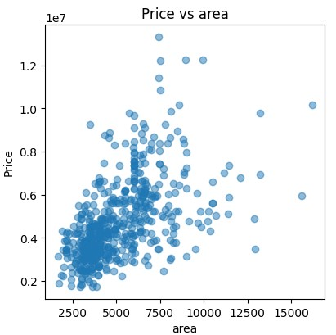
Price vs Bedrooms Plot
Price vs Area Plot

Slide 8
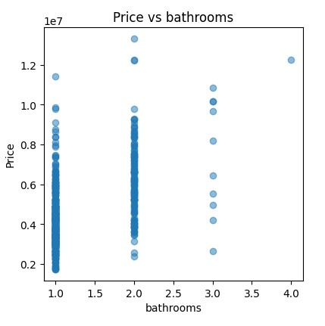
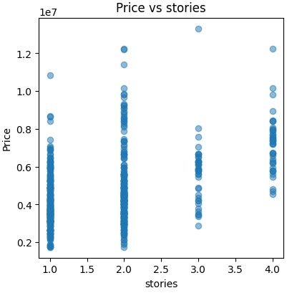
Price vs Bathroom Plot Price vs Stories Plot

Slide 9
Model Selection-
Linear Regression- It is a ml algo used for regression task which attempts to find linear relationship between input data and target variable y=b0+b1x1+e,,where e is error, b0 is intercept and b1 is slope, and in the case of multiple linear model each bi represents change in y for every xi.
Random-Forest- Random Forest works by constructing multiple decision trees during training and averaging their predictions for more accurate, stable results.Uses ensemble method to create forest of decision trees, each decision tree is trained on random subset of training data features, it uses bootstrap sampling where each tree is trained on a random subset. Every tree gives its prediction then its average is taken to calculate final accuracy.
XGBoost-XGBoost (Extreme Gradient Boosting) is a powerful machine learning algorithm known for its high performance in regression, classification, and ranking tasks. It builds an ensemble of decision trees through a technique called gradient boosting, where each new tree corrects errors made by previous trees. XGBoost is efficient and optimized, making it popular in competitions and applications where speed and accuracy are critical.

Slide 10
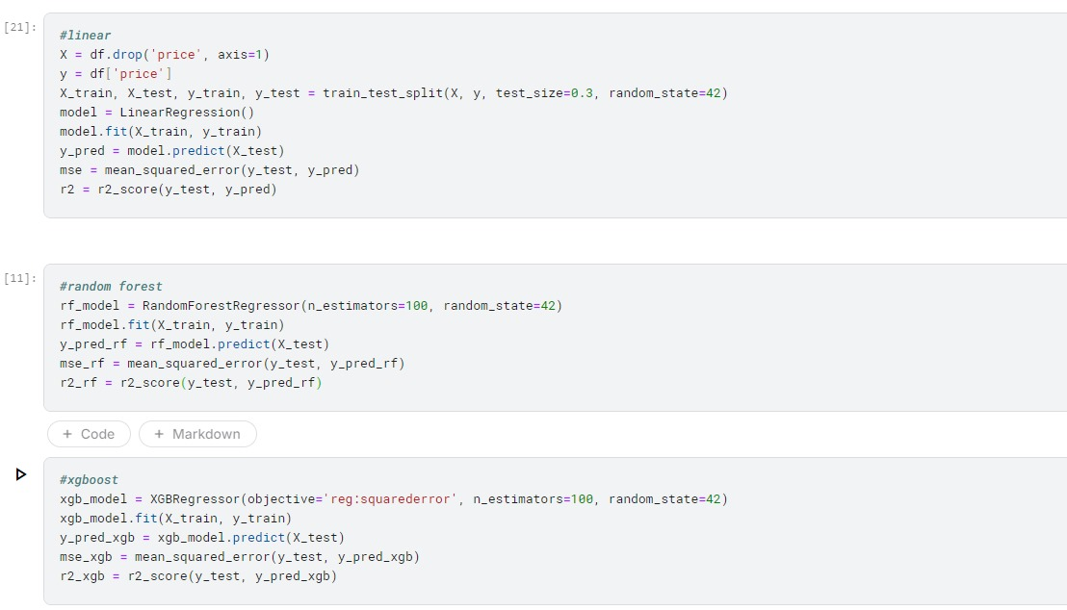

Slide 11
Evaluation-
Used MSE(Mean Squared Error) and R^2 Score to determine and compare the accuracy of all the models.
MSE- MSE measures the average squared difference between the actual and predicted values. A lower MSE indicates a better fit, as it means predictions are closer to the actual values.
MSE=(1/n)∑n​(yi​−y^i​)^2
R^2 Score-R^2 score ranges from 0-1 where the value is as close to 1 it is more accurate, i.e. predicted value is that much close to actual value
R2=1-(∑n​(yi​−y^​i​)^2)/(∑n​(yi​−yˉ​)^2​)

Slide 12
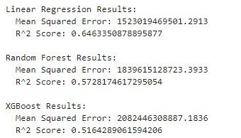
Results
Each model provide their MSE and R^2
Score and on comparison you can see that
Linear Regression Model gives the best
output as it has highest R^2 Score value and
lowest MSE value which shows Linear
Regression model works best for our given
dataset as we have used linear dataset
which is not complex, so that is why Random Output for our dataset
Forest and XGBoost gives lower values

Slide 13
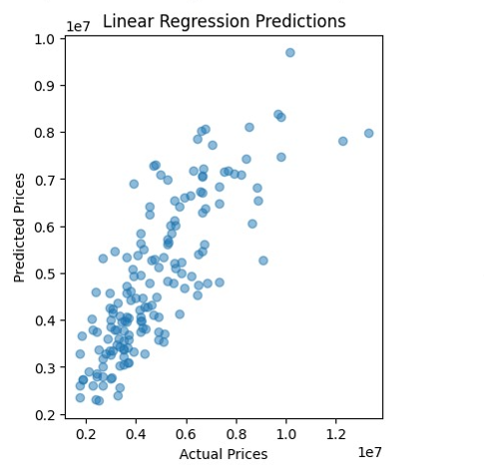
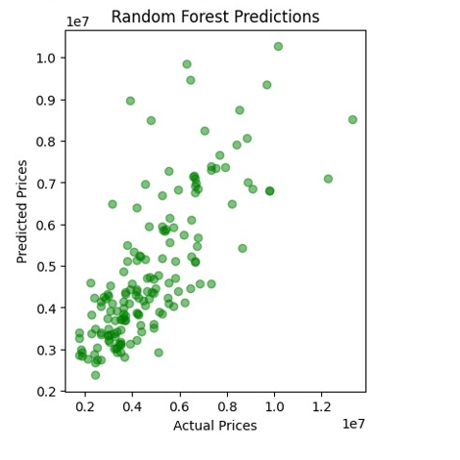

Slide 14
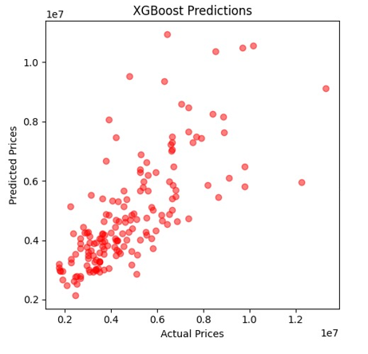

Slide 15
Summary
House price prediction has evolved from basic statistical models like linear regression to advanced machine learning techniques such as Random Forest and Neural Networks. These methods enable the modeling of complex, nonlinear relationships between housing features and prices. Key factors influencing house prices include location, property characteristics (e.g., size, number of rooms), neighborhood attributes, and market dynamics. While advancements have improved prediction accuracy, challenges like region-specific models, limited adaptability to market changes, and data quality issues persist. Additionally, balancing model complexity with interpretability remains a concern. By addressing these gaps, future models can become more robust, generalizable, and user-friendly for real estate stakeholders.

Slide 16
References
Kaggle-for using dataset and writing code (https://www.kaggle.com)
Youtube-for learning purpose (https://www.youtube.com)
GeeksforGeeks- for educational purposes (https://www.geeksforgeeks.org/)

Slide 17
Thank You

