Slide 1


Institute of Technology of Cambodia
Department of Information and Communication Engineering
Book Inventory Management System
Academic Supervisor : Mr. NOP Phearum
Company Advisor : Mr. VON Seyha
Student : Mr. VEN Thon
Duration : 19 February – 31 May, 2024
Academic Year 2023-2024

Slide 2
Table of Contents
1
INTRODUCTION
2
ANALYSIS AND DESIGN
01
3
IMPLEMENTATION
4
CONCLUSION
5
DEMONSTRATION
01

Slide 3
01
1. Introduction
Content 1
2

Slide 4

1 . Introduction
2. Analysis and Design
3. Implementation
4. Conclusion
5. Demonstration
1. General Presentation
The internship was at the Legal Council of the Ministry of Economy and Finance
The internship starts from 19 February – 31 May 2024
Address: St 92, SangKat Wat Phnom, Khan Duan Penh,
Phnom Penh.
Tel : ( + 8 5 5 ) 97 252 8358
Email: legalconcilmef@gmail.com
Web site :https://www.legalconcilmef.com/en
About the legal Council of the Ministry of Economy and Finance
The Legal Council of the Ministry of Economy and Finance was established in 2013 by Prâkas No. 290 SHV.BRK. It has been revised and modified by Sub-decrees No. 75 ANKR.BK, No. 488 ANKR.BK, and No. 76 ANKR.BK. Its purpose is to ensure legality, consistency, and harmonization in the drafting of legal texts, manage implementation effectively, and participate in the execution of the Public Financial Management Reform Program (PFMRP).
3

Slide 5
1 . Introduction
2. Analysis and Design
3. Implementation
4. Conclusion
5. Demonstration
2. Project overview
What is Book Inventory Management System?
Book Inventory Management System, that is the system that ensure efficiency in managing the inventory of quotations within the Secretariat of the Legal Council and Additionally, this software will facilitate the monthly preparation of reports and make it easier to search for specific data within the document collection.
4

Slide 6
1 . Introduction
2. Analysis and Design
3. Implementation
4. Conclusion
5. Demonstration
What is Securing Wireless Access Management System?
5

Slide 7
1 . Introduction
2. Analysis and Design
3. Implementation
4. Conclusion
5. Demonstration
Why should we create Securing Wireless Access Management System?
Problem Overview
01
02
03
04
05
Unlimite Access
Un
security
Lose quality
Over control
Not Authorization
6

Slide 8
1 . Introduction
2. Analysis and Design
3. Implementation
4. Conclusion
5. Demonstration
01
User Registration
Objective
02
Automated Device Connection
03
Unauthorized Use Prevention
04
Administrative Control
05
Device Usage
7

Slide 9
02
2. Analysis and Design
Agenda 2
8

Slide 10


1 . Introduction
2. Analysis and Design
3. Implementation
4. Conclusion
5. Demonstration
Functionalities for Each Roles
Admin Roles
Manage user
Manage many user by file excel
Crud operation on user
( Create, Read, Update, Delete)
Manage device user
Search Information user
Control Information user
User Roles
Login
Change password
Register device
Delete device
Edit device
Number of register device
9

Slide 11
1 . Introduction
2. Analysis and Design
3. Implementation
4. Conclusion
5. Demonstration
Planning
For the development, testing, and documentation as well I had to spend time 8 weeks to develop the project that we spend time from fist week to eight weeks.
Tasks |  |  |  | Weeks
 | 1 | 2 | 3 | 4 | 5 | 6 | 7 | 8
Learn Technology
Mockup UI
Design Database
Analyze Requirement
Development
Testing
Report
10

Slide 12
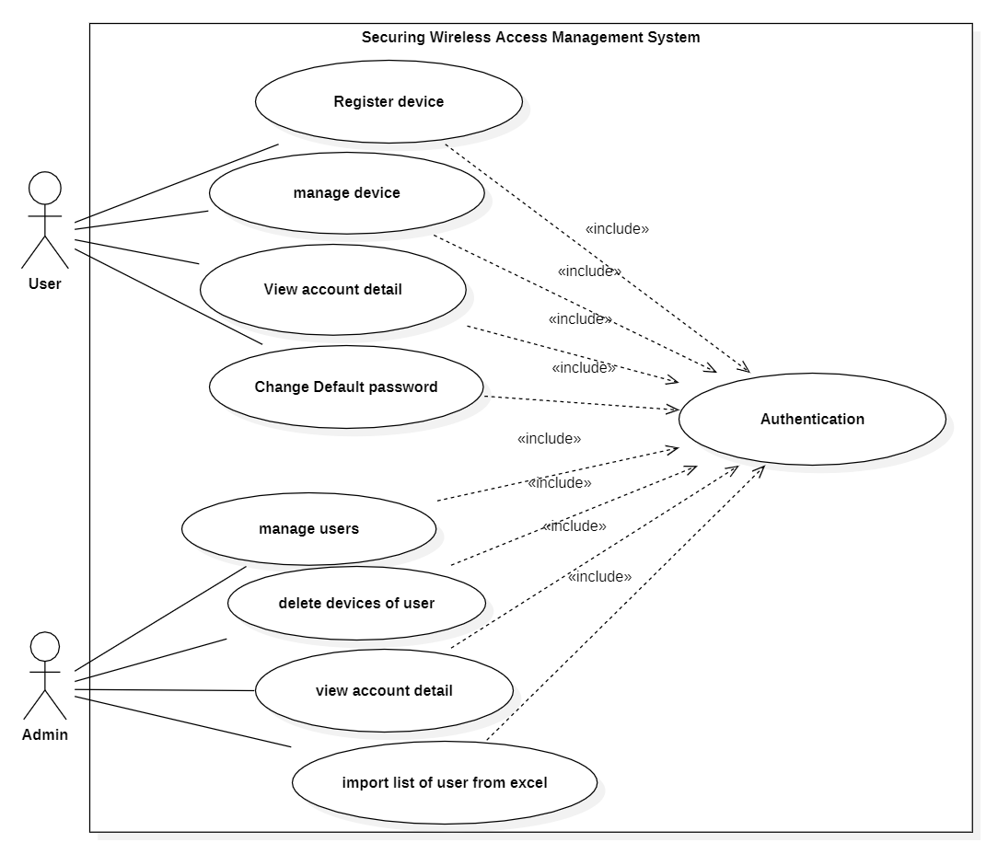
1 . Introduction
2. Analysis and Design
3. Implementation
4. Conclusion
5. Demonstration
Use Case diagram
11

Slide 13









1 . Introduction
2. Analysis and Design
3. Implementation
4. Conclusion
5. Demonstration
Chooses Technologies
Languages
Frameworks
Library
Technologies
HTML
TailwindCSS
Vue JS
CSS
JavaScript
Laravel
Flowbite
PHP
12

Slide 14







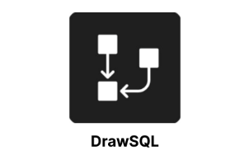
1 . Introduction
2. Analysis and Design
3. Implementation
4. Conclusion
5. Demonstration
Tools
Visual Studio Code
Postman
GitHub
GitBash
draw.io
Figma
StarUML
13

Slide 15
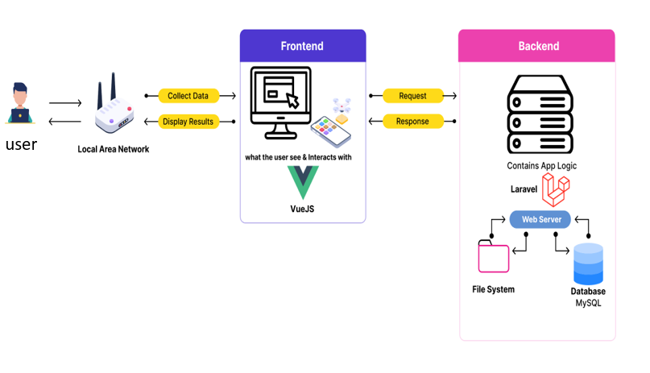
1 . Introduction
2. Analysis and Design
3. Implementation
4. Conclusion
5. Demonstration
Physical Architecture
14

Slide 16
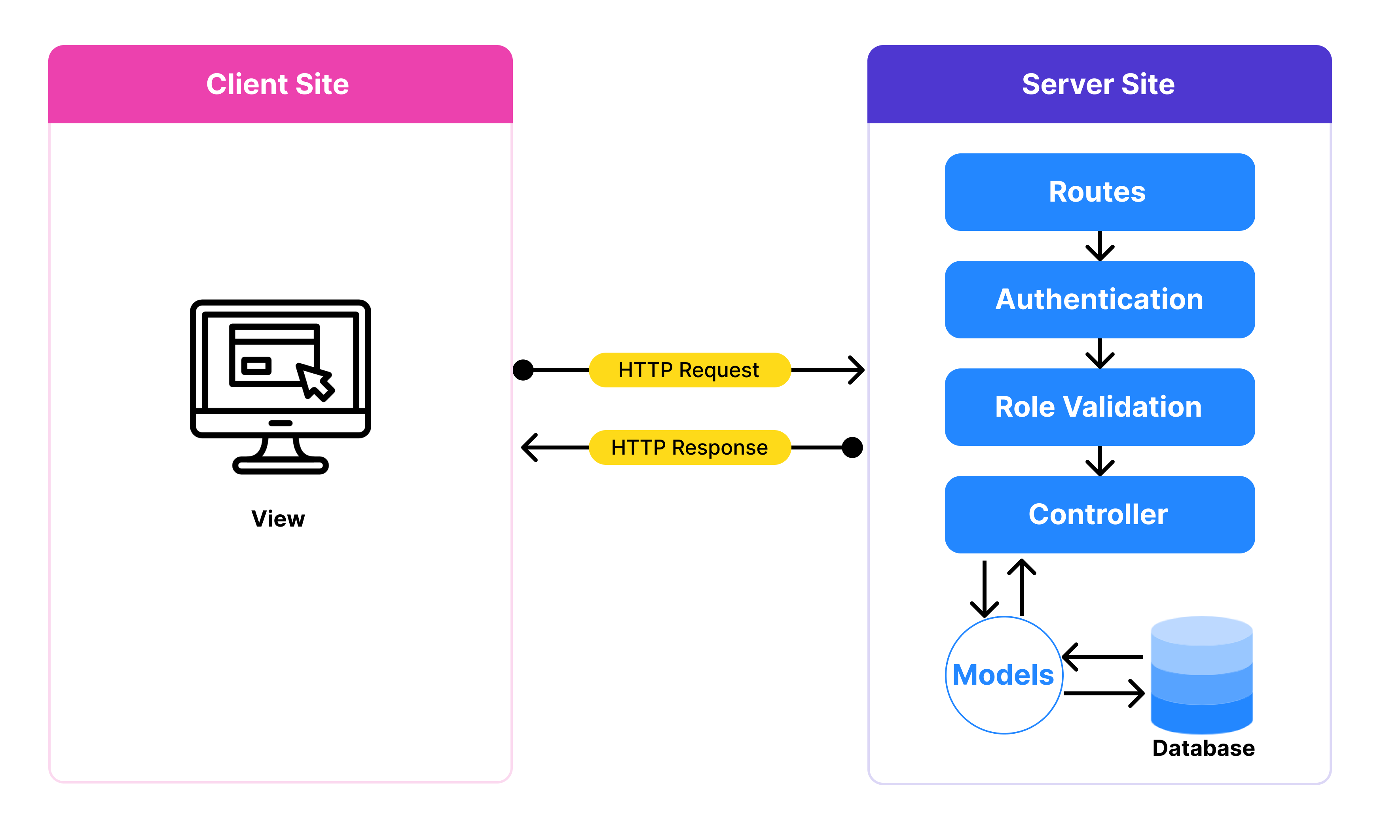
1 . Introduction
2. Analysis and Design
3. Implementation
4. Conclusion
5. Demonstration
Logical Architecture
15

Slide 17
03
3. Implementation
Agenda 3
16

Slide 18
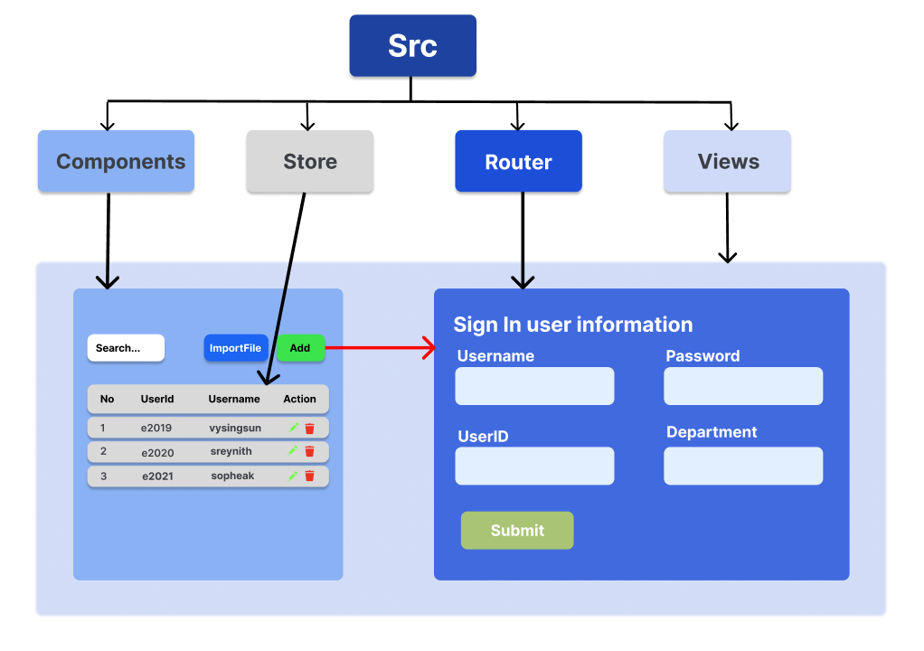
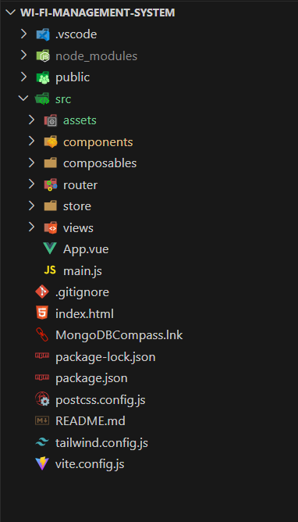
1 . Introduction
2. Analysis and Design
3. Implementation
4. Conclusion
5. Demonstration
Frontend Project Structure
17

Slide 19
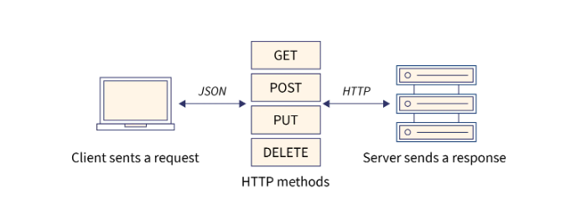
1 . Introduction
2. Analysis and Design
3. Implementation
4. Conclusion
5. Demonstration
Connection Backend to Frontend
Axios is a popular JavaScript library used for to fetch data from APIs and update the user interface dynamically. It supports various features such as request and response interception, automatic request cancellation, and the ability to send HTTP requests with different methods (GET, POST, PUT, DELETE).
POST: Its used for create new resource
GET: Its used for read or display data
PUT: Its used for update existing data
Delete: Its used for delete existing data form database.
18

Slide 20
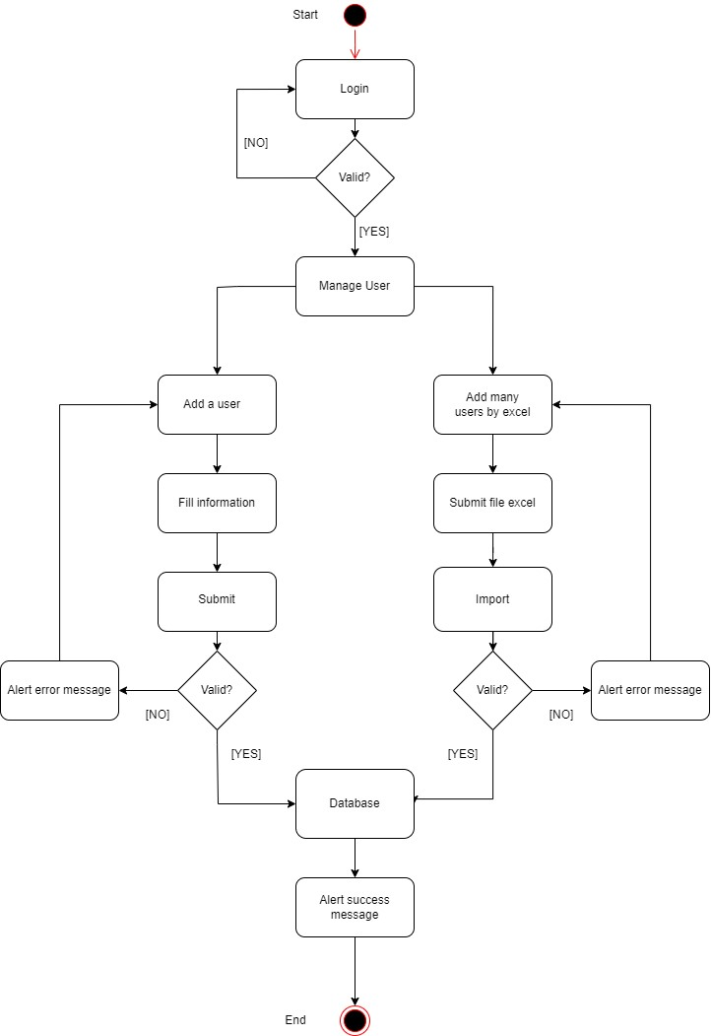
1 . Introduction
2. Analysis and Design
3. Implementation
4. Conclusion
5. Demonstration
Activity diagram manage user
19

Slide 21
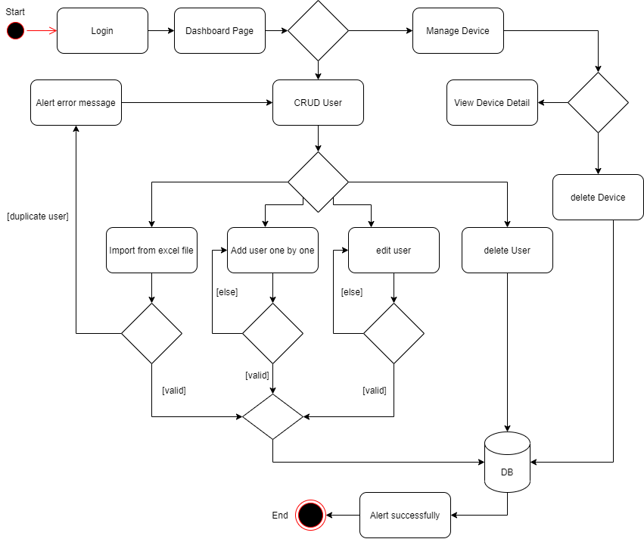
1 . Introduction
2. Analysis and Design
3. Implementation
4. Conclusion
5. Demonstration
Activity Admin Dashboard
20

Slide 22
04
4. Conclusion
Agenda 4
21

Slide 23
1 . Introduction
2. Analysis and Design
3. Implementation
4. Conclusion
5. Demonstration
Result
Admin
 | Role of Admin
Modules | Functionalities | Status
Authentication | Login | Completed
 | Logout | Completed
 | Create user | Completed
 | View user information | Completed
 | Update user information | Completed
Menu | Delete user | Completed
 | Import data by file excel | Completed
 | Search user information | Completed
 | Show device user | Completed
 | Get mac address | Completed
22

Slide 24
1 . Introduction
2. Analysis and Design
3. Implementation
4. Conclusion
5. Demonstration
Result
User
 | Role of user
Modules | Functionalities | Status
 | Login | Completed
Authentication | Logout | Completed
 | Change password | Completed
 | View information user | Completed
Menu | Device detail | Completed
 | Delete device | Completed
 | Register device | Completed
Integrate with network
Modules | Functionalities | Status
Integrate | Use radius server | In progress
23

Slide 25


1 . Introduction
2. Analysis and Design
3. Implementation
4. Conclusion
5. Demonstration
Difficulties
Technical
Short time to build the system
Professional code development
Database design and analysis
User interface design
Project management
Learn technologies
Non-technical
Internet connection
Environment
24

Slide 26

1 . Introduction
2. Analysis and Design
3. Implementation
4. Conclusion
5. Demonstration
Experiences
Learn about technologies
Understand more about project management
Estimate tasks and time
Adapt to a new environment
Understand about project methodology
Works teams and communicate
Database management
Perspectives
Improve UI
Responsive
Improve performance
Add more feature and function
25

Slide 27
05
5. Demonstration
Agenda 5

Slide 28
Thank you !
For your attention

Slide 29
Q & A

