Slide 1
VendinGoGo
Fully Open-Sourced and
Crowd-Sourced Vending Machines
Notes:
Idk about subtitle there but i want it to know we’re FOSS

Slide 2
The Problem
If you’re anything like Josh, you probably have a debilitating caffeine addiction.
You can quit any time, we know that. But you won’t, because Mountain Dew and PopTarts are forever.
So, where can you fuel this addiction on campus?

Slide 3
The Solution
Crowdsourcing vending machines.
Users can post new vending machines and update existing ones.

Slide 4
Who We Are
Eli Davis
Google Maps
User Experience
Josh Hawkins
User Interaction
Server Administration
Kaleb Pace
Twitter OAuth
Security (SSL)
Hunter Holder
A E S T H E T I C S
Error Handling
Notes:
I assume we move from UI and interaction down to hardware, and speak in that order. Or we can do reverse.
UI to Hardware => Eli, Hunter, Josh, Kaleb
Or
Hardware to UI => Kaleb, josh, hunter, eli
Kaleb:
We decided to implement user accounts and tracking using twitter so that we didn’t have to store user info locally. By doing so, we provide users
With a higher level of security over their personal information. The OAuth works by obtaining a request token from twitter, redirecting the user to
Twitter login, verifying the oauth_tokens with the request_token, and finally parsing the access_token returned by twitter for a successfully logged in user. Now,
There is a lot of data returned from twitter about a user, such as, profile photo, latest tweets, their location, hometown, etc etc. And you might be wondering what
We do with that information and how we secure it. We decided to secure our client/server connections with a free SSL certificate granted by the outstanding Let’s
Encrypt foundation. SSL ensures that every client, regardless of their access point, is sending and receiving encrypted data specific for their device. No one else
Will be able to see your information being transmitted between you and us. The only information we store about a user in our database is the authentication id and name that
Verifies you as a valid user and lets us know who you are so we can save any preferences you might have. And with that, I pass it on to the next willing victim.
Josh:
Talk about how shit twitter api is
Hunter:
Talk about why we chose certain colors
Why we implemented the “high contrast” accessibility
Eli:
Be a BAMF
Talk about how the entirety of your team let you down until the last week of school
Magic n stuff

Slide 5
Site Features
Create Vending Machine
Update Statuses
Share Location Links
View Source on GitHub
View VendinGoGo’s Profile on Twitter
Notes:
VendinGoGo’s website

Slide 6
Twitter Features
Update Status of Nearest Vending Location
Authorize VendinGoGo Website for Login
Both of these are accomplished by tweeting your precise location with @VendinGoGo in the body of your tweet.
Notes:
VendinGoGo’s website

Slide 7
Our Process
User Creates Vending Machine on Website
Users Update Status
via Web or Twitter
Users Find Nearby Vending Machines

Slide 8
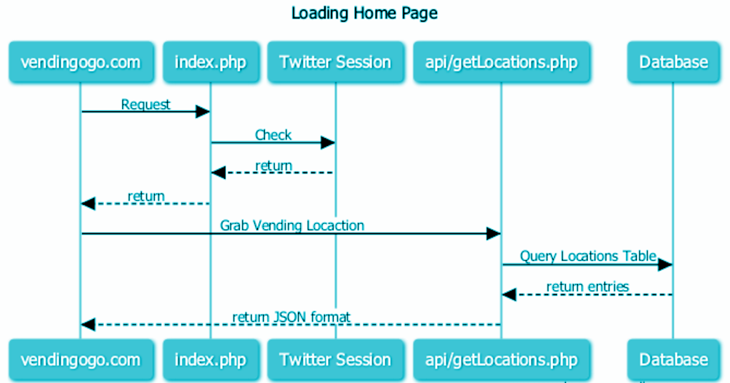
Behind the Scenes
Notes:
title Loading Home Page
vendingogo.com -> index.php: Request
index.php -> Twitter Session: Check
Twitter Session --> index.php: return
index.php --> vendingogo.com: return
vendingogo.com -> api/getLocations.php: Grab Vending Locaction
api/getLocations.php -> Database: Query Locations Table
Database --> api/getLocations.php: return entries
api/getLocations.php --> vendingogo.com: return JSON format

Slide 9
Tools We Used
Apache
Knockout
Bootstrap
JQuery
Google Maps
TweePy
Twitter API (Abraham / Twitter OAuth)
OpenSSL/Let’s Encrypt

Slide 10
Mistakes Were Made
NEVER COMMIT YOUR PASSWORDS
Thoroughly inspect docs before choosing APIs
Understand security measures before diving in
Going Green

Slide 11
What We Gained
Josh can satisfy his caffeine addiction
Eli finally installed a PHP environment locally
Kaleb learned not to commit his passwords
Hunter has a love/hate relationship with Bootstrap

Slide 12
$35
6 users
1000%
That’s a lot of money
And a lot of users
For a total success!

Slide 13
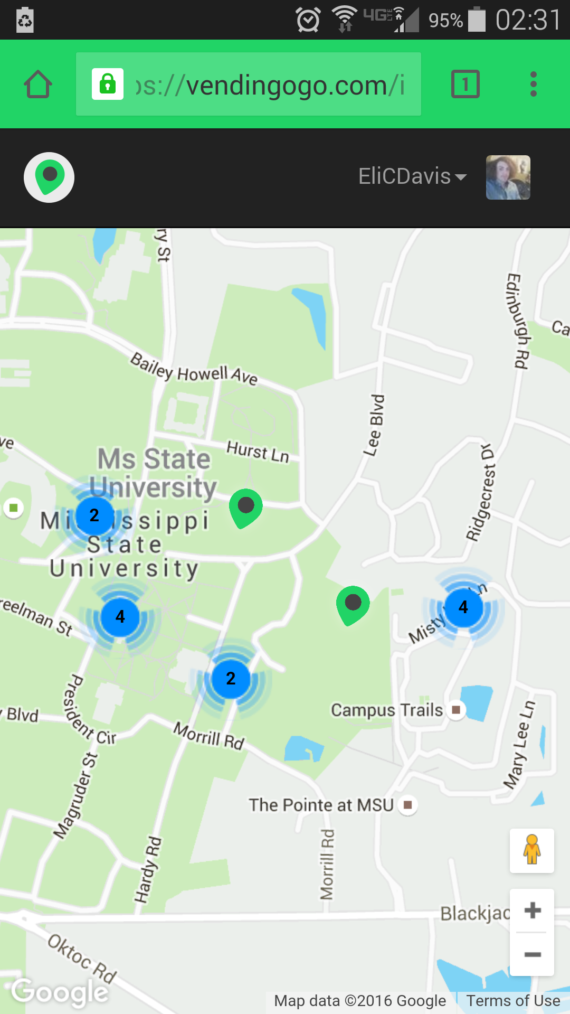
Mobile Phone Support
VendinGoGo is supported on both desktop and mobile devices

