Slide 1
Business Case Analysis
Where are my golden goose? -Yuhong

Slide 2
Content
User Analysis
Acquisition
Activation
Trend Analysis
Customer Segmentation by Using FRM Analysis
Brief introduction of FRM model
How FRM mode is constructed in this case
Further analysis and discussion of key segments
Appendix

Slide 3
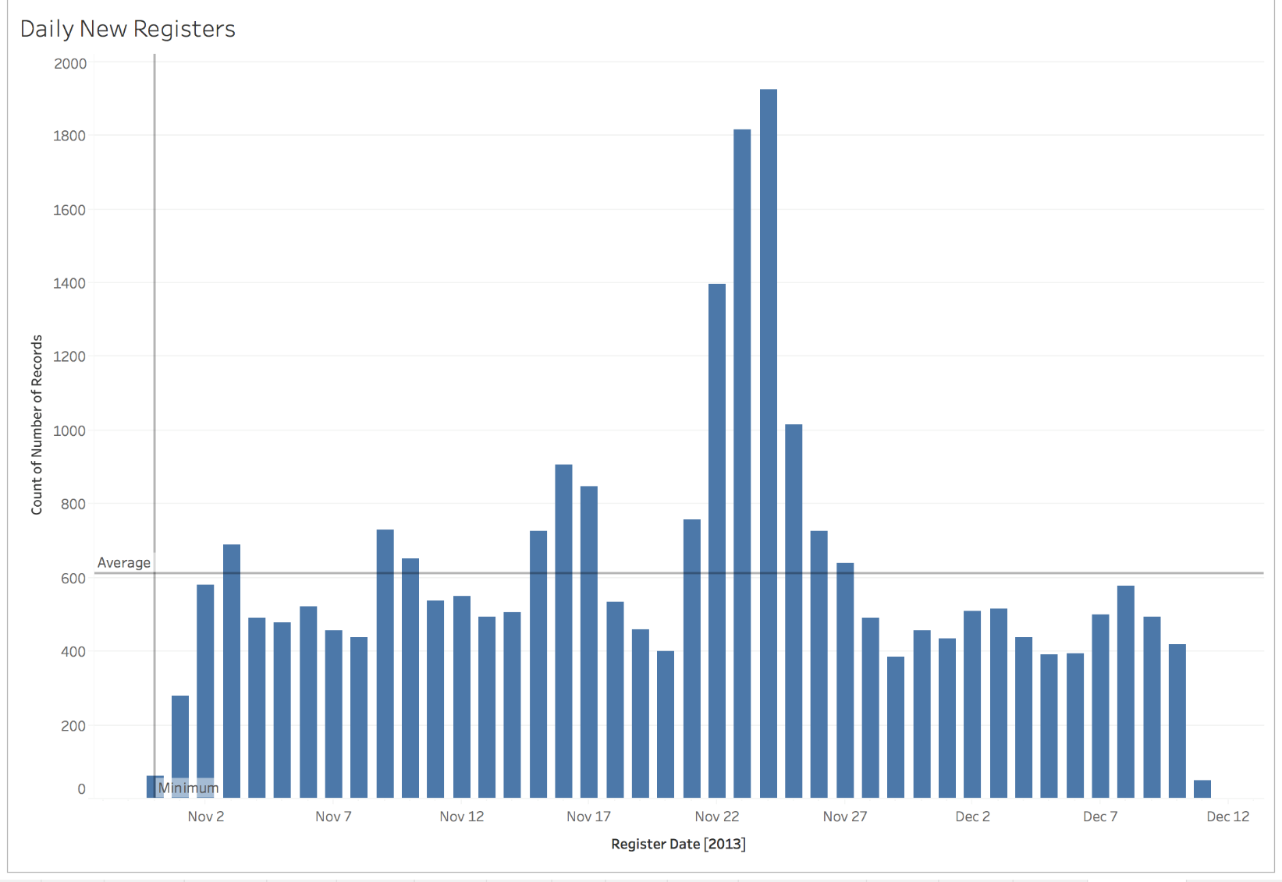
User Analysis
Daily register number fluctuates instead of growing steadily, suggesting that user registration is most likely driven by independent marketing campaigns.
Data point of how registers direct to our platform and GMV of first 30 days should be captured. By doing so, we can optimize marketing channels.
User referral program is recommended to incentivize existing customers to invite new registers.

Slide 4
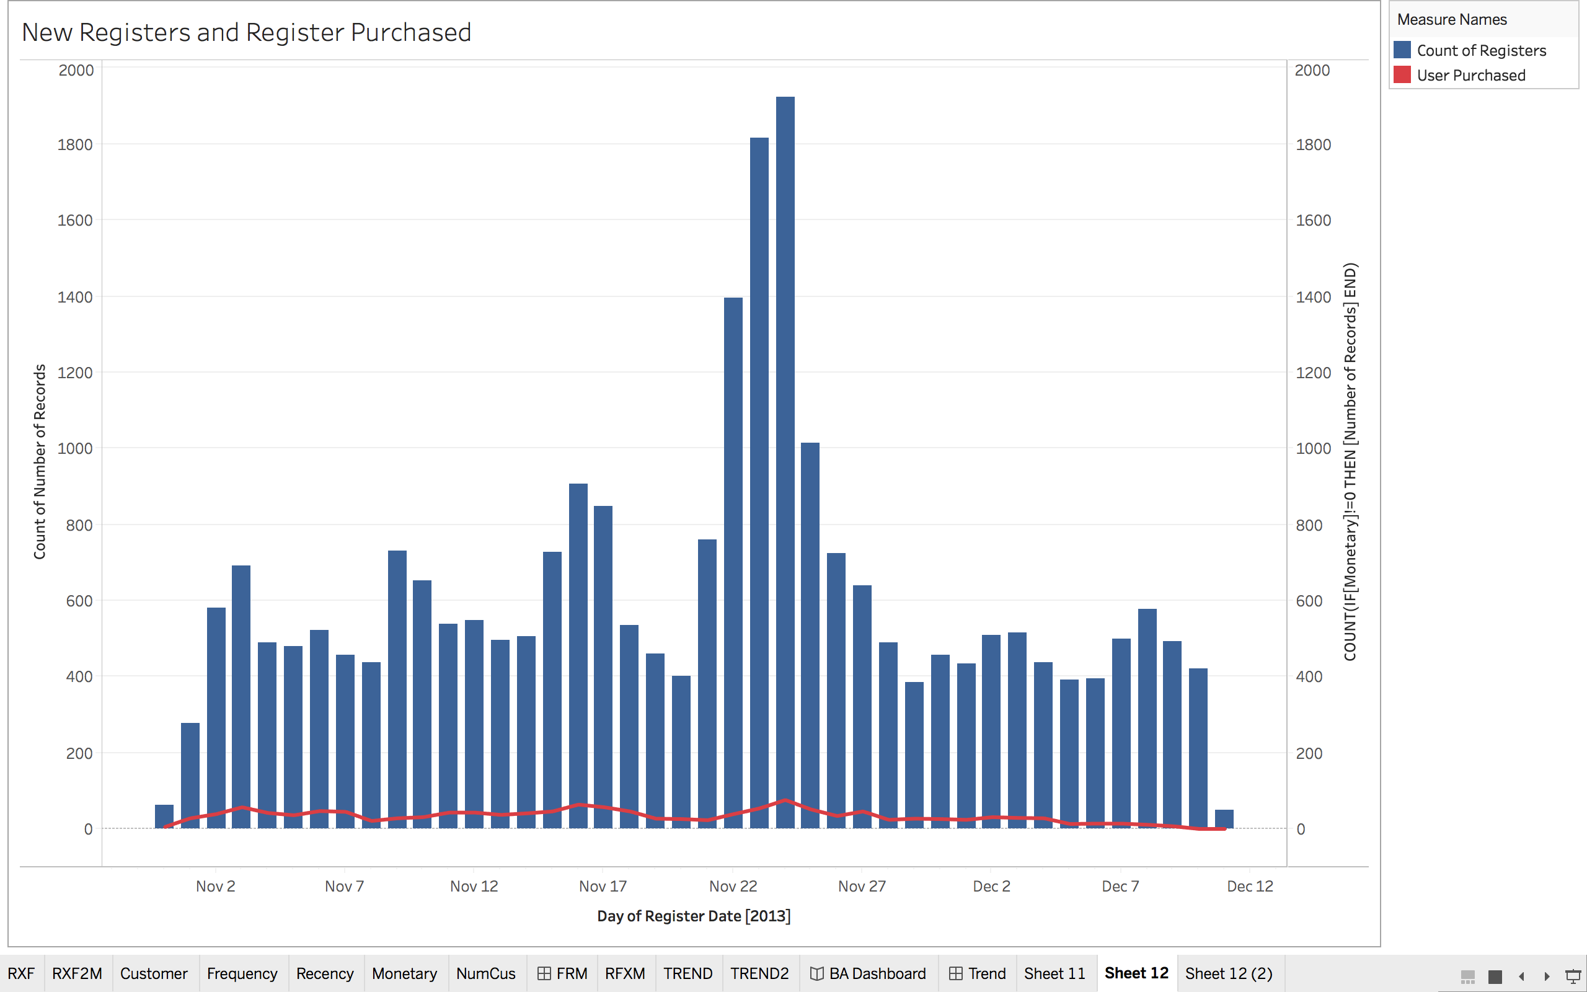
User Analysis
Within daily registers, the number of registers who purchased on platform is low. This might suggest opportunities to optimize user activation process.
A further study is required to understand user activation behavior and optimize activation process. A A/B testing is suggested when implementing those changes.

Slide 5
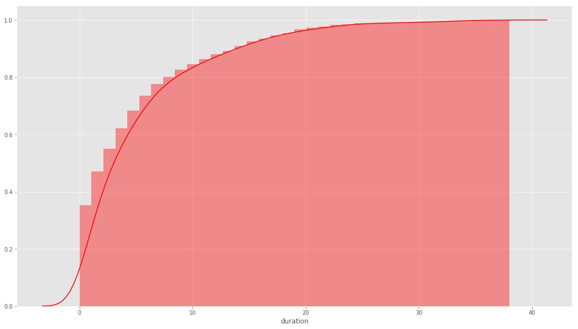
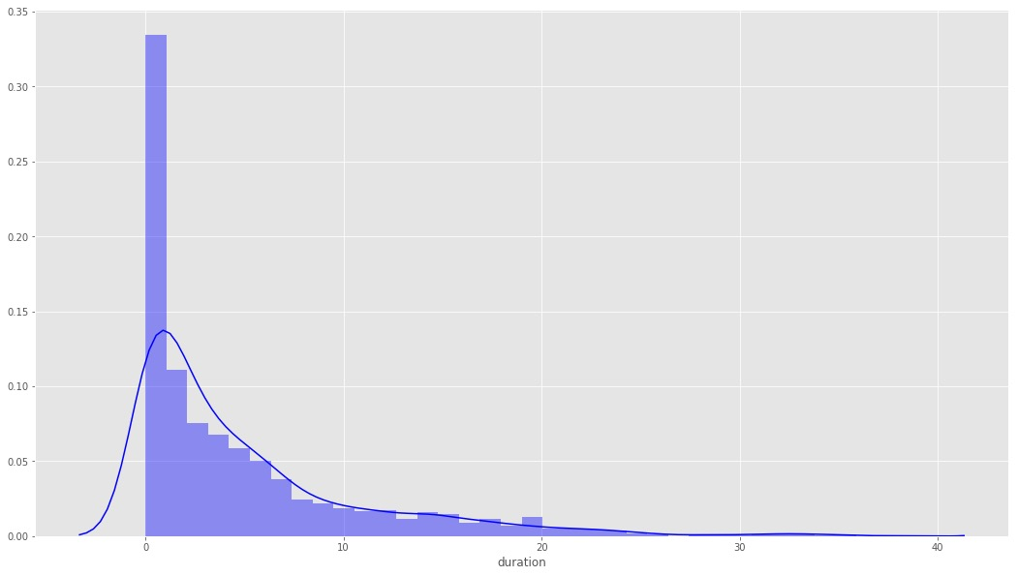
Duration Analysis from Register to First Purchase
PDF Distribution
We also try to understand the distribution of time duration between the register to first purchase. For this analysis, the CDF (Cumulative Distribution Function) and PDF (Probability Density Function) are plotted, which indicates some interesting insights. For example, for users with at least one purchase, around 80% of the first purchase happens within 10 days, 90% happens within 20 days. Around 35% of the users have same day purchase. We may use this data to guide our activation process, e.g. providing incentive to activate new user within the first 10 days.
CDF Distribution

Slide 6
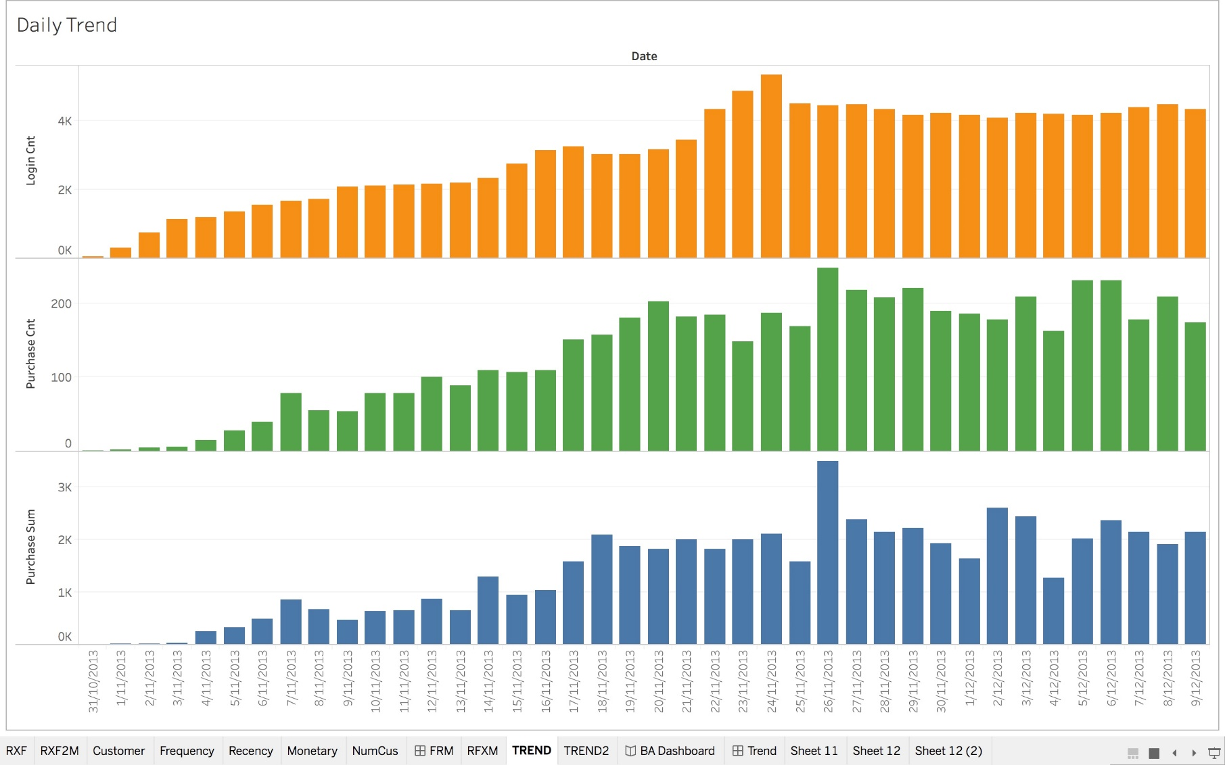
Daily Trend Analysis
All three indicators grow steadily from Nov to 24th Nov. after that, daily user login and transactions slowed down and reached plateau. Most worriedly, both transactions an GMV dropped on few days after 24th Nov.
If the business is still in growth stage, a slow down signals weak engagement etc. a further study is required.

Slide 7
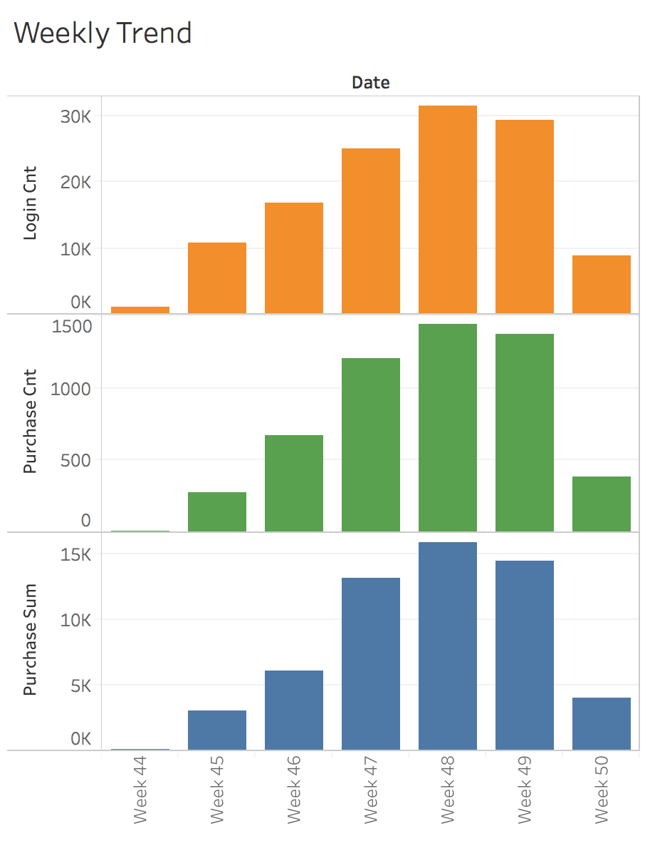
Weekly Trend Analysis
The weekly trend is also provided as to provide a monitoring and diagnosis of how the business is going.
Compared to the daily trend, weekly trend is more smooth and noise robust.

Slide 8
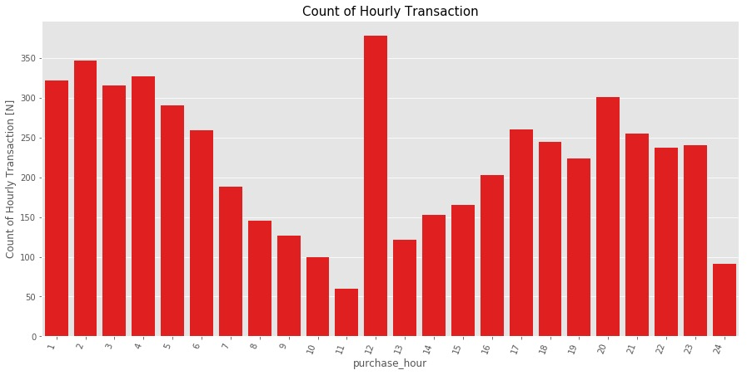
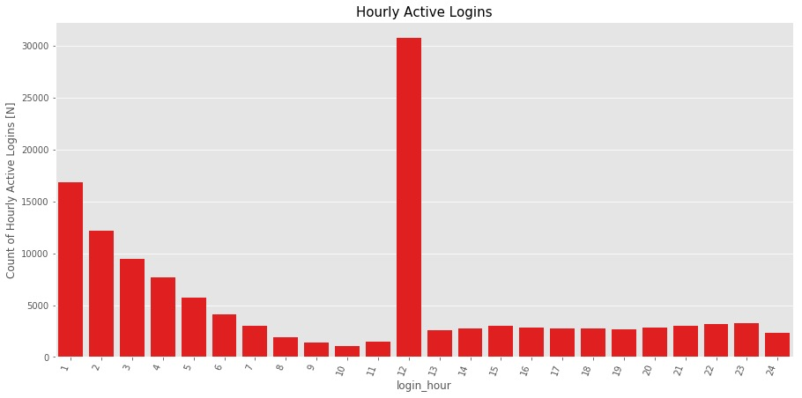
Hourly Trend Analysis
From the hourly login and transaction trend, we can identify the daily peak and off-peak periods when users come to the platform.
The data can be used to guide on (1) deciding when we should use push notifications to engage uses; (2) hours for system upgrade as to minimize the business impact.

Slide 9
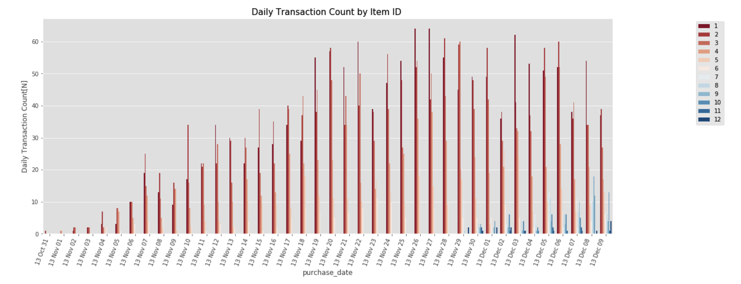
Daily Trend by Items
The daily trend by item is also shown as above, which indicates that there are more and more SKUs on the platform. We also notice that while the purchase of some items increase, the purchase of others are decreasing. A decision-making process might be required to determine if a particular SKU should be kept or discontinued. So the company can reduce inventory costs, simplify the procurement, and avoid cannibalization.

Slide 10
FRM Analysis
What is FRM model?
FRM model segment customers based on customer purchase history data, so that company can adjust marketing/customer experience strategy accordingly.
What FRM stands for?
Recency (R) - Days since last purchase
Frequency (F) - Total number of purchases
Monetary value (M) - Total merchandise value
Benefits of RFM analysis
Increased customer retention e.g. higher incentive to retain champion customers.
Increased response rate e.g. different response level based on segments
Increased conversion rate e.g. adjust marketing strategy to move customers to champion segment.
Increased revenue

Slide 11
FRM Model
Percentile | Monetary($) | Recency(Days) | Frequency(Counts)
min | 0.990000 | 22.000000 | 1.000000
25% | 4.980000 | 25.000000 | 1.000000
50% | 16.990000 | 32.000000 | 2.000000
75% | 37.865000 | 40.000000 | 4.000000
max | 1206.770000 | 61.000000 | 50.000000
Divide each into 4 groups by percentile.
[below 25% percentile]
[from 25% to 50% percentile]
[from 50% to 75% percentile]
[above 75% percentile]
On a scale from 1 to 4, 4 means best. E.g. if a user is in 444 segment, then the user purchased most recently(below 25% percentile), spent most(above 75% percentile), and purchased frequently(above 75% percentile)

Slide 12
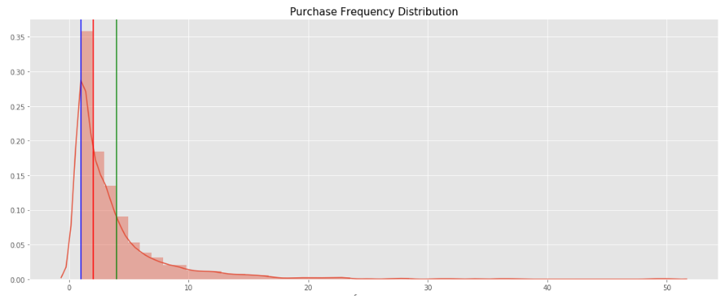
FRM Analysis
1
2
3
4

Slide 13
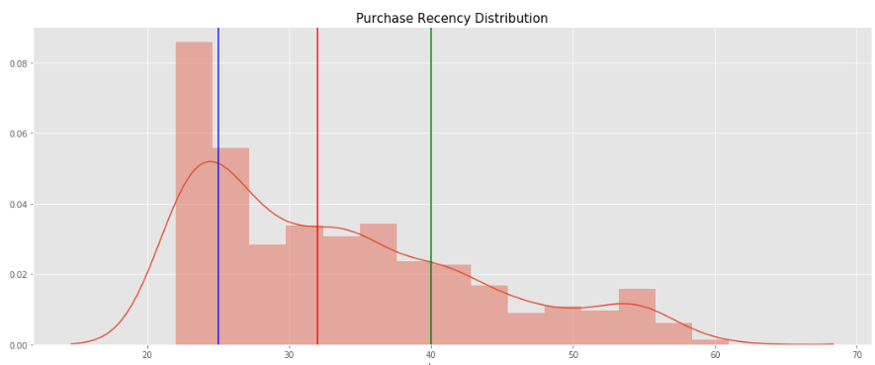
FRM Analysis

Slide 14
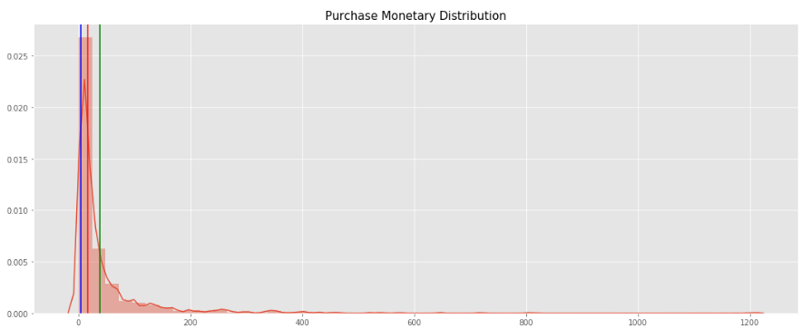
FRM Analysis

Slide 15
Key Segments
Segment | RFM | Description | Marketing Ideas for Discussion
Champions | 444 | Bought recently, buy often and spend the most | Focus on user retention, such as better service, responsive customer support. No price incentives and promotions
Loyal Customers | X4X | Customers who bought most frequently | Use R and M to further segment Further explore user behavior, such as if user is promotion-responsive
Big Spenders | XX4 | Customers who spent the most | Market more frequently and more expensive products Improve user engagement
Recent Customer | 4XX | Customer who bought most recently | Use F and M to further segment
Almost Lost | 244 | Haven't purchased for some time, but purchased frequently and spend the most | Agressive incentives
Lost Customers | 144 | Haven't purchased for long time, but purchased frequently and spend the most | Agressive incentives to re-activate
Lost Cheap Customers | 111 | Last purchase long ago, purchased few and spend little | Don't spend too much trying to re-acquire

Slide 16
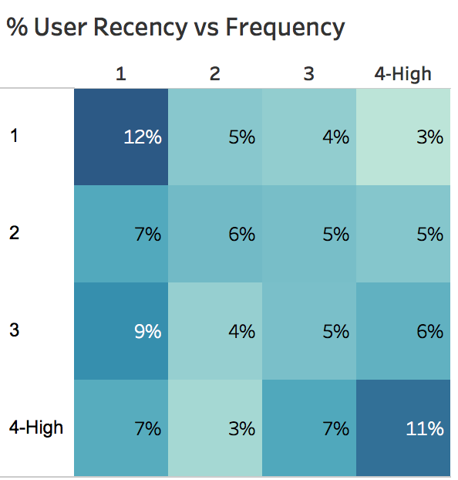
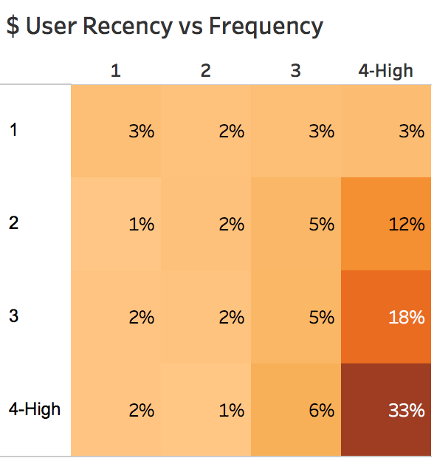
Segments Overview
Majority users are in 44x and 11x segment. However, 11x does not contribute much revenue.
44X, 43X, and 42X collectively contributes 63% revenue.

Slide 17
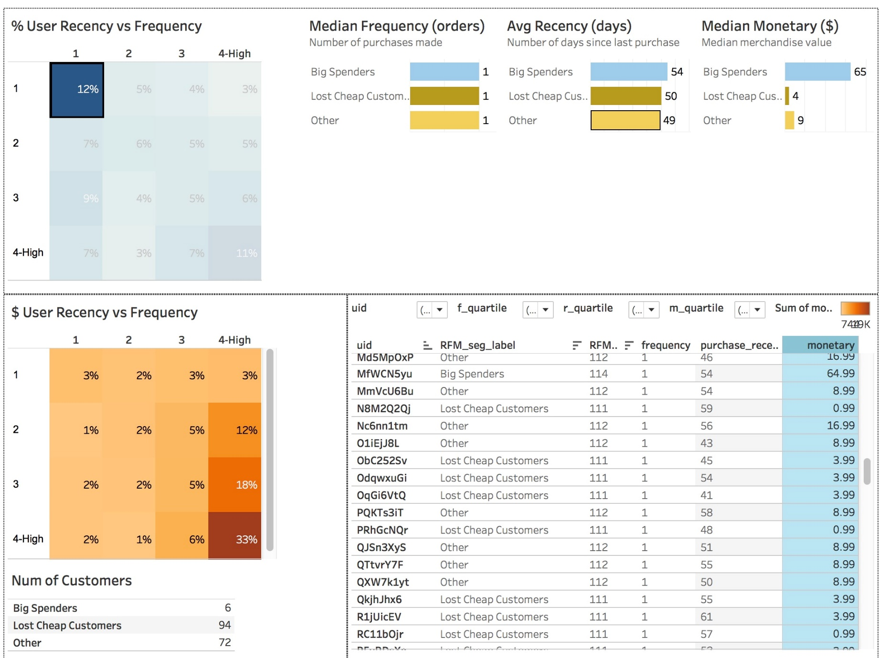
Closer look into 11X
11X segment includes 172 customers: 6 big spenders, and 72 others, whose GMV is about 9 dollars.
For big spenders in 11X, marketing strategy should focus on engagement and retention. They are likely to become champions once engagement is increased.
For others in 11X, marketing strategy could focus on engagement and upsell by providing promotion incentive.
For lost cheap customers in 11X, company could stop re-acquisition efforts.

Slide 18
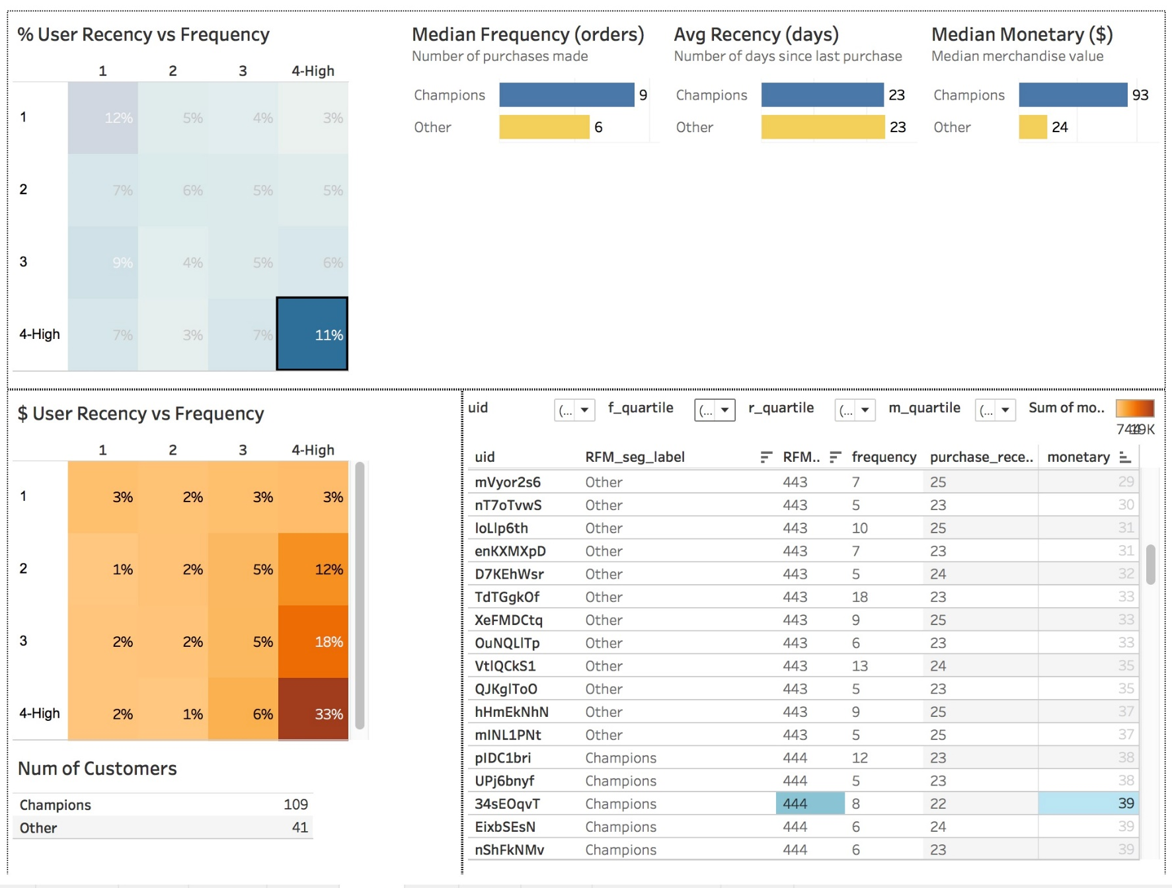
Retain and Convert 44X
44X segment includes 150 customers: 109 champions, and 41 others, whose GMV is about 24 dollars.
For champions in 44X, marketing strategy should focus on retention and service excellence.
For others in 44X, marketing strategy could focus on upsell to convert them into champions by incentivizing them to spend more.

Slide 19
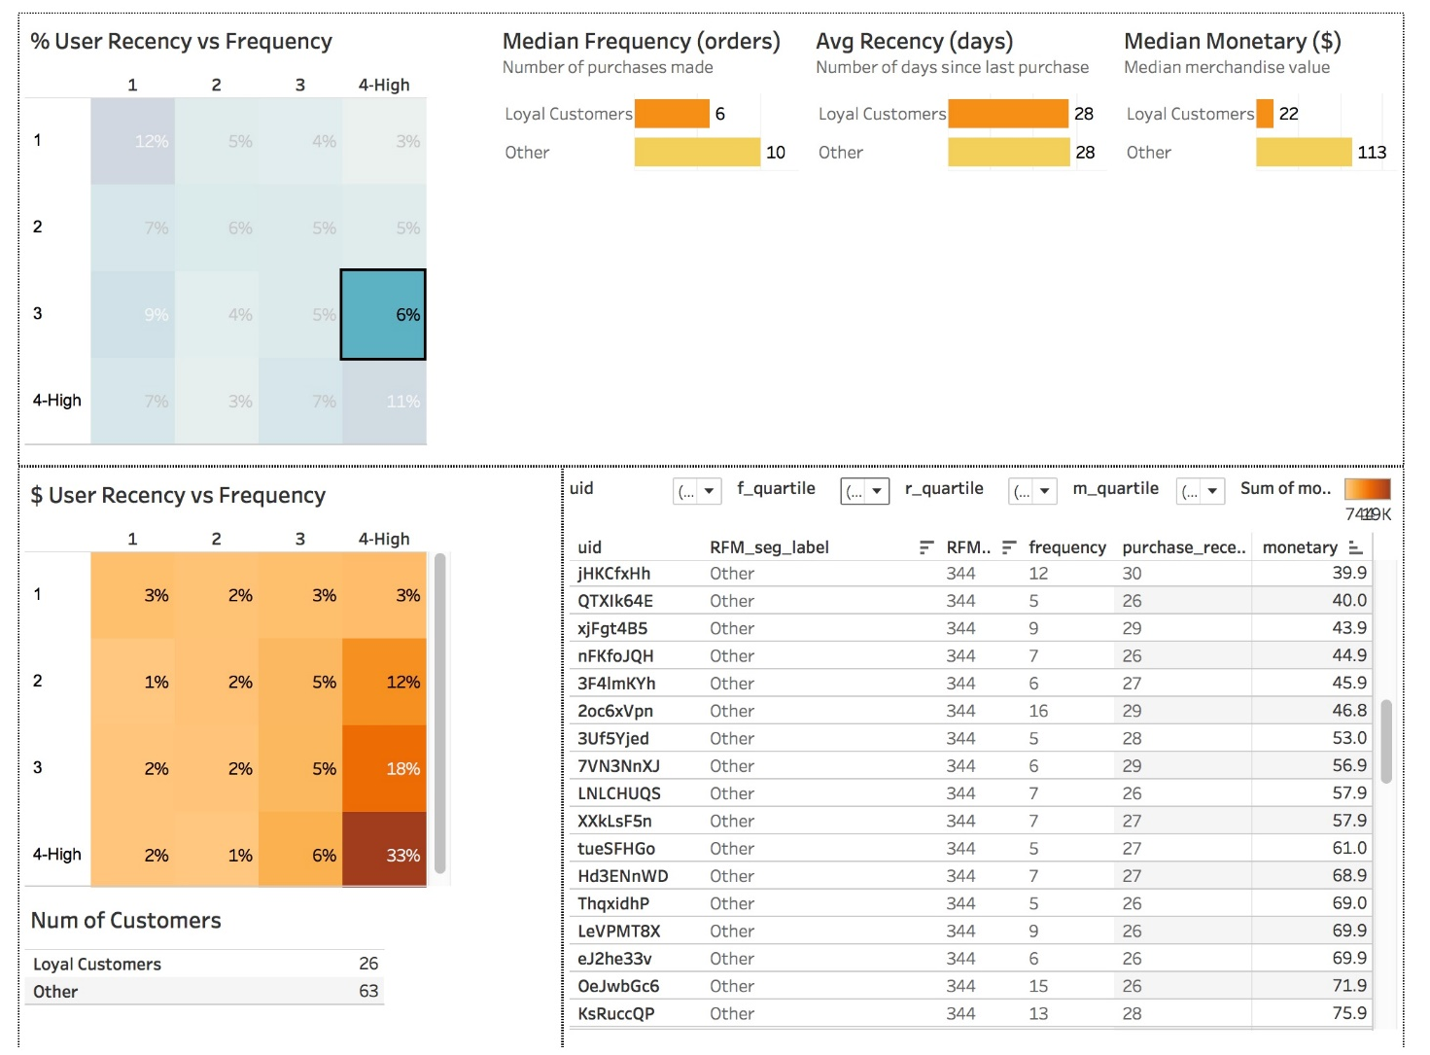
34X
34X segment includes 89 customers: 24 loyal customers, and 63 others, whose GMV is about 113 dollars even higher than champions.
For loyal customers in 34X, marketing strategy should focus on upsell by incentivizing them to purchase more higher value products.
For others in 34X, their GMV is even higher than champions, suggesting golden goose are not necessarily the one who purchased most recently.

Slide 20
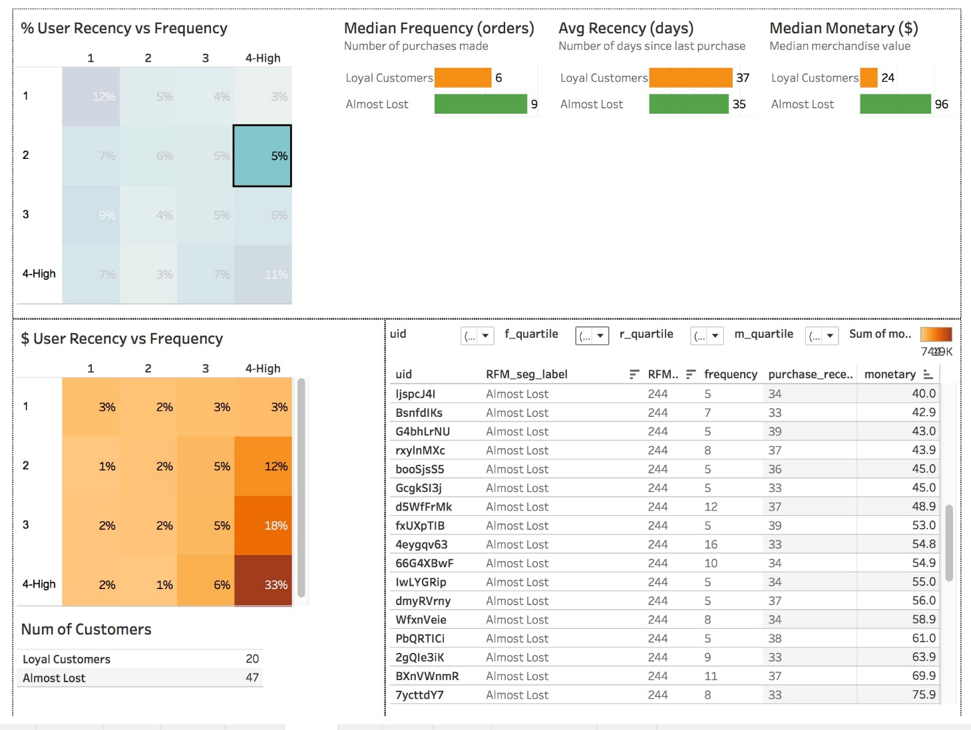
24X
24X segment includes 5% of total customers but contributes 12% of total revenue. The segment includes 47 almost lost customers, whose GMV is even higher than champions
For loyal customers in 24X, marketing strategy should focus on upsell by incentivizing them to purchase more higher value products.
For Almost Lost in 24X, their GMV is even higher than champions, though recency is not a good gauge of valuable customer, but low recency could suggest low engagement. Marketing strategy could focus more on reteinion for this group.

Slide 21
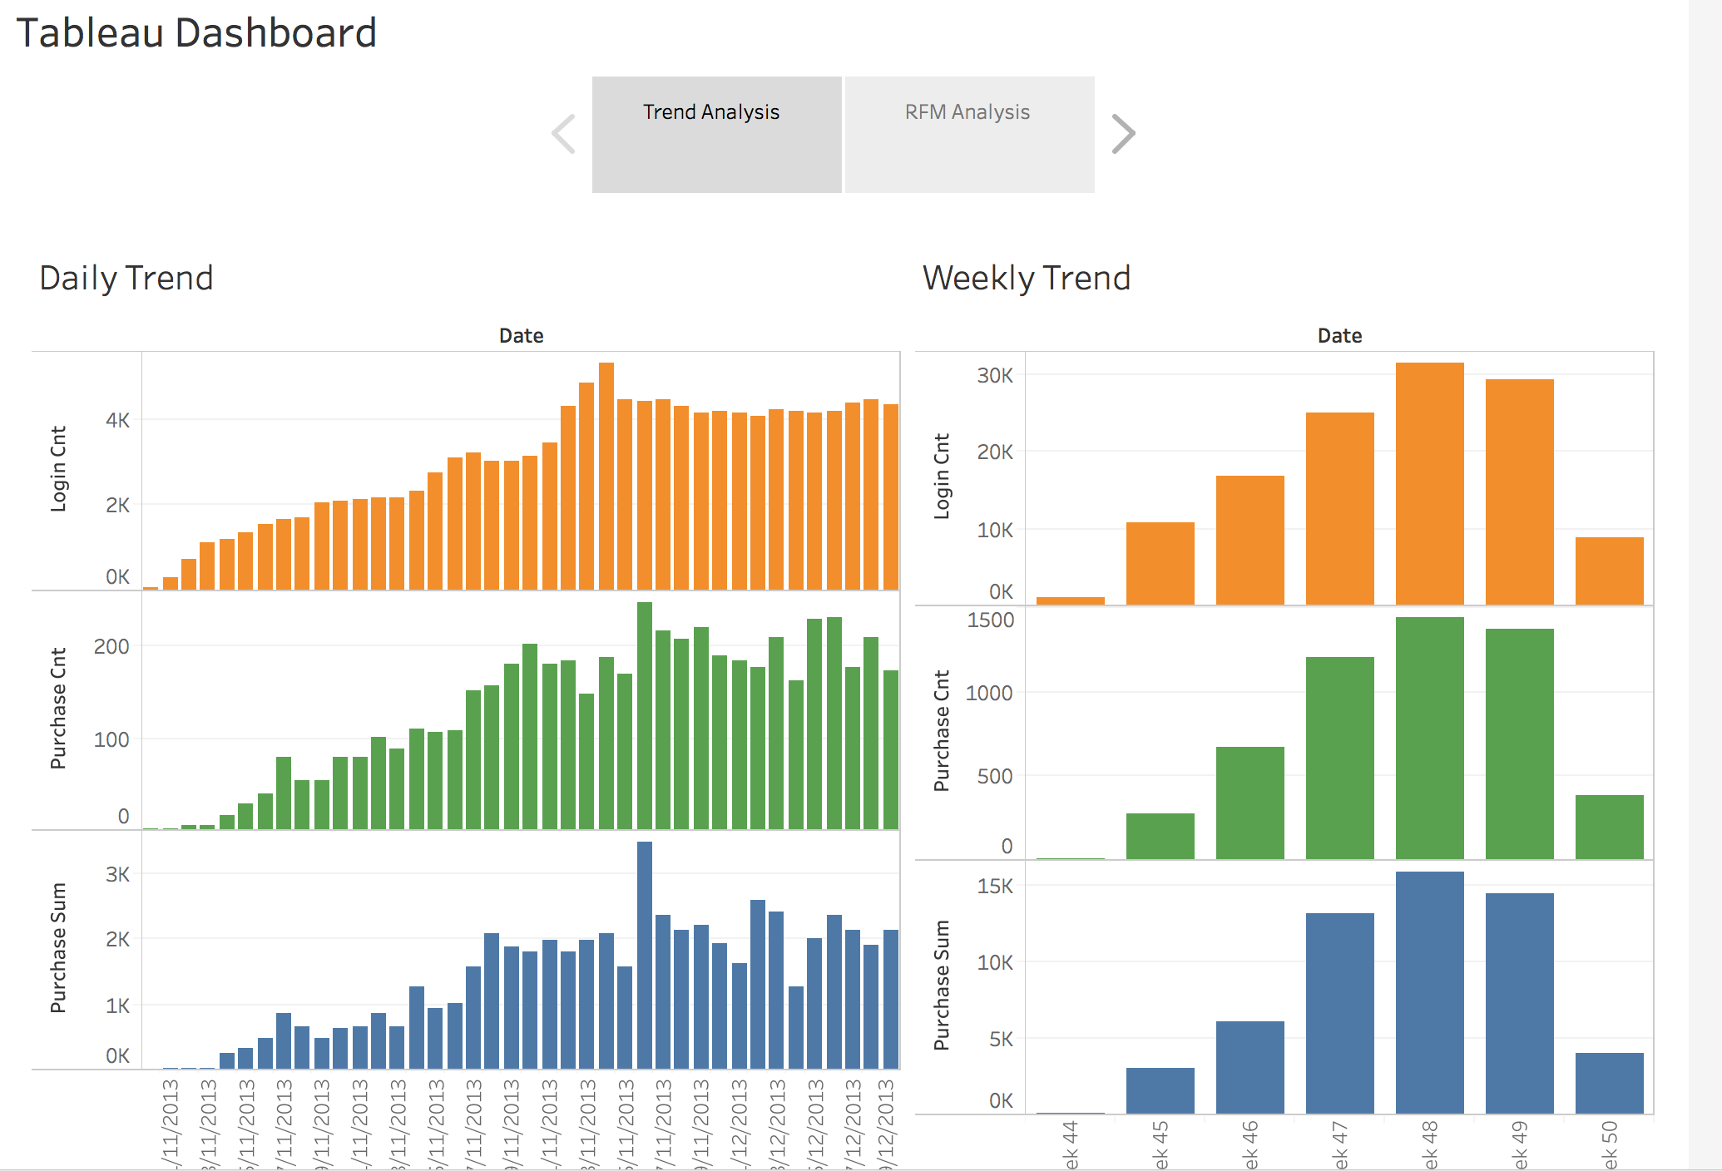
Appendix 1: Tableau BA Board

Slide 22
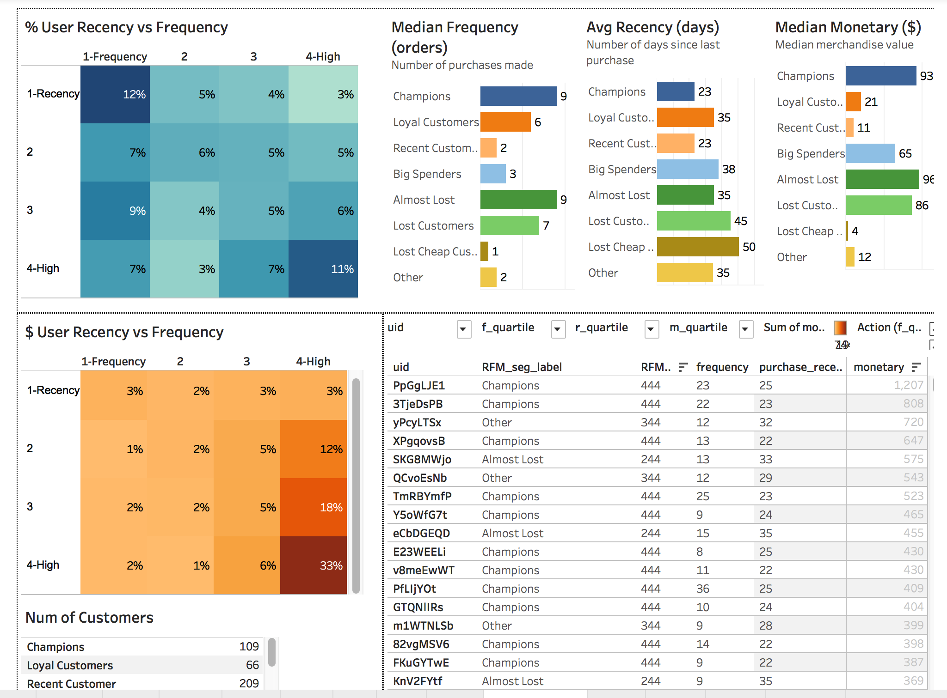
Appendix 2: Tableau BA Board

