Slide 1

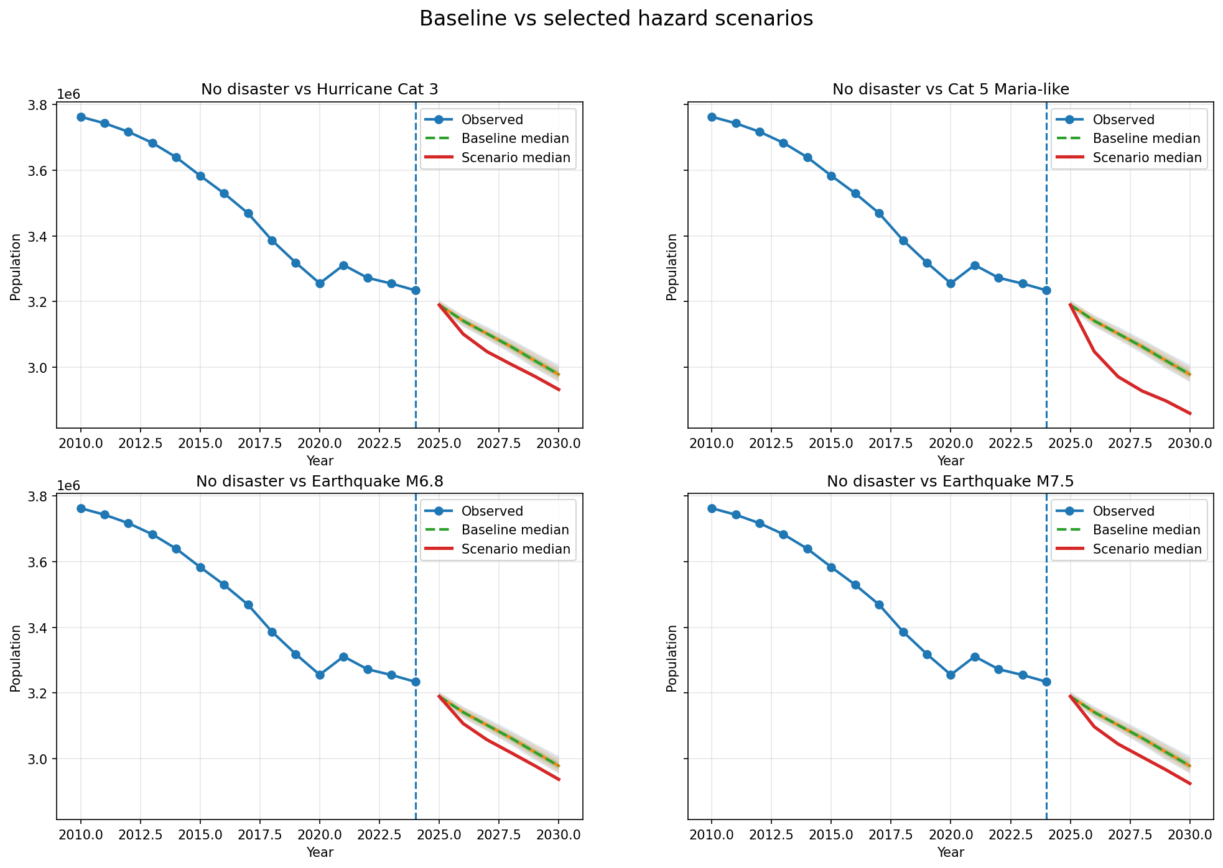
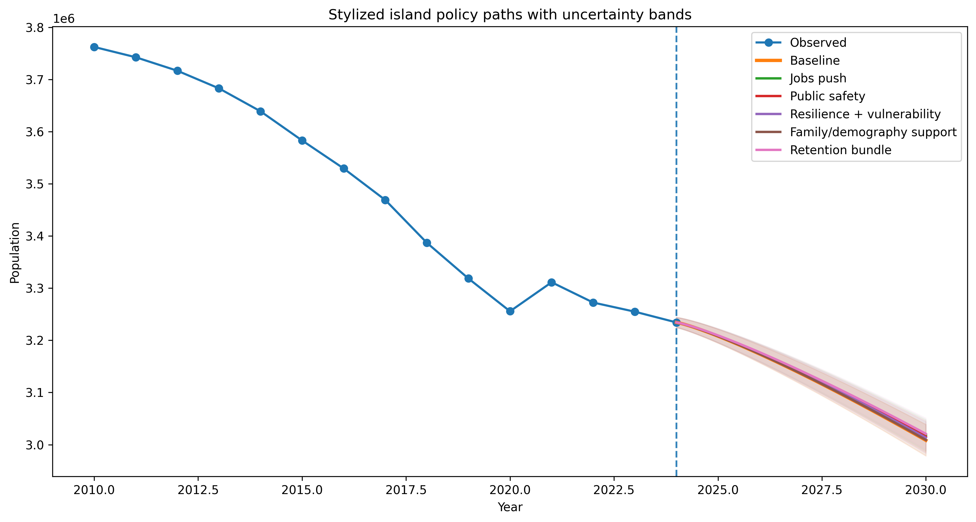
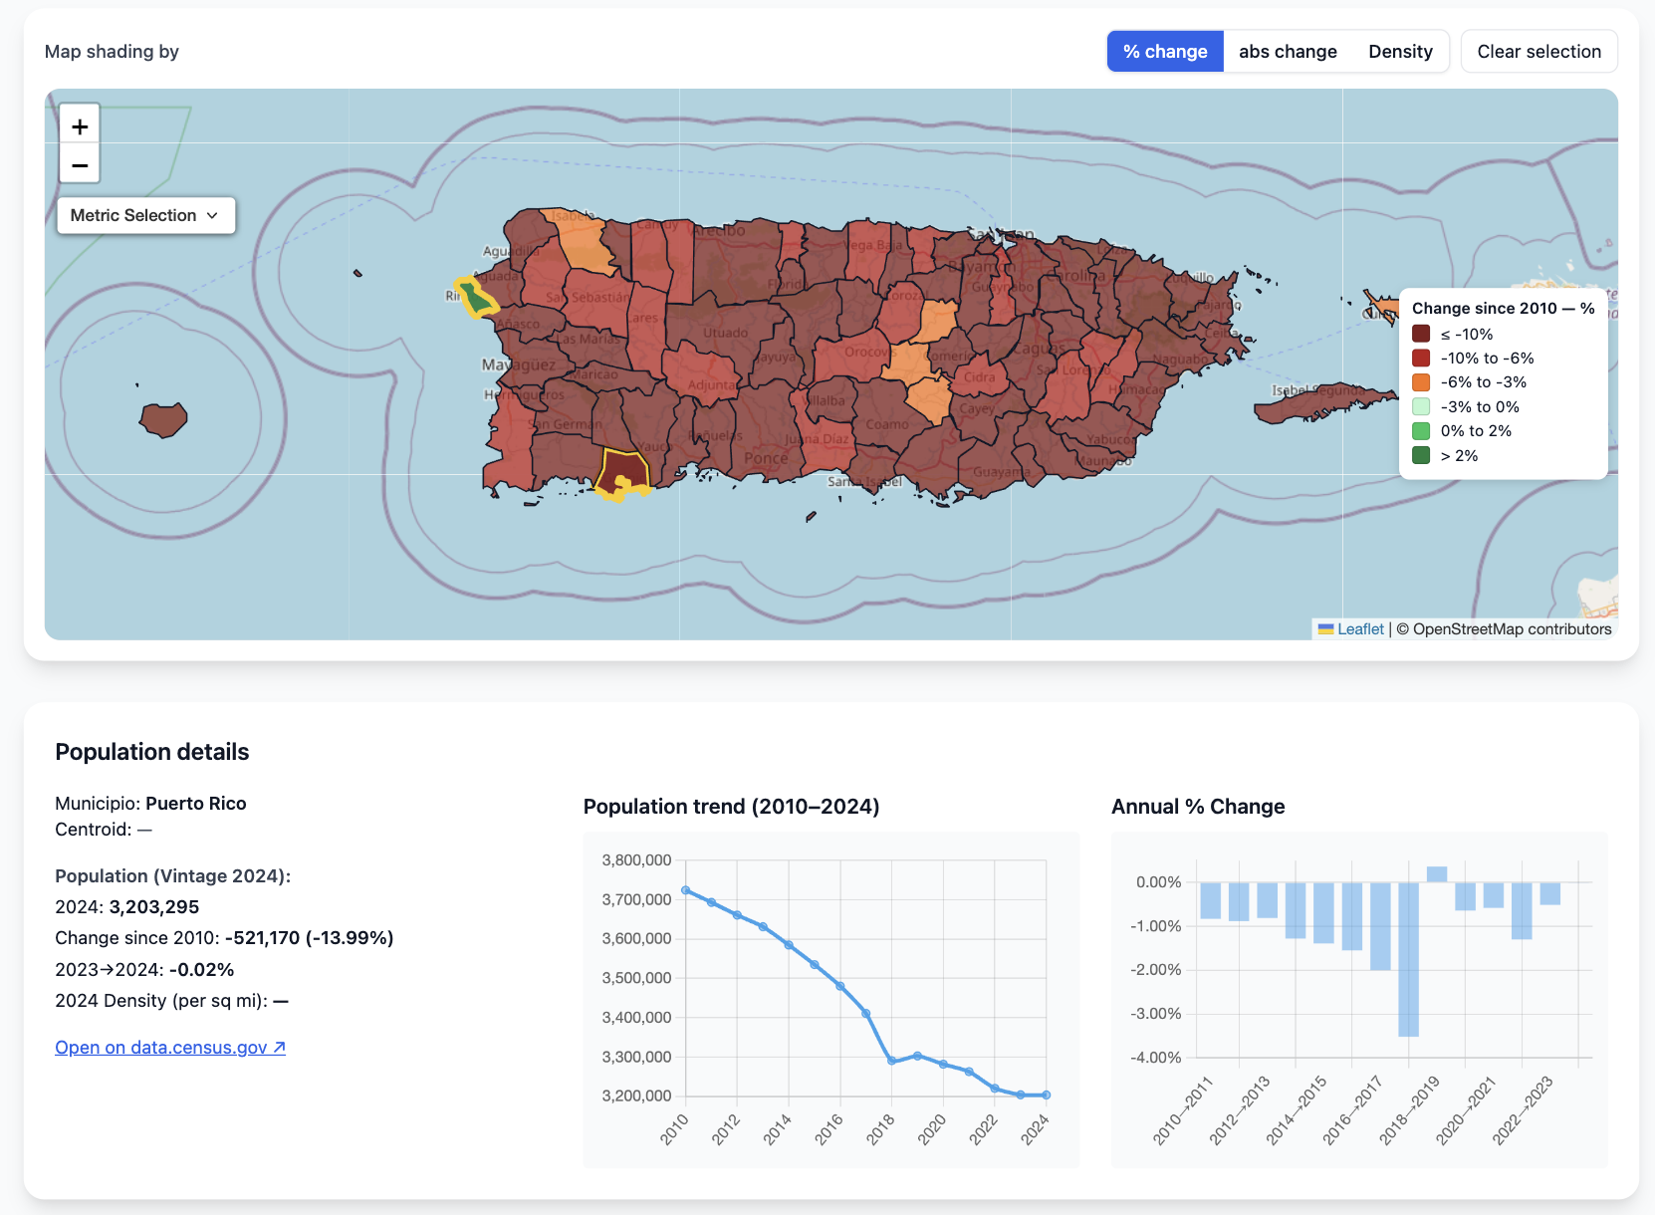
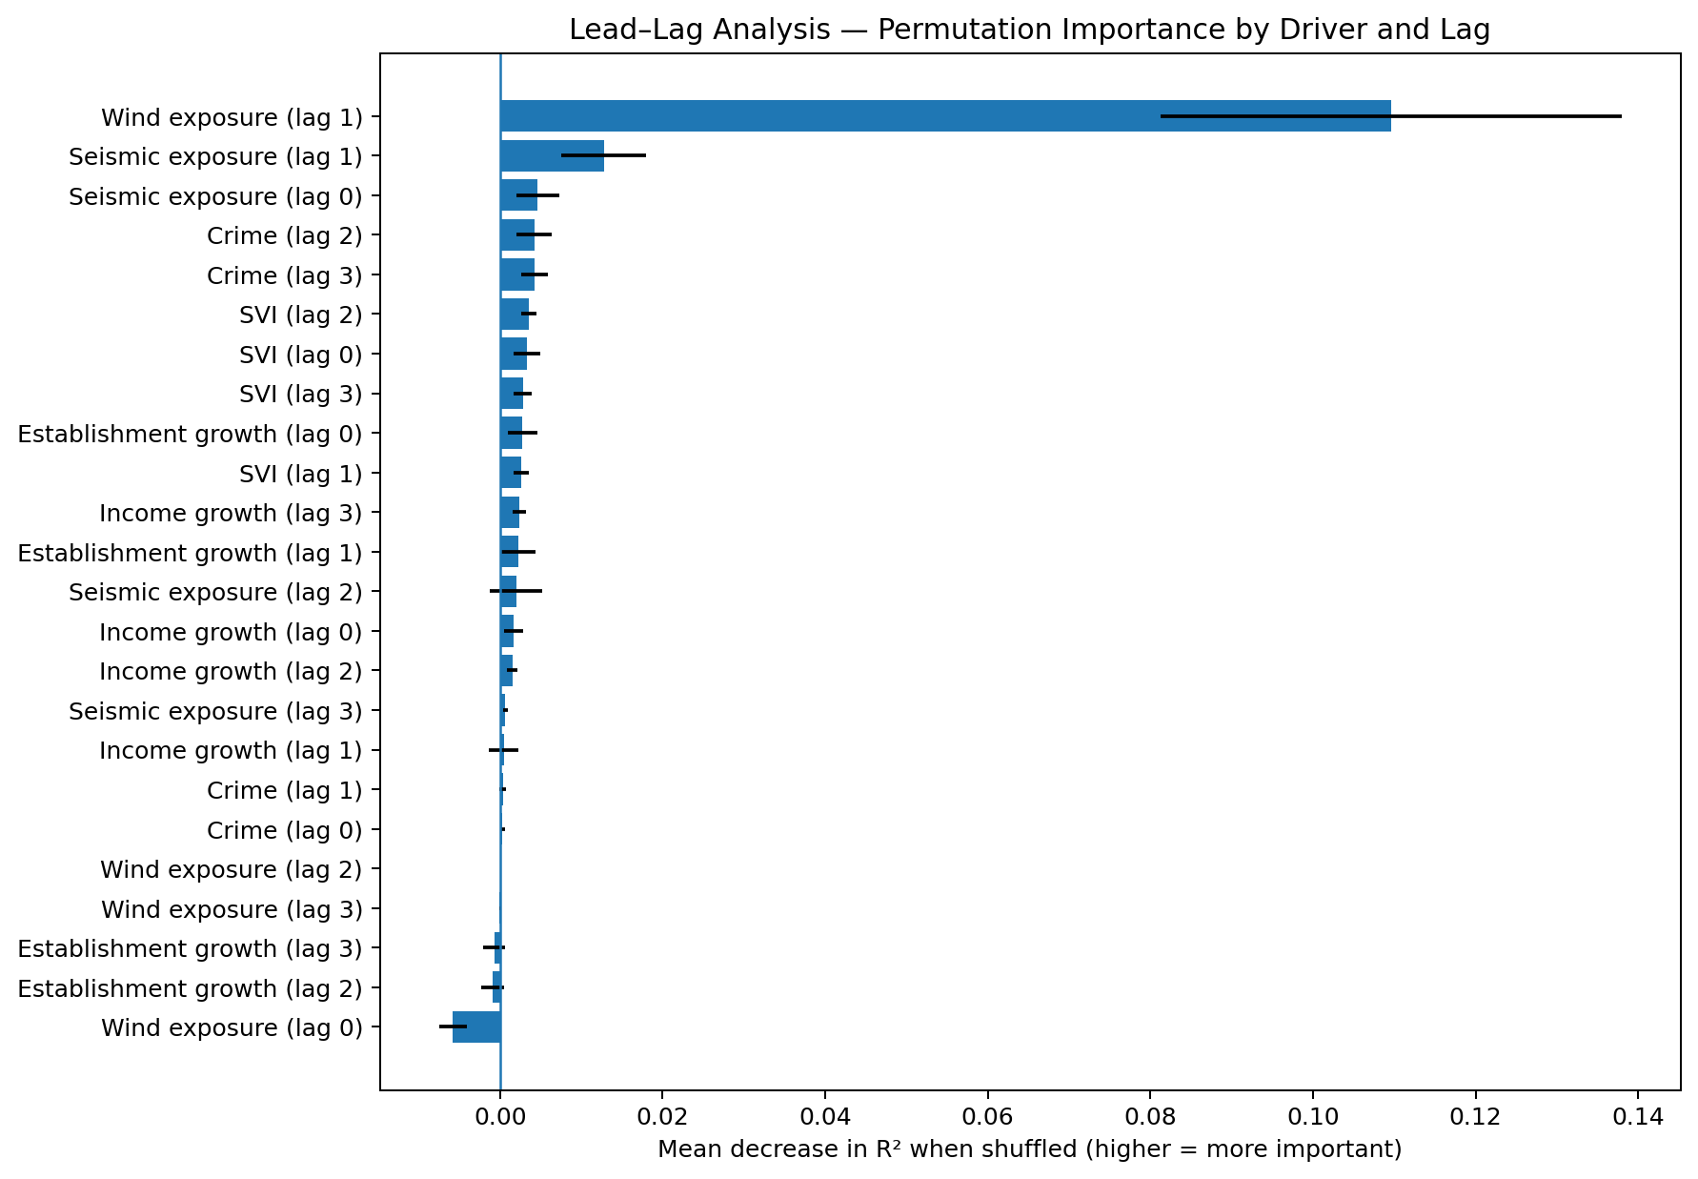
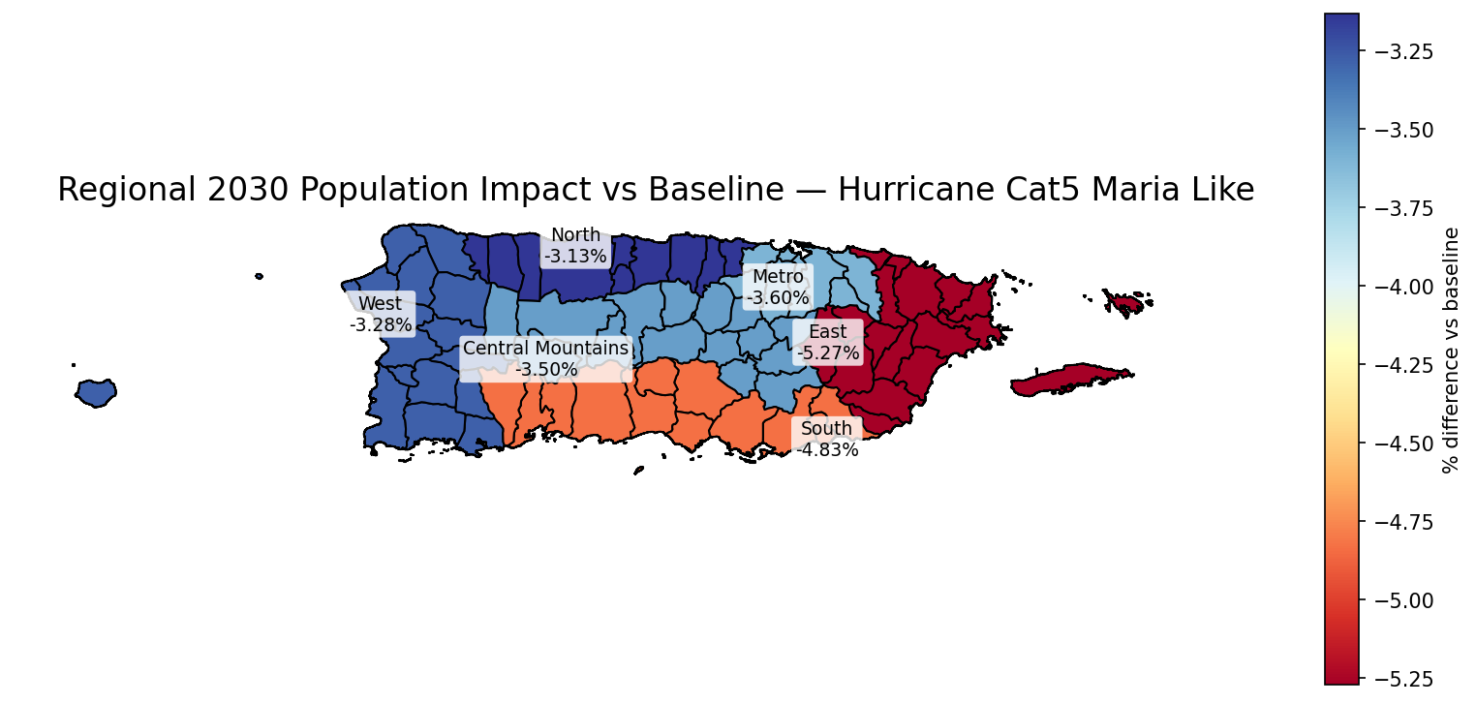
Population & Migration Forecasting in Puerto Rico
Machine Learning, Scenario Analysis, and Disaster Impacts
Jose Andres Rivera Ruiz
Introduction
Puerto Rico has experienced sustained population decline driven by economic conditions, migration, and natural disasters. This project analyzes municipal-level population change using machine learning models and integrated socioeconomic and disaster data.
Objective: Identify key drivers of population dynamics and evaluate how future trends may evolve under different conditions. Provide customer with Interactive Dashboard: https://venettov.github.io/CAPSTONE_DATA_SCIENCE_RIVERARUIZ/dashboards.html
Methods
Municipal population change is modeled using a 3-year forward target to capture longer-term dynamics. A chronological split (train ≤2018, validation=2019, test ≥2020) preserves temporal structure and avoids data leakage. A Lasso model is trained on lagged population, economic, demographic, and vulnerability features, with interpretability assessed using coefficients and SHAP analysis.
MODEL DEVELOPMENT AND FEATURES
Lagged population change to capture persistence
Disaster exposure ( cumulative wind and seismic activity)
Crime Activity at municipal and island levels
Socioeconomic indicators
MODEL SELECTION AND EVALUATION
Compared linear and nonlinear models.
Selected Lasso based on strongest out-of-sample performance under a chronological split, providing a stable and interpretable model aligned with lag-driven population dynamics.
Results
Nonlinear models significantly improve performance compared to linear baselines, capturing structure in a high-noise outcome. Extra Trees achieves the strongest and most stable results, improving test performance from ~0.17 to ~0.23 and establishing a reliable forecasting backbone.
Key patterns show strong temporal persistence in population change, with disaster and socioeconomic variables contributing meaningful signal. Model outputs highlight regional disparities and increased volatility following major events, supporting the importance of structural and delayed effects in population dynamics.
Conclusion
Population dynamics in Puerto Rico are shaped by structural persistence, regional disparities, and external shocks such as natural disasters. Machine learning models reveal that, despite high variability, meaningful patterns can be identified and used to understand population change.
Temporal Persistence: Population trends are strongly influenced by past changes, indicating path-dependent dynamics.
Delayed Disaster Effects: Hurricane and seismic impacts emerge with a lag, reflecting gradual migration and recovery processes.
Regional Vulnerability: Certain regions experience greater long-term effects, highlighting uneven exposure and resilience across municipalities.
Data Analysis
Municipal-level data (2010–2023) integrates population, socioeconomic, and disaster variables [See Figure A].
Widespread population decline across municipalities
Strong regional disparities (South and East most affected)
Increased volatility following disaster events
References
U.S. Census Bureau. American Community Survey (ACS)
U.S. Census Bureau. Population Estimates Program (PEP): Puerto Rico Municipal Population Estimates, Vintage 2024.
NOAA National Hurricane Center
USGS (United States Geological Survey).
Graduate School of Arts and Sciences
M.S. Data Science

