Slide 1

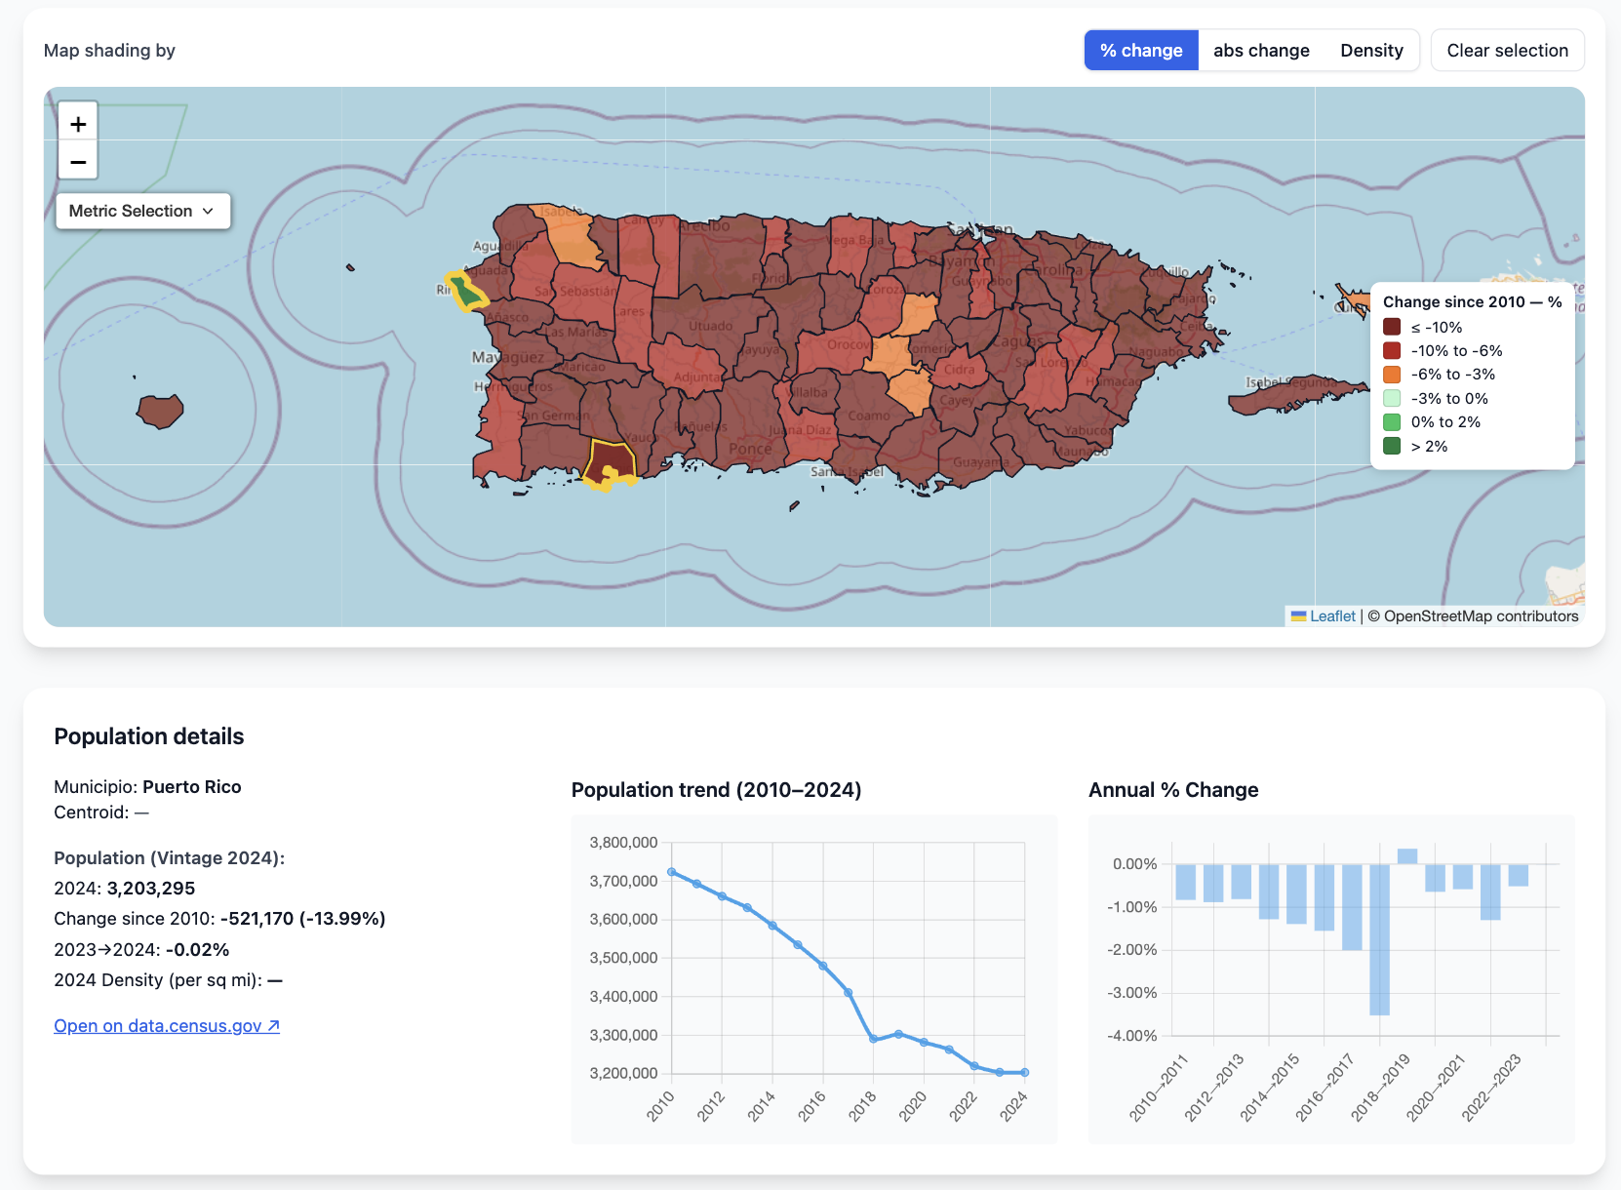
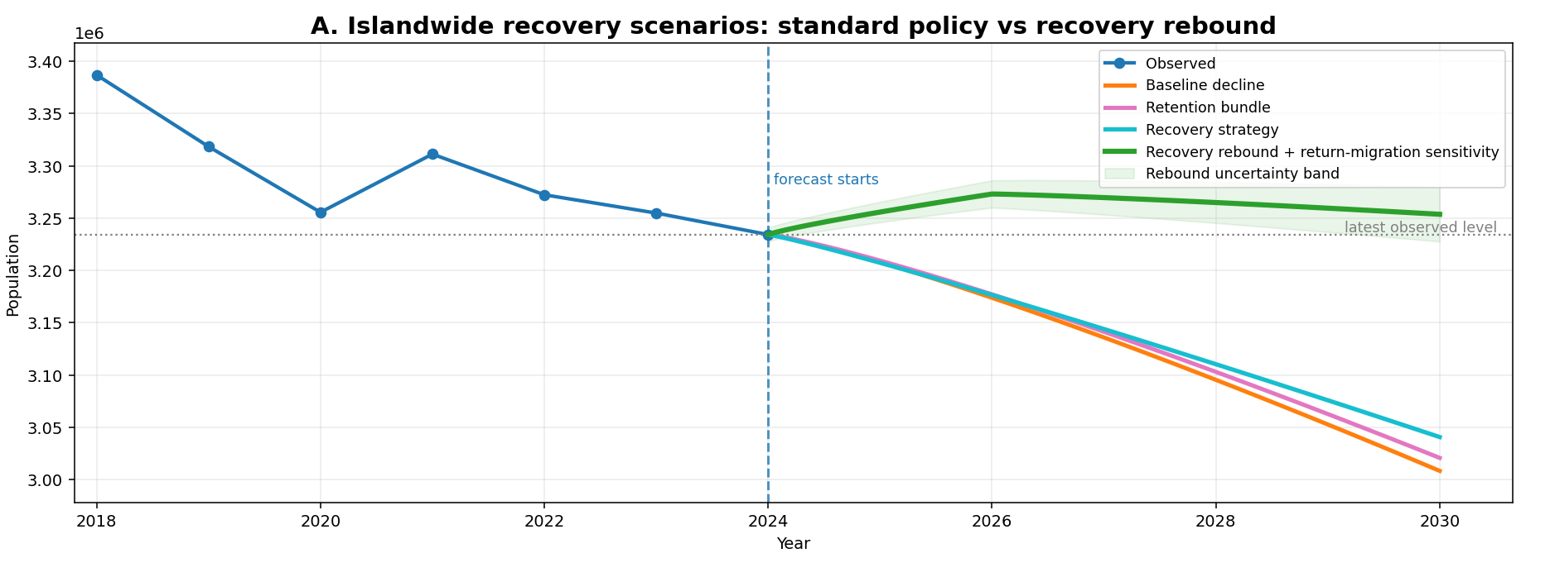
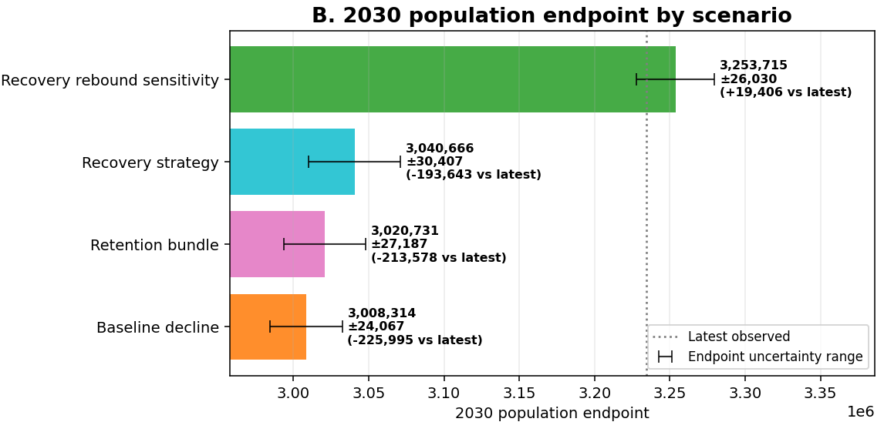
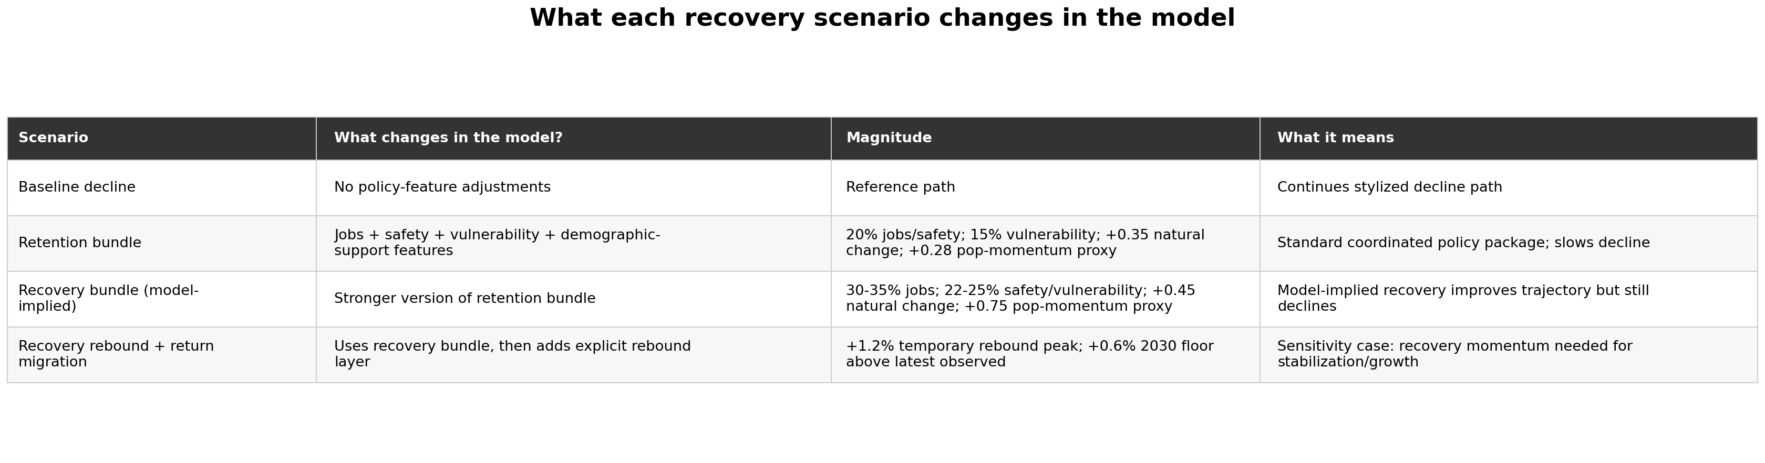
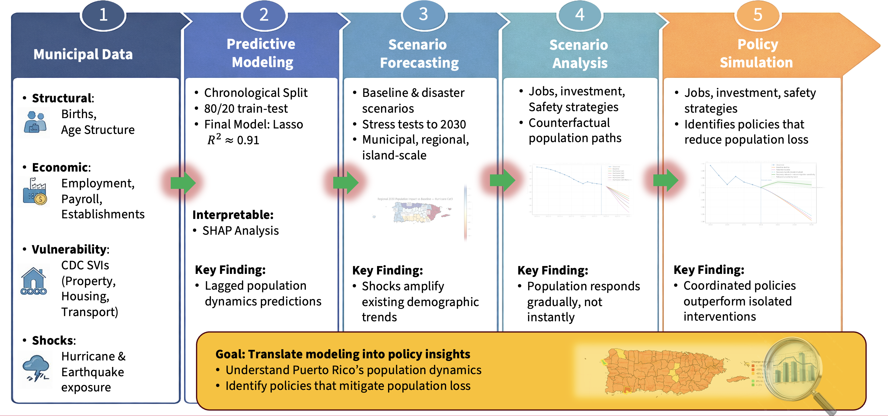
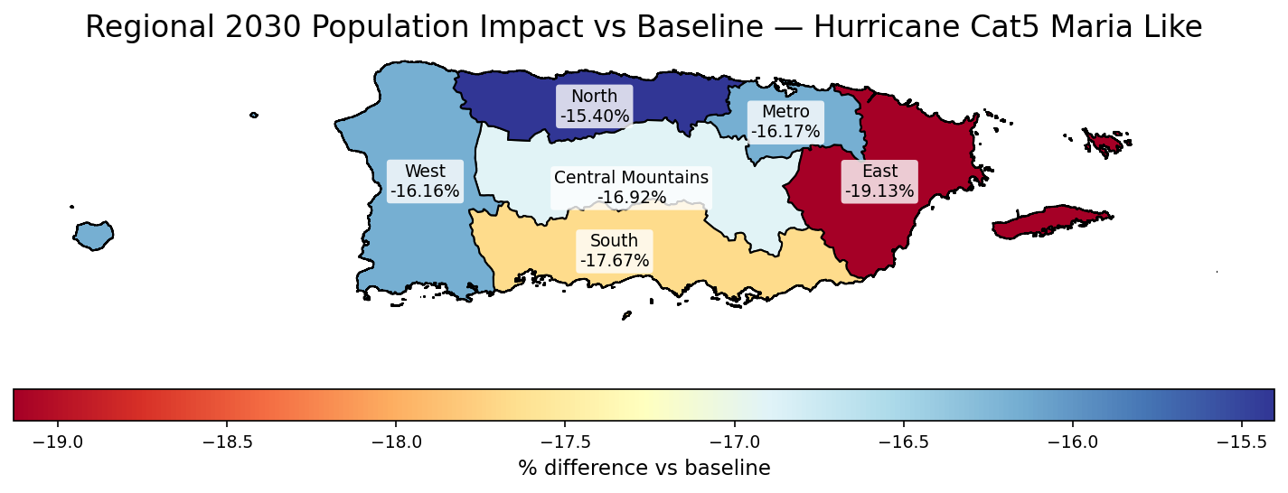
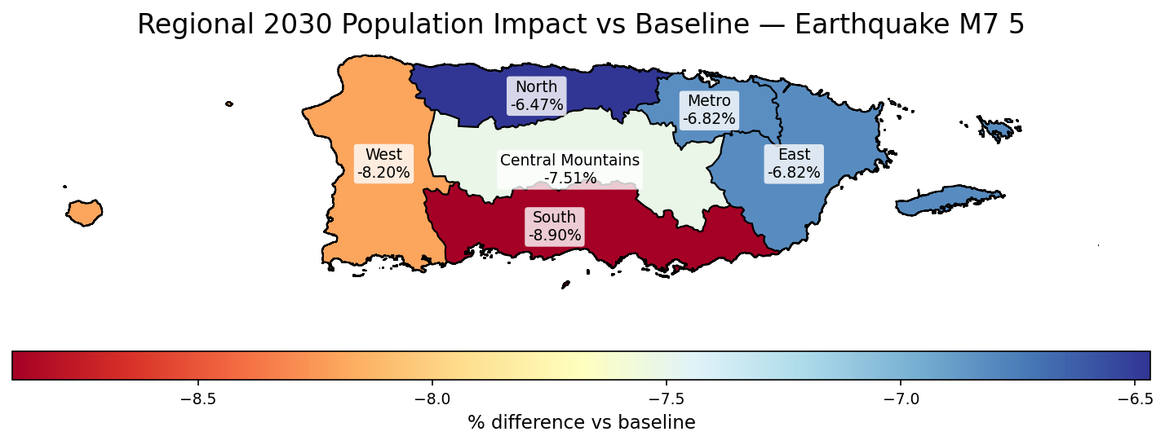
Population & Migration Predictions in Puerto Rico
Jose Andres RiveraRuiz
Graduate School of Arts and Sciences
Dr. Bilgin Altundas, Faculty Advisor
Abstract
Objectives
Results & Discussion
Puerto Rico has experienced sustained population decline driven by natural disasters, social conditions, and resources allocation. Understanding how these forces interact is critical for:
predicting future population trends
identifying vulnerable regions
informing government policy responses
This project applies machine learning and scenario analysis to model regional-level population change and evaluate how structural dynamics dominate long-term population change, with natural disasters acting as amplifiers.
Identify key drivers of population change
Evaluate the role of key drivers:
natural disasters (hurricanes & earthquakes)
economic conditions
government migration strategies
Develop scenario forecasts through 2030
Assess how policy-relevant factors influence outcomes
Key findings:
Population decline follows a persistent trajectory across the island
Without strong intervention, existing trends continue over time
Disasters are strong direct predictors
Strong regional disparities
Vulnerability and exposure vary significantly
Model performance:
Lasso achieves strong out-of-sample results (R² ≈ 0.91)
Stable across temporal split
Scenario insight:
Shocks amplify existing trends, not create new ones
Policy bundles can slow decline, but population increase requires strong, coordinated recovery that supports return migration and improves structural conditions
Interpretation: Population decline is driven primarily by persistent structural dynamics, with disasters acting as accelerators rather than root causes
Main takeaway:
Population decline in Puerto Rico is persistence-driven; reversing it requires a coordinated recovery strong enough to overcome demographic momentum
Methods
Exploratory Data Analysis:
Municipal-level (2010–2023)
Economic, safety, demographic, vulnerability, disaster features
Reference: U.S. Census Bureau. American Community Survey
Split:
Train ≤ 2018
Validation = 2019
Test ≥ 2020
(chronological → no data leakage)
Final Model:
Lasso (R² ≈ 0.91) selected for strong out-of-sample performance and interpretability
Features:
Hurricane and earthquake exposure
Crime rates
Income & establishment growth
Social vulnerability indicators (SVIs)
Natural change (births–deaths)
Results Interpretation:
Predictive population graphical representations
Background
Puerto Rico has seen persistent population loss since ~2010
Decline is uneven across regions (South and East more affected as seen on maps below)
Hurricanes and earthquakes introduce long-term shocks and volatility
Long-term dynamics are driven by:
natural disasters
migration patterns
economic opportunity
Safety and social vulnerability factors
Key challenge: Separating short-term shocks vs long-term structural trends.
References
U.S. Census Bureau. American Community Survey (ACS)
U.S. Census Bureau. Population Estimates Program (PEP): Puerto Rico Municipal Population Estimates, Vintage 2024.
NOAA National Hurricane Center
USGS (United States Geological Survey)

Slide 2
Poster Guidelines
Poster Print Size:
This poster template is 36” high by 48” wide. It can be used to print any poster with a 3:4 aspect ratio.
Placeholders:
The various elements included in this poster are ones we often see in medical, research, and scientific posters. Feel free to edit, move, add, and delete items, or change the layout to suit your needs. Always check with your conference organizer for specific requirements.
Image Quality:
You can place digital photos or logo art in your poster file by selecting the Insert, Picture command, or by using standard copy & paste. For best results, all graphic elements should be at least 150-200 pixels per inch in their final printed size. For instance, a 1600 x 1200 pixel photo will usually look fine up to 8“-10” wide on your printed poster.
To preview the print quality of images, select a magnification of 100% when previewing your poster. This will give you a good idea of what it will look like in print. If you are laying out a large poster and using half-scale dimensions, be sure to preview your graphics at 200% to see them at their final printed size.
Please note that graphics from websites (such as the logo on your hospital's or university's home page) will only be 72dpi and not suitable for printing.
Change Color Theme:
This template is designed to use the built-in color themes in the newer versions of PowerPoint.
To change the color theme, select the Design tab, then select the Colors drop-down list.
The default color theme for this template is “Office”, so you can always return to that after trying some of the alternatives.

