Slide 1
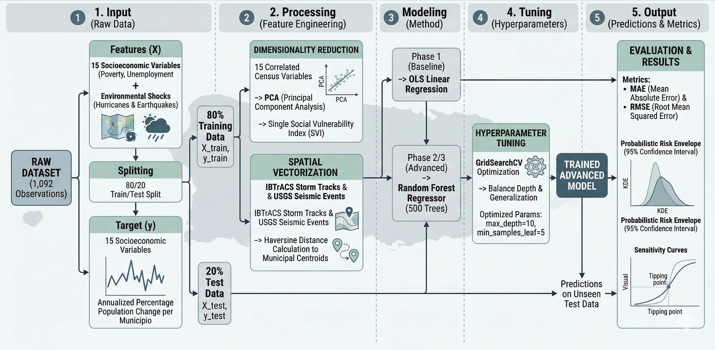
Notes:
Ordinary Least Squares (OLS) is a non-parametric method used in statistics and machine learning to estimate the relationship between one or more independent variables (predictors) and a dependent variable (target).

Slide 2
Draft pipeline slide
This is the high-level figure I can iterate on. It foregrounds leakage control, baseline benchmarking, and the deterministic-to-probabilistic transition.
1
1. Input
2
2. Processing
3
3. Modeling
4
4. Prediction
5
5. Output
Raw data
Feature engineering
Methods
Hypothesis testing
Decision support
Master historical profile
78 municipios x 14 years
Target y = annual % population change
Clean + numeric coercion
80/20 split first
Scaler + PCA fit on train only
Transform test with trained params only
Phase 1: OLS baseline
Phase 2: Random Forest
GridSearchCV for tuning
Phase 3: simulation model
What-if scenarios
Wind and seismic sweeps
Threshold / tipping-point inspection
Expected forecast
5th and 95th percentiles
Risk envelope + dashboard-ready plots
Baseline benchmark
How to frame the advanced model
OLS gives the reference floor on unseen data:
R² = 0.0137 | MAE = 1.1702% | RMSE = 2.1122%
Use the Random Forest as the mechanism for feature importance, scenario simulation, and threshold discovery. That is the strongest story even before the model clearly beats the baseline on R².

Slide 3
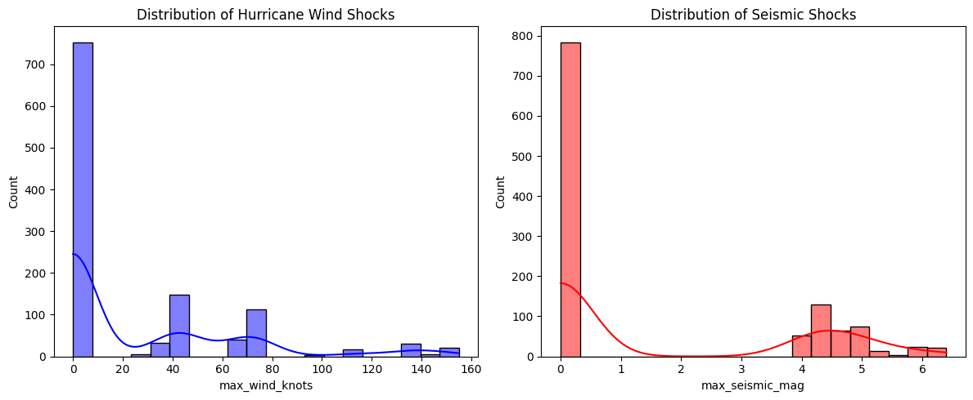
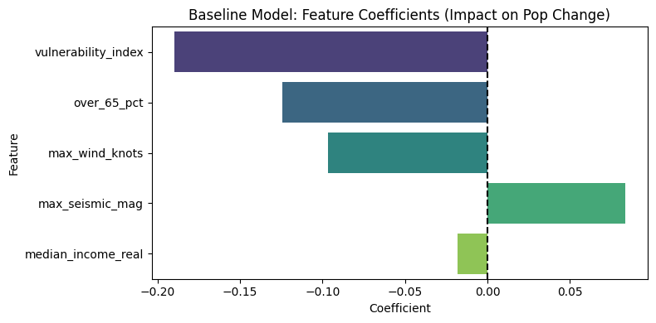
Feature engineering and the non-leaked baseline
These slides answer the Week 6 requirement directly: what goes in, how it is processed, and how the baseline benchmark is created.
What Phase 1 establishes
Reality check on shock features
Baseline coefficients
• Master panel merges population, vital stats, establishments, SVI metrics, and disaster shocks
• Target y is annualized population change by municipio
• Fifteen highly collinear SVI indicators are compressed into one PCA-based vulnerability_index
• Train/test split happens before scaler or PCA fitting
• Baseline OLS is trained on the engineered training set only
Baseline takeaways for presentation
R² = 0.0137
MAE = 1.1702%
RMSE = 2.1122%
The baseline is intentionally simple and quick to implement. Its real value is that it gives us a leak-free benchmark and a disciplined starting point before we move to more expressive models.
Why the next step is justified: the shock distributions are sparse and extreme, and the linear coefficients already suggest that disaster intensity and aging structure matter. That is why Phase 2 turns to a non-linear ensemble.

Slide 4
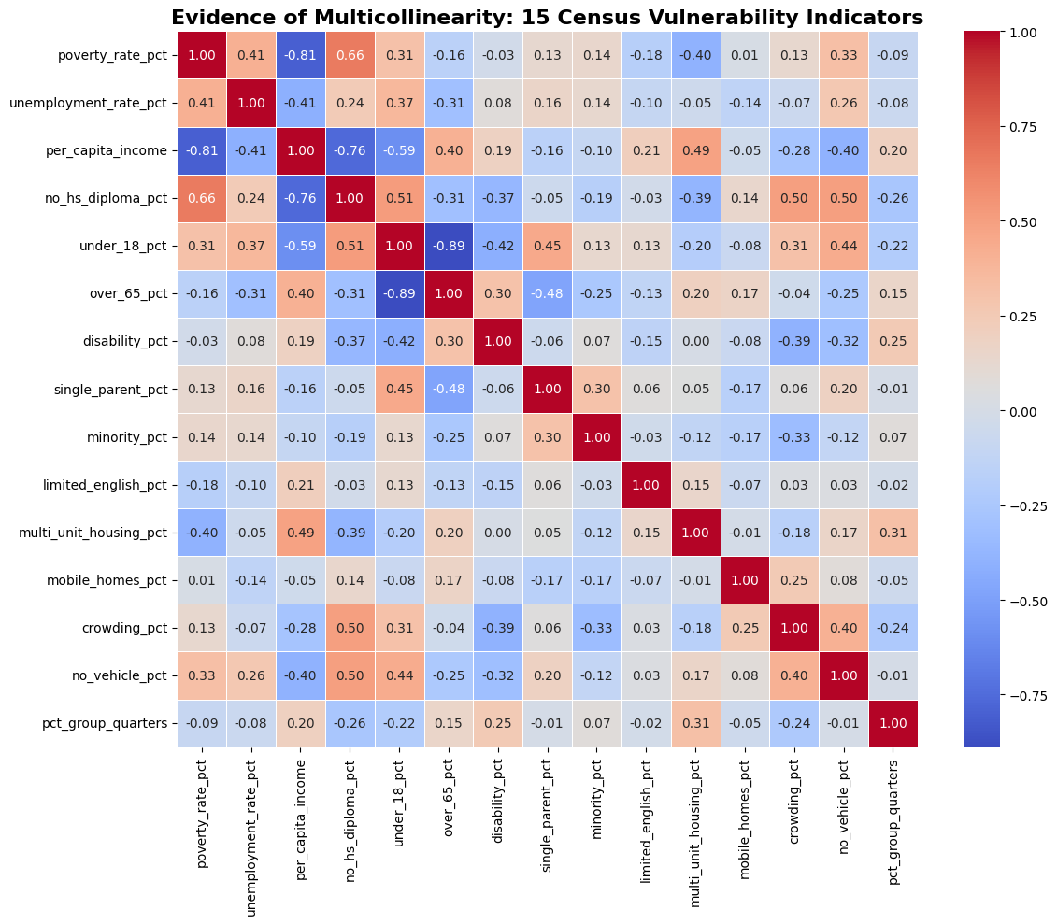
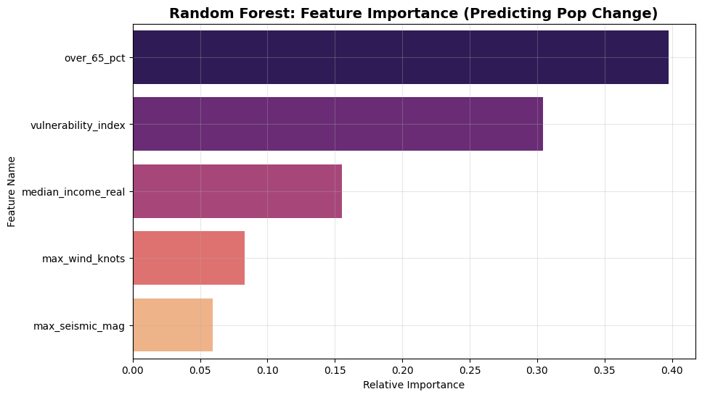
Phase 2: the non-linear model is useful even before it wins on R²
Present the Random Forest: it strengthens structural interpretation, feature ranking, and downstream simulation capability.
What Phase 2 adds
Feature importance
15 Vulnerability Indicators
Poverty
Unemployment
Per Capita Income (USD)
No High School Diploma
Population under 18
Population 65+
Persons with a Disability
Single Parent
Minority Population
Speaks Limited English
Population in Multi-Unit Dwellings (10+ units)
Mobile Homes Estimate
Crowding - Households with More People than Rooms
No Vehicle
Persons Living in Group Quarters
• Random Forest handles non-linear relationships and feature interactions
• GridSearchCV tests various parameter settings with 5-fold CV
• Best documented tuned model in the notebook:
bootstrap=True, max_depth=10, min_samples_split=10, n_estimators=300
• The optimized R² in the notebook remains modest (0.0044), so the model should be framed as a threshold-discovery engine rather than a headline accuracy winner
Analysis
1) The baseline remains the benchmark for straightforward predictive accuracy.
2) The Random Forest is valuable because it uncovers which inputs matter most and creates the foundation for scenario simulation.
Phase 2 charts: feature importance and predicted-vs-actual scatter from the uploaded notebook.

Slide 5
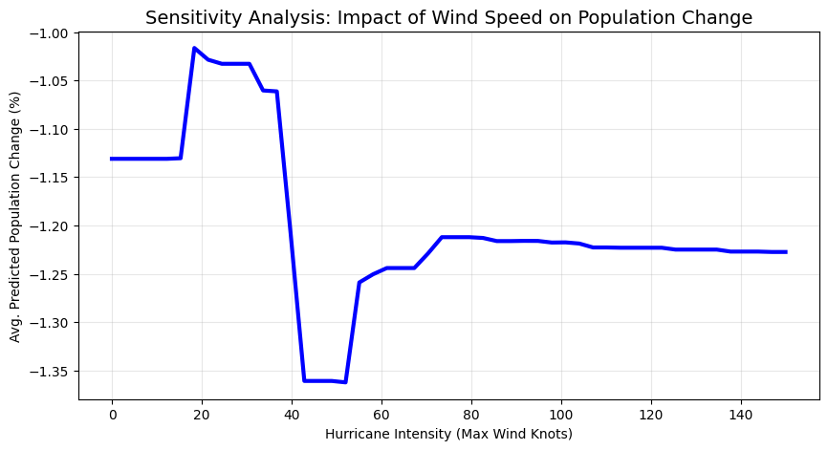
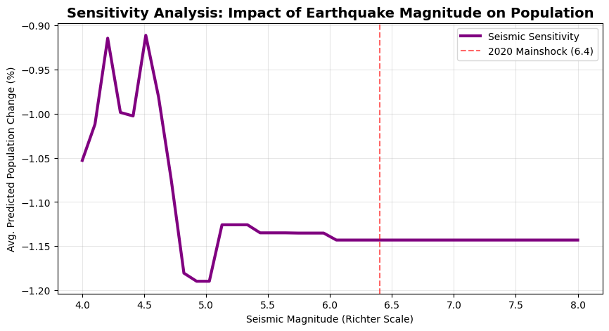
Phase 3: Sensitivity analysis
The Phase 3 notebook already contains the key plots: vary one shock feature while holding the rest of the profile fixed, then measure how predicted population change responds.
Wind-speed sensitivity sweep
Earthquake-magnitude sensitivity sweep
These curves show that the model is not treating shock variables as linear. Population response changes non-uniformly as intensity increases, which is exactly the threshold behavior we hoped to surface.

Slide 6
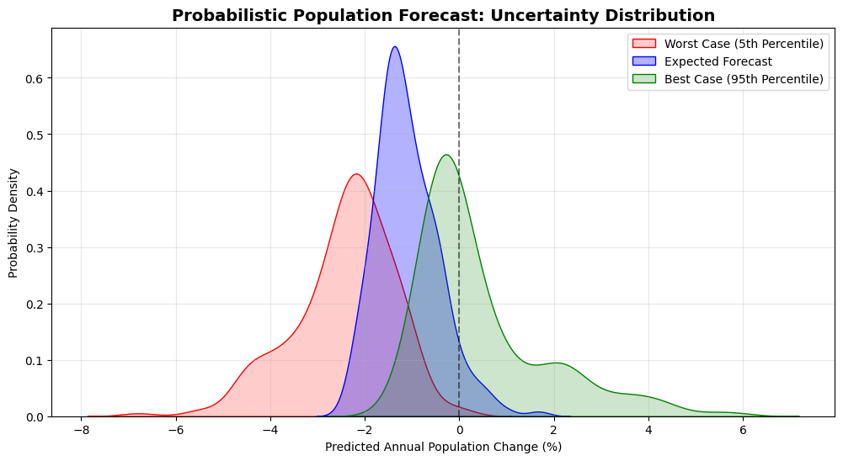
Probabilistic analysis: from point prediction to a risk envelope
This slide answers the second explicit expectation from Prof. Altundas. The ensemble itself becomes the uncertainty engine by exposing per-tree prediction variability.
How the probabilistic step works
Notebook output: uncertainty distribution
How to frame the payoff
• Extract predictions from every tree in the Random Forest
• Aggregate them into a mean forecast plus 5th and 95th percentiles
• Present the spread as a risk envelope rather than a single point estimate
• This is what makes the dashboard decision-support oriented rather than merely descriptive
Expected forecast
= blue mean
Worst case
= red 5th percentile
Best case
= green 95th percentile
This satisfies the request for a probabilistic extension while keeping the deterministic baseline intact.

