Slide 1

VIVITSU
2K24

Slide 2
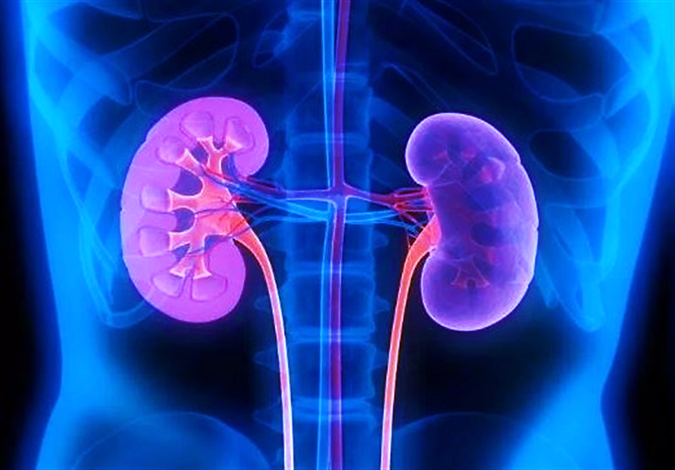
RENAL GUARDIAN
A Machine Learning Tool to detect
Chronic Kidney Disease
By
V . Eshwar (TL) U . Aravind G . Vamshi Yadav T . Sai Kumar

Slide 3
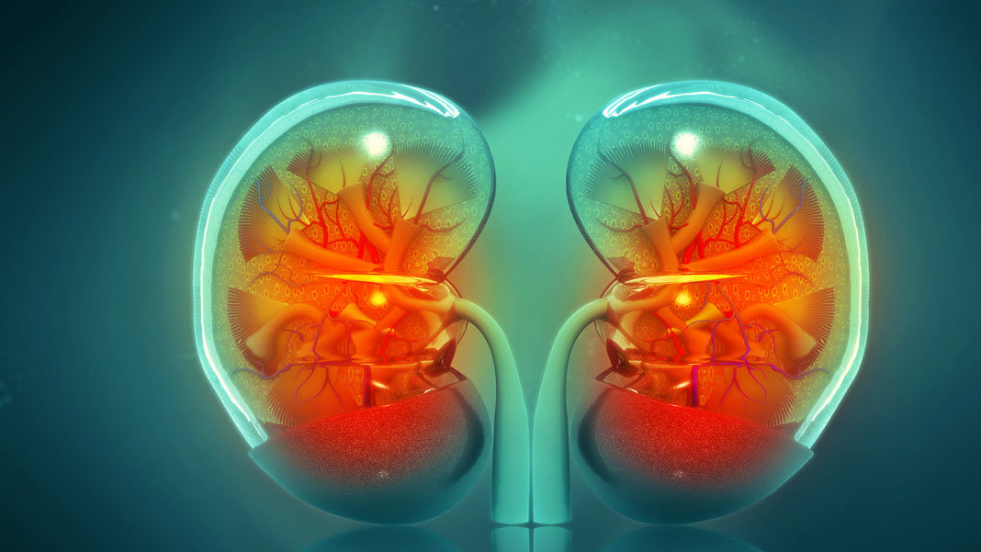
Chronic Kidney Disease (CKD) is a prevalent health condition affecting millions worldwide, particularly driven by the aging population and increasing rates of diabetes and hypertension.
CKD typically progresses slowly, often with mild or no symptoms in the early stages, but it can lead to severe complications if left untreated. Common risk factors for CKD include diabetes, hypertension, obesity, smoking, family history of kidney disease, and certain ethnic backgrounds. Symptoms of CKD may include fatigue, swelling, changes in urine output, and hypertension initially, progressing to more severe symptoms such as nausea, vomiting, and difficulty concentrating as the disease advances.
Complications associated with CKD include cardiovascular disease, anemia, bone disease, electrolyte imbalances, and increased susceptibility to infections. Diagnosis of CKD involves medical history, physical examination, blood and urine tests, imaging studies, and sometimes kidney biopsy.
Treatment aims to slow disease progression, manage symptoms, and prevent complications through lifestyle modifications, medications, and medical interventions such as dialysis or kidney transplantation.
Prognosis varies depending on the stage of CKD, underlying health conditions, and response to treatment, emphasizing the importance of early detection and proactive management for improving outcomes and quality of life.

Slide 4

OUR GOAL
Our goal is to develop a user friendly Interface with machine learning (ML) model for predicting Chronic Kidney Disease (CKD) based on various patient attributes and clinical data. Additionally, we aim to provide suggestions for preventing or managing the disease effectively. In summary, your goals include:
1. Building an ML model: Develop a predictive model that accurately identifies the presence or absence of CKD based on input features such as age, blood pressure, urine analysis results, and other relevant medical data.
2. Providing preventive suggestions: Utilize insights from the ML model to offer personalized recommendations for preventing CKD, such as lifestyle modifications (e.g., diet, exercise), early detection strategies, and regular monitoring of risk factors.
3. Offering treatment recommendations: For individuals diagnosed with CKD, leverage the ML model to provide tailored suggestions for managing the condition, including medication adherence, dietary guidelines, and lifestyle interventions to slow disease progression and minimize complications.
By achieving these goals, our ML model can contribute to early detection, proactive management, and improved outcomes for individuals at risk of or affected by Chronic Kidney Disease.

Slide 5
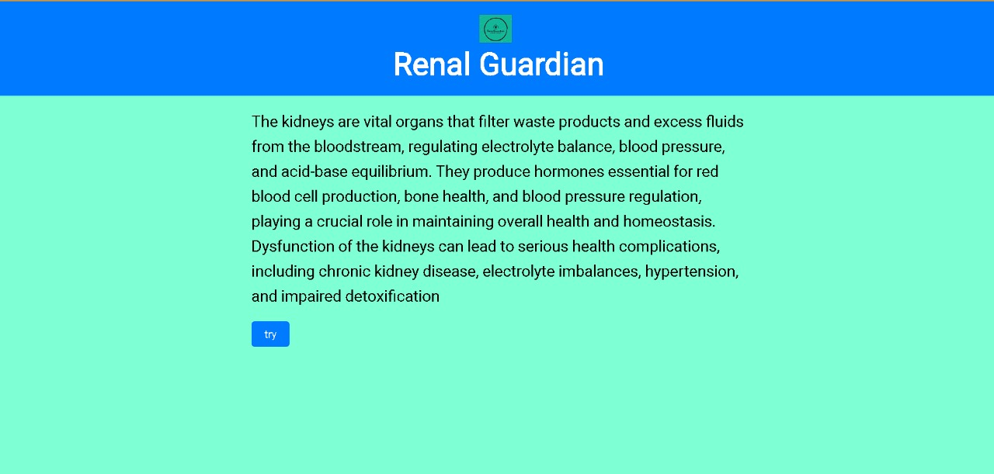
USER INTERFACE
User has to click the “check” button to enter into the test
User has to select multiple option from the select to get the over all kidney related and health information like Age,bp,sugar and other 22 attributes

Slide 6
Then you are redirected to a new page where you are asked to fill the form or list of things that reflect your health.
1.Age(numerical)
age in years
2.Blood Pressure(numerical)
bp in mm/Hg
3.Specific Gravity(nominal)
sg - (1.005,1.010,1.015,1.020,1.025)
4.Albumin(nominal)
al - (0,1,2,3,4,5)
5.Sugar(nominal)
su - (0,1,2,3,4,5)
6.Red Blood Cells(nominal)
rbc - (normal,abnormal)
7.Pc Cell (nominal)
pc - (normal,abnormal)
8.Pcc Cell clumps(nominal)
pcc - (present,notpresent)
9.Bacteria(nominal)
ba - (present,notpresent)
10.Blood Glucose Random(numerical)
bgr in mgs/dl
11.Blood Urea(numerical)
bu in mgs/dl
12.Serum Creatinine(numerical)
sc in mgs/dl
13.Sodium(numerical)
sod in mEq/L
14.Potassium(numerical)
pot in mEq/L
15.Hemoglobin(numerical)
hemo in gms
16.Packed Cell Volume(numerical)
17.White Blood Cell Count(numerical)
wc in cells/cumm
18.Red Blood Cell Count(numerical)
rc in millions/cmm
19.Hypertension(nominal)
htn - (yes,no)
20.Diabetes Mellitus(nominal)
dm - (yes,no)

Slide 7
21.Coronary Artery Disease(nominal)
cad - (yes,no)
22.Appetite(nominal)
appet - (good,poor)
23.Pedal Edema(nominal)
pe - (yes,no)
24.Anemia(nominal)
ane - (yes,no)
25.Class (nominal)
class - (ckd,notckd)
Now , Our Machine Learning Model determines whether the person has Chronic Kidney Disease based their given inputs

Slide 8





TECHNOLOGIES WE USED
This Photo by Unknown Author is licensed under CC BY-SA
This Photo by Unknown Author is licensed under CC BY-SA

Slide 9
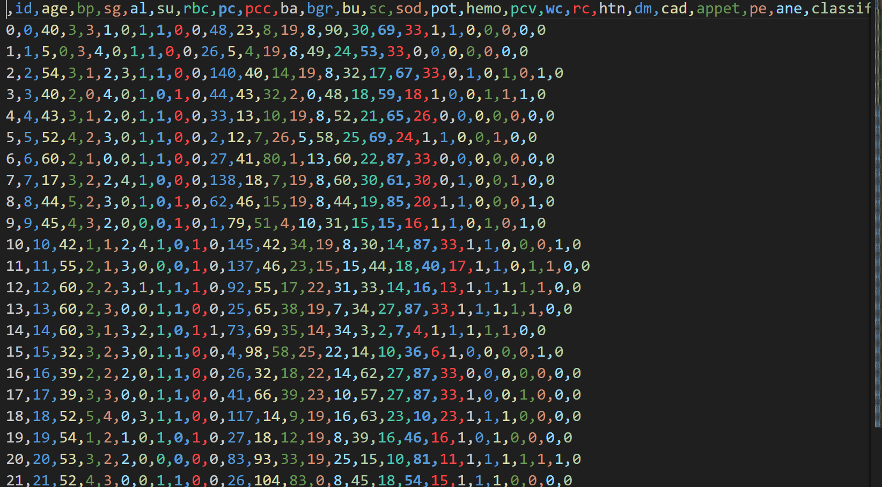
We gathered Dataset from Online and we cleaned and processed the data
Here is the snap shot of the dataset we processed and through this we train our model

