Slide 1

PLANT DISEASE DETECTION USING CNN
Bapatla Engineering College :: Bapatla, (Autonomous)
Department of Computer Science and Engineering
Under the Guidance of Mr. Krishna Kishore Thota ,M.Tech. Asst. Professor, CSE Department
Presented By:
Batch-C2
V. Rakesh(Y20ACS584)
P. Kethana Sai(Y20ACS531)
S. Appala Swamy (Y20ACS555)
Y. Hussain Valli (Y20ACS588)

Slide 2

Contents:
Abstract
Existing System
Proposed System
Design
Implementation
Results
Conclusion

Slide 3
Abstract
Modern agriculture faces numerous challenges, from combating diseases that threaten food security.
Plant disease detection is an application which will detect and provide some remedial measures for diseases in the crop to the users.
So, we here to present a comprehensive overview of advancements in plant leaf disease detection through the application of deep learning methodologies.
With the increasing global concern over agricultural productivity and food security, there is a need is to minimize crop losses and protect agricultural productivity.

Slide 4
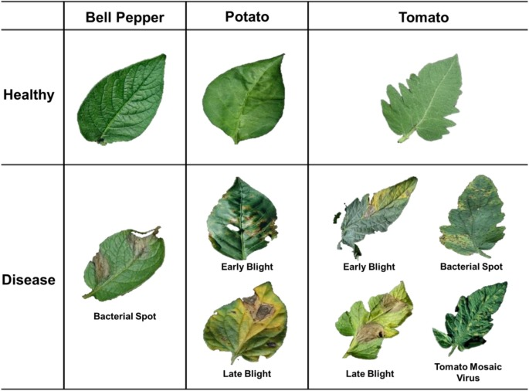
Existing Methodologies
Traditional Techniques:
Disease detection is performed by simply naked eye observation or laboratory testing by experts through which identification and detection of plant diseases done.
Machine Learning and Deep Learning Techniques:
Machine learning techniques like Support Vector Machines are applied for classification tasks.
In recent years, Deep leaning approaches has gained prominence by developing accurate detection systems but there scope is limited to particular variety of crop.

Slide 5
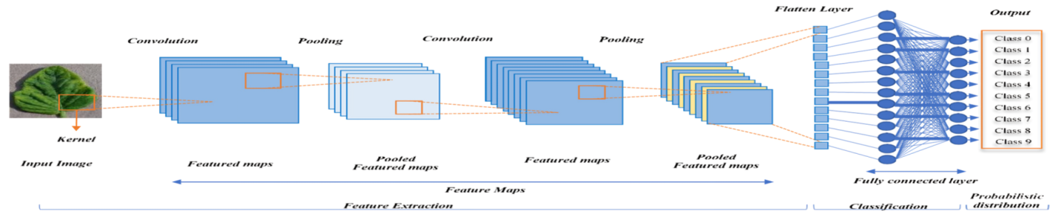
Proposed System
Convolution Neural Network:
The goal of this architecture is to learn hierarchical features from input images, reduce spatial dimensions through pooling, and make predictions through the fully connected layers.

Slide 6
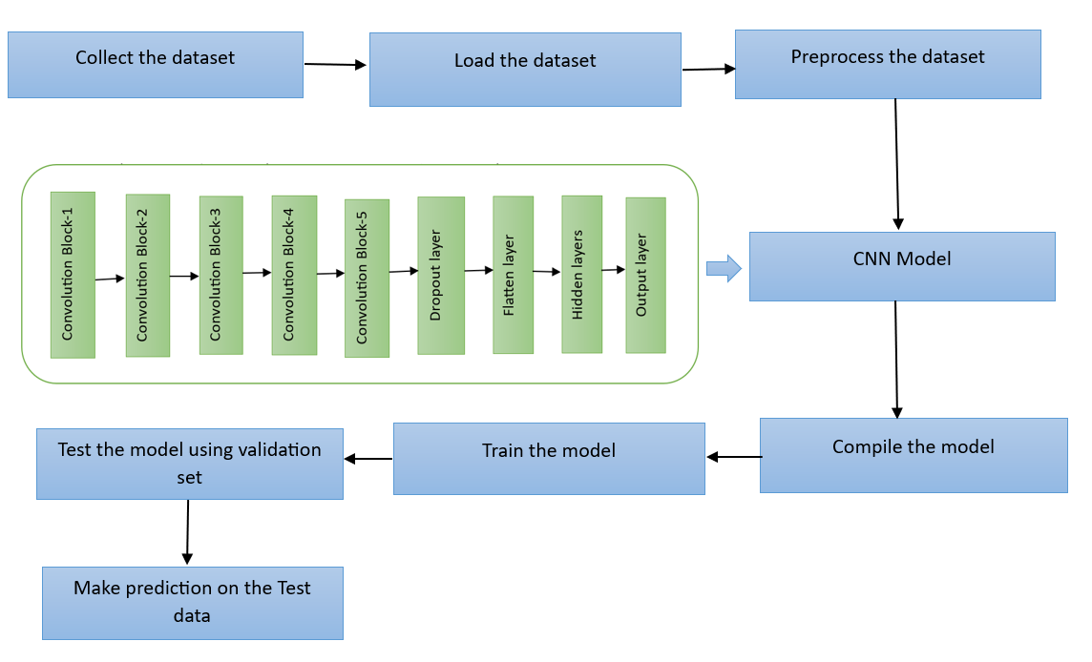
Working Flow of the model

Slide 7
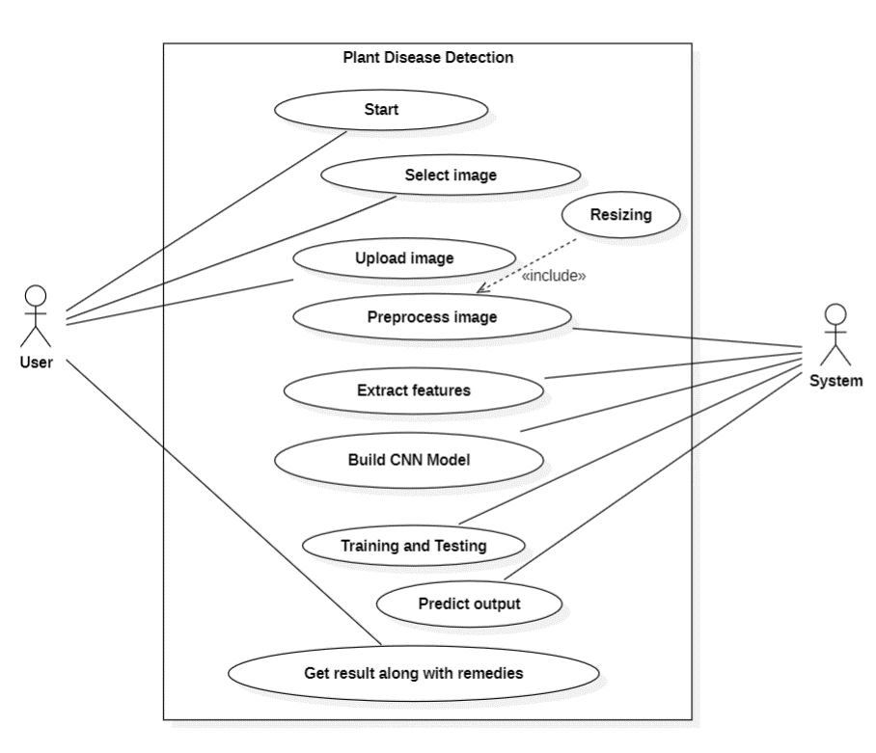
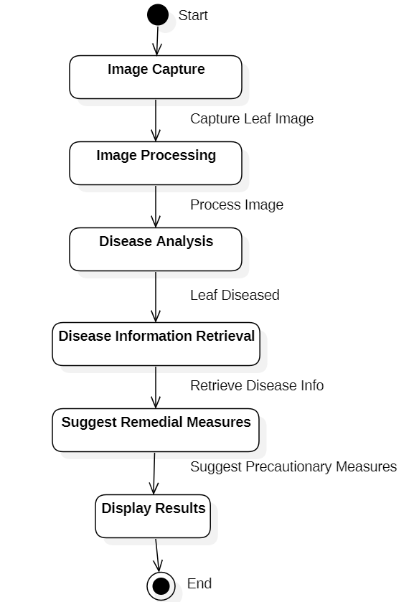
Design
Use Case Diagram
State Chart Diagram

Slide 8
Implementation
Importing all the necessary libraries
Preprocessing
Defining CNN Model
Training and Evaluation
Testing the Model
Integrating with Web Application
https://github.com/VengalaRakesh/Plant_Disease_Detection

Slide 9
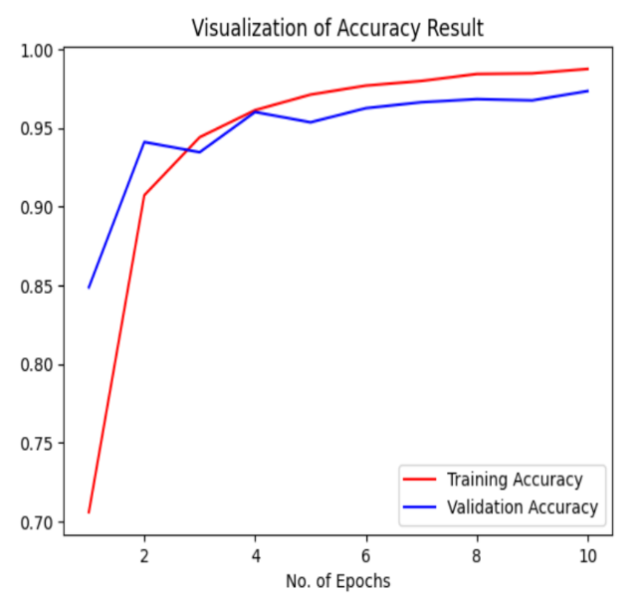
Results
The proposed CNN model was trained and tested using the New Plant Disease dataset.
The proposed model can able to recognize 14 crop species and 26 prevalent illnesses. When verified in a controlled setting, an overall accuracy of 97.34% is shown.

Slide 10
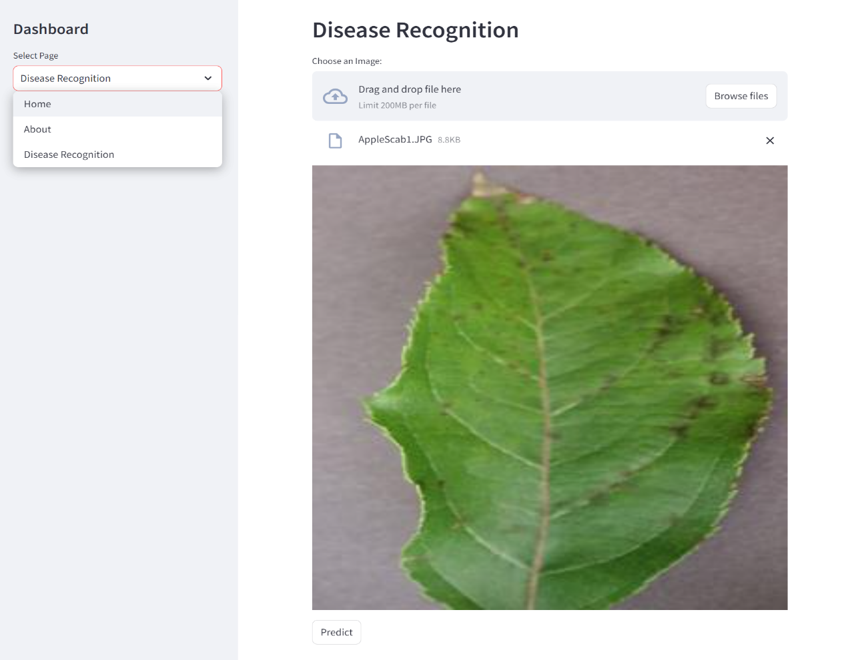
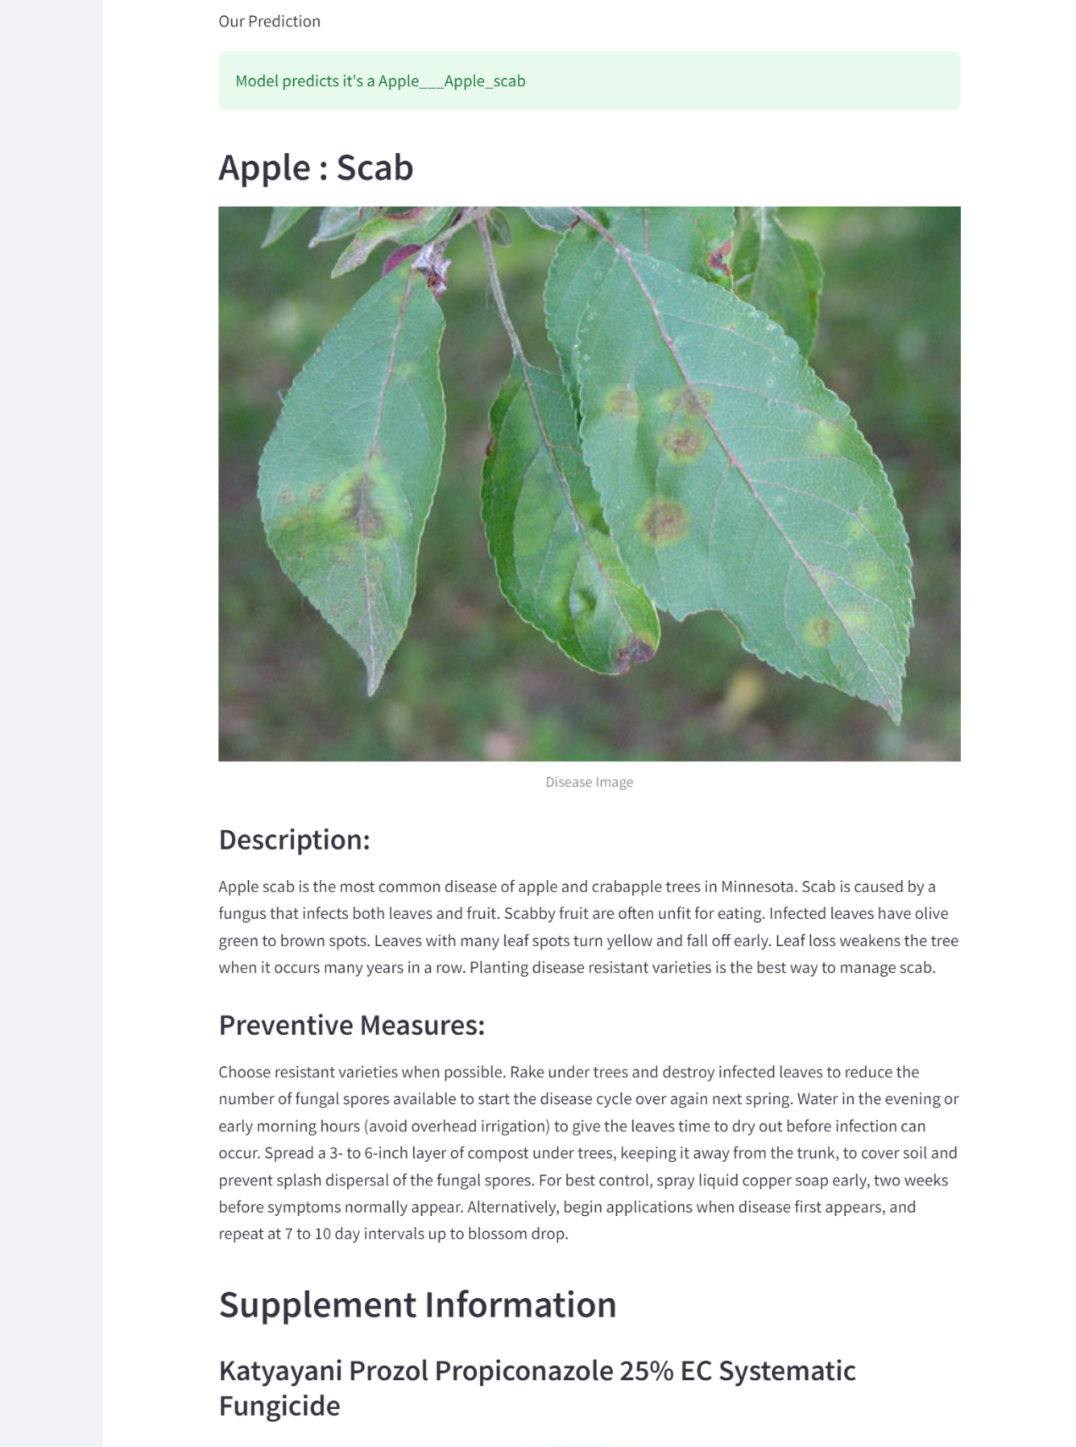

Slide 11
Conclusion
Crop diseases are the major risks which should be addressed to ensure food security.
Recognizing the disease accurately and efficiently is mainly the purpose of the proposed approach.
The experimental results indicate that the proposed approach is a valuable approach, which can significantly support an accurate detection of leaf diseases along with providing remedial measures.

Slide 12
THANK YOU

