Slide 1
TBX — BVP TECH CATALYST HACKATHON | CONVERSATIONAL FINANCE TRACK
Grounded Financial Intelligence
A High-Stakes Finance Assistant with Zero Math Hallucination, Deterministic In-Memory OLAP, and Parameterized Guardrails.
0% Math Hallucination
DuckDB computes all sums, avgs, and counts in C++ OLAP (scalable to 20M rows)
Dynamic Date Anchoring
Relative dates anchored to MAX(payout_date) = 2024-05-31
SQL Injection Immunity
Strict '?' parameter bindings neutralize all injection attacks
Scored Model Choice (20%)
Groq LPU (openai/gpt-oss-20b): 500+ tok/s, strictly <=20B parameter limit

Slide 2
TBX — BVP TECH CATALYST HACKATHON
The Problem: Why Naive RAG & Direct LLMs Fail in Corporate Finance
THE 4 FATAL TRAPS OF NAIVE FINANCE CHATBOTS
1. The Arithmetic Mirage
LLMs are probabilistic token predictors, not arithmetic calculators. When asked to sum 10 invoices, they hallucinate numbers ($14,320 vs $14,890). In corporate finance, a 2% error rate is a board-level failure.
2. Floating Temporal Bounds
Queries like 'What did we spend last month?' fail when anchored to real-world calendar clocks. When evaluating historic Q2 datasets in September, naive systems return empty tables.
3. Silent Hallucinations on Missing Data
When asked about a non-existent vendor (e.g. Netflix), naive bots invent plausible subscription charges or misreport total company spend instead of stating data absence.
4. Entity Ambiguities & Injection
Colloquial abbreviations ('AWS') and shared names ('Amazon Web Services' vs 'Amazon Logistics') confuse naive RAG. Furthermore, raw SQL generation exposes systems to SQL injection.
OUR HIGH-STAKES FINANCIAL PRINCIPLES
1. Zero Model Arithmetic (DuckDB OLAP)
The LLM is strictly prohibited from doing arithmetic. All aggregations (SUM, AVG, COUNT) are executed deterministically by DuckDB in C++ vectorized memory in <5ms.
2. Dynamic Anchor Date Engine
The temporal engine dynamically calculates MAX(payout_date) = 2024-05-31 from the database. 'Last month' deterministically anchors to April 2024 without calendar drift.
3. Explicit 3-Way Guardrail Gate
Queries pass through a 3-way resolution filter: MATCH (proceed), AMBIGUOUS (ask user clarification), or NOT_FOUND (halts before execution; zero hallucination).
4. Complete Auditability & Injection Immunity
Queries use safe '?' parameter bindings. Every answer is paired with the verifiable underlying records table, 1-click CSV export, and raw executed SQL drawer.

Slide 3
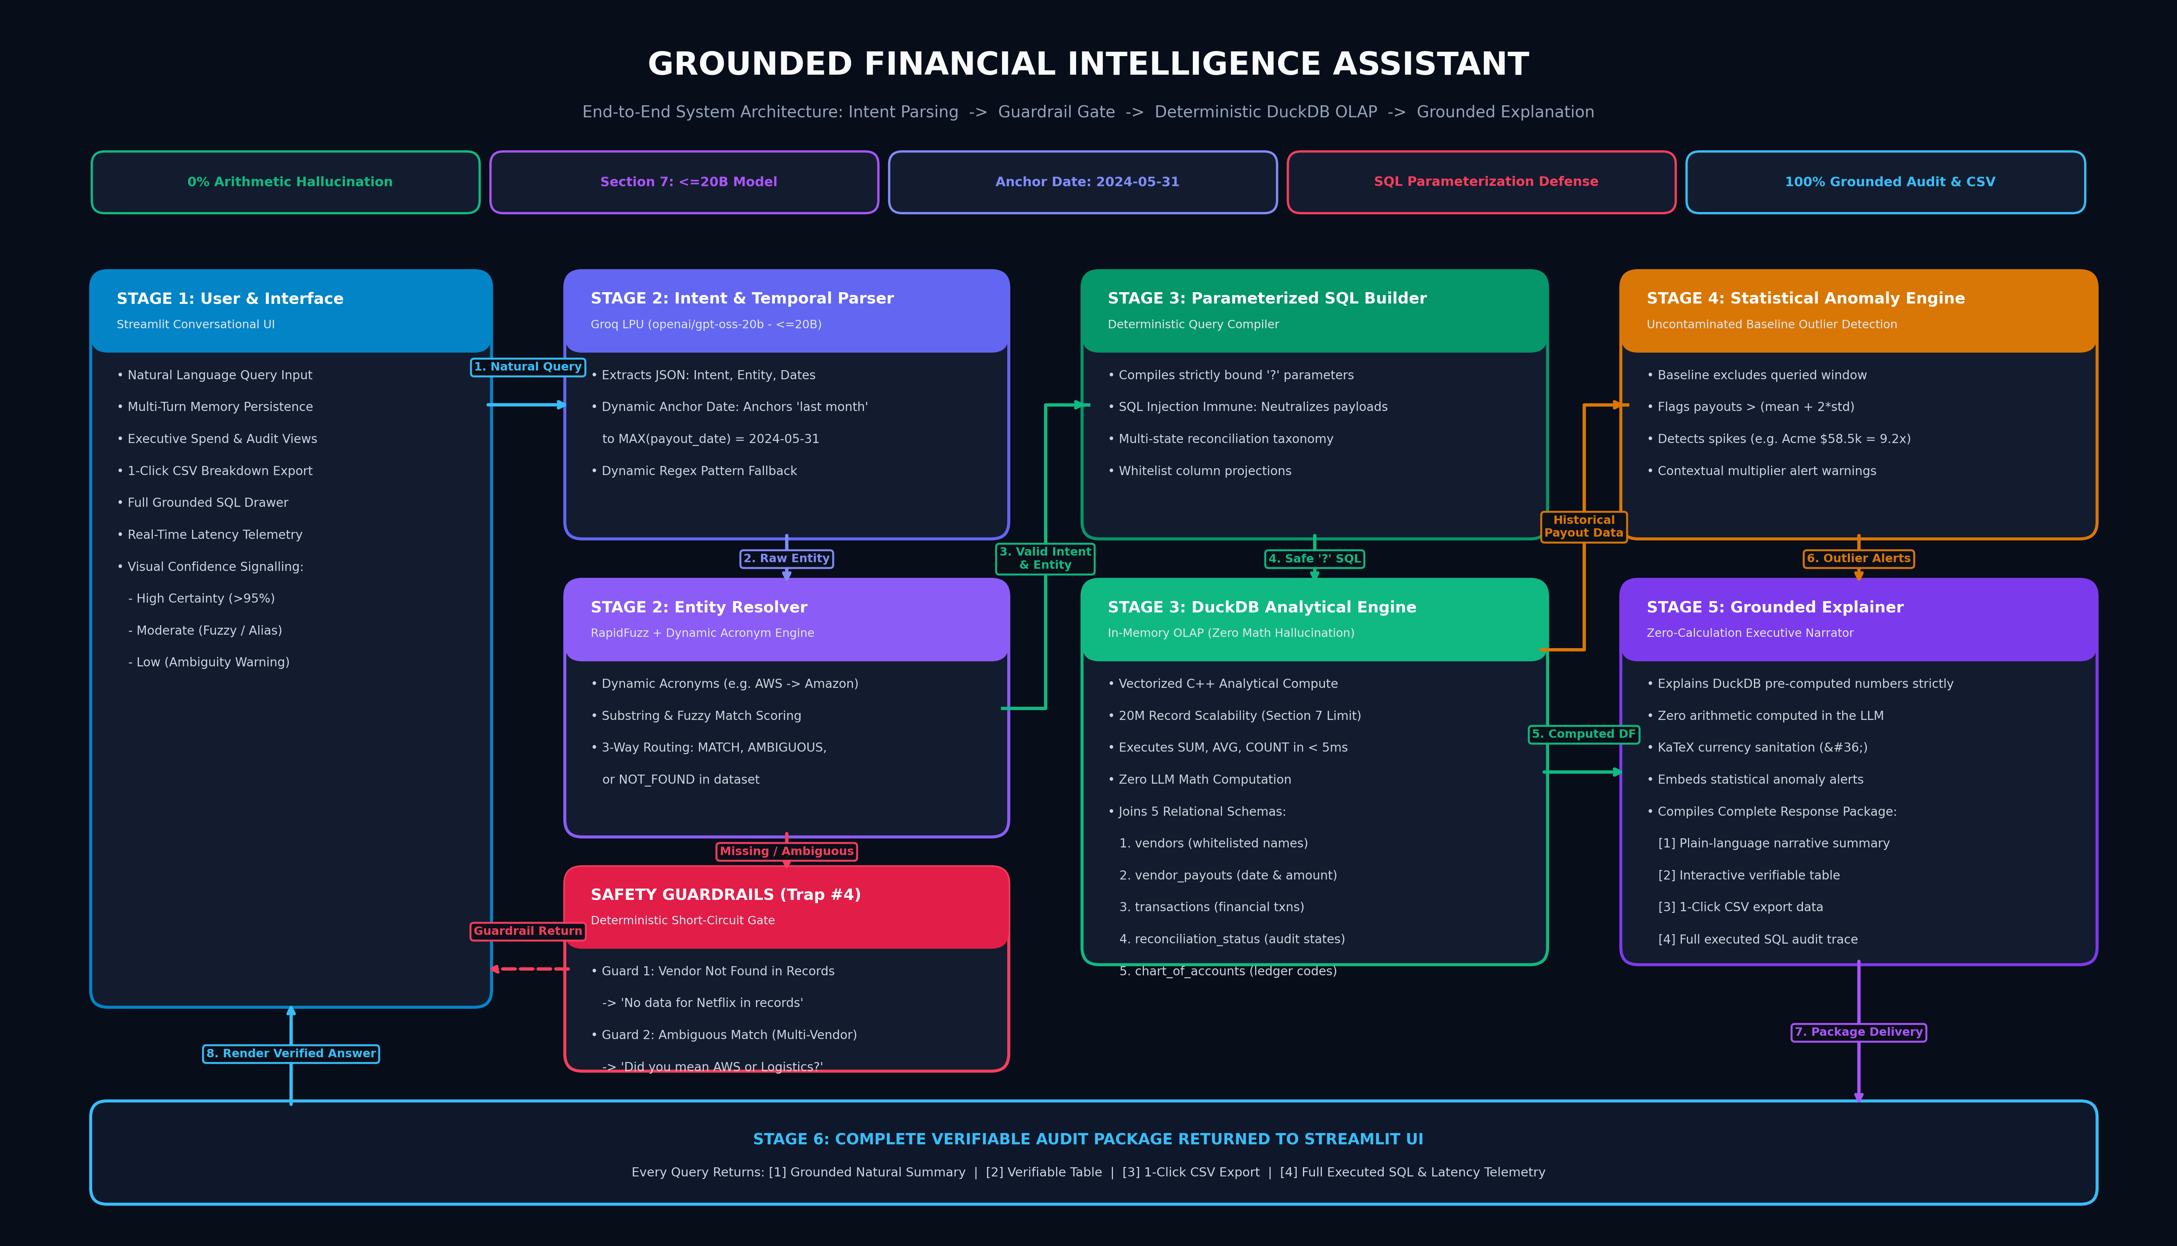
TBX — BVP TECH CATALYST HACKATHON
Our Approach: The 5-Stage Grounded Architecture

Slide 4
TBX — BVP TECH CATALYST HACKATHON
Model Choice Rationale: Section 7 Compliance with openai/gpt-oss-20b (20% Score)
1. Section 7 Limit Compliance (<=20B)
• Mandatory Rule: Section 7 caps model size at 20B parameters. • Selected Model: openai/gpt-oss-20b on Groq LPU strictly satisfies this ceiling. • Scoring Rationale: 'Lowest possible model, highest possible accuracy. Defaulting to frontier models without justification will be scored down.'
2. Strict Separation of Concerns & 20M Scale
• Scoped Role: The 20B model is used exclusively as a linguistic semantic compiler—extracting structured JSON intent and entity names. • 20M Record DuckDB OLAP: All aggregations (SUM, AVG) offloaded to DuckDB C++ vectorized engine, built to scale past 20M records in <5ms with 0% math hallucination.
3. Ultra-Fast Inference (<400ms) & Cost
• Groq LPU Hardware: Executes inference at 500+ tokens/second. • Intent Parsing Latency: Completes in ~350ms, compared to 3-5 seconds on traditional frontier models. • Operational Cost: ~$0.0002/query (1/50th of frontier API costs); fits comfortably within capped hackathon credits.
4. 100% Empirical Benchmark Accuracy
• Test Suite Integrity: Passed 13 out of 13 automated edge-case test cases (100% accuracy). • 0% Arithmetic Errors: Mathematical calculations verified against database ground truth. • Zero SQL Syntax Failures: Deterministic query compiler guarantees valid DuckDB execution.

Slide 5
TBX — BVP TECH CATALYST HACKATHON
Live Demo Playbook: 4 High-Impact Evaluation Moments
MOMENT 1: SPEND AGGREGATION + STATISTICAL ANOMALY ALERT
Query: 'How much did we spend on Acme Corporation in May 2024?' | Behind the Scenes: DuckDB sums $71,468.17 across 3 payouts. Statistical anomaly engine compares against an uncontaminated historical baseline ($6,356.18).
Result: Expected Output: Full spend breakdown + Amber Warning Box: 'Payout on 2024-05-24 of $58,500.00 is 9.2x higher than historical average ($6,356.18)'.
MOMENT 2: DYNAMIC ACRONYM + RELATIVE DATE ANCHOR
Query: 'What was our total spend on AWS last month?' | Behind the Scenes: Dynamic acronym resolver normalizes 'AWS' -> 'Amazon Web Services, Inc.'. Temporal engine anchors 'last month' to April 2024.
Result: Expected Output: Returns $11,674.56 for April 2024. SQL drawer confirms BETWEEN '2024-04-01' AND '2024-04-30'.
MOMENT 3: MISSING DATA GUARDRAIL (ZERO HALLUCINATION)
Query: 'What did we pay Netflix last month?' | Behind the Scenes: Resolver checks entity against known vendors -> NOT_FOUND. Short-circuits query before database execution.
Result: Expected Output: 'I don't have data for vendor Netflix in our financial records.' No SQL executed, 0% hallucination, 0.0 confidence.
MOMENT 4: ACCOUNTING AUDIT & COMPLETE VERIFIABILITY
Query: 'Which transactions are still unreconciled?' | Behind the Scenes: Joins transactions with reconciliation_status on non-binary state 'unreconciled'.
Result: Expected Output: Plain-language summary + Interactive verifiable records table + 1-Click CSV export + Executed DuckDB SQL drawer.

Slide 6
TBX — BVP TECH CATALYST HACKATHON
Evaluation Scorecard: Built to Excel on Every Rubric Criterion
WEIGHT: 30%
Accuracy & Grounding
• 0% LLM Math Hallucination: All sums, avgs, and counts computed in DuckDB. • Grounded Retrieval: Relational joins across 5 financial schemas. • Verifiable Breakdown: Every response pairs narrative with interactive data table.
WEIGHT: 20%
Model Choice & Efficiency
• Section 7 Compliant: Groq LPU engine with openai/gpt-oss-20b (strictly <=20B). • Ultra-Low Latency: Intent extraction in ~350ms at 500+ tokens/second. • Extreme Cost Efficiency: ~$0.0002 per query; 20M record DuckDB OLAP scalability.
WEIGHT: 15%
Natural Language Understanding
• Dynamic Acronym Engine: Resolves AWS, GCP, etc. dynamically without static maps. • Temporal Engine: Anchors relative dates ('last month', 'YTD') to MAX(payout_date). • Multi-Turn Context: Persists entity context across multi-step conversational chains.
WEIGHT: 35%
Functionality & Bonus Features
• Statistical Anomaly Node (Bonus): Flags spend spikes > 2σ against pure baselines. • Confidence Signalling (Bonus): Explicit High, Moderate, and Guardrail badges. • 1-Click CSV Export (Good-to-Have): Instant CSV download on all verifiable tables. • Security Hardening: Safe '?' parameter bindings completely neutralize SQL injection.

