Slide 1

OWASP Top 10 in Python-Based Development Framework
VENHAR ADEMI 201501

Slide 2

CONTENTS
01
02
Introduction
Required Hardware/Software
03
04
Detailed Instructions
Summary and Conclusion

Slide 3
1. Introduction
Web applications are critical in modern digital infrastructure.
They are prime targets for cyber threats.
This project analyzes OWASP Top 10 vulnerabilities in a Django-based application.
It demonstrates their impact strategies.

Slide 4


OWASP Top 10 Vulnerabilities Overview
1
SQL Injection (SQLi)
2
Cross-Site Scripting (XSS)
3
Broken Authentication
4
Insecure Deserialization
5
Security Misconfiguration
6
Cross-Site Request Forgery (CSRF)
7
Server-Side Request Forgery (SSRF)
8
Insufficient Logging & Monitoring
9
XML External Entity (XXE) Injection
10
Broken Access Control

Slide 5

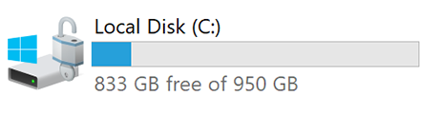
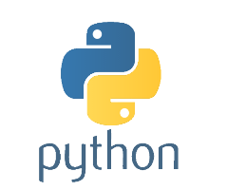
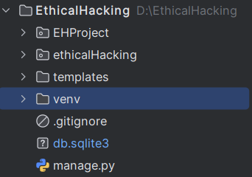


2. Required Hardware/Software
Hardware:
Minimum 8 GB RAM
50 GB disk space
Software:
Virtual Environment

Slide 6
3. Detailed Instructions
3.1 Environment Setup
Step 1:
Clone the GitHub repository
Step 2:
Step 4:
Create and activate a virtual environment
Apply migrations and run the server
Step 3:
Step 5:
Installing dependencies
Access the application at http://127.0.0.1:8000/

Slide 7
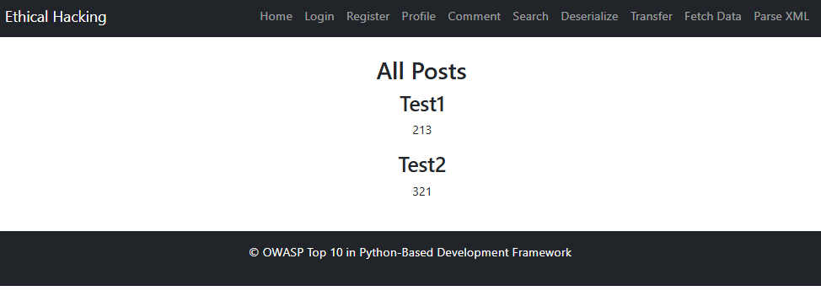
3.2 Implementing the Vulnerabilities

Slide 8
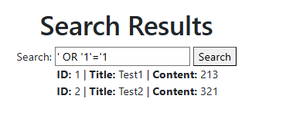
SQL Injection (SQLi)
SQL injection occurs when user input is directly inserted into an SQL query, allowing attackers to manipulate the query and access sensitive data.

Slide 9
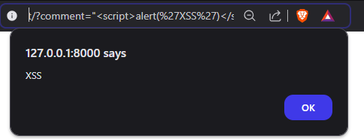
Cross-Site Scripting (XSS)
Cross-Site Scripting (XSS) occurs when an attacker injects malicious scripts into a webpage, which are then executed by other users' browsers.

Slide 10
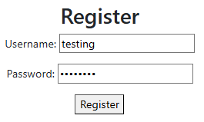
Broken Authentication
Broken authentication occurs when sensitive data, such as passwords, is not securely stored or handled, making it easy for attackers to access user credentials.

Slide 11
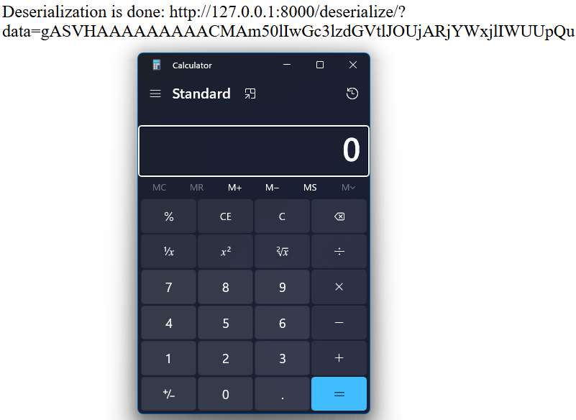
Insecure Deserialization
Insecure deserialization occurs when untrusted data is deserialized, potentially allowing attackers to execute arbitrary code on the server.

Slide 12
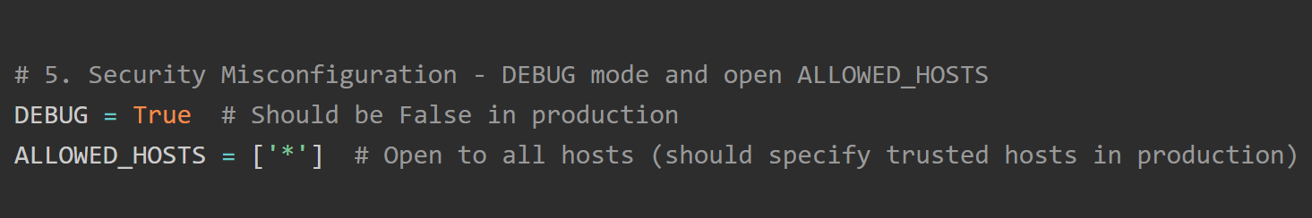
Security Misconfiguration
Security misconfiguration occurs when security settings are not properly applied, leaving the application vulnerable to attacks.

Slide 13
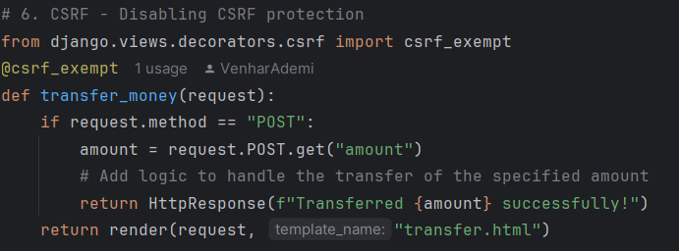

Cross-Site Request Forgery (CSRF)
CSRF allows attackers to make unauthorized requests on behalf of authenticated users without their consent.

Slide 14
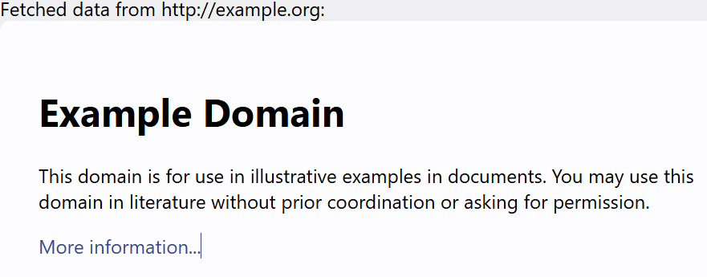
Server-Side Request Forgery (SSRF)
SSRF occurs when an attacker can make requests from the server to internal resources, potentially exposing sensitive information.

Slide 15
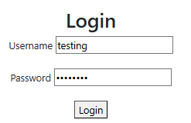

Insufficient Logging & Monitoring
Insufficient logging and monitoring make it difficult to detect and respond to attacks, allowing attackers to operate undetected.

Slide 16
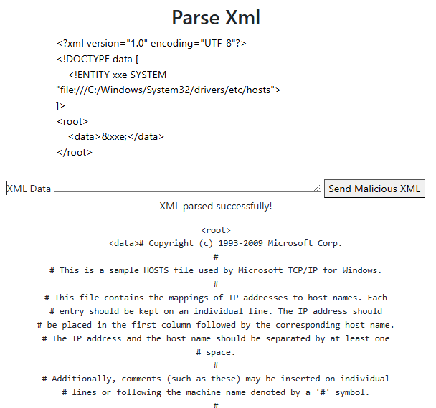
XML External Entity (XXE) Injection
XXE occurs when untrusted XML input is processed with external entity references, allowing attackers to read local files or execute remote requests.

Slide 17
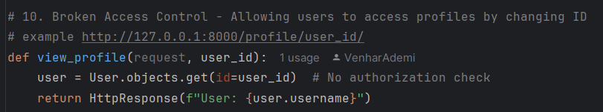
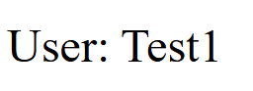
Broken Access Control
Broken access control occurs when unauthorized users can access restricted resources. In this case, users can view other users’ profiles by manipulating the URL.

Slide 18



4. Final Steps and Conclusion
Steps for Deleting the Defined Environment
Step 1:
Deactivate the Virtual Environment
Step 2:
Delete the Virtual Environment
Step 3:
Delete the Cloned Repository

Slide 19
Conclusion
Understanding and implementing OWASP Top 10 vulnerabilities
Hands-on approach to identifying and mitigating risks
Secure coding practices in Django
GitHub Repository: https://github.com/VenharAdemi/EthicalHacking

Slide 20
Thank you for your attention!
Questions or feedback?

