Slide 1
Final capstone project – Coursera – IBM – Data science - Report
Krishnaveni Singaram
THE BATTLE OF NEIGHBOURHOODS – ASIAN RESTAURANTS IN TORONTO CANADA

Slide 2
Introduction
The project is intended to submit to Coursera-IBM as a Final Capstone project.
The problem take to analyse is to explore the neighbourhoods of Toronto Canada, cluster the neighbourhoods and short list the good Asian restaurants for the Indians or any traveller who visits Canada Toronto for a short time

Slide 3
Problem Statement
Many Indian people go to Canada on business trips who usually search for Good Asian restaurants where they get good Asian food.
Now-a-days Indian people prefer also the other Asian countries food than Indian food. Some of the Chinese, Japanese, Thai food items became regular in-takes whenever they visit hotels both within India or other countries
And people check the ratings of the hotels before they choose to visit
The project is to help the people who go on business trips to Canada - Toronto to find better staying place which has good Asian restaurants

Slide 4
Target Audience
The Indian business people or anyone who is visiting Canada - Toronto for a short term stay
The audience is not restricted to Indian people but all the visitors of Toronto who are interested in Asian food items
The visitors who usually refer the ratings of the restaurants before they choose to visit them

Slide 5
Data Source
Toronto Postal codes
Wikipedia lists the postal codes of Toronto in the follwing link https://en.wikipedia.org/wiki/List_of_postal_codes_of_Canada:_M
The data source will be scraped to obtain the postal codes
Geographical coordinates
To get the geographical coordinates of the neighbourhoods using the Geocoder package, the following link is used to pull a csv file that has the geographical coordinates of each postal code: http://cocl.us/Geospatial_data

Slide 6
Methodology
Setup the environment with all the required libraries
Pull the data for Canada Toronto neighborhoods from Wikipedia and data scrape to postal codes
Clean up the data to pull only the neighborhoods with assigned Boroughs
Filter only the downtowns as most business visitors will be traveling to downtowns
Cluster the downtowns using k-Means by available Asian Restaurants
Explore the Asian Restaurants available in downtowns using Foursquare API
Find the cluster where maximum number of asian restaurants available
Find the ratings of the restaurants using Foursquare API
Sort and conclude the highly rated restaurant

Slide 7
K-Means - Algorithm
Why
The K-means clustering algorithm is used to find groups which have not been explicitly labelled in the data. This can be used to confirm business assumptions about what types of groups exist or to identify unknown groups in complex data sets.
As we are using data source which has to clustered using unlabelled data, k-means is a better algorithm as fit-to-purpose

Slide 8
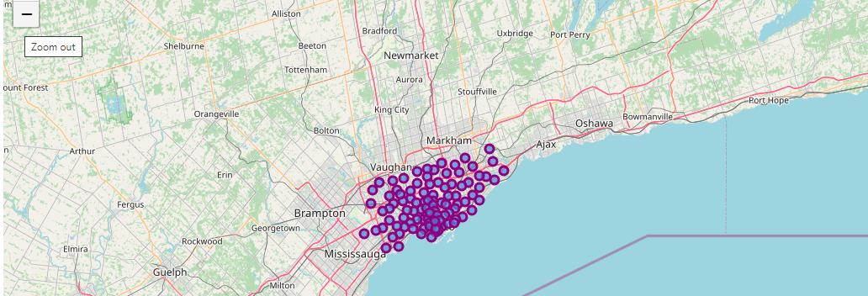
K-Means –How is it used
The Neighborhoods of Toronta which have Boroughs assigned

Slide 9
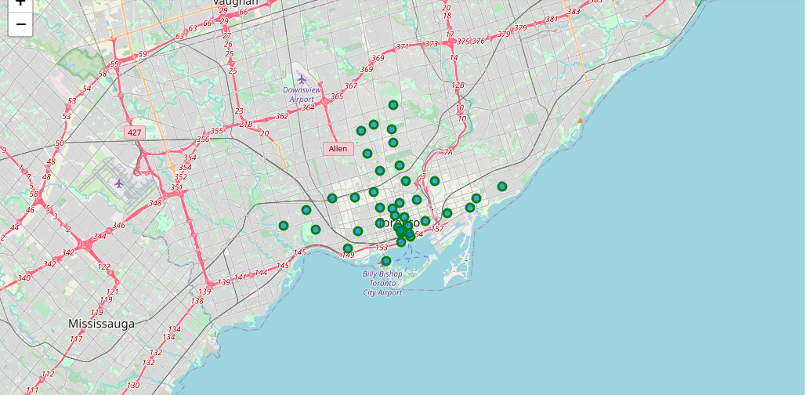
K-Means – How is it used (2)
The clustered downtowns which has Asian Restaurants

Slide 10
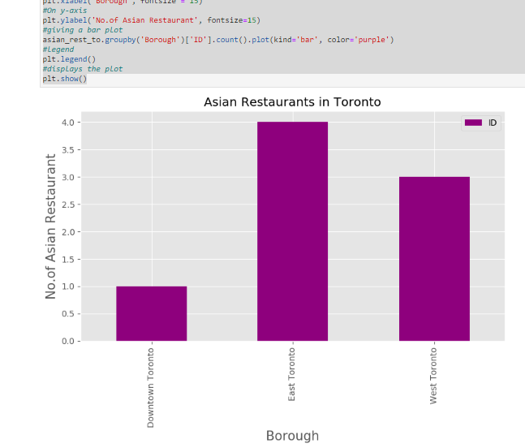
Neighborhood with more Asian Restaurants
Eexplored Asian Restaurants in Downtowns using Four Square places API
East Toronto seems have more number of Asian Restaurants

Slide 11
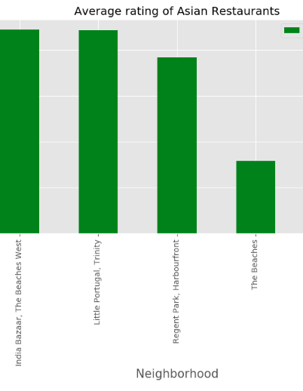
Best Rated Asian Restaurant in East Toronto
Eexplored Asian Restaurant details in East Downtown using Four Square places API
Sorted and picked the top rated Asian Restaurant

Slide 12
Conclusion
k-Means algorithm has been used to cluster and explore the neighbourhoods. Three clusters are created and the cluster with higher dense of Asian Restaurants was explored to find the best rated Asian Restaurant. The chosen downtown was East Downtown.
As per the statistics explained above and as per the graph show here, India Bazaar, The Beaches West is the best rated in East Toronto and the East Toronto has the maximum number of Asian Restaurants.

