Slide 1

The Revenue Question
Where Supernova loses 1 in 3 quotes before anyone sees a price
Veniamin Davydenko · Supernova BIA Externship · June 2026

Slide 2
Why do 1 in 3 applicants quit before they see a price?
9,817
Insurance quote attempts in the dataset
67%
Reach a final price (6,578 quotes complete)
3,239
Abandon the quote before pricing — 33% of all traffic

Slide 3
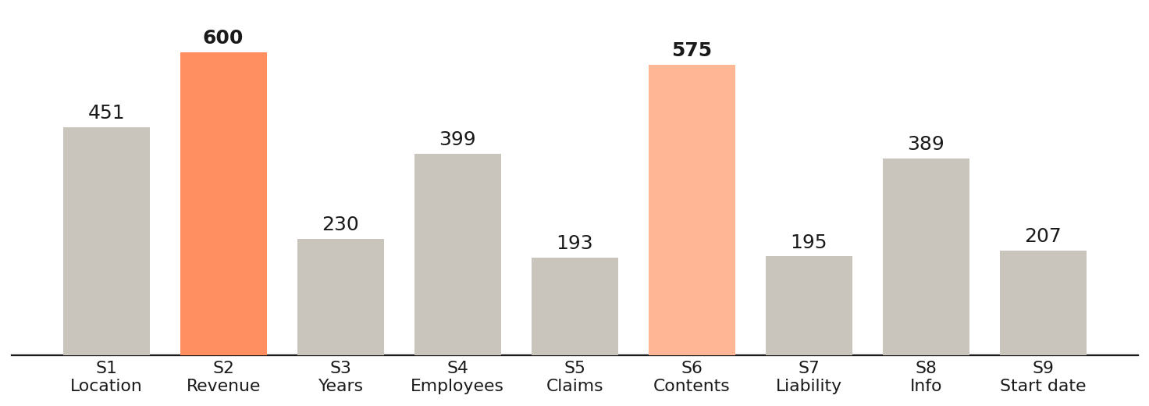
One question does the most damage
Annual Revenue (Stage 2) is the single biggest leak in the funnel.

Slide 4
The revenue question carries too much
The biggest leak
600 applicants quit at the Annual Revenue question (Stage 2) — the single biggest drop-off, and the first sensitive money question we ask.
It is also the eligibility gate
Supernova declines firms over $2M revenue — but only at the very end. About 35% of everyone who completes the form is then rejected for being too big.
Two jobs, one question
Reducing friction means asking revenue later; filtering ineligible firms means asking first. One late question cannot do both — so split it.

Slide 5
Even finishing isn’t safety
The cause
About 1,000 completed quotes generate $0 premium — an estimated $10.4M in pipeline that finishes the form but is never priced.
Most have no verified address or map link — an address-lookup failure. The form completes, but pricing never runs. It is not an underwriting decline.

Slide 6
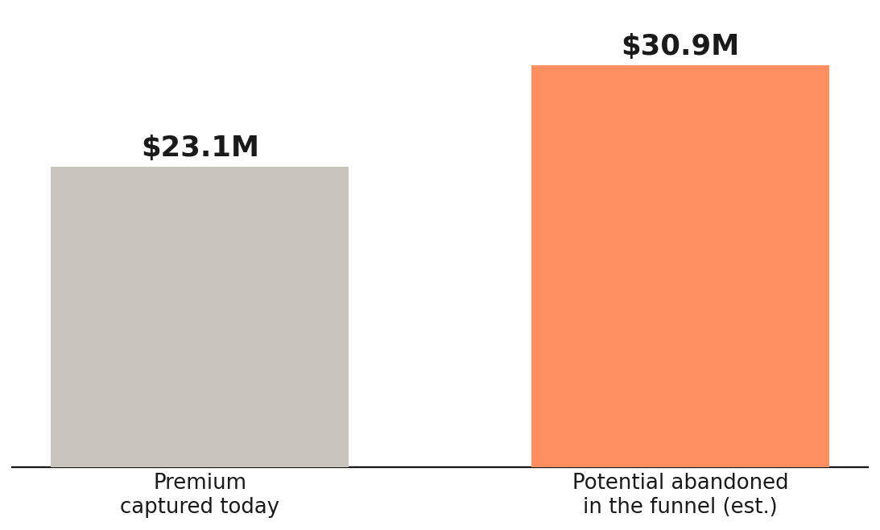
What the leak is worth
~$30.9M is abandoned in the funnel.
That is more potential premium than the $23.1M the book captures today — which makes the funnel the single biggest lever in the data.

Slide 7



Three moves to recover the leak
Split the revenue question
Add a quick eligibility gate up front; keep the detailed revenue where rating needs it.
Fix the address lookup
Require a verified address (Place ID) at Stage 1 so pricing always runs.
Re-test and measure
A/B the new flow; track completion and priced-quote rates before rollout.

Slide 8

Thank you
Veniamin Davydenko · Supernova BIA Externship

