Slide 1
Statistical and practical issues for replicating GWAS signals in meta-analysis
Dajiang Liu
Reproducibility Boot Camp
06/07/2019

Slide 2
Outline
Forewords
Overview of GWAS Meta-analysis and follow-up studies
Motivation of assessing reproducibility of GWAS signals
MAMBA method
Joint work with Dan McGuire and Qunhua Li
Conclusions

Slide 3
Forewords
Why reproducibility?
People all make mistakes
People are inclined to rush to conclusions and publish
Reproducibility does not make research error-free
But allows us to “reproduce errors” and seek their root causes
Reproducibility can be achieved by
The right attitude
Careful documentation
Statistical methods

Slide 4
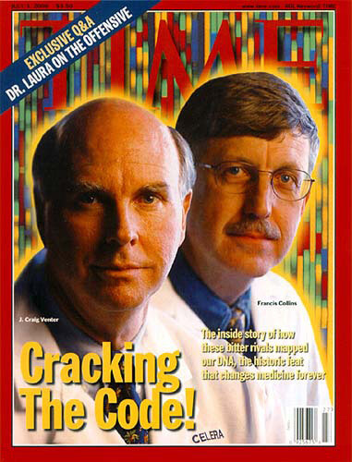
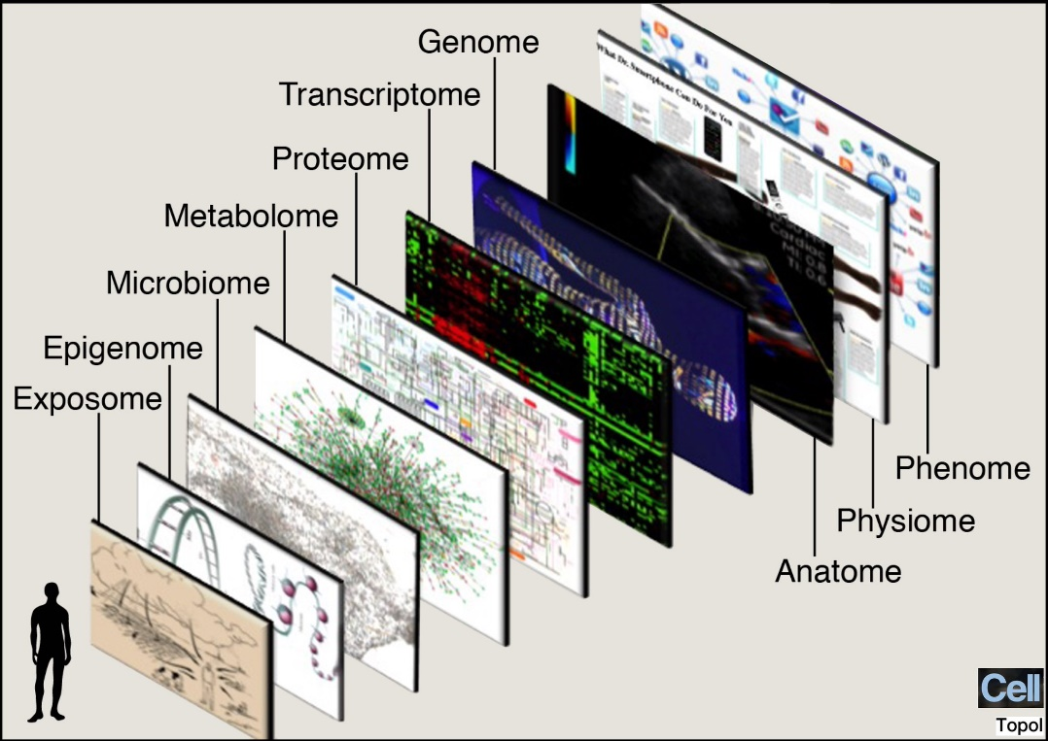
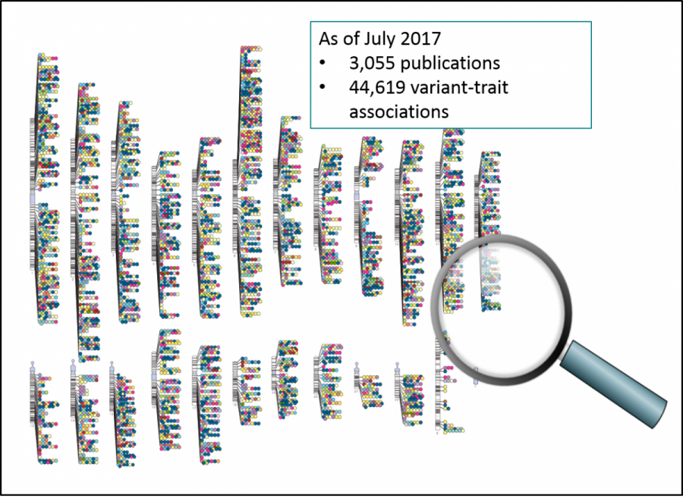
A Quick Look Back
Booming of GWAS:
Lots of discoveries made; many hypotheses generated;
Even more unknowns to be explored
Mechanistic studies:
Dissect GWAS loci;
Learn new biology;
Personalized medicine;
Initial Optimism:
Human genome project, a historic feat that changes medicine forever

Slide 5
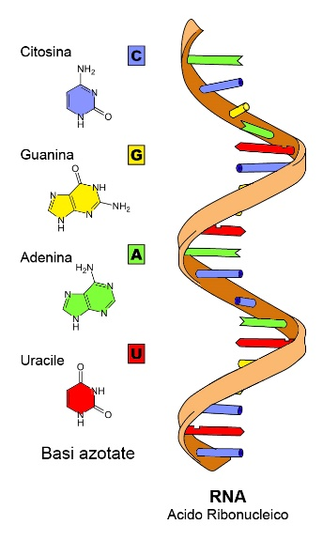
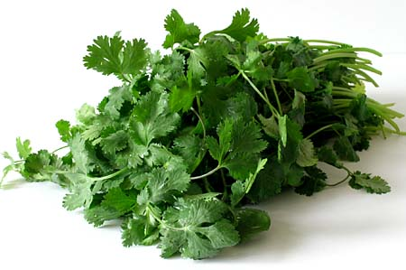
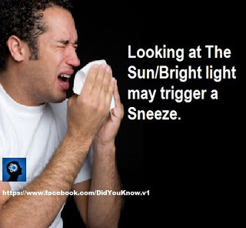


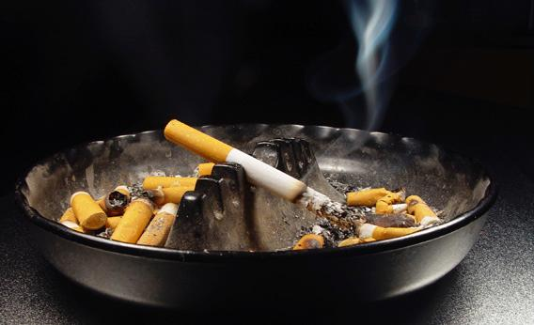
Big Picture Questions
Mechanism
Molecular Phenotypes
Complex
Phenotypes
DNA
Clinical Translation

Slide 6
Smoking and Drinking – Biggest Modifiable Risk Factor for Death

Slide 7
Despite Being Heritable, Little was Found for Cigarette-Per-Day with N=75,000 (in 2010)
CHRNA3-CHRNA5-CHRNB4

Slide 8
GSCAN Study Design
GWAS and Sequencing Consortia of Alcohol and Nicotine Use (GSCAN)
Scott Vrieze, Univ. Minnesota
Each study contribute summary association statistics
Genetic effect estimates and their standard deviations
Imputation to Haplotype Reference Consortium panel
15.9 million variant post filtering

Slide 9
GSCAN Study
Phenotypes | Abbreviations | Sample Size | Type
Age of Initiation of Smoking | AgeInit | 341,427 | Continuous
Smoking Initiation (Ever Smoker vs. Never Smoker) | SmkInit | 1,232,091 | Binary
Cigarettes Per Day | CigPerDay | 337,334 | Continuous
Smoking Cessation (Current vs. Former Smoker) | SmkCes | 547,219 | Binary
Drinks Per Week | DrnkWk | 941,280 | Continuous

Slide 10
Workflow for RAREMETAL
Generating Summary Level Statistics for Cohort 1
Generating Summary Level Statistics for Cohort K
Zhan X, Hu Y, Li B, Abecasis G, Liu DJ RVTESTS: an efficient and comprehensive tool for rare variant association analysis using sequence data, Bioinformatics 2016
Central Quality Control (e.g. Check for strand flips)
Liu DJ et al Meta-analysis of Gene-level Tests of Rare Variant Association, Nature Genetics 2014
Perform centrally
Meta-analysis of Single Variant Test Statistics (imputation Quality Aware Meta-analysis)
Jiang Y et al, Proper conditional analysis in the presence of missing data: Application to large scale meta-analysis of tobacco use phenotypes, PLOS Genetics, 2018
Secondary Analysis (E.g. conditional analysis)

Slide 11
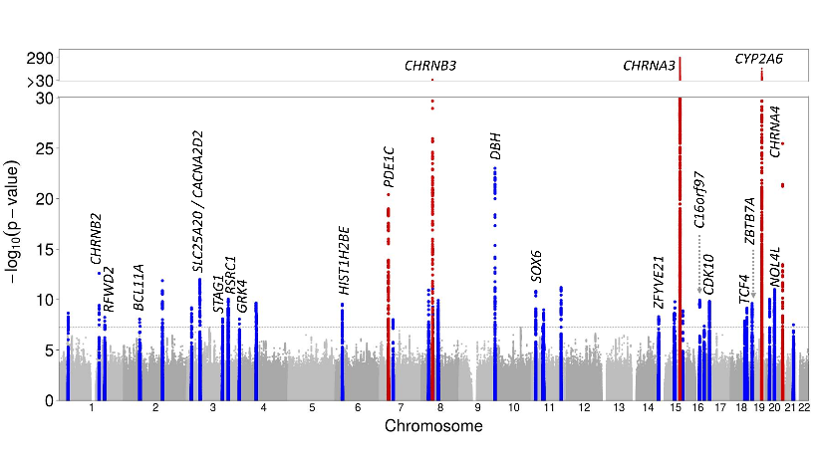
Results for CigDay N=1,000,000

Slide 12
Results for CigDay N=1,000,000

Slide 13
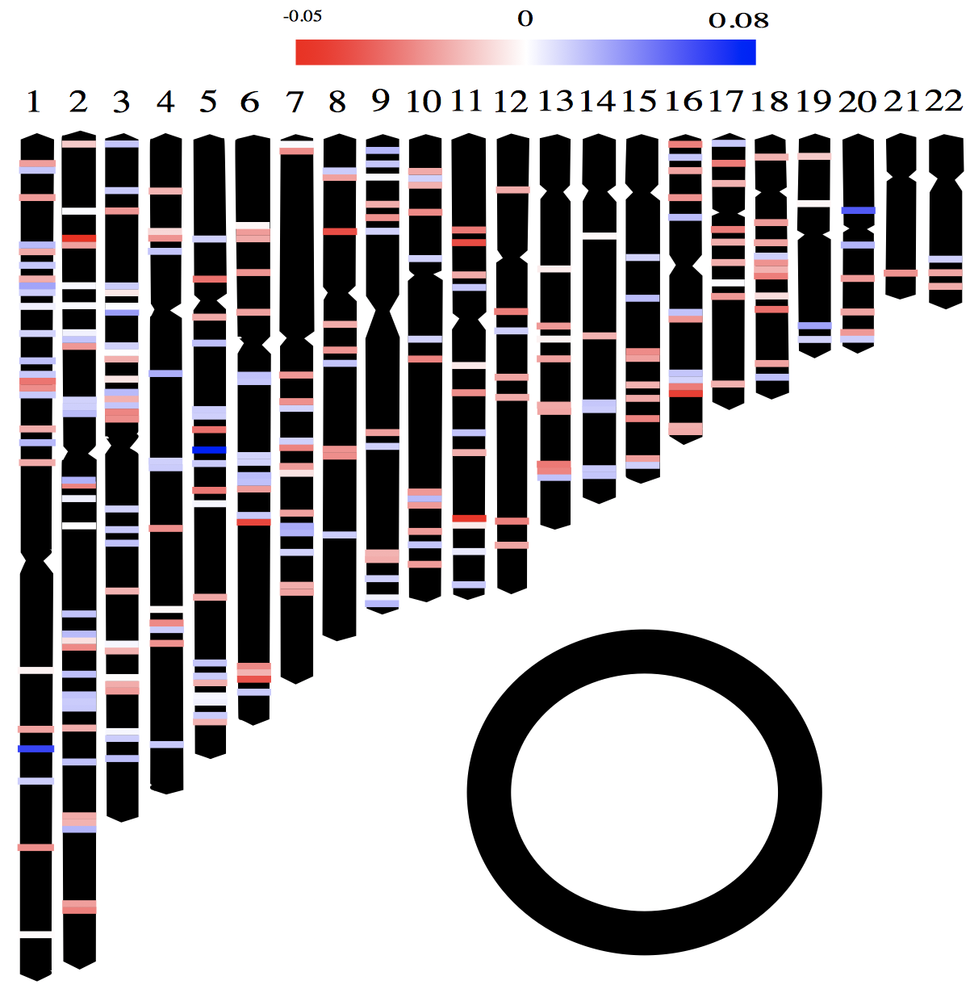
GSCAN GWAS results (All Traits)
GSCAN GWAS phase 1, completed!
406 loci uncovered
Next challenge: Interpret the functional consequence of these loci

Slide 14
How Many Loci Are “Real”?
Population based studies can be subject to artefacts
Population structure;
cryptic relatedness;
Genotyping error
Etc
Conventional approach to ensure the validity of the discovery is replication
But
Having a well-powered replication study is almost impossible in modern-day genetic studies
Ad-hoc procedures can be applied, but hard to be broadly applied and generalize

Slide 15
The Field Recognized This Problem, But No Solution

Slide 16
False Positive Signals Often “Disguise” Themselves

Slide 17
A Behavioral Experiment

Slide 18
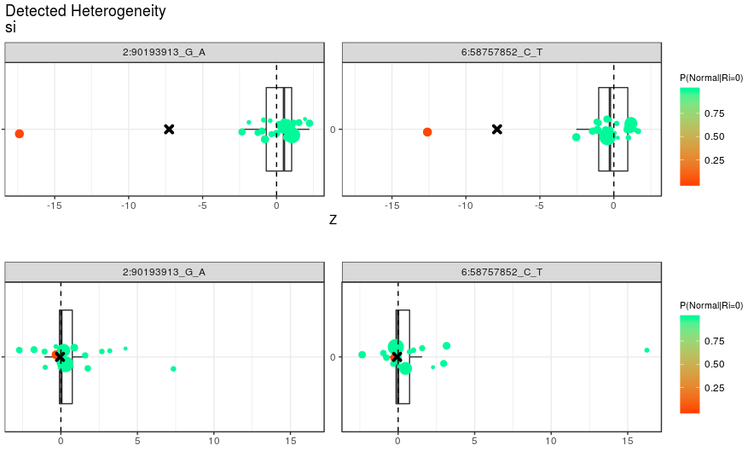
How to Assess Replicability
Size of the point: Sample Size
A motivating example
Z-score
Beta

Slide 19
Method for Assessing Replicability
MAMBA: meta-analysis model-based assessment of replicability
Observation:
Real signals are more likely to be significantly associated in multiple studies
Real signals are likely to be consistent across different studies
Key idea:
Use mixture model to represent replicable and non-replicable SNPs
Based upon empirical data, non-replicable SNP is modeled as SNPs with disproportionally large variability in the effect sizes
Develop a coherent framework for robust meta-analysis and assessing replicability at the same time
Posterior probability of replicability can be estimated using ECM algorithms
Frequentist p-values can be calculated using parametric bootstrap based upon the posterior probability of replicability

Slide 20
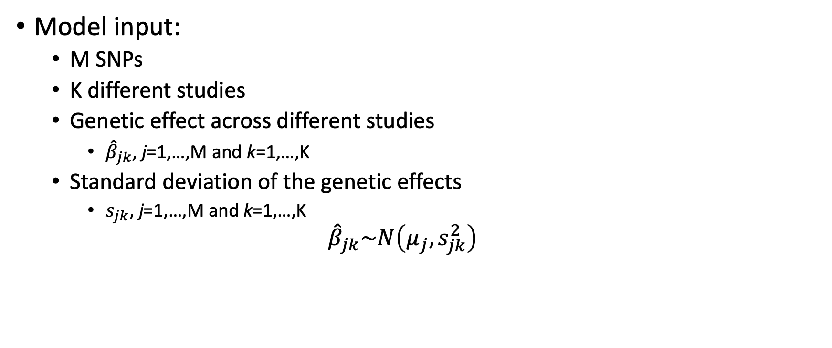
Model Details
Model input:
M SNPs
K different studies
Genetic effect across different studies
${\hat{β}}_{jk}$, j=1,…,M and k=1,…,K
Standard deviation of the genetic effects
$s_{jk}$, j=1,…,M and k=1,…,K
$${\hat{β}}_{jk}\sim N\left(μ_{j},s_{jk}^{2}\right)$$

Slide 21
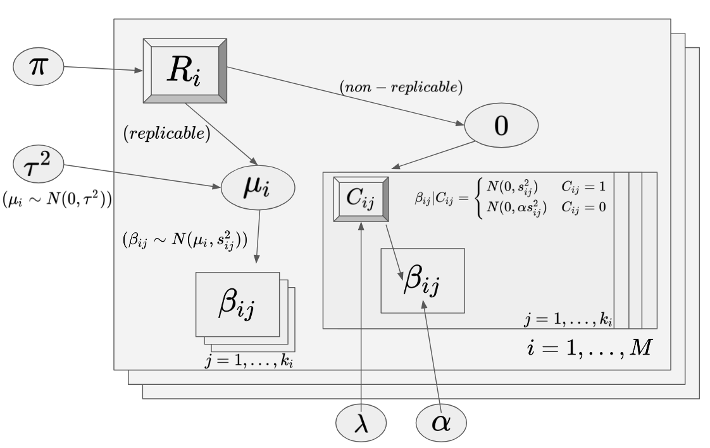
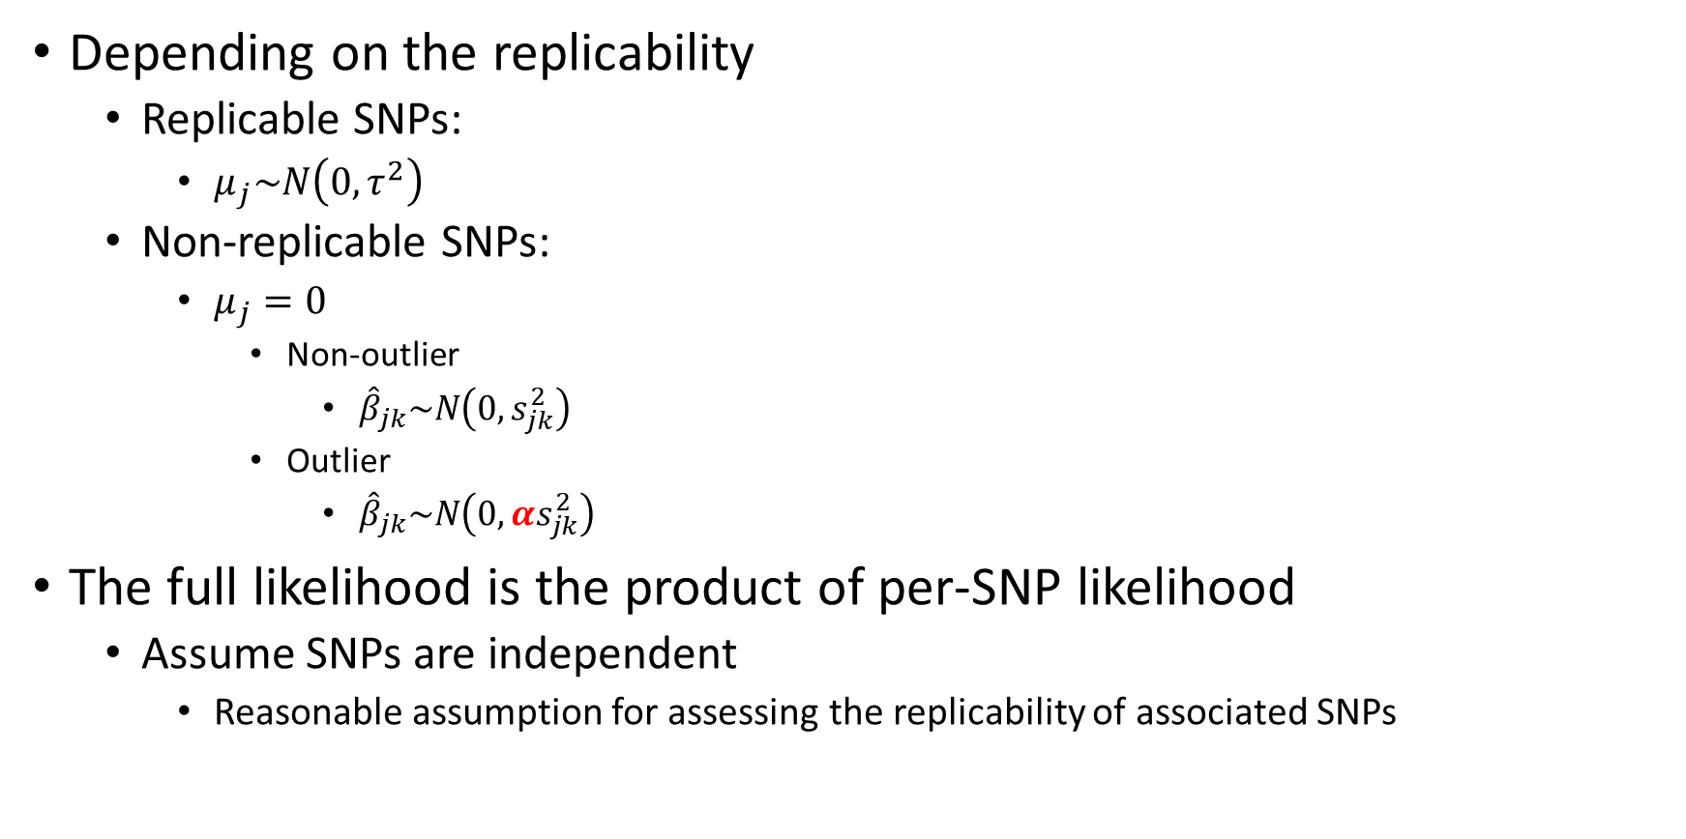
Model Details
Depending on the replicability
Replicable SNPs:
$μ_{j}\sim N\left(0,τ^{2}\right)$
Non-replicable SNPs:
$μ_{j}=0$
Non-outlier
${\hat{β}}_{jk}\sim N\left(0,s_{jk}^{2}\right)$
Outlier
${\hat{β}}_{jk}\sim N\left(0,{αs}_{jk}^{2}\right)$
The full likelihood is the product of per-SNP likelihood
Assume SNPs are independent
Reasonable assumption for assessing the replicability of associated SNPs

Slide 22
Workflow of MAMBA
Step 0: Do fixed-effects GWAMA first, to identify loci of interest we want to test with the MAMBA model.
Step 1: Prune summary statistics and obtain approximately independent set of variants based upon a reference panel
Step 2: Create dataset for MAMBA model by combining pruned variants
Step 3: Fit MAMBA models (by chromosome)

Slide 23
Comparison with Alternative Methods
Alternative methods considered
FE:
Fixed effect meta-analysis
RE:
Random effect meta-analysis (with maximum likelihood estimation)
RE2:
Random effect meta-analysis assuming no heterogeneity under the null
BE
Binary effect model assuming the effect is a mixture of 0 and a non-zero fixed effect

Slide 24
Real Data Evaluation
Discovery cohort
GSCAN – 23andMe data
Replication:
23andMe
Phenotype | Discovery N (# Contributing Studies) | Replication N
Cigarettes Per Day | 263,954 (34) | 73,380
Drinks Per Week | 537,349 (33) | 403,931
Smoking Initiation | 651,337 (35) | 599,289

Slide 25
Rank Correlation of Effect Sizes Between Discovery and Replication Data
CigDay
DrnkWk
SmkInit
MAMBA
FE
TE
BE
MAMBA
FE
TE
BE
MAMBA
FE
TE
BE

Slide 26
P-Value Comparison in GSCAN Data (MAMBA)
Red color represent non-replicable SNP
MAMBA gives conservative p-values than fixed effect for red colored SNPs
Green color represent replicable SNP
MAMBA gives comparable p-values to fixed effects

Slide 27
P-Value Comparison in GSCAN Data (BE)
BE assigned very significant p-values for a lot of non-replicable SNPs (red)

Slide 28
P-Value Comparison in GSCAN Data (RE2)
RE2 assigned very significant p-values for a lot of non-replicable SNPs (red)

Slide 29
P-Value Comparison in GSCAN Data (RE)
RE assigned conservative p-values for a lot of replicable SNPs (green)

Slide 30
Examples of Non-replicable Associations Before Filtering
Trait | Variant | PVALUE in 23andMe Replication | MAF | PVALUE (MAMBA) | PVALUE (FE) | PVALUE (RE2) | PVALUE (BE) | PVALUE (RE)
SmkInit | 6:58757852 | 0.31 | 9.9×10⁻⁴ | 1.0 | 3.0×10⁻¹⁵ | 2.3×10⁻³² | 5.1×10⁻²⁷ | 0.10
SmkInit | 2:90193913 | 0.25 | 4.7×10⁻⁴ | 1.0 | 3.7×10⁻¹³ | 1.5×10⁻⁶² | 3.3×10⁻⁵⁶ | 0.43
CigDay | 13:89700202 | 0.46 | 2.0×10⁻⁵ | 0.15 | 4.6×10⁻⁷ | 9.0×10⁻⁷ | 7.3×10⁻⁶ | 9.0×10⁻⁷
CigDay | 6:150560926 | 0.39 | 7.1×10⁻⁶ | 0.078 | 7.1×10⁻⁶ | 4.3×10⁻⁶ | 7.6×10⁻⁷ | 0.030
DrnkWk | 5:113421490 | 0.75 | 1.2×10⁻⁵ | 0.051 | 3.3×10⁻⁶ | 6.9×10⁻⁶ | 8.1×10⁻⁶ | 3.8×10⁻⁴
DrnkWk | 11:73222943 | 0.29 | 1.1×10⁻⁵ | 0.11 | 5.1×10⁻⁶ | 9.3×10⁻⁶ | 3.6×10⁻⁶ | 0.012

Slide 31
Posterior Probability of Replicability for GSCAN Result

Slide 32
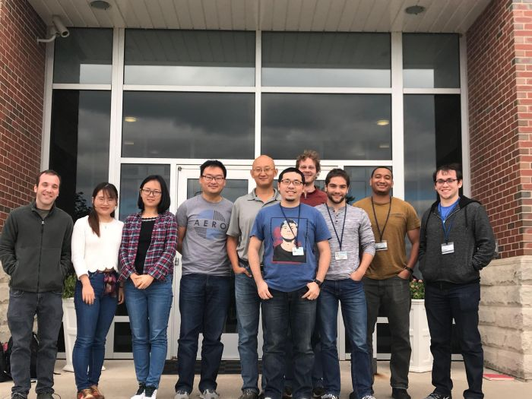
Acknowledgement
Lab members
Dr. Qunhua Li
GSCAN Consortium Collaborator
Lab members
Yu Jiang
Fang Chen
Dan McGuire
Jordan Hughey
Dylan Weissenkampen
Lina Yang
Scott Eckert
Renan Sauteraud
Xingyan Wang
Joe Cirilo
Funding support
NIH/NIDA R21DA040177 (Liu)
NIH/NHGRI R01HG008983 (Liu)
NIH/NIGMS R01GM126479 (Liu)
NIH/NIDA R01DA037904

