Slide 1
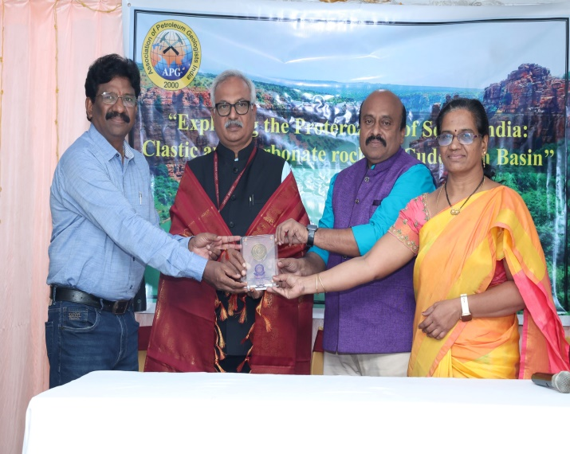
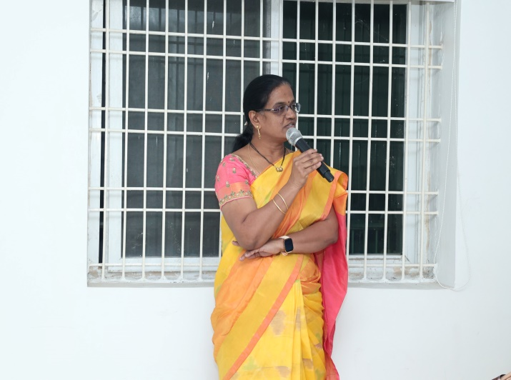
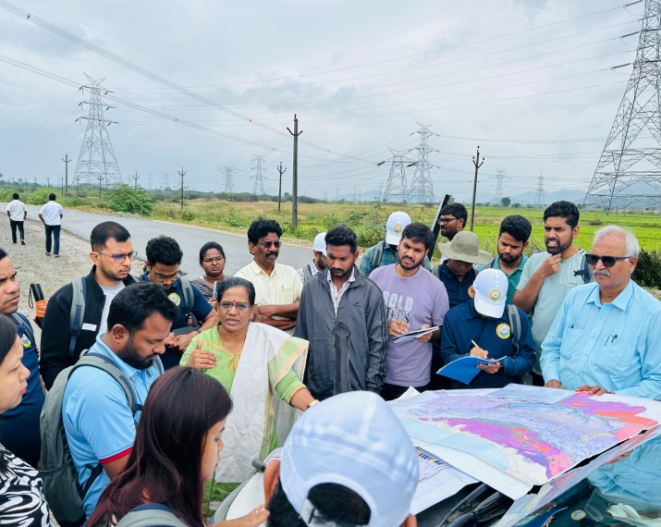
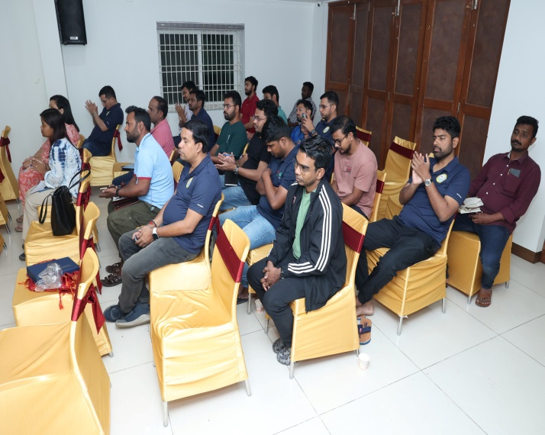
APG Field Visit to Cuddapah Basin in association with YVU Geology Department
Memento presentation to APG team
Addressing the gathering
Field discussion of Vempalle formation
APG team

