Slide 1
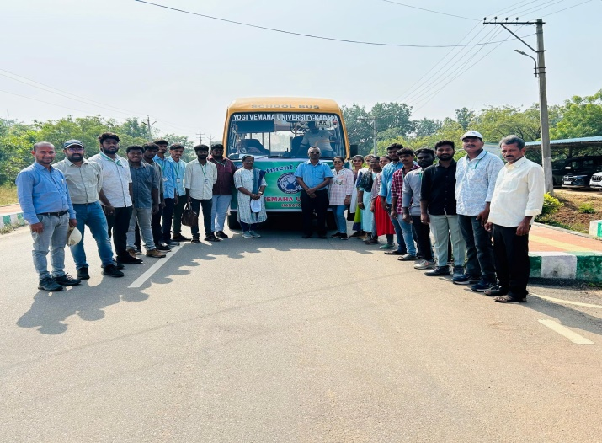
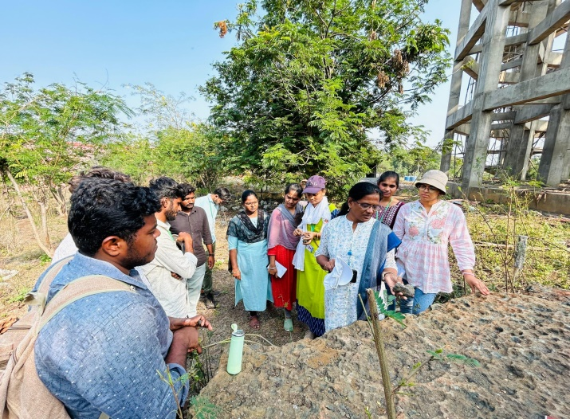
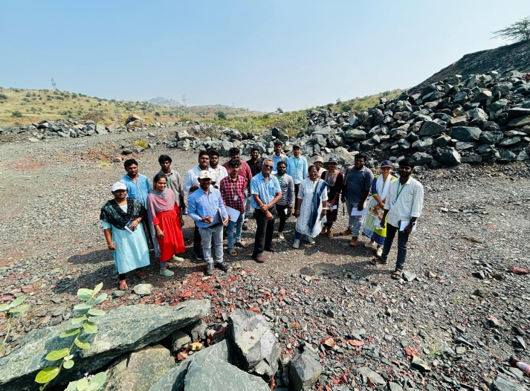
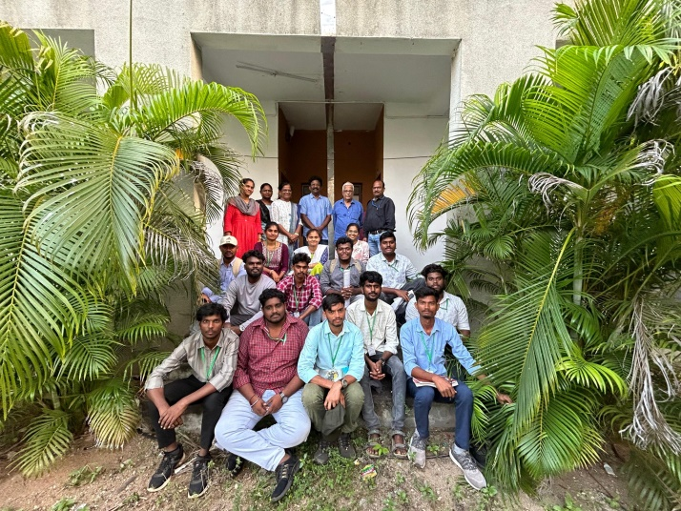
YVU Geology Department Field visit to Vempalle Formation
YVU Geology faculty, students
Observing Volcanic flows at Pulivendula
Volcanic flows in Vempalle Formation
Meeting with GSI officials

