Slide 1
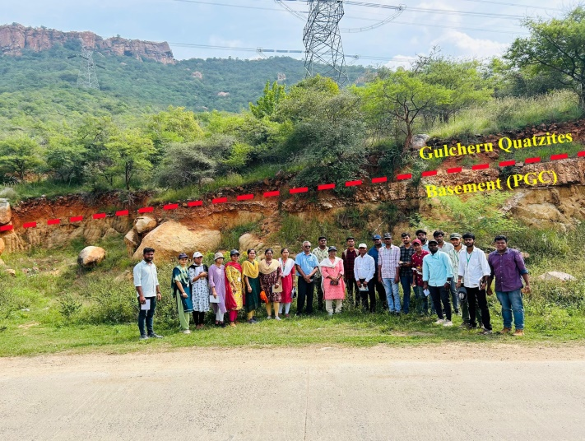
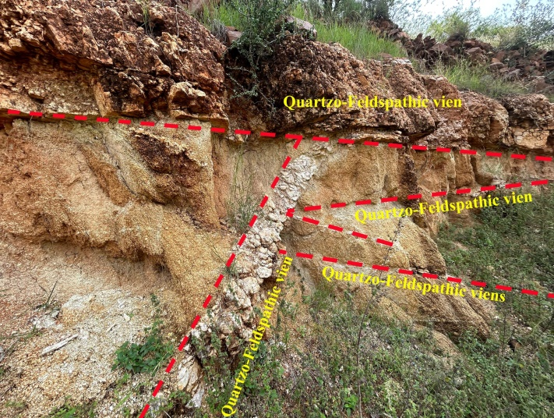
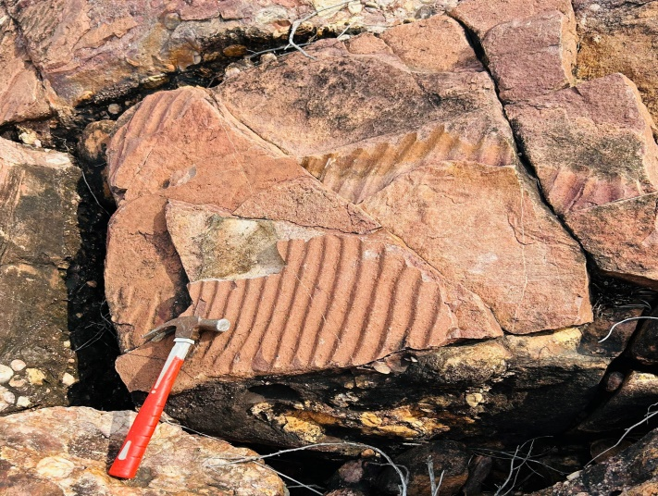
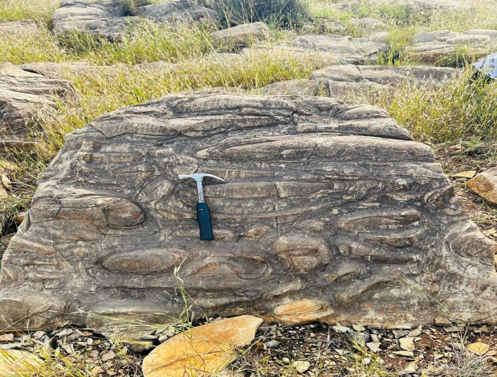
YVU Geology Department Field visit to Vempalle Formation
Eparchean unconformity
Quartz and Feldspar veins
Ripple Marks on Quartzite
Stromatolites on Dolomites

