Slide 1
Superstore Sales Dashboard –
Overview (2014–2017)
By SHRAVYA

Slide 2
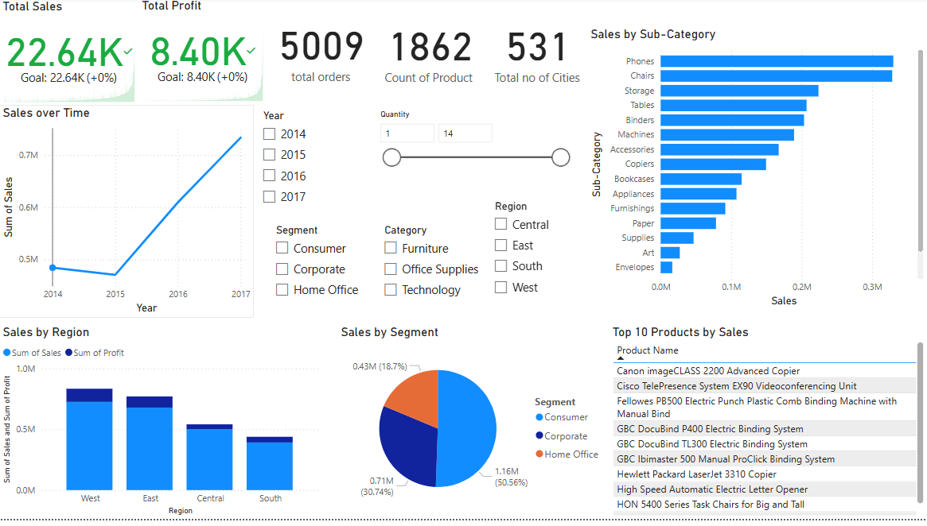
Overview
• Total Sales: 22.64K, Total Profit: 8.40K • Over 5,000 orders, spanning 1,800+ products and 531 cities • Key focus areas: Sales trends, product/category performance, regional analysis

Slide 3
Sales Performance Trends
- Sales Over Time: • A notable surge in sales occurred in 2017, following decline in 2015 • The highest recorded annual sales surpassed 0.75 million in 2017 - Sales by Region: • The West region leads in both total sales and overall profitability • The South region exhibits the weakest performance in sales and profit

Slide 4
Product & Category Insights
- Top Products: • Canon, Cisco and Fellowes lead in overall sales
performance • Strong sales trend observed in technology and
office automation categories
- Sub-Category Sales: • Phones, Chairs, Storage are dominant sub-
categories • Art suppliers and envelopes show week sales performance, lagging behind categories

Slide 5
Customer Segment Analysis
- Segment-wise Sales: • The customer segment dominates with over 50% of total sales • Corporate and Home Office . . provide balanced support - Category Trends: • Technology and Furniture . . . . Experiences strong and consistent demand

Slide 6
Strategic Insights & Recommendations
- Key Takeaways: • Phones and tech products dominate • South region underperforms • Yearly growth is promising - Recommendations: • Prioritize best-selling categories • Improve outreach in low-performing regions • Create segment-based marketing plans

Slide 7
Thank you
Queries?

