Slide 1
Genesys Voice Platform 8.x

Slide 2
Agenda
GVP Overview
GVP Core Components
GVP Architecture & VSS
Genesys Administrator
Composer Voice

Slide 3
GVP Overview
Genesys Voice Platform provides a variety of features that support call handling for voice and call-control applications through either Time Division Multiplexing (TDM) or VoIP functionality. As a flexible, standards-based voice processing platform, GVP also expands traditional IVR functionality with self-service and assisted-service capabilities that are tightly integrated with the Genesys product suite.
Support for voice and call-control applications written in standard VoiceXML and CCXML, respectively. GVP also supports extensions, to assist in the call-control requirements of a voice application with integration of automatic speech recognition and text-to-speech.
Conferencing, Call parking, providing multi-site contact centers with the ability to enable self-service and call queuing on GVP, before transferring or bridging the call to an agent.
Intelligent call routing provided by Genesys Enterprise Routing Solution (ERS) and Network Routing Solution (NRS), when GVP is combined with other Genesys products. Graphical User Interface (GUI) for the development of VoiceXML applications using Composer.

Slide 4
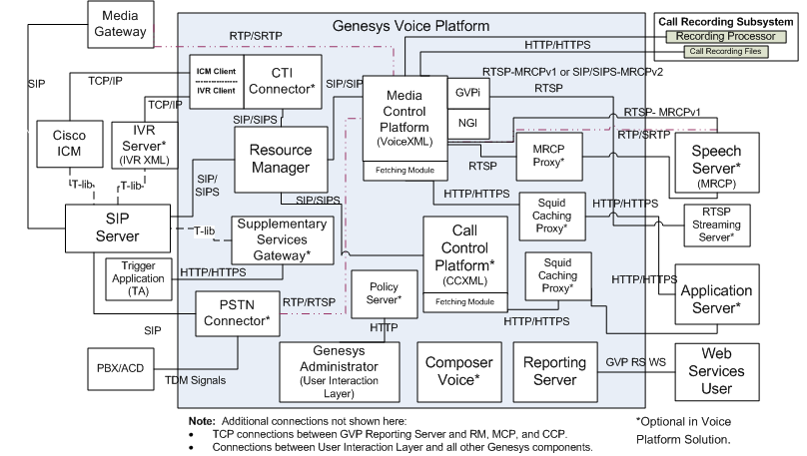
GVP Architecture

Slide 5
GVP Components
GVP comprises the following components:
Resource Manager
Media Control Platform
Reporting Server
MRCP Proxy
Call Control Platform
CTI Connector
Supplementary Services Gateway
PSTN Connector
SQUID PROXY
Policy Server

Slide 6
Resource Manager
The Resource Manager controls access and routing to all resources in a GVP deployment.
The Resource Manager is the first element to process requests for services, and it interacts with the Configuration Server to determine the Interactive Voice Recognition (IVR) Profile, Voice Extensible Markup Language (VoiceXML), Call Control Extensible Markup Language (CCXML), Announcement, and Conference application, resource, and service profile required to deliver the service. It then pushes the profile to a component that can deliver the service, such as the Media Control Platform or Call Control Platform, or CTI Connector

Slide 7
Resource Manager Functions
The Resource Manager performs the following functions:
Resource management—The Resource Manager allocates and monitors SIP resources to maintain a current status of the resources within a GVP deployment.
Session management—The Resource Manager combines two logical functions of session management:
Physical resource management—The Resource Manager monitors the status of the various GVP resources and, based on request-for-service and capability mapping, routes to other resources that offer a particular set of capabilities or services.
Logical service management—The Resource Manager applies high-level application and business logic to select the service that is delivered and the parameters that are applied.
Service selection—When a call session arrives at the Resource Manager, the Resource Manager maps the call to an IVR Profile and, if applicable, to a tenant, and selects a service for the request.

Slide 8
MCP
The Media Control Platform is the core component of GVP, because it executes the actual voice applications in the solution. In addition, it is used by other communication layer components, such as SIP Server, to provide broader customer service scenarios, such as agent interactions, and many other functions.
Media Control Platform Functions
Performs application-initiated calls. Supports VoiceXML applications.
Plays audio, video, and TTS prompts. Streams TTS, audio, and video
Records utterance data.
Initiates outbound calls.
Handles network-initiated call disconnections.
Records audio and video.
Supports dual audio channel and dual video channel call recordings.
Collects call recordings.
Performs ASR and dual tone multi-frequency (DTMF) input handling (barge-in or non-barge-in).
Streams audio data to an ASR server for speech recognition.
Reserves ASR and TTS resources at call initiation.
Transfers calls.

Slide 9
VoiceXML
Media Control Platform services are defined by voice applications that are executed when a SIP session is established between the Media Control Platform and the service user. The Media Control Platform can host various application execution environments and use multiple implementations of a particular language. The Media Control Platform is most often used to deploy dialog-based services that are built using VoiceXML.
NETANN
The Media Control Platform supports two other predefined services:
announcements and conferencing. In conjunction with an underlying media-processing resource, the Media Control Platform can provide extended versions of all services defined in Network Announcements (NETANN) for example, announcements with prerecorded audio prompts.
MSML
The Media Control Platform supports the conferencing service through Media Server Markup Language (MSML). In conjunction with an underlying media-processing resource, the Media Control Platform can provide extended MSML conferencing features, such as the ability to set the conference role, perform prechecks to ensure the audio or video prompt file is found before the conference begins, and support for relative path URIs to the media file.
Service Delivery
The Media Control Platform controls overall execution of the voice applications, but the applications rely heavily on access to media-processing resources. One or more underlying, third-party media-processing resources (such as media servers, speech recognition servers, or speech synthesis servers) deliver ASR and TTS services.

Slide 10
Policy Server
The Policy Server component validates and resolves GVP-specific business rules (the policies that are enforced by the Resource Manager) and provides this information to Genesys Administrator in response to HTTP queries.
It is a stand-alone Java process that exposes an HTTP interface through which it connects to Management Framework.
The read permissions that are granted when a user logs into Genesys Administrator determine which Management Framework objects are accessible.

Slide 11
Communication Protocols
SIP For call-control messaging between the Resource Manager and SIP Server, and for source-management messaging between the Resource Manager and GVP resource components.
HTTP For fetch communications among the NGI/CCXMLI, Fetching Module, and Squid caching Proxy, and between the Fetching Module and web application server. HTTP is also used for communication between the Reporting Clients and Reporting Server, between the Reporting Web Services and Genesys Administrator, and between the Supplementary Services Gateway and third-party Trigger Application.
MSML For media services communications between SIP Server and the Media Server through the Resource Manager.
MRCP For managing speech services between the Media Control Platform and the ASR or TTS speech engines. GVP 8.5 supports MRCPv1 over Real-time Streaming Protocol (RTSP) and MRCPv2 over SIP.
RTP For delivering media (audio and video data) between the Media Control Platform and the external media gateway, and between the Media Control Platform and the speech engines.
IVR XML For accessibility to CTI functionality through the IVR Server to the CTI Connector, and the CTI connector to the GVP components.

Slide 12
Inter-process Communication
MCP
CCP
SIP
RM
SIP Server
SIP
CTIc

Slide 13
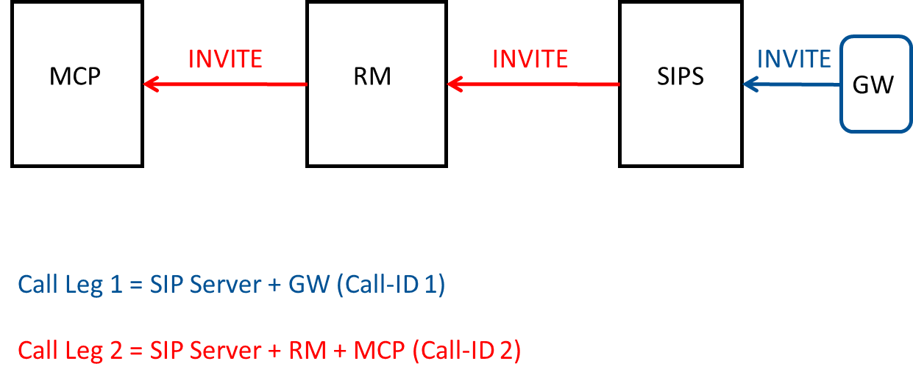
Interaction Flow

Slide 14
Tracking Calls in Genesys Logs,
Key | Type | Created by
ConnID | T-LIB | SIP Server
Call-ID | SIP | SIP Server/MCP/CTIc/CCP/PSTNc
X-Genesys-GVP-Session-ID | SIP (Custom header) | RM/PSTNc
CallId | IVR XML | CTIc
sessionID |  | MCP
CCXMLSessionId |  | CCP
X-Genesys-geo-location | SIP (Custom header) | SIP Server
X-Genesys-GVP-Site-ID* | SIP (Custom header) | RM

Slide 15
Thank You...

