Slide 1
Structured query language(sql)

Slide 2
CONTENTS
SELECT Statement
FROM
WHERE Clause
AS
JOIN
AND Operator
OR Opeartor
LIMIT
IN Opeartor
CASE Expression

Slide 3
IS NULL Operator
LIKE Operator
COMMIT
ROLLBACK
ALTER TABLE
UPDATE
CREATE
DELETE
INSERT
DROP
GROUP BY
ORDER BY

Slide 4
HAVING
COUNT
SUM
AVG
MIN
MAX

Slide 5
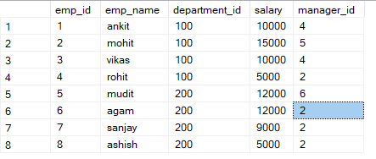
select
SELECT statement is one of the most fundamental SQL commands used to retrieve data from a database table.
Example Query:
SELECT * FROM Employee;
Below table is the result set of select statement

Slide 6
FROM
FROM Clause is used to specify the table . It means from which data should be retrieved in a query
Mainly it specifies about the table from which table the query has to execute
Example:
SELECT * FROM Employee;

Slide 7

wHERE
WHERE Clause is used to filter the rows that it which returned by a query based on specific condition
It allows us to filter the rows based on certain criteria
Example:
SELECT * FROM EMPLOYEE
WHERE EMP_NAME = ‘ANKIT’;

Slide 8
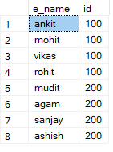
AS
AS Keyword is used to provide alternative name to the column .
It makes output of the query more readable.
Example:
SELECT EMP_NAME AS E_NAME ,DEPARTMENT_ID AS ID FROM EMPLOYEE;

Slide 9
joinS
JOIN Clause is used to combine a rows from two or more tables based on related column between them.
It allows us to retrieve data from multiple tables in a single query.
There are several joins in sql and each perform different operation
Joins operation is done that built on tables and the columns in the table
There are following joins exists in sql
1.Inner Join / Join
2.Left Join
3.Right Join
4.Full Join / Full Outer Join

Slide 10

1.INNER JOIN
INNER Join returns only a matching records from left table and right table
It fetches only matched records from both the tables
Example:
SELECT S.STUDENT_NAME, C.COURSE_NAME FROM STUDENT S JOIN COURSES C ON S.COURSE_ID = C.COURSE_ID;

Slide 11
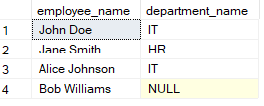
2.LEFT JOIN
Left join returns all the records from the left table and matched records from the right table
We can simply define as it does like:
inner join + any additional records in the left table
Example:
SELECT E.EMPLOYEE_NAME,D.DEPARTMENT_NAME FROM EMPLOYEES E LEFT JOIN DEPARTMENTS D ON E.DEPARTMENT_ID = D.DEPARTMENT_ID;

Slide 12
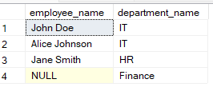
3.Right JOIN
Right join returns all the records from the right table and matched records from the left table.
We can simply define like :
Inner join + any addtional records in the right table
Example:
Select e.employee_name,d.department_name from employee e Right join department d on e.department_id = d.department_id;

Slide 13
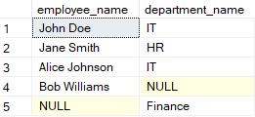
4.FULL JOIN
FULL JOIN is also known as Full Outer Join
Full Join combines the result of both left join and right join
It returns all the records from both the left table and right table
If there is no match ,NULL values are included for the columns from the non-matching table.
We can simply define like :
Inner join + all remaining records from left table + all remaining records from right table
Example:
select e.employee_name,d.department_name from employes e full join departmets d on e.department_id = d.department_id;

Slide 14

AND
AND Operator is a logical operator and it is used to combine multiple conditions in where clause.
It allows us to retrieve the rows from a table that satisfy a specific conditions
Example:
select * from employee where employee_name = 'John Doe' and department_id = 1;

Slide 15

OR
OR Opeartor is logical operator and it is used to combine multiple conditions in where clause
It allows us to retrieve the rows from table that satisfy atleast one of the specified conditions.
Example:
select * from employee where employee_name = 'John Doe' or department_id = 2;

Slide 16

LIMIT
LIMIT Clause is used to restrict the number of rows returned by a query
It is particularly useful when we want to retrieve certain number of rows from a result set.
Example:
select top 3 * from employee;

Slide 17

IN
IN Operator is used to specify multiple values in where clause
It allows us to retrieve a rows where a specified column value matches any value in list of specified values
Example:
select * from users where id in (1,4,7);

Slide 18
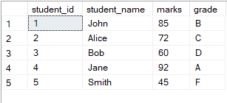
CASE
CASE Expression is like a switch statement in programming languages.
It evaluates the list of conditions and return a result based on first condition that is true
Example:
select student_id, student_name, marks,
case when marks >=90 then 'A'
when marks >=80 then 'B'
when marks >=70 then 'C'
when marks >=60 then 'D'
else 'F'
end as grade
from student;

Slide 19

Is null
NULL is used in the absence of a value or unknown value.
IS NULL Operator is used to check whether a value is NULL or not
Example:
select * from student
where student_name is null;

Slide 20

LIKE
LIKE Operator is used to search for a specified pattern with in a column.
It is used in combination with wildcards characters to perform pattern matching.
Example:
select * from student
where student_name like 'j%’;

Slide 21
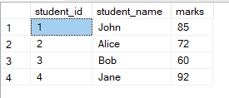
commit
COMMIT Statement is used to permanently save changes that made in transaction to the database
Example:
begin tran
delete from students
where student_name = 'smith';
commit;

Slide 22
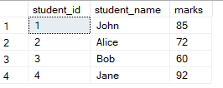
ROLLBACK
ROLLBACK Statement is used to undo the changes made in transaction and restore the database to its state before transaction began
It is used when there is any error or any transaction needs to be cancelled for any reason.
Example:
begin tran
update students
set student_name ='sumanth'
where student_name ='john';
Rollback;

Slide 23


ALTER TABLE
ALTER TABLE is used to modify the existing table structure.
It allows us to add, modify, drop the columns in a table.
Example:
alter table test2 alter table test2
add sumant varchar(100); drop column sumant;

Slide 24
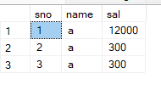
UPDATE
UPDATE Statement is used to modify the existing records in a table.
It allows us to change the values of one or more columns in one or more rows of a table based on specified condition.
Example:
update test2
set sal = 12000
where sno = 1;

Slide 25

CREATE
CREATE Statement is used to create new database objects such as tables, views, indexes etc.
It allows us to define structure and properties of object being created.
Example:
create table luman(
sno int,
email_id varchar(100),
mobile_no int);

Slide 26

DELETE
DELETE Statement is used to delete one or more rows from a table based on specified condition.
It is normally used to delete unwanted data from table.
Example:
delete from test2
where sno = 3;

Slide 27

INSERT
INSERT Statement is used to add new rows of data into table.
It allows us to specify the values for each column of the table being inserted into.
Example:
INSERT INTO department (department_id, department_name) VALUES (1, 'IT'),(2, 'HR’),(3, 'Finance’);

Slide 28
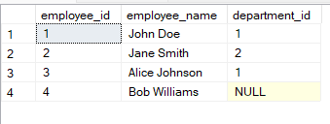

DROP
DROP Statement is used to delete database objects like tables, views, indexes, sequences and constraints.
It effectively deletes the specified object from the database
Example:
Drop table employe;
Before Deletion After Deletion

Slide 29

GROUP BY
The GROUP BY clause in SQL is used to arrange rows that have the same values in specified columns into summary groups.
It is often used in conjunction with aggregate functions to perform operations on each group of rows
Example:
select category, sum(quantity) as total_quantity from sales
group by category;

Slide 30
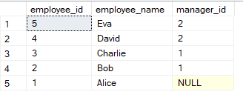
ORDER BY
ORDER BY Clause is used to sort the result set of a query based on one or more columns
It allows us to specify the order in which the rows should be returned.
Example:
select * from employees
order by employee_id desc;

Slide 31

HAVING
HAVING Clause is used to filter groups after the grouping operation has been performed.
It is similar to where clause but its specially designed to work with aggregate functions like ‘sum’, ‘count’, ‘avg’, ‘min’, ‘max’.
Example:
select customer_id, sum(total_amount) as total_spent from orders
group by customer_id
having sum(total_amount) > 1000;

Slide 32

COUNT
COUNT Function is used to count the number of rows returned by a query
It can be used with the SELECT statement to count the number of rows in a table
Example:
select sum(salary) as total_sal, count(department_id) as total_no from employee;

Slide 33

SUM
SUM Function is used to calculate the sum of the values in a specified column.
It is commonly used with the SELECT Statement to perform the calculations on numeric data.
Example:
select sum(salary) as'total salary', department_id from employee
group by department_id;

Slide 34

AVG
AVG Function is used to calculate the average value of a set of values in a specified column.
It is used with the SELECT Statement to compute the average of numeric data.
Example:
select avg(salary) as salary from employee
where department_id = 100;

Slide 35

MIN
MIN Function is used to find the minimum value in a set of values in a specified column.
It is used with the SELECT Statement to retrieve the smallest value from a column.
Example:
select min(salary) as salary, count(department_id) as id from employee;

Slide 36

max
MAX Function is used to find the miximum value in a set of values in a specified column.
It is used with the SELECT Statement to retrieve the largest value from a column.
Example:
select max(salary) as salary, count(department_id) as id from employee;

