Slide 1

VST-Kaggle
House Prices: Advanced Regression Techniques

Slide 2
Workflow
Feature Engineering:
Univariate Analysis
Bivariate Analysis
Missing Values Imputation
Label Encoding, Box-cox, and dummifying
Modeling
Lasso
Ridge
ElasticNet
XGBoost

Slide 3
Dataset
Train data shape: (1460, 81)
Test data shape: (1459, 80)
Target: SalePrice, the property’s sale price in dollars
43 Categorical features: LotShape, Neighborhood, Garage Type…
37 Numerical features: First/Second square feet, number of kitchens…

Slide 4
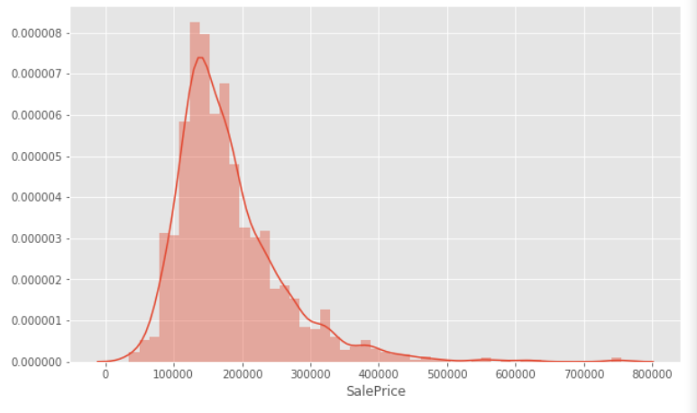
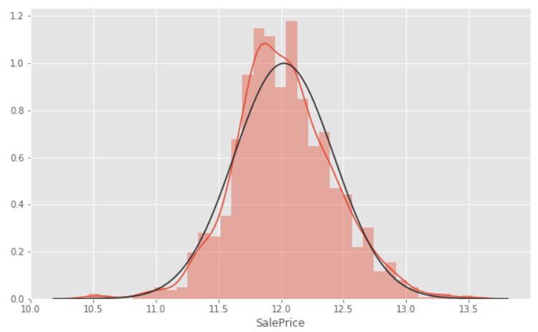
Univariate Analysis
Study of the target feature: property’s sale price
Distribution shows that target is highly skewed to the right => log transformation

Slide 5
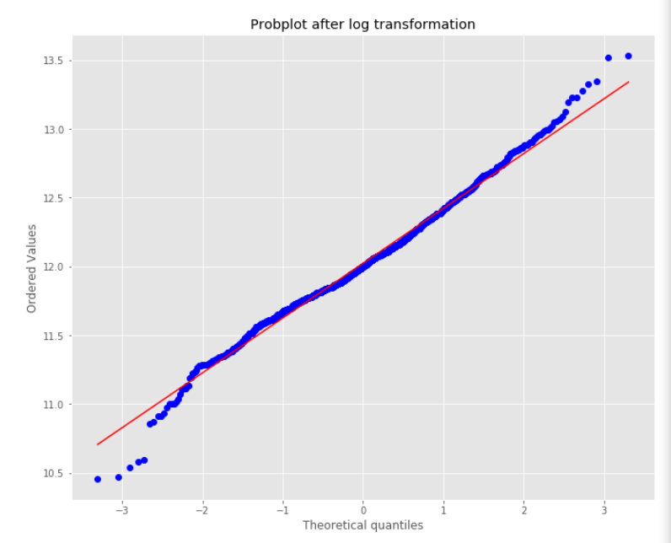
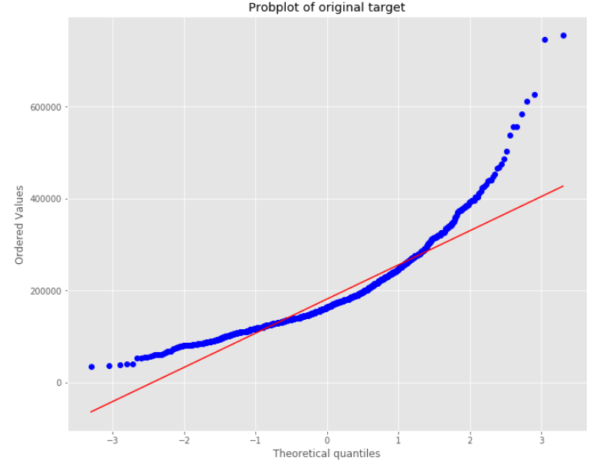
Probplot after log transform
Comparison of the normality of target before and after log transform

Slide 6
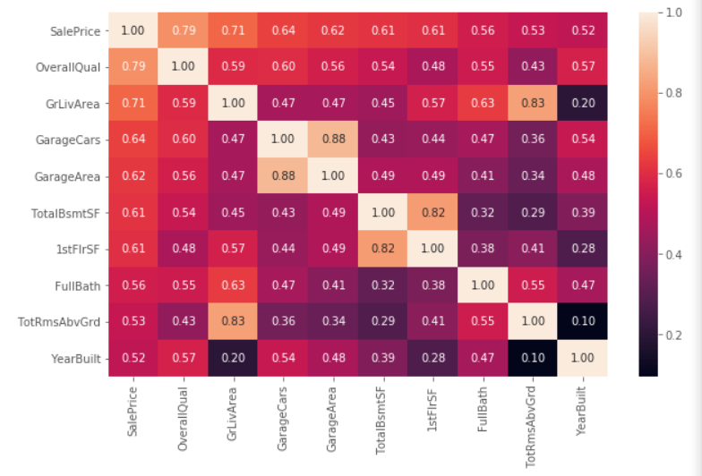
Bivariate Analysis : correlation matrix
We should see which features are highly correlated with the target and investigate them for outliers and linear relationship.

Slide 7
Feature Engineering

Slide 8
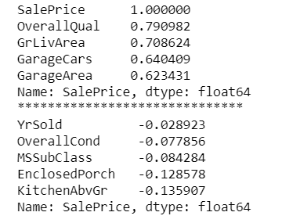
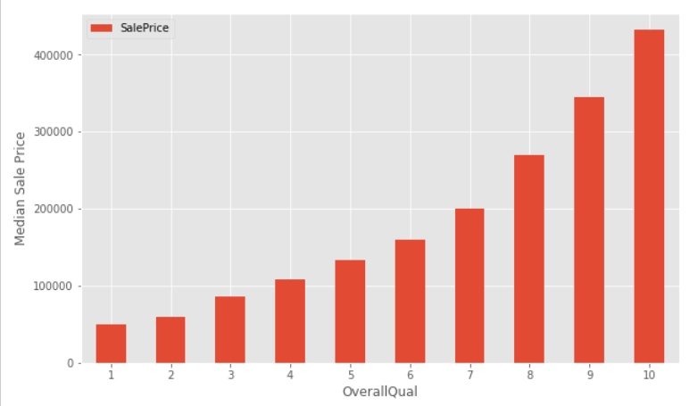
Correlation

Slide 9
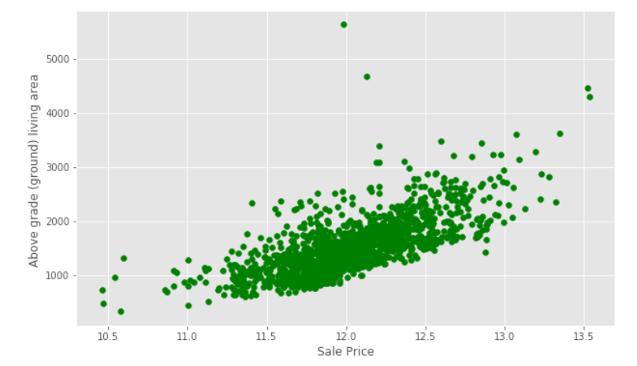
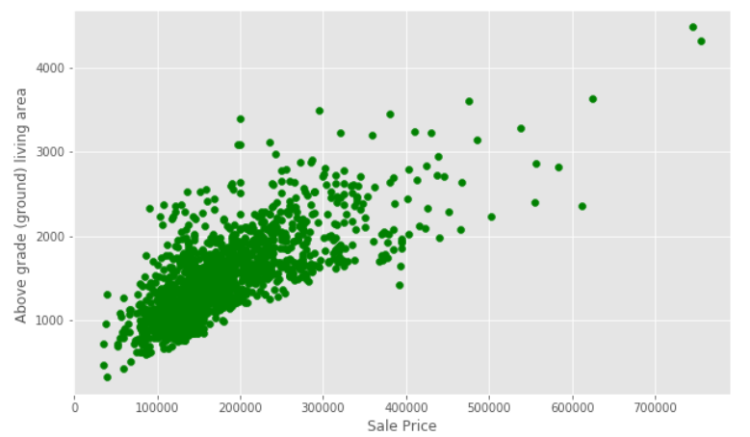
Price vs GrLivArea

Slide 10
Imputation Missing Values

Slide 11
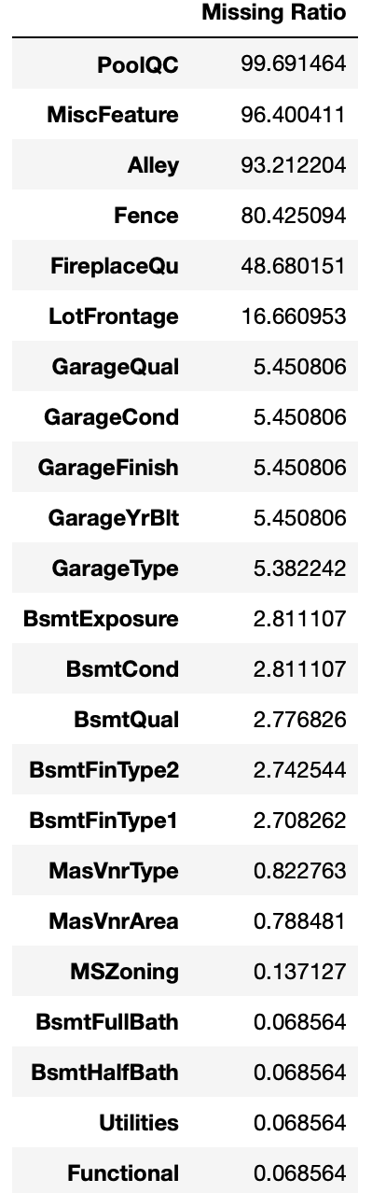
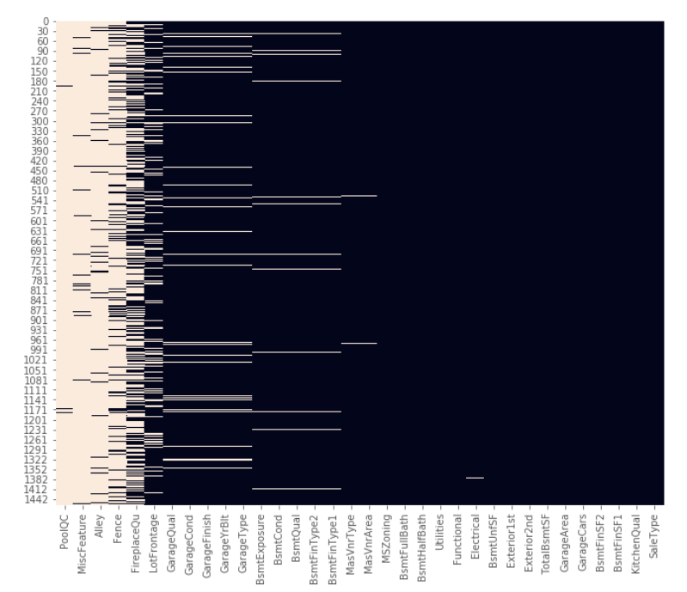
Missing Ratio in the Data

Slide 12
Imputing Missing Values
The following Categorical Features were imputed with ‘None’ for missing values:
PoolQC, MiscFeature, Alley, Fence, FirePlaceQu, GarageType, GarageCond, GarageFinish, GarageQual, BsmtCond, BsmtExposure, BsmtFinType1, BsmtFinType2, BsmtQual, MasVnrType.
The following Numerical Features were imputed with 0 for missing values:
GarageCars, GarageArea, GarageYrBlt, BsmtFinSF1, BsmtFinSF2, BsmtFullBath, BsmtHalfBath, BsmtUnfSF, TotalBsmtSF, MasVnrArea.
The following Categorical Features were imputed with most appeared value(Mode) for missing values:
MSZoning, Functional, Electrical, Exterior1st, Exterior2nd, KitchenQual, SaleType

Slide 13
Imputing Missing Values
The following Numerical Features were imputed with ‘Median’ values based on the ‘Neighborhood’ for missing values:
LotFrontage

Slide 14
Label Encoding

Slide 15
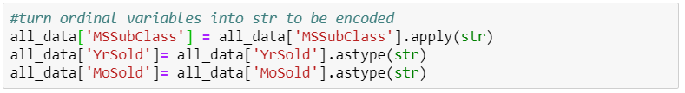
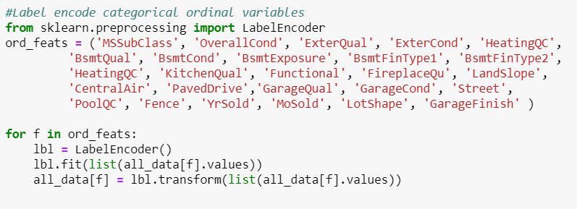
Convert some numerical features to categorical & Label-encoding

Slide 16
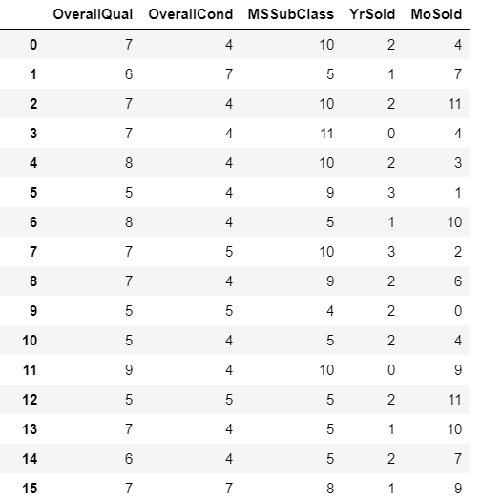
After encoding:

Slide 17
TotalSF = TotalBsmtSF + 1stFlrSf +2ndFlrSF
Add new feature TotalSF

Slide 18
Box Cox Transformation of highly skewed features

Slide 19
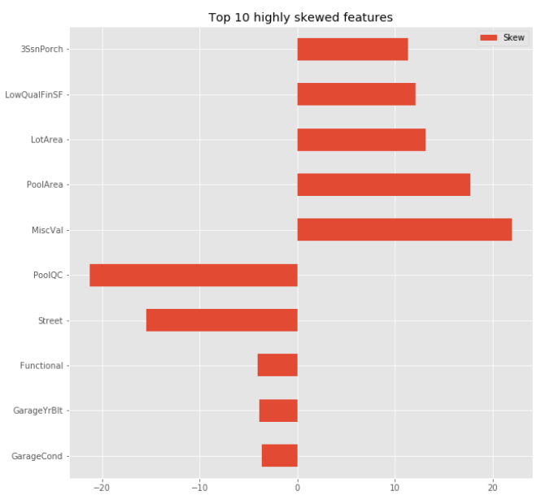
Highly Skewed Features
Skewness affects the regression intercept, coefficients associated with the model.
Asymmetrical data behavior may lead to bias in the model and normality is an important assumption for many statistical techniques. Therefore, in this case we choose to use Box Cox transformation.
There are 59 skewed numerical features to transform. (>0.5)
Dummify => (2917,223)

Slide 20
Modelling

Slide 21
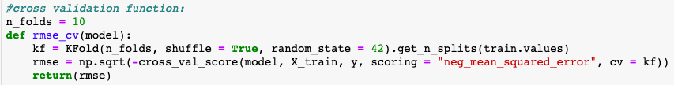
RMSE function
This function measures the distance between our predicted value.
As a validation strategy, we did CV with k = 10, using 9 parts of our data for fitting models and 1 part to obtain predictions.
We trained: Lasso, Ridge, ElasticNet, and XGBoost.

Slide 22
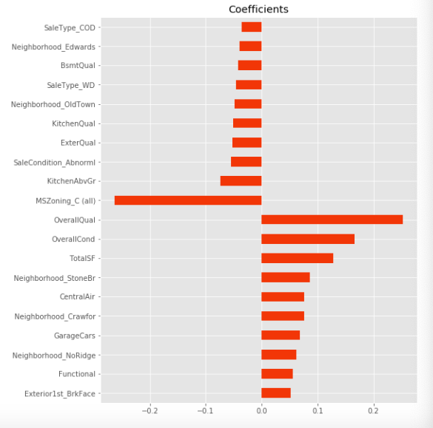
Lasso
RMSE: 0.1115211499
Does parameter shrinkage and variable selection automatically.
Alpha: 1, 0.1, 0.001, 0.0005
Lasso picked 95 variables, and eliminated 128 variables.
Suggest TotalSF and Neighborhood, apart from OverallQual and OverallCond, greatly impact SalePrice.

Slide 23
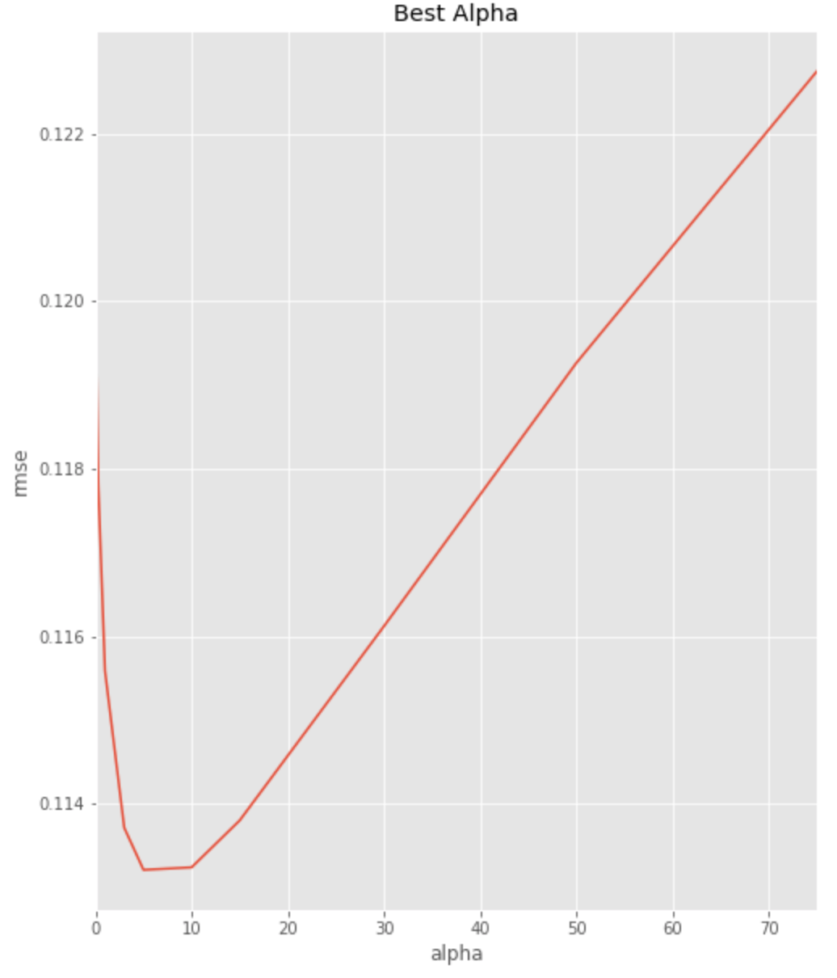
Ridge
RMSE: 0.11321474678983763
Alpha: 0.05, 0.1, 0.3, 1, 3, 5, 10, 15, 30, 50, 75
Prevents multicollinearity by shrinking the parameters.
It uses L2 regularization technique.

Slide 24
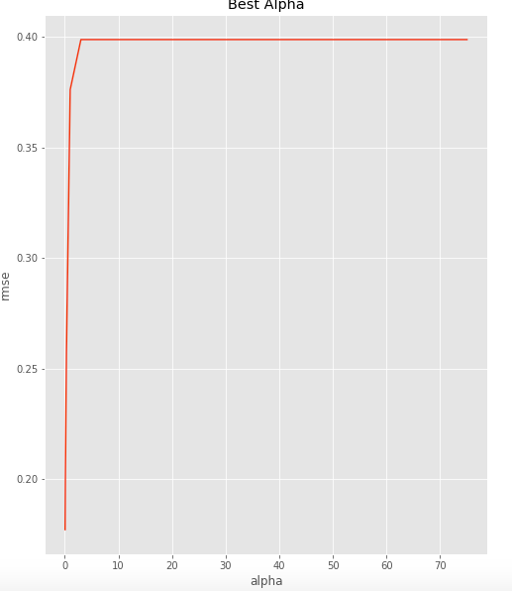
ElasticNet
RMSE : 0.17712364615
Hybrid of Ridge and Lasso
Alpha: 1, 0.1, 0.001, 0.0005
generality of the elastic net regression: do not prefer either L1 or L2 regularization on its own

Slide 25
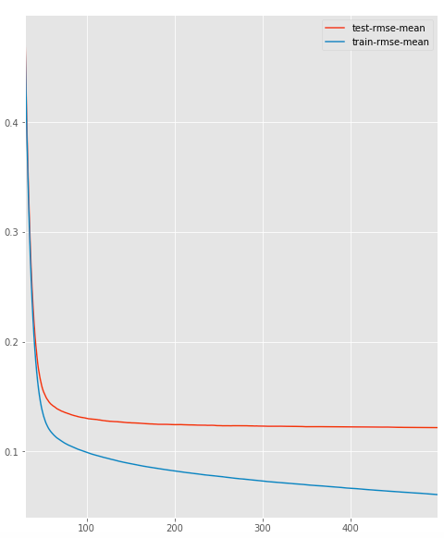
XGboost
Difference between train and test rmse mean
RMSE 0.1166624769
parallelizable algorithm
combines a set of weak learners and delivers improved prediction
Hyperparameters :
max_depth = 2, determines how deeply each tree is allowed to grow during any boosting round.
k-fold cross validation :
num_boost_round=500, number of trees we build
early_stopping_rounds=100, finishes training of the model early if the rmse does not improve for a given number of rounds.

Slide 26
Submission

Slide 27
Thank you for your attention !

