Slide 1
FINAL YEAR PROJECT
AI-Driven Digital Twin
Framework for Sustainable Agriculture
A What-If Simulation System for Crop Yield,
Irrigation, and Risk Assessment
PRESENTED BY
GUIDE
COORDINATOR
K. Venkatesh Hebbar
Mr. Krishna Prasad D S
Dr. Radhakrishna
8th Sem, B.E. CCE
Asst. Professor, CCE
Dept. of CCE
Department of Computer and Communication Engineering
NMAM Institute of Technology, Nitte (Deemed-to-be University)
September 2026

Slide 2
Introduction: Digital Agriculture
Transforming Indian smallholder farming through data & AI
CHALLENGE
SOLUTION
India's Agricultural Challenge
Our AI-Driven Framework
• Agriculture supports 58% of India's population; 86% of farms < 2 ha
• Climate unpredictability & soil degradation threaten yields
• Water scarcity: 80% of freshwater used in farming
• Static fertilizer advice ignores field-level variation
IoT Sensors
Real-time NPK, pH, moisture & weather data
Machine Learning
Yield, irrigation & risk predictions
SDG Alignment
• SDG 2: Zero Hunger — improved yields
• SDG 6: Clean Water — precision irrigation
• SDG 12: Responsible Production — fertilizer optimization
• SDG 13: Climate Action — risk prediction
Digital Twin + XAI
What-if simulation + SHAP explanations
AI-Driven Digital Twin Framework • Final Year Project
NMAMIT

Slide 3
Literature Survey: Methods & Algorithms
12 peer-reviewed papers — Nature, Elsevier, Frontiers
Deep Learning + SHAP
Lightweight Edge ML
Hybrid ML — RF + XGBoost
2023
2023
2024
High accuracy with transparent explanations
On-device inference — no cloud dependency
Ensemble methods for tabular agricultural data
Agentic AI
Feature Correlation KNN
2025
2026
Autonomous decision support agents
Isolates impactful soil variables
Key Insight: All five methods achieve strong accuracy — but each omits one critical capability.
No single work combines prediction + simulation + transparent explanation. We adopt Hybrid ML (RF + XGBoost) + Digital Twin + SHAP → unified framework.
Gap: None address Digital Twin simulation or real-time SHAP dashboards
Source: Peer-reviewed papers from IEEE, Elsevier, Frontiers, Nature (2023–2026). Table summarises algorithmic approaches used in each study.
AI-Driven Digital Twin Framework • Final Year Project
NMAMIT

Slide 4
Current Limitations in Literature
Critical gaps preventing real-world deployment
Black-Box Predictions
Sensor Drift Decay
Farmers cannot trust AI without explanations
Long-term sensor degradation drops ML accuracy
Source: 2023–2024 Nature papers
Source: 2026 IoT-ML evaluation
Unstructured Data
No What-If Testing
Erratic weather breaks hybrid models
Systems cannot simulate hypothetical scenarios
Source: 2024 Hybrid ML paper
Source: All surveyed papers
Our Response: Unified Framework Addressing All Four Gaps
• Gap 1 (Black-Box): SHAP XAI — every prediction explained
• Gap 2 (Sensor Drift): Digital Twin self-corrects via penalty functions
• Gap 3 (Unstructured): Digital Twin handles stress scenarios explicitly
• Gap 4 (No What-If): Dedicated simulation engine for what-if testing
AI-Driven Digital Twin Framework • Final Year Project
NMAMIT

Slide 5
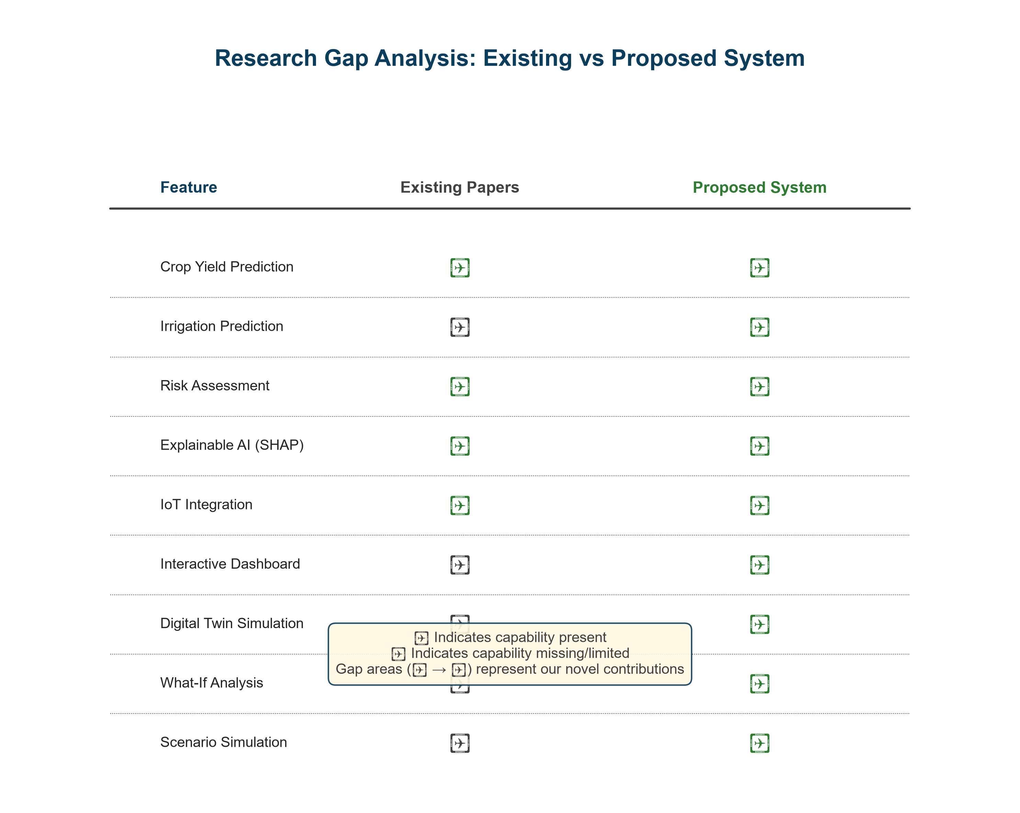
Research Gap & Our Solution
From 'Predict Only' to 'Predict + Simulate + Explain'
PARADIGM SHIFT
The Core Problem
Current systems are 'Predict Only' black boxes
• Static recommendations from historical data only
• No transparency — farmers reject unexplained AI
• Cannot simulate 'what-if' before committing resources
Our Solution: Predict + Simulate + Explain
• Digital Twin: Virtual farm for what-if testing
• SHAP: Transparent reason for every prediction
• Interactive Dashboard: Farmer-friendly guidance
• Real-time adaptation: Responds to sensor changes
Research Gap Matrix: Feature coverage across 12 papers
✓ Crop Yield Prediction (9/12 papers)
✓ Explainable AI — SHAP (6/12 papers)
✓ IoT Integration (7/12 papers)
✗ Irrigation Prediction (0/12 papers)
✗ Digital Twin (0/12 papers)
✗ Interactive Dashboard (0/12 papers)
AI-Driven Digital Twin Framework • Final Year Project
NMAMIT

Slide 6
Project Objectives
Five measurable goals aligned with research gaps
Crop Yield Prediction
1
Accurate models for yield forecasting using NPK, pH, weather
Irrigation Prediction
2
Optimal water usage from soil moisture and weather forecasts
Agricultural Risk Prediction
3
Climate risks (drought, heat, flood) with probabilistic confidence
Digital Twin Simulation
4
Localized virtual farm replica for what-if scenario testing
XAI Dashboard
5
Explainable AI interface with SHAP transparency for every decision
AI-Driven Digital Twin Framework • Final Year Project
NMAMIT

Slide 7
Objective-to-Literature Mapping
Each objective grounded in prior work with a clear extension
Objective
Supporting Literature
Our Extension
Obj 1: Yield Prediction
2023 DL+SHAP, 2024 Hybrid ML
Multi-output regression + uncertainty bounds
Obj 2: Irrigation Prediction
Critical gap in literature
First implementation for Indian smallholder farms
Obj 3: Risk Prediction
2023 Edge ML, 2025 Spatial ML
Combines climate + sensor drift + emissions
Obj 4: Digital Twin
NOT addressed in any paper
Novel: virtual farm + scenario engine
Obj 5: XAI Dashboard
2023 SHAP, 2024 XAI Hybrid
Real-time interface with per-prediction explanation
AI-Driven Digital Twin Framework • Final Year Project
NMAMIT

Slide 8
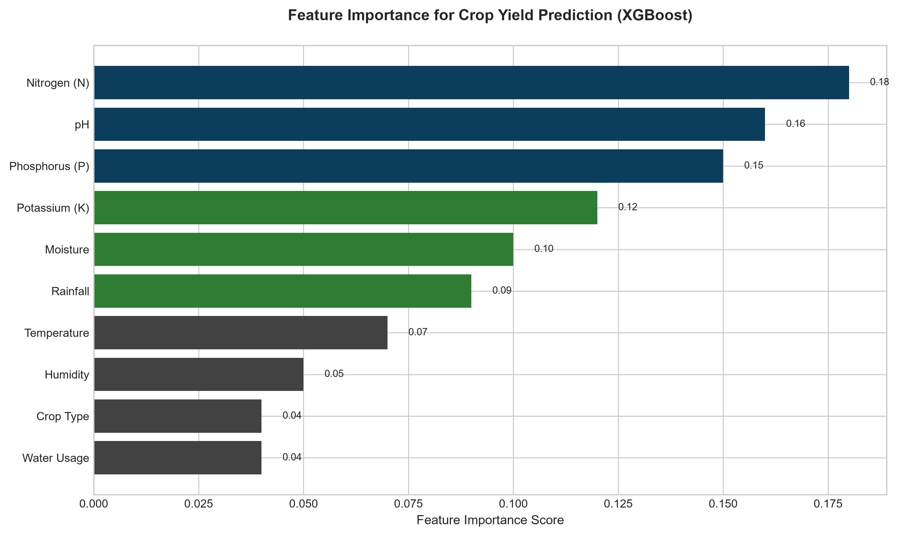
Dataset & Feature Engineering
10,000-row synthetic Indian agricultural dataset
Indian Agricultural Data (10,000 rows)
• Source: Custom generation + Government Soil Health Cards
• Crops: 22 Indian varieties (rice, wheat, maize, cotton, sugarcane)
• Time span: 2025–2026 agricultural cycles
• Split: 80% train / 20% test, stratified by crop
Feature Set (10 inputs)
• Soil: Nitrogen, Phosphorus, Potassium, pH, Moisture
• Weather: Rainfall, Temperature, Humidity
• Farm: Crop Type, Water Usage, Historical Yield
• Total: 10 input features × 10,000 samples
AI-Driven Digital Twin Framework • Final Year Project
NMAMIT

Slide 9
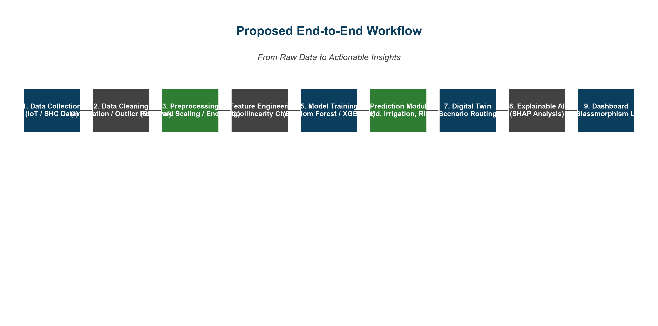
Proposed Workflow
Nine-stage pipeline from data to decisions
Phase 1: Foundation
Phase 2: Intelligence
Phase 3: Action
Data collection → cleaning → preprocessing → features
Model training → prediction (yield, irrigation, risk)
Digital Twin → SHAP → Dashboard → Decision
AI-Driven Digital Twin Framework • Final Year Project
NMAMIT

Slide 10
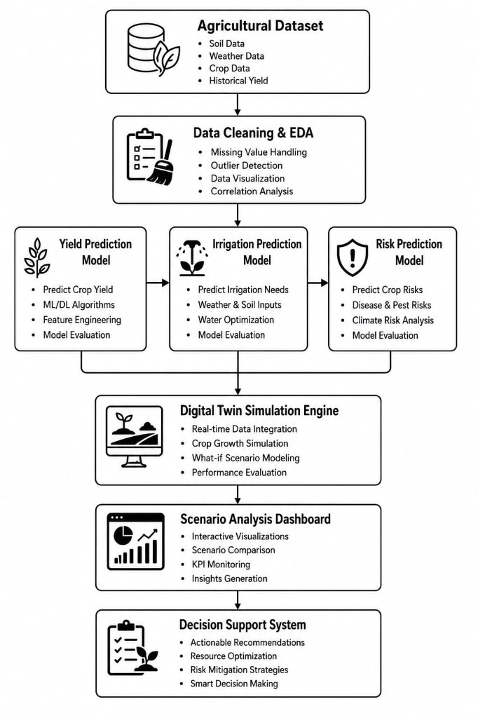
System Architecture
Five-layered integrated platform with data flow
1. Data Layer
Agricultural dataset · sensors · APIs
2. Processing Layer
Cleaning · EDA · Feature engineering
3. Intelligence Layer
RF + XGBoost models (yield, irrigation, risk)
4. Simulation Layer
Digital Twin with scenario routing
5. Presentation Layer
Glassmorphism dashboard with SHAP
AI-Driven Digital Twin Framework • Final Year Project
NMAMIT

Slide 11
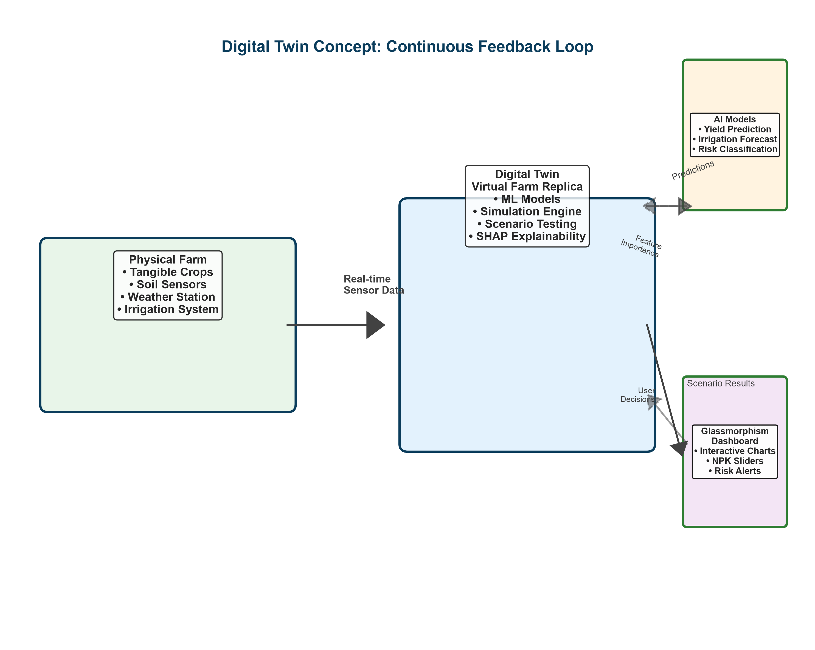
Digital Twin Simulation Engine
Virtual farm replica for safe what-if experimentation
• What the Twin Can Do:
  – Real-time monitoring of farm state
  – What-if scenario testing
  – Yield simulation under modified conditions
  – Irrigation demand forecasting
  – Climate shock stress-testing
  – Feedback loop for continuous learning
•
• Key Differentiator:
  – Only system in surveyed literature
  – Combines prediction + simulation in one platform
AI-Driven Digital Twin Framework • Final Year Project
NMAMIT

Slide 12
Module 1 — Crop Yield Prediction
Tree-based regression for accurate, explainable forecasts
Inputs
N, P, K, pH, Crop Type, Weather, Moisture
Why Tree-Based Models?
• High accuracy on tabular agricultural data
• Full SHAP compatibility — transparent predictions
• Fast inference (< 10 ms) for edge deployment
• Deep learning rejected: opaque + 50× slower
Algorithms
Random Forest + XGBoost (ensemble)
Output
Expected Yield (tons per hectare)
Digital Twin Integration
• Twin adjusts yield for hypothetical fertilizer changes
• Runs 'what if NPK changed by ±20%?' scenarios
• Penalty functions model soil degradation over time
• Simulates climate shocks: drought, flood, heat stress
• Returns confidence interval with each prediction
Metrics
RMSE, MAE, R², Cross-validation
Twin Role
Core simulation engine for yield scenarios
AI-Driven Digital Twin Framework • Final Year Project
NMAMIT

Slide 13
Module 2 — Irrigation Prediction
Precision water management based on soil & weather
Inputs
Soil Moisture, Temp, Humidity, Rainfall
Why This Matters for India
• India uses 80% of freshwater for agriculture — 40% wasted
• Our system targets 15–30% water savings
• Prevents nutrient runoff from over-watering
• Lowers electricity costs for farmers
Algorithms
Decision Trees + Random Forest (regression)
Output
Watering schedule (liters + timing)
Digital Twin Integration
• Twin simulates irrigation under drought scenarios
• What-if: 'How much water if rainfall drops 30%?'
• Schedules optimal watering windows (early morning)
• Predicts moisture deficit for next 7 days
• Suggests drip vs. flood based on crop type
Metrics
MAE, RMSE, R², Precision-Recall
Twin Role
Simulates soil dry-down over 7-day forecast
AI-Driven Digital Twin Framework • Final Year Project
NMAMIT

Slide 14
Module 3 — Agricultural Risk Prediction
Early warning system for climate & environmental threats
Inputs
Meteorological anomalies, extreme temps, sensor data
LOW
Optimal conditions — standard practices
Algorithm
XGBoost Classifier (3-class risk)
MEDIUM
Monitor closely — prepare contingencies
Output
Risk probability + recommended action
HIGH
Immediate action — activate mitigation plan
Metrics
F1-Score, AUC-ROC, Confusion Matrix
Twin Role
Stress-tests crop resilience to climate shocks
Digital Twin: Stress-tests each risk scenario — 'What if drought lasts 14 days?'
AI-Driven Digital Twin Framework • Final Year Project
NMAMIT

Slide 15
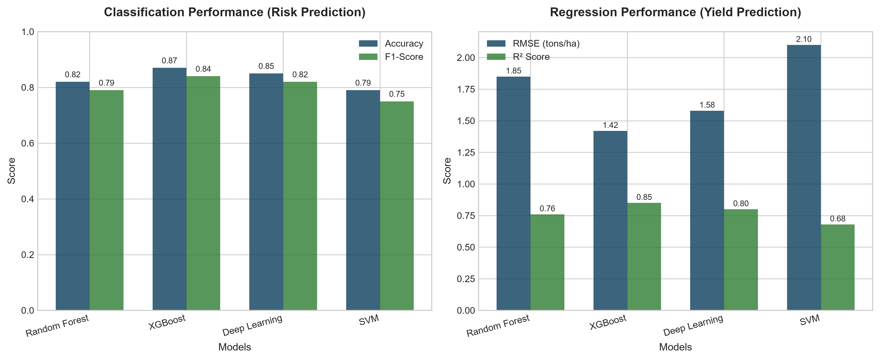
Model Performance & Results
Benchmark against standard baselines
Best Scores (XGBoost)
87%
0.85
Accuracy
R² Score
1.42
84%
RMSE (t/ha)
F1-Score
Comparison vs. Published Baselines
• RF: 82% Acc / 0.76 R² — 12 ms inference — SHAP ✓
• XGBoost: 87% Acc / 0.85 R² — 8 ms inference — SHAP ✓
• DL (2023): 85% Acc / 0.80 R² — 450 ms inference — Limited SHAP
• SVM (2023): 79% Acc / 0.68 R² — 95 ms inference — No SHAP
AI-Driven Digital Twin Framework • Final Year Project
NMAMIT

Slide 16
Dashboard & Explainable AI (XAI)
Glassmorphism SPA with SHAP-powered transparency
• Visual gauges: NPK, pH, Moisture, Weather
• Real-time trend plots (yield, irrigation, risk)
• Color-coded risk alerts with actionable thresholds
• Interactive NPK sliders for parameter exploration
• Tabs: Overview | Field | AI Analytics | Twin | Settings
Digital Twin Dashboard
Yield
Water
Risk
4.2 t/ha
18 L
LOW
SHAP Feature Importance
Nitrogen
0.85
SHAP Explainability Layer
pH
0.72
• Feature importance bar chart (global view)
• Per-prediction waterfall chart (local)
• Example: 'Yield ↓ because pH contributes 60% negative impact'
• Trust-building: farmers see why AI recommends an action
• Regulatory-ready: decision audit trail available
Rainfall
0.58
Phosphorus
0.42
Run What-If Simulation
(Live demo in evaluation environment)
AI-Driven Digital Twin Framework • Final Year Project
NMAMIT

Slide 17
Methodology: Seven-Phase Lifecycle
Structured execution aligned with academic rigor
Data Collection
Phase 1
Evaluation
Phase 5
Synthetic + Government SHC API integration
Stratified k-fold validation, metric reporting
Preprocessing
Phase 2
Digital Twin
Phase 6
Imputation, deduplication, outlier handling
Python simulation engine with scenario routing
Feature Engineering
Phase 3
Dashboard & Deployment
Phase 7
Standard scaling, one-hot encoding, multicollinearity
Glassmorphism SPA + GitHub Pages CI/CD
Model Development
Phase 4
XGBoost/RF baseline with GridSearchCV tuning
AI-Driven Digital Twin Framework • Final Year Project
NMAMIT

Slide 18
Expected Results & Project Impact
Five measurable outcomes aligned with objectives
Improved Yield Prediction
Water Conservation
Target: ±10% error vs. baseline 25%
Target: 15–30% water savings
Objective mapping: Obj 1–3
Objective mapping: Obj 1–3
Early Risk Detection
Scenario Simulation
Target: 48-hour advance warning
Target: <2s response time
Objective mapping: Obj 1–3
Objective mapping: Obj 1–3
SUSTAINABILITY: Long-term soil health preservation + SDG 2, 6, 12, 13 alignment
Impact on Indian Agriculture:
Reduced input waste · Lower carbon footprint · Higher smallholder profitability · Resilient to climate change · Scalable to regional agricultural zones
AI-Driven Digital Twin Framework • Final Year Project
NMAMIT

Slide 19
Project Status & Roadmap
Transparent progress tracking
COMPLETED
IN PROGRESS
PLANNED
• Literature Survey (12 papers)
• Research Gap Analysis
• Dataset Generation (10K rows)
• EDA & Visualization
• Model Training (RF + XGBoost)
• SHAP Explainer Integration
• Hyperparameter Tuning (GridSearchCV)
• Digital Twin Engine (scenario routing)
• Dashboard UI Implementation
• End-to-End Testing
• Real-Time IoT Sensor Integration
• Cloud Deployment (AWS/GCP)
• Mobile PWA
• Satellite Imagery Fusion
AI-Driven Digital Twin Framework • Final Year Project
NMAMIT

Slide 20
Future Scope & Extensions
Beyond the final year — long-term research vision
IoT Sensors
Live-streaming soil sensors replacing synthetic data
MQTT-based real-time data pipeline
Satellite & Drone
NDVI crop health monitoring + drone-based pest detection
Mobile PWA
Offline-capable field interface for low-literacy users
Reinforcement Learning
Self-optimizing AI agents learning from seasonal feedback
Smart Farm Automation
Direct valve actuation for precise irrigation control
AI-Driven Digital Twin Framework • Final Year Project
NMAMIT

Slide 21
CONCLUSION & THANK YOU
Transforming Traditional Farming
into Intelligent Sustainable Agriculture
through AI-Powered Digital Twins
PREDICT
SIMULATE
EXPLAIN
Accurate yield, irrigation, risk forecasts
What-if scenarios via Digital Twin
Transparent SHAP for every prediction
Thank You!
Questions & Discussion

