Slide 1
AI-Driven Digital Twin Framework for Sustainable Agriculture
A What-If Simulation System for Crop Yield, Irrigation, and Risk Assessment
Presented By: K. Venkatesh Hebbar
Guide: Mr. Krishna Prasad D S (Assistant Professor Gd-II)
Project Coordinator: Dr. Radhakrishna (Professor & Head)
Department of Computer and Communication Engineering
NMAM Institute of Technology, Nitte
Notes:
Introduce the project as an AI-powered decision support system that helps farmers predict crop yield, irrigation needs, agricultural risks, and evaluate future farming scenarios using Digital Twin technology.

Slide 2
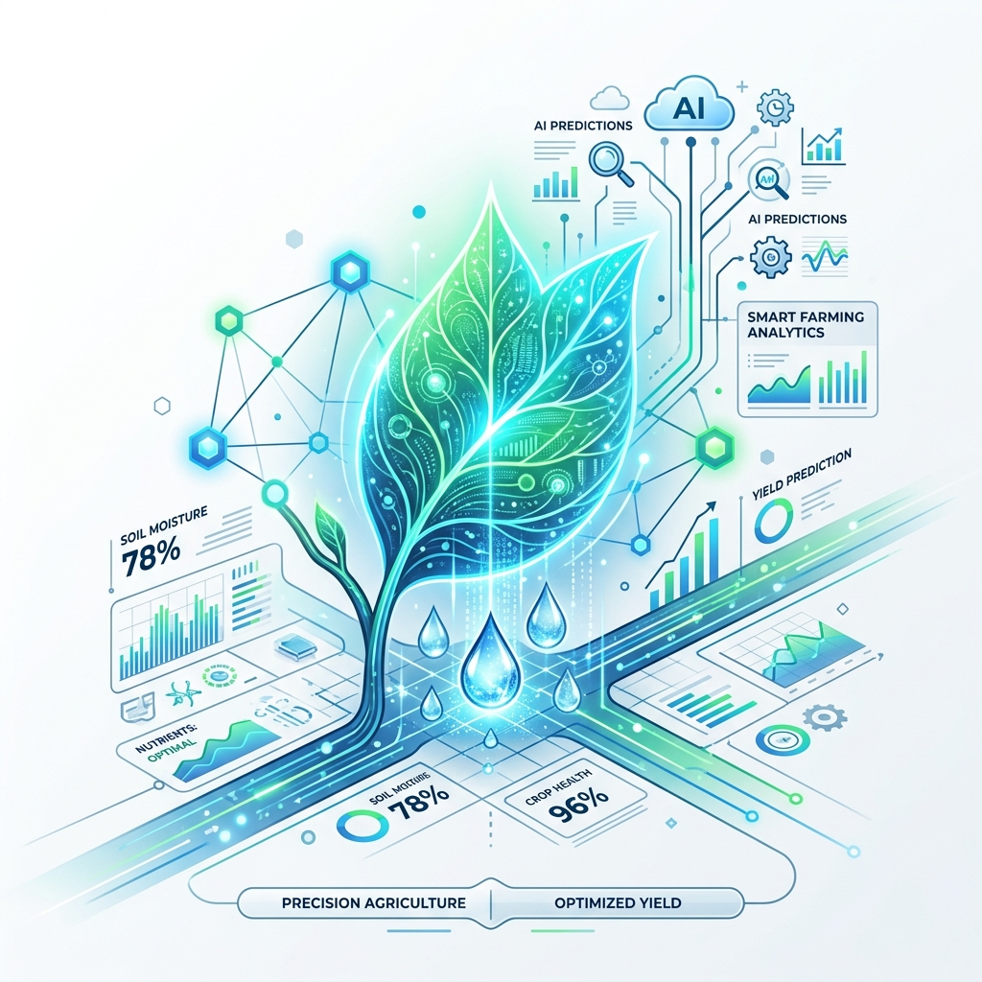
Introduction & Problem Statement
Agriculture Challenges:
• Climate variability & Water scarcity
• Soil degradation & Increasing production demands
Current intelligent farming systems:
• Predict crop yield & Recommend irrigation schedules
• Limitations: Cannot simulate future scenarios, lack integrated decision support
Problem Statement (Farmers need answers to):
• 'What will happen if rainfall decreases?'
• 'What if irrigation is reduced?'
• 'What if fertilizer application increases?'
Notes:
Explain how current systems only provide predictions while farmers require predictive simulation before taking action.

Slide 3
Research Gap & Motivation
Existing Research Focus:
• Crop Yield Prediction, Irrigation Recommendation, Weather, Disease
Research Gap:
Most existing systems work independently (Single objective).
Missing: Integrated framework, Digital Twin, Multi-scenario simulation.
Proposed System vs Existing Systems:
• Prediction + Simulation vs Prediction only
• Multi-objective framework vs Single-purpose models
• Digital Twin enabled vs No simulation
Motivation:
Develop a sustainable agriculture framework to test decisions virtually.
Notes:
Emphasize that the Digital Twin simulation engine is the key novelty and research contribution.

Slide 4
Project Objectives
1. Develop an AI-based Crop Yield Prediction Model.
2. Develop an Intelligent Irrigation Prediction Model.
3. Develop an Agricultural Risk Prediction Module.
4. Implement a Digital Twin Simulation Engine.
5. Develop an Explainable AI Dashboard for decision support.
Notes:
Explain how each objective contributes toward sustainable and intelligent farming.

Slide 5
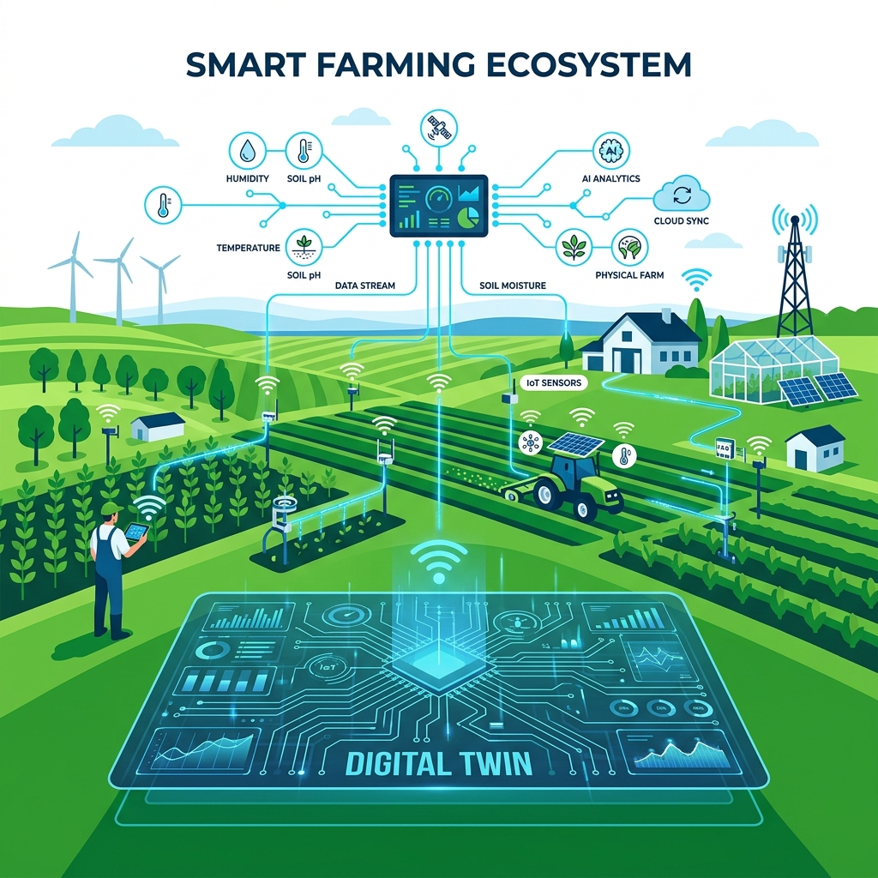
Objective 1 – Crop Yield Prediction
Purpose:
Predict crop yield using environmental and soil parameters.
Input Parameters:
• Nitrogen (N), Phosphorus (P), Potassium (K), pH
• Rainfall, Temperature, Humidity
Algorithms:
• Decision Tree, Random Forest, XGBoost
Evaluation Metrics:
• MAE, RMSE, R² Score
Notes:
Describe how machine learning algorithms learn relationships between environmental factors and crop productivity.

Slide 6
Objectives 2 & 3 – Irrigation & Risk Assessment
Irrigation Prediction:
• Inputs: Soil Moisture, Rainfall, Temp, Humidity, Crop Type
• Outputs: Irrigation Demand, Water Requirement
• Benefits: Water conservation, Efficient scheduling
Agricultural Risk Prediction:
• Risks: Drought, Crop Failure, Water Stress, Climate Variability
• Outputs: Low, Medium, High Risk
• Metrics: Accuracy, Precision, Recall, F1 Score
Notes:
Explain how irrigation optimization and risk prediction improve sustainability and reduce farming losses.

Slide 7
Methodology
Phase 1: Data Collection (Kaggle, UCI, Govt Portals)
Phase 2: Data Preprocessing
• Missing Values, Outliers, Normalization, Encoding, EDA
Phase 3: Model Development
• Yield, Irrigation, and Risk Models
Phase 4: Performance Evaluation
Phase 5: Digital Twin Development
Phase 6: Dashboard Development
Notes:
Walk through the complete workflow from data collection to deployment.

Slide 8
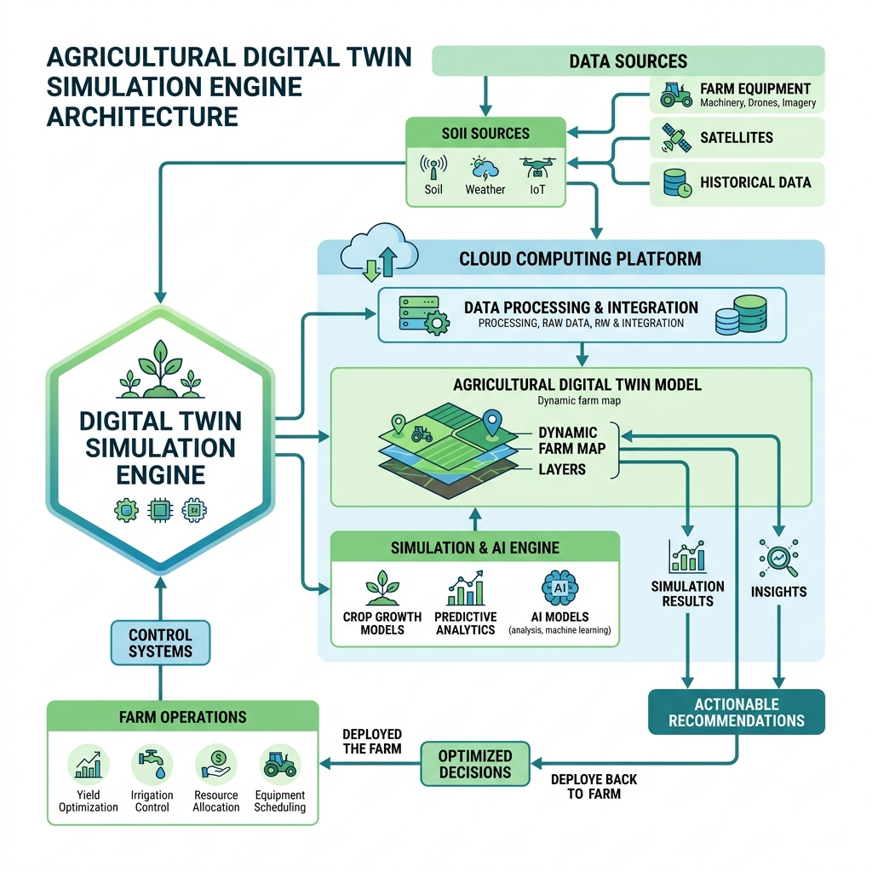
Architecture & Digital Twin Simulation
Digital Twin What-If Simulation Examples:
• Scenario 1: Rainfall decreases by 20%
• Scenario 2: Fertilizer increases by 15%
• Scenario 3: Temperature rises by 3°C
• Scenario 4: Irrigation reduced by 10%
Outputs:
• Yield Changes, Water Requirement, Risk Level
Notes:
Highlight this slide as the core innovation of the project.

Slide 9
Expected Results & Benefits
Expected Performance:
• Yield Prediction R² Score > 90% | Risk Accuracy > 90%
Before Project vs After Project:
• Manual decisions → Data-driven farming
• High uncertainty → Smart irrigation & Early risk detection
• Resource wastage → Sustainable resource utilization
Impact:
• Supports precision agriculture
• Reduces water wastage
• Enhances food security & sustainable farming
Notes:
Discuss the practical benefits to farmers and agricultural planners.

Slide 10
Conclusion & Future Scope
Conclusion:
• Integrated AI-powered Digital Twin framework.
• Simulates future scenarios for smart decision-making.
Future Scope:
• IoT Sensor & Satellite Image Integration
• Weather API & Mobile App Development
• Smart Farm Automation via Reinforcement Learning
Final Message:
"Transforming Traditional Farming into Intelligent Sustainable Agriculture Through AI and Digital Twins"
Notes:
Conclude by emphasizing innovation, sustainability, and real-world impact.

