Slide 1
AI-Driven Digital Twin Framework for Sustainable Agriculture

Slide 2
Introduction: Digital Agriculture
Digital Agriculture is the integration of advanced technologies (AI, IoT) into farming.
It transforms traditional, intuition-based farming into highly precise, data-driven science.
Our project perfectly aligns with the United Nations Sustainable Development Goals (SDGs):
- SDG 2: Zero Hunger (Optimizing crop yields)
- SDG 6: Clean Water and Sanitation (Intelligent irrigation)
- SDG 12: Responsible Consumption and Production (Precise fertilizer use)
- SDG 13: Climate Action (Climate-resilient risk prediction)

Slide 3
Literature Survey: Methodologies & Algorithms
Analyzed recent, verified Journal/Transaction papers (2023-2026).
Algorithms Evaluated:
- Deep Learning + SHAP (High accuracy, transparent, but needs large datasets).
- Lightweight Edge ML (Real-time, local processing, limited by compute power).
- Hybrid ML (Random Forest, XGBoost) combined with Explainable AI.
- Agentic AI & Decision Trees (Autonomous but high setup complexity).
- Feature Correlation KNN (Isolates impactful variables but computationally heavy).

Slide 4
Literature Survey: Current Limitations
Current agricultural ML systems act as strict 'Predict Only' tools.
Major Flaws Identified in Literature:
- Hardware degradation: 'Sensor drift' causes long-term ML accuracy decay (2026).
- Unstructured Data: Hybrid models struggle significantly with erratic meteorological anomalies (2024).
- Scalability: Cloud-based models face extreme latency in rural areas.
- The 'Black Box' Barrier: Farmers reject unexplained AI recommendations.

Slide 5
Literature Survey: Proposed Solution
To overcome the 'Predict Only' limitation, we introduce:
1. Digital Twin Simulation: A virtual replica to test 'What-If' scenarios (e.g., 'What if rainfall drops 20%?').
2. Explainable AI (SHAP): Translates complex AI decisions into human-readable insights to build farmer trust.
This transitions the paradigm from reactive prediction to proactive simulation.

Slide 6
Research Gap Analysis
Existing Research: Provides highly accurate, but static, 'One-Size-Fits-All' recommendations.
Findings: ML models can predict yields, but lack transparency and dynamic simulation.
Limitations: Systems cannot answer hypothetical questions or simulate changing environments.
Missing Features: Dynamic scenario testing, transparent logic interfaces, Digital Twin representation.
Final Gap: There is a critical need to transition from a rigid 'Predict Only' paradigm to a resilient, transparent 'Predict + Simulate Future Scenarios' framework.

Slide 7
Project Objectives
1. Develop an AI-based crop yield prediction model using environmental and soil parameters.
2. Design an intelligent irrigation prediction model for efficient water management.
3. Develop a crop risk prediction module to estimate agricultural risks under varying climates.
4. Implement a Digital Twin simulation engine for interactive 'what-if' scenario analysis.
5. Build an Explainable AI (SHAP) dashboard that provides transparent decision support.

Slide 8
Objective Mapping to Literature
Obj 1 (Yield Prediction): Supported by 2023 (DL+SHAP) and 2024 (Hybrid ML) papers. Solves static NPK calculations.
Obj 2 (Irrigation Prediction): Addresses the critical gap in localized water management tools.
Obj 3 (Risk Prediction): Supported by 2023 & 2024 papers on climate resilience and weather anomalies.
Obj 4 (Digital Twin): Solves the 'Predict Only' limitation identified across all surveyed literature.
Obj 5 (XAI Dashboard): Directly solves the 'Black Box' trust barrier noted in 2023 & 2024 research.

Slide 9
Dataset Details
Synthetic/Advanced Indian Soil Health Data (10,000 rows):
- Source: Custom Generation + Government Portals (Soil Health Cards).
- Objective: Trains Yield, Irrigation, and Risk models.
- Year: Baseline data curated for 2026 execution.
Features Extracted:
- Soil: Nitrogen (N), Phosphorus (P), Potassium (K), pH, Moisture.
- Weather: Rainfall, Temperature, Humidity.
- Farm: Crop Type, Water Usage.

Slide 10
Proposed Workflow
1. Data Collection (IoT / SHC Data)
2. Data Cleaning (Imputation / Outlier Removal)
3. Preprocessing (Standard Scaling / Encoding)
4. Feature Engineering (Multicollinearity Checks)
5. Model Training (Random Forest / XGBoost)
6. Prediction Modules (Yield, Irrigation, Risk)
7. Digital Twin (Scenario Routing)
8. Explainable AI (SHAP Analysis)
9. Dashboard (Glassmorphism UI) -> Decision Support

Slide 11
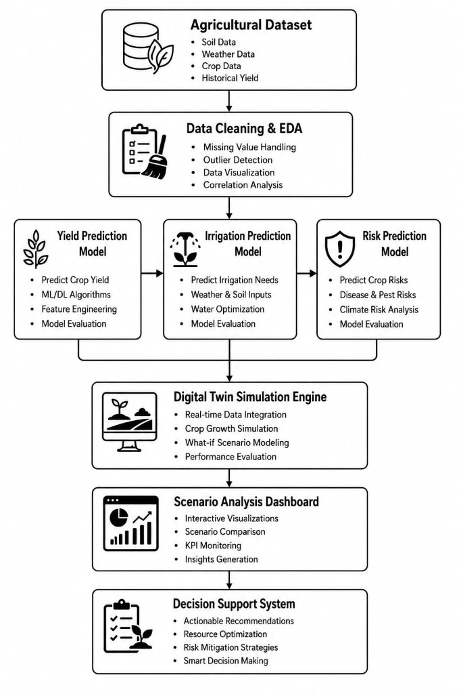
.
System Architecture

Slide 12
Digital Twin Concept
Physical Farm: Tangible Crops, Soil, Sensors, Irrigation, and Weather.
Digital Twin: The Virtual Farm Replica.
Functions: Real-Time Monitoring, Analytics, Simulation, Predictions, Decision Support.
Continuous Feedback Loop:
Physical Farm ↔ Sensors ↔ Data Stream ↔ Digital Twin ↔ AI Models ↔ Recommendations ↔ Physical Farm

Slide 13
Objective 1: Crop Yield Prediction
Inputs: Nitrogen, Phosphorus, Potassium, pH, Crop Type, Historic Weather.
Algorithms: Random Forest, XGBoost (Tree-based for XAI compatibility).
Outputs: Expected Yield (Tons/Hectare).
Metrics: RMSE, R-squared Score, MAE.
Contribution to Twin: Projects final harvest based on simulated soil degradation.

Slide 14
Objective 2: Irrigation Prediction
Inputs: Soil Moisture, Temperature, Humidity, Rainfall Forecast.
Algorithms: Decision Trees, Random Forest.
Outputs: Precise Watering Schedule (Liters / Timing).
Metrics: Accuracy, Precision, Recall.
Contribution to Twin: Simulates soil dry-down to prevent over-watering and nutrient runoff.

Slide 15
Objective 3: Agricultural Risk Prediction
Inputs: Meteorological Anomalies, Extreme Temperature Ranges.
Algorithms: XGBoost Classifier.
Outputs: Risk Probability Percentage (High/Medium/Low).
Metrics: F1-Score, AUC-ROC.
Contribution to Twin: Introduces virtual climatic shocks to test crop resilience.

Slide 16
Methodology Overview
Phase 1: Data Collection (Synthetic generation & API integration).
Phase 2: Data Preprocessing (Imputation, deduplication).
Phase 3: Feature Engineering (Standard Scaling, One-Hot Encoding, Multicollinearity handling).
Phase 4: Model Development (XGBoost/RF baseline with GridSearchCV tuning).
Phase 5: Model Evaluation (Strict validation scoring).
Phase 6: Digital Twin Development (Python logic routing).
Phase 7: Dashboard Development (SPA integration).

Slide 17
Dashboard & Explainable AI (XAI)
Dashboard Features (Glassmorphism SPA):
- Visual gauges for Soil Status (NPK, Moisture) & Weather.
- Numerical outputs for Yield and Irrigation scheduling.
- Color-coded Risk Alerts and Historical Trend plotting.
Explainable AI (SHAP):
- Unlocks the 'Black Box'.
- Feature Importance Breakdown.
- Decision Explanation (e.g., 'Yield reduced because pH contributed 60% negative impact').

Slide 18
Expected Results
1. Improved Yield Prediction: Accurate, localized forecasting overriding generic regional estimates.
2. Better Irrigation Planning: Prevention of water wastage and chemical runoff.
3. Early Risk Detection: Actionable alerts prior to climatic shocks.
4. Scenario Simulation: Farmers can safely test 'What-If' decisions virtually.
5. Sustainable Agriculture: Long-term preservation of soil health aligned with SDGs.

Slide 19
Project Status
COMPLETED:
- Literature Survey & Gap Analysis
- Objective Definition & Architecture Design
- Dataset Generation & Advanced EDA
IN PROGRESS:
- Model Development (Hyperparameter tuning)
- Digital Twin Engine (API routing)
- Dashboard UI Implementation
PLANNED:
- Real-Time Validation & Cloud Deployment

Slide 20
Future Scope
IoT Deployment: Replacing synthetic data with live-streaming soil sensors.
Satellite Imagery: Fusing ML models with remote sensing for macro-analysis.
Mobile App: Progressive Web App (PWA) for field access.
Reinforcement Learning: Self-optimizing AI agents that learn from seasonal feedback.
Smart Farm Automation: Direct integration with automated irrigation valves.

Slide 21
Conclusion & Thank You
By transitioning from static predictions to interactive, transparent simulations, this AI-Driven Digital Twin Framework empowers smallholder farmers.
It bridges the gap between global AI capabilities and the localized needs of Indian agriculture, fostering sustainability and resilience.
Thank You.

