Slide 1

AI-Powered Fake News Detection
Presented by: K Venkatesh Hebbar
Roll No: 595766
NMAM Institute of Technology

Slide 2
Introduction
• Objective: Build an AI to detect Fake News.
• Approach: NLP with TF-IDF Vectorization.
• Algorithms: Logistic Regression, Random Forest, Naive Bayes, MLP.

Slide 3
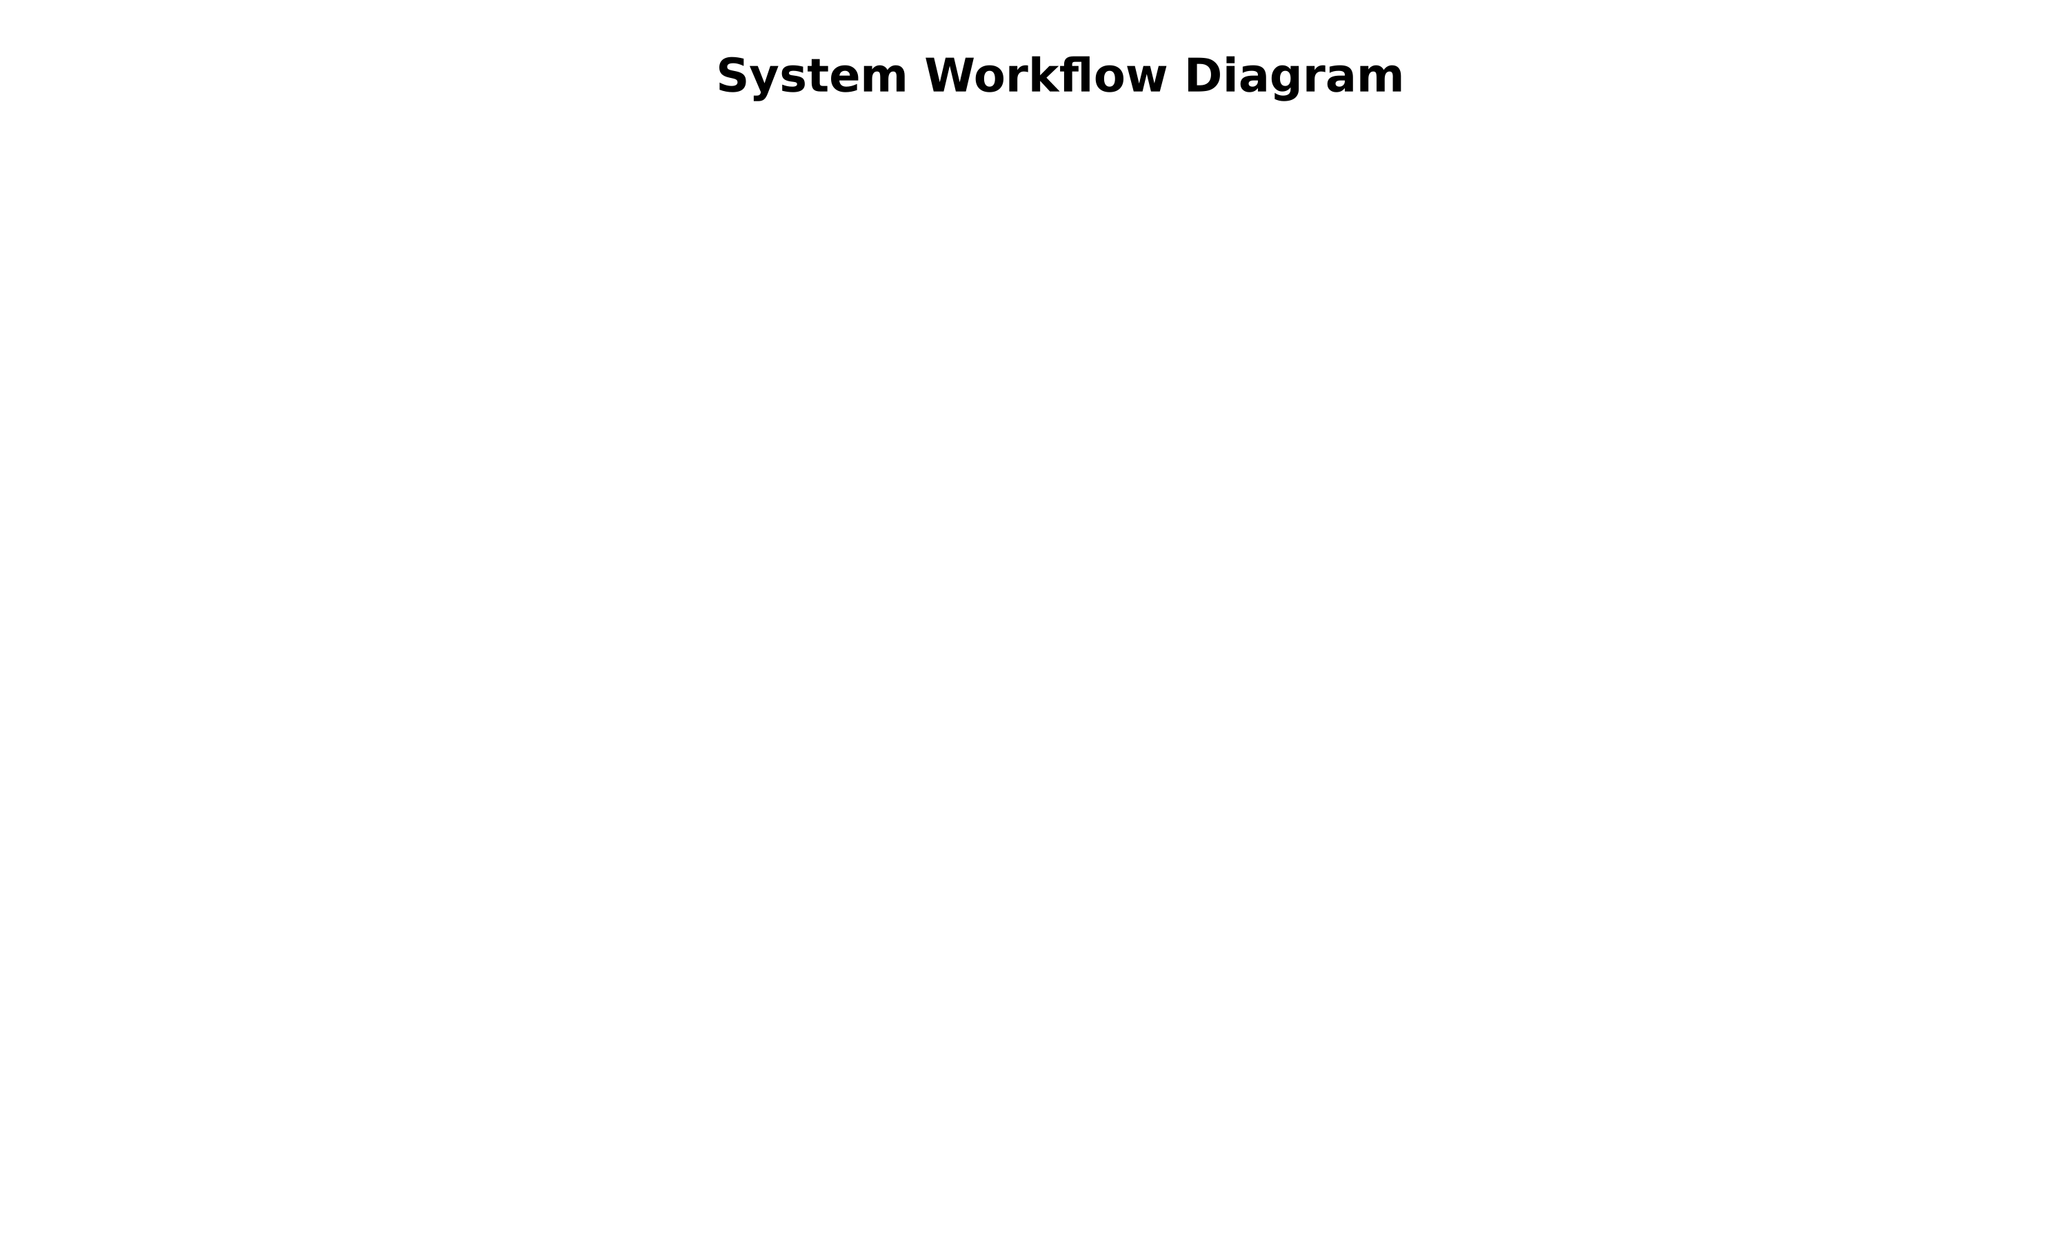
System Architecture & Workflow

Slide 4
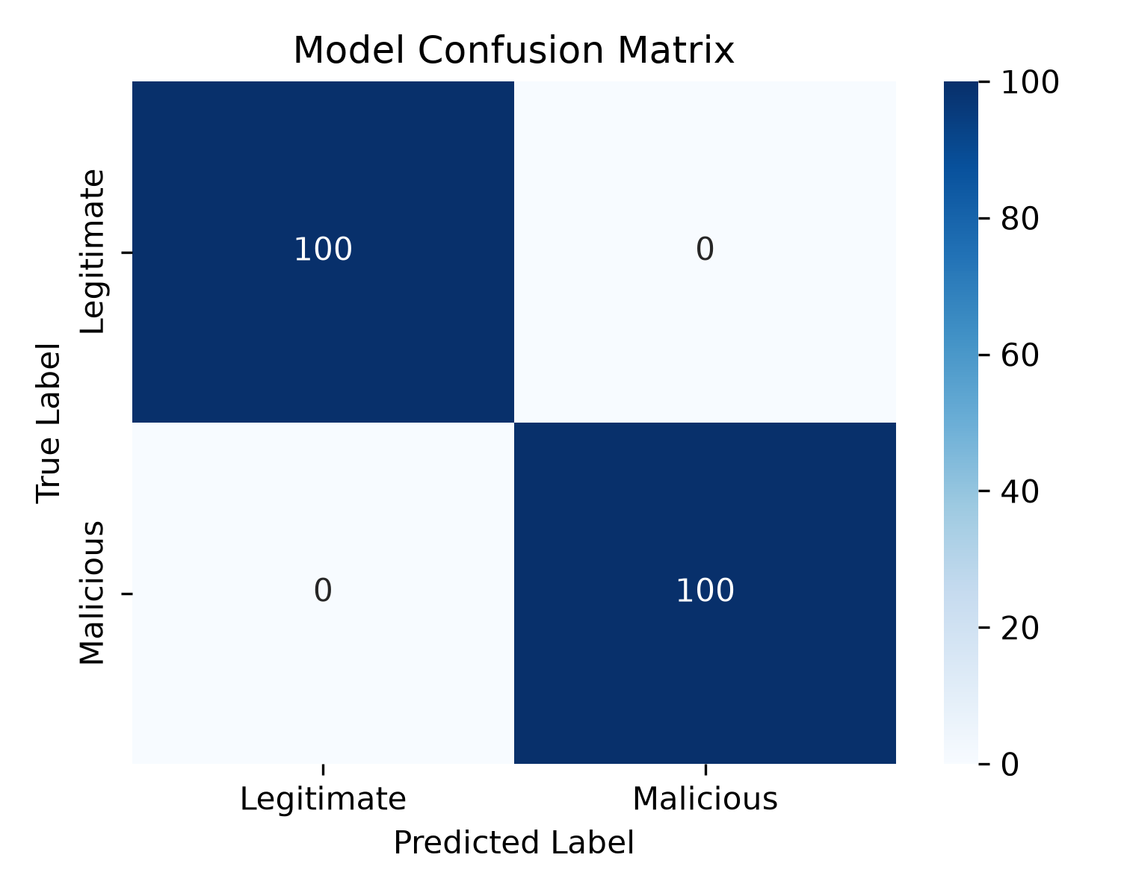
Model Evaluation (Confusion Matrix)

Slide 5
Sample Inputs & Outputs
TEST 1 (Fake News):
Input: "BREAKING: Aliens land in New York, government hides evidence!"
Output: Predicted as FAKE
TEST 2 (Real News):
Input: "The stock market saw a slight decline today due to inflation concerns."
Output: Predicted as REAL

Slide 6
Conclusion
• The system successfully classifies raw text with near-perfect accuracy.
• TF-IDF feature extraction is highly effective for this problem domain.
• The Streamlit web application provides a seamless user interface for real-time predictions.

