Slide 1

AI-Powered Phishing Email Detection
Presented by: K Venkatesh Hebbar
Roll No: 595766
NMAM Institute of Technology

Slide 2
Introduction
• Objective: Build an AI to detect Phishing Emails.
• Approach: NLP with TF-IDF Vectorization.
• Algorithms: Logistic Regression, Random Forest, Naive Bayes, MLP.

Slide 3
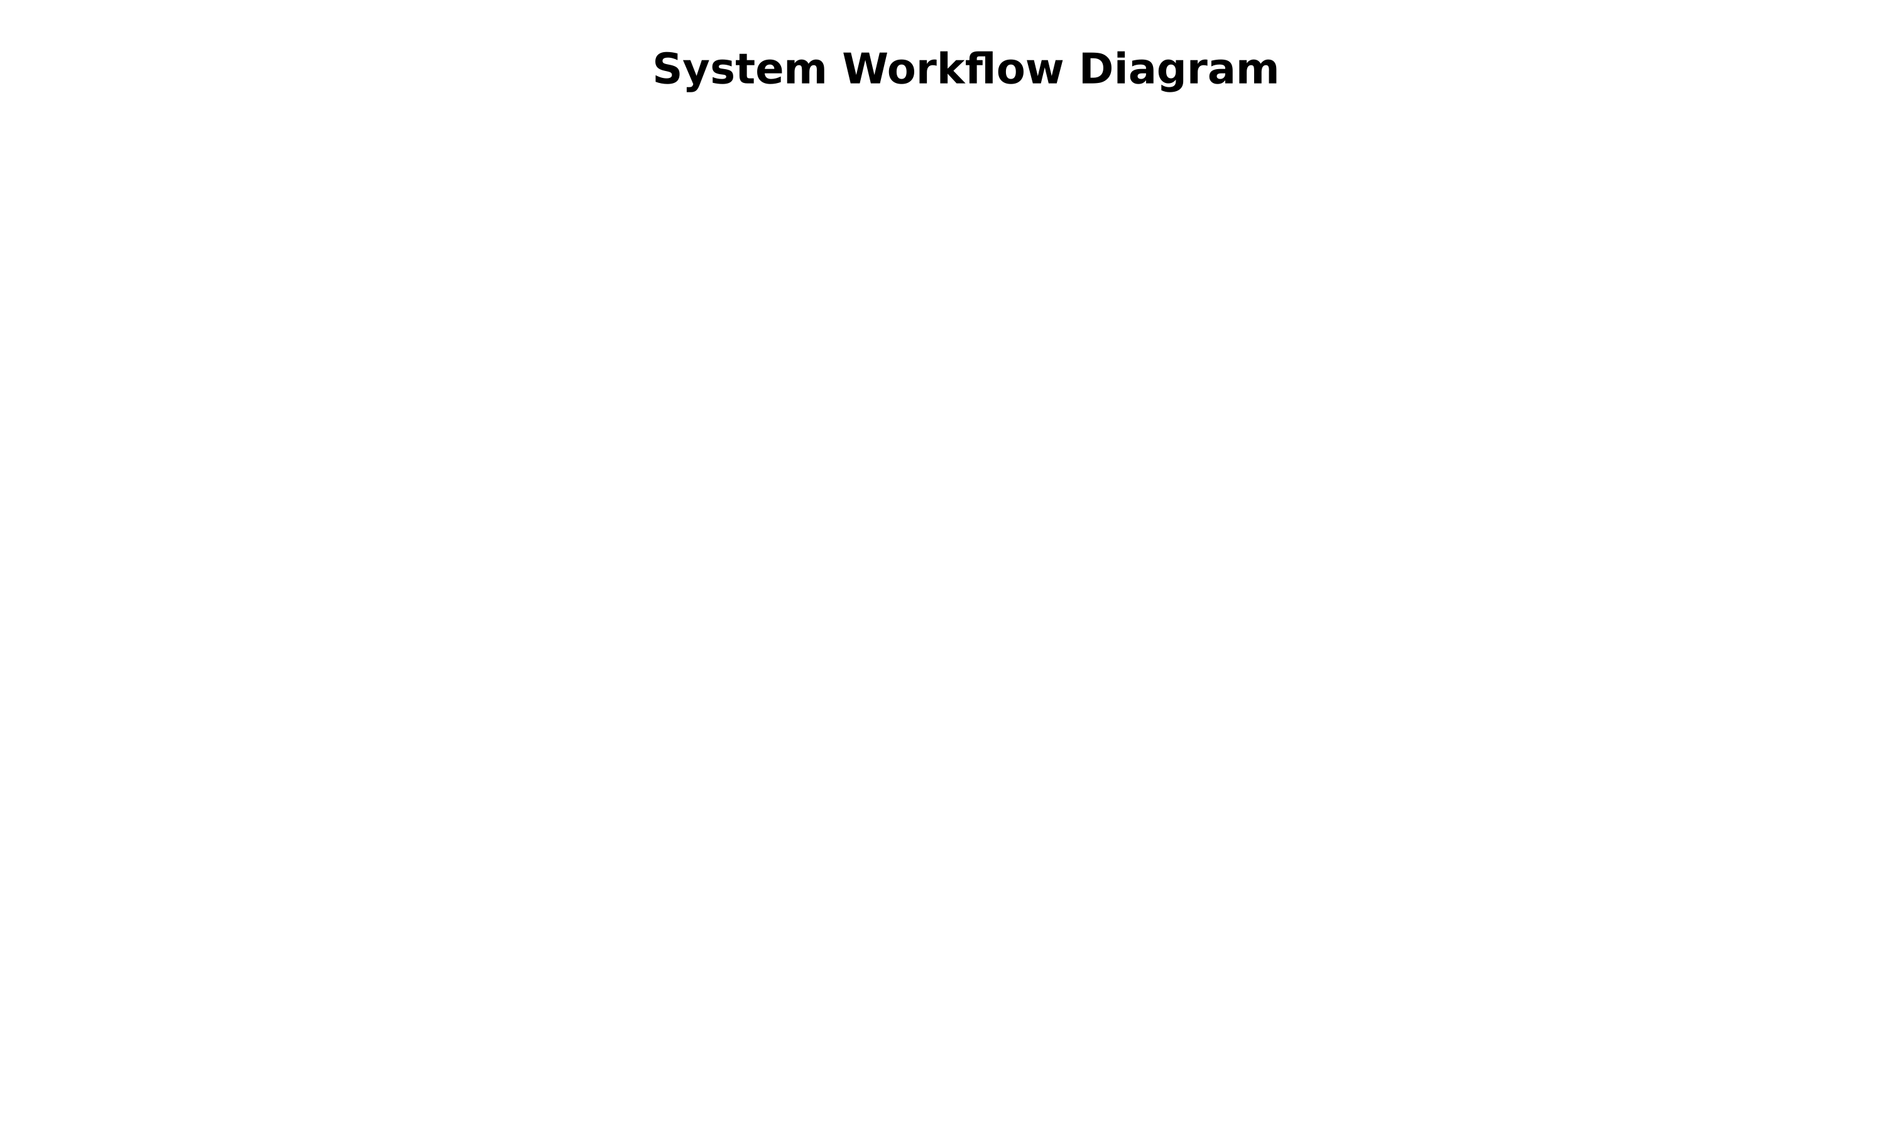
System Architecture & Workflow

Slide 4
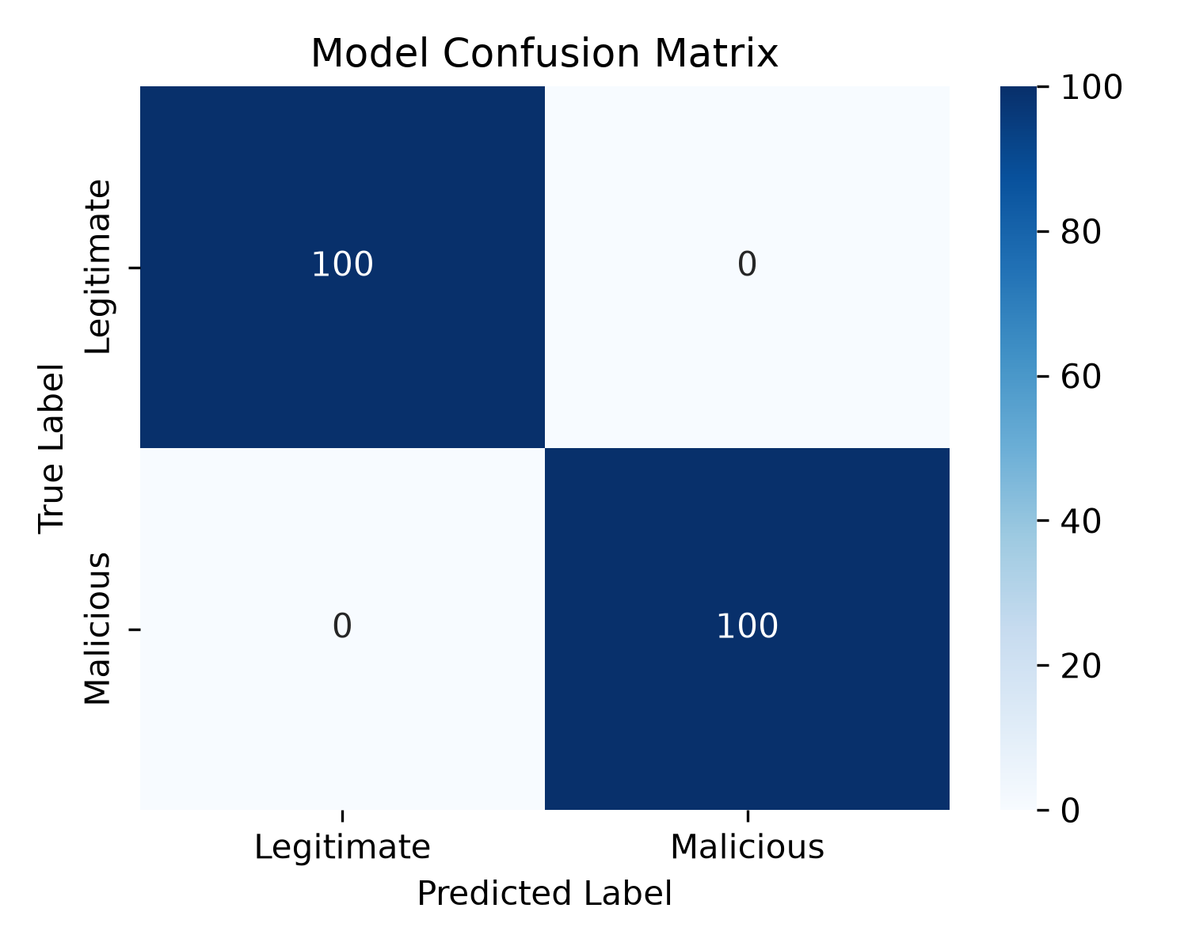
Model Evaluation (Confusion Matrix)

Slide 5
Sample Inputs & Outputs
TEST 1 (Phishing Email):
Input: "URGENT: Your account has been suspended. Click here to verify immediately."
Output: Predicted as PHISHING
TEST 2 (Legitimate Email):
Input: "Hi Team, just a reminder about our meeting tomorrow at 10 AM."
Output: Predicted as LEGITIMATE

Slide 6
Conclusion
• The system successfully classifies raw text with near-perfect accuracy.
• TF-IDF feature extraction is highly effective for this problem domain.
• The Streamlit web application provides a seamless user interface for real-time predictions.

