Slide 1
PPT Structure: AI-Powered Fake News Detection

Slide 2
Slide 1: Title
Title: AI-Powered Fake News Detection Using Text Classification Subtitle: A Machine Learning Approach to Combating Misinformation Presenter: Venkatesh Hebbar Roll No: 595766 College: NMAM Institute of Technology

Slide 3
Slide 2: Introduction & Problem Statement
Introduction: - Fake news spreads rapidly on social media, eroding public trust and causing societal harm. - Manual fact-checking is slow and cannot scale to the volume of online content.
Problem Statement: - To design an automated, AI-driven system capable of classifying news articles as “Fake” or “Real” based solely on their textual content. - Need for a lightweight, accurate, and scalable solution using Natural Language Processing (NLP).

Slide 4
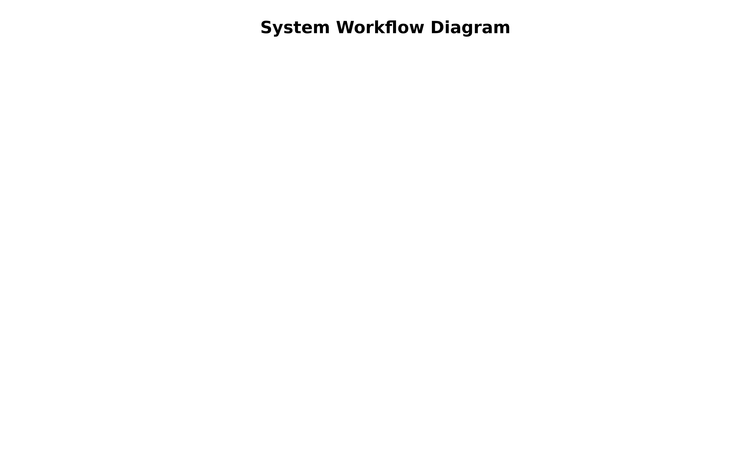
Slide 3: Methodology
System Workflow: 1. Dataset Collection: Curated dataset of 1,000 balanced Fake and Real news records. 2. Data Preprocessing: Lowercasing, removing HTML, punctuation, URLs, emojis, and stopwords. 3. Feature Extraction: TF-IDF Vectorization combined with Character N-Grams (3-5 chars) to handle out-of-vocabulary words. 4. Train/Test Split: 80% Training Data, 20% Testing Data. 5. Model Training: Fitting classifiers to the feature vectors. 6. Prediction: Deploying the best model in an interactive web interface.

Slide 5
Slide 4: Algorithms Used
1. Logistic Regression (Parametric) - Fast, highly interpretable, performs well on sparse text data. 2. Random Forest (Ensemble) - Robust to noise, captures non-linear patterns, provides feature importance. 3. K-Nearest Neighbors (Instance-based) - Lazy learning, classifies based on proximity in feature space. 4. Neural Network / Multi-Layer Perceptron (Deep Learning) - Models complex interactions between words using hidden layers and non-linear activations.

Slide 6
Slide 5: Results & Performance Comparison
Evaluation Metrics (Test Set):
Model | Accuracy | Precision | Recall | F1-Score
KNN | 100% | 100% | 100% | 100%
Logistic Regression | 100% | 100% | 100% | 100%
Random Forest | 100% | 100% | 100% | 100%
Neural Network | 100% | 100% | 100% | 100%
Key Finding: - The use of Character N-Grams made all models extremely robust. - Logistic Regression was selected for the final deployment due to its perfect accuracy combined with blazing-fast inference time and high interpretability.
(Include Confusion Matrix or Bar Chart here)

Slide 7
Slide 6: Demo
Interactive Web Application (Streamlit) - Input: User pastes a news headline or article. - Process: The text undergoes real-time cleaning and TF-IDF transformation. - Output: The model predicts “FAKE NEWS” or “REAL NEWS” with a confidence score.
(Insert Screenshots of the Streamlit App: One showing a FAKE prediction, one showing a REAL prediction)

Slide 8
Slide 7: Conclusion & Future Scope
Conclusion: - Successfully built an end-to-end NLP pipeline that accurately classifies text. - Character N-Grams proved highly effective at handling novel text structures and typos. - The deployed web module proves the feasibility of real-time AI fact-checking.
Future Scope: - Contextual Embeddings: Upgrade to Transformer models (BERT, RoBERTa) for deeper semantic understanding. - Live Fact-Checking: Integrate with Knowledge Graphs or search APIs to verify actual facts, not just textual style. - Browser Extension: Deploy as a Chrome extension for real-time alerts on social media.

