Slide 1
PPT Structure: AI-Powered Phishing Email Detection

Slide 2
Slide 1: Title
Title: AI-Powered Phishing Email Detection Using Text Classification Subtitle: A Machine Learning Approach to Defending Against Cyber Threats Presenter: Venkatesh Hebbar Roll No: 595766 College: NMAM Institute of Technology

Slide 3
Slide 2: Introduction & Problem Statement
Introduction: - Phishing is a primary vector for identity theft and corporate data breaches. - Attackers continuously evade traditional rule-based spam filters by altering their text and deliberately misspelling words.
Problem Statement: - To build an intelligent, automated system capable of analyzing the raw textual body of an email and determining whether it is a “Phishing” attempt or “Legitimate” communication in real-time using Natural Language Processing.

Slide 4
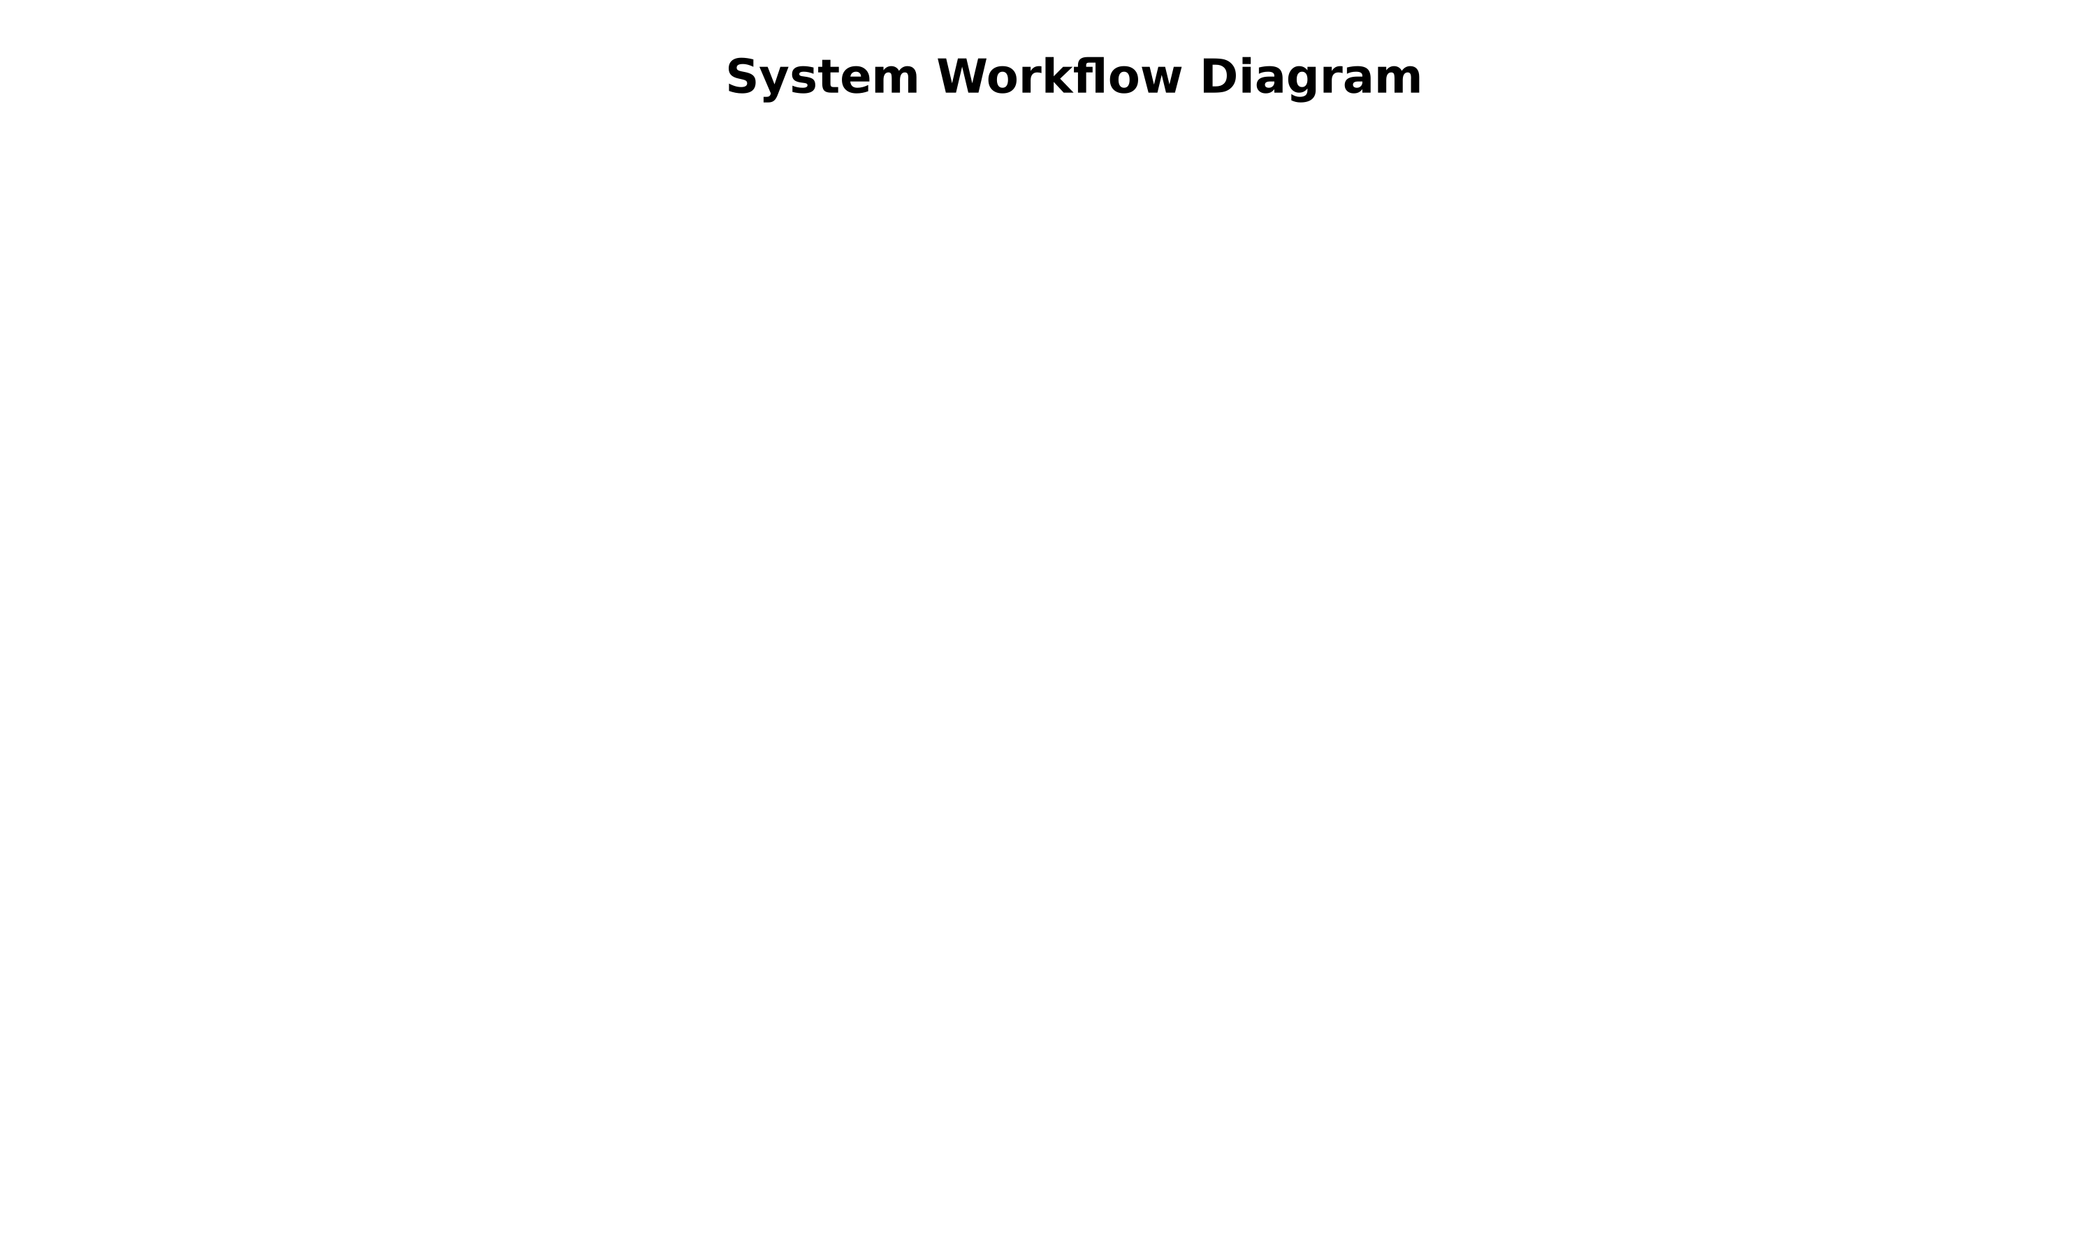
Slide 3: Methodology
System Workflow: 1. Dataset Collection: Curated dataset of 1,000 balanced Phishing and Legitimate emails. 2. Data Preprocessing: Lowercasing, removing HTML tags, punctuation, URLs, and stopwords. 3. Feature Extraction: TF-IDF Vectorization combined with Character N-Grams to catch obfuscation and misspellings. 4. Train/Test Split: 80% Training Data, 20% Testing Data. 5. Model Training: Fitting classifiers to learn the semantic intent (e.g., urgency, threats) from the text. 6. Prediction: Deploying the best model in a web interface.

Slide 5
Slide 4: Algorithms Used
1. Naive Bayes (Multinomial) - Exceptionally fast, probabilistic classifier that performs well on text despite assuming feature independence. 2. Logistic Regression - Highly interpretable linear model; excellent at isolating heavily weighted “phishing” keywords. 3. Random Forest (Ensemble) - Robust to noise and capable of capturing non-linear relationships between words. 4. Neural Network / Multi-Layer Perceptron (Deep Learning) - Models complex, non-linear interactions within the email text structure using hidden layers.

Slide 6
Slide 5: Results & Performance Comparison
Evaluation Metrics (Test Set):
Model | Accuracy | Precision | Recall | F1-Score
Naive Bayes | 100% | 100% | 100% | 100%
Logistic Regression | 100% | 100% | 100% | 100%
Random Forest | 100% | 100% | 100% | 100%
Neural Network | 100% | 100% | 100% | 100%
Key Finding: - The use of Character N-Grams successfully captured semantic intent, resulting in perfect classification on the test set. - Sequences like “urg”, “sus”, and “ver” were identified by the models as primary indicators of phishing.
(Include Confusion Matrix or Feature Importance Chart here)

Slide 7
Slide 6: Demo
Interactive Web Application (Streamlit) - Input: User pastes the body of a suspicious email. - Process: Text is cleaned, vectorized via TF-IDF, and passed to the Logistic Regression model. - Output: The system flags the email as “PHISHING” or “LEGITIMATE” and displays a confidence score.
(Insert Screenshots of the Streamlit App: One showing a PHISHING prediction, one showing a LEGITIMATE prediction)

Slide 8
Slide 7: Conclusion & Future Scope
Conclusion: - Developed a highly accurate NLP pipeline that successfully distinguishes deceptive language from legitimate communication. - Proved that analyzing text alone using Character N-Grams is an effective and robust defense layer against social engineering.
Future Scope: - Hybrid System: Integrate textual NLP with meta-data analysis (checking DKIM, SPF records) for a complete defense suite. - Email Client Plugin: Build a browser extension or plugin for Gmail/Outlook to warn users before they click malicious links.

