Slide 1

AtliQ Hospitality Analysis
Designed and Presented By
Venkatramana E

Slide 2

Introduction
Your Search for dataset, ends here 😀
As part of this challenge, we have to provide insights to the revenue team of AtliQ hotels by utilizing the provided data

Slide 3
AtliQ
Delhi
Bangalore
Mumbai
Hyderabad
Atliq Bay
Atliq Blu
Atliq City
Atliq Grands
Atliq Palace
Atliq Bay
Atliq Blu
Atliq City
Atliq Exotica
Atliq Grands
Atliq Palace
Atliq Bay
Atliq Blu
Atliq City
Atliq Exotica
Atliq Grands
Atliq Palace
Atliq Seasons
Atliq Bay
Atliq Blu
Atliq City
Atliq Exotica
Atliq Grands
Atliq Palace

Slide 4
Dataset Details
We are provided 3 moths booking details data of all the atliq hotels.
Dataset contains 5 excel files.
Dim_date
Dim_hotels
Dim_rooms
Fact_aggregated_bookings
Fact_bookings
Metric list excel file
Mock-up Dashboard

Slide 5
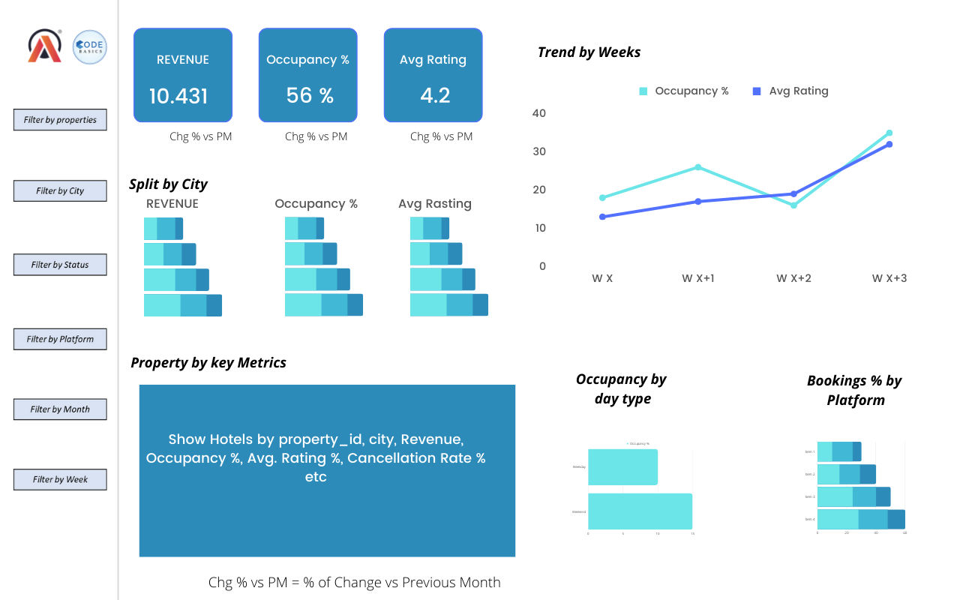
Mock-up Dashboard

Slide 6
Expected outcome after this analysis?
Regain their market share in the luxury/business hotels category.
Understanding the revenue trend by week/month/day
To get insights where business is failing and what can be done to tackle them

Slide 7
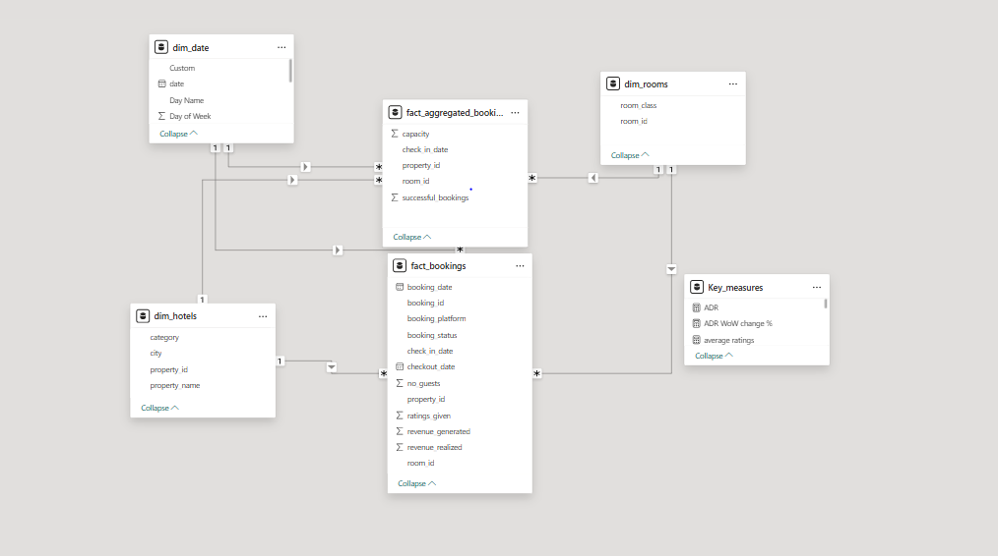
Data Model

Slide 8
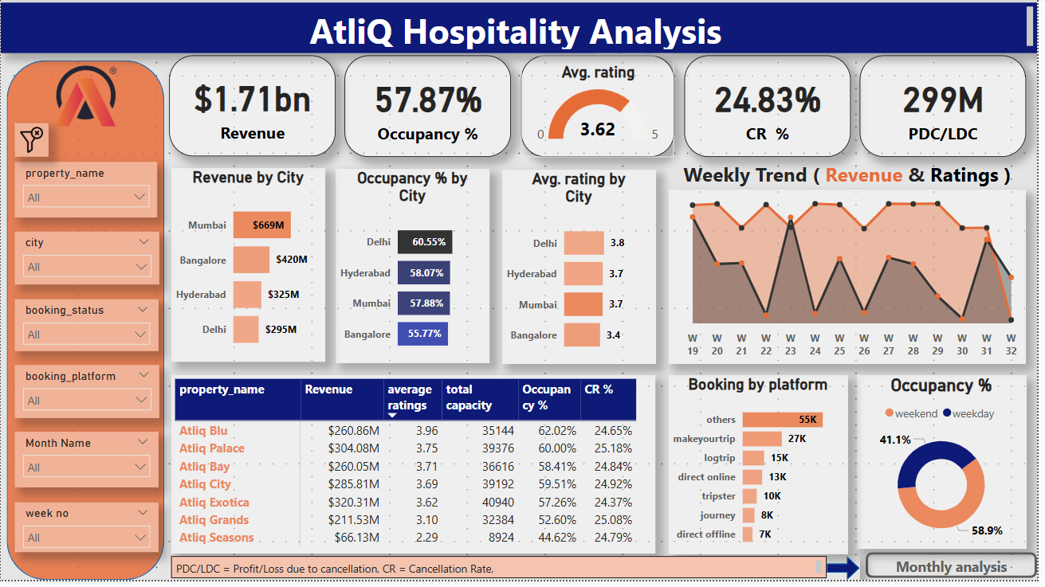
Overall Analysis Dashboard View

Slide 9
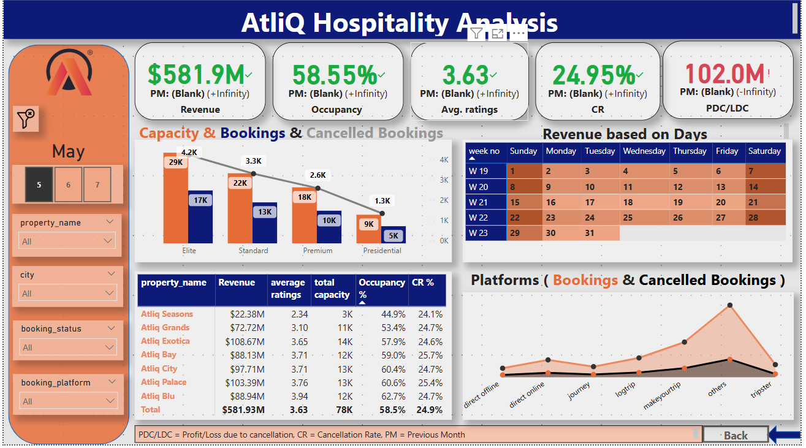
Monthly Analysis Dashboard View

Slide 10
Important insights from the Dashboard
Mumbai generates the highest revenue (669 M) followed by Bangalore, Hyderabad and Delhi
AtliQ Exotica performs better compared to all 7 type of properties with 320 Million revenue, rating 3.62, occupancy percentage 57 and cancellation rate as 24.4%.
AtliQ Blu has the highest occupancy of 62%
Week 29 recorded the highest revenue among all, which is 139.7 Million
Delhi tops both in occupancy and rating followed by Hyderabad, Mumbai, Bangalore
Weekend Occupancy is more when compared with weekdays
Elite type rooms has the most booking and as well higher cancellation rate

Slide 11


