Slide 1
ONLINE OUTPATIENTS APPOINTMENT AND HOSPITAL INFORMATION SYSTEM
Presented By:
M.UDHAYASHANKAR (B20CS060)
S.YUVARAJ (B20CS065)
S.KESAVAMURTHY(b20cs305)
s.VENKATESH(B20CS315)

Slide 2
ABSTRACT
Current hospital system for managing visiting doctor slips is manual and relies on paper forms.This manual system leads to incomplete data, inconsistencies in data across different departments, and loss of forms.Hospitals need to manage large volumes of information related to doctors, patients, rooms, and departments.Hospital token management proposes an automated system to manage hospital operations.The goal is to make the hospital system more efficient, error-free, and cost-effective for outdoor patients.

Slide 3
PROJECT OVERVIEW
The Online Outpatients Department (OPD) Appointment and Hospital Information System is a web-based application project.
The project aims to develop an application that allows patients to schedule and manage appointments with doctors in a hospital's OPD.
Patients will be able to create and manage their accounts, view doctors' schedules and availability, and book appointments online.
The application will also allow patients to receive reminders about their upcoming appointments, cancel or reschedule appointments, and view their medical history and test reports online.

Slide 4
DOMAIN
Frontend - The frontend is the user-facing part of the system, which includes the website or application that patients and staff use to interact with the system. The frontend should be designed to be user-friendly, accessible, and responsive, and should allow patients to schedule appointments, view their medical records, and receive notifications.
The project will be developed using modern web technologies such as HTML, CSS, JavaScript, and PHP.
Backend –SQL using Firebase tool in Android Studio

Slide 5
EXISTING SYSTEM
This paper proposed an online patient appointment scheduling system built on the Web Services architecture in a heterogeneous healthcare environment.
It shows that the Web Services architecture provides an appropriate paradigm for the development of an integrated health system which enables the communication among heterogeneous, autonomous and distributed healthcare information systems.

Slide 6
PROPOSED SYSTEM
The methodology of project is consist of four modules Admin module, Doctor module,Patient module. If the patient enter into hospital first, they have to register their name at reception counter. According to their problem they can take appointment of particular specialist. The name of all the patients will display on the digital display screen which is placed outside of all the department. For display the name of patients this system use queue technique to display the name one by one. In this Employee first register and login in employee module then register name of patients and give initial treatment to patients if there is any emergency then they send patients to specialist according to their problem otherwise they generate bill with prescription.

Slide 7
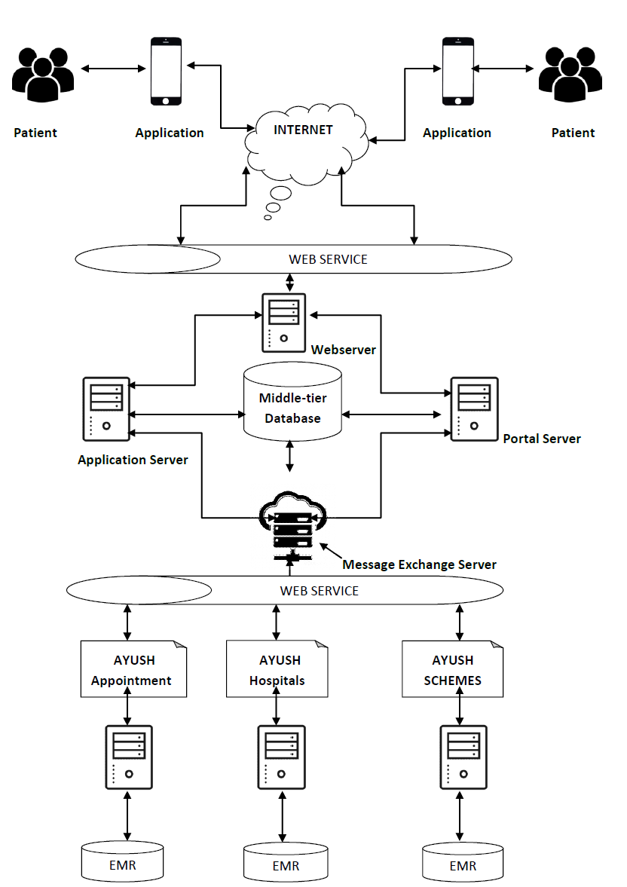
ARCHITECTURE
Appointment scheduling module: This module should allow patients to schedule appointments online, view available appointment times, and receive notifications about their appointments. It should also allow staff to manage appointments, reschedule or cancel appointments, and view patient information.
Medical records module: This module should allow patients and staff to view and update medical records online. It should include features such as electronic prescriptions, lab results, and radiology images.

Slide 8
ADVANTAGES
Increased Efficiency: An online appointment and hospital information system can help streamline hospital operations by automating tasks such as appointment scheduling, patient registration, and billing. This can reduce the workload for staff and improve the overall efficiency of the hospital.
Cost-Effective: An online appointment and hospital information system can reduce the need for manual administrative tasks, such as paper-based appointment scheduling, registration, and billing. This can reduce costs associated with staffing, paper, and storage.

Slide 9
DISADVANTAGES
Technical Issues: The online system is dependent on technology and may encounter technical issues such as system failures or crashes. These issues can disrupt the hospital's operations, including appointment scheduling, record-keeping, and communication.
Cybersecurity Risks: With an online system comes the risk of data breaches and cyber attacks. Hackers may attempt to gain access to patient records or other sensitive information, which can lead to legal and financial consequences for the hospital.

Slide 10
SOFTWARE HARDWARE REQUIREMENT
HARDWARE REQUIREMENTS
Processor :Dual core processor2.6.0 GHZ
RAM : 4GB
HARD DISK : 512 GB
Compact Disk :650 MB
Keyboard :Standard Keyboard
Monitor :15-inch Color monitor

Slide 11
SOFTWARE REQUIREMENTS
Operating system : Windows OS( 7, 8)
Front End : HTML,CSS
Back End : MYSQL, PHP

Slide 12
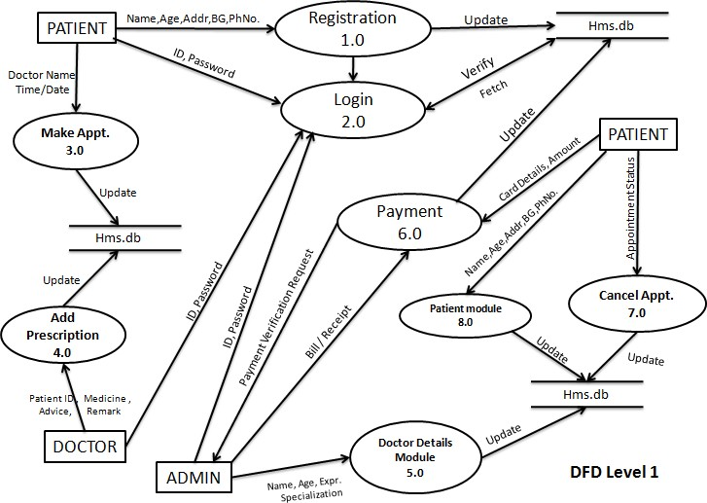
DATA FLOW DIAGRAM

Slide 13
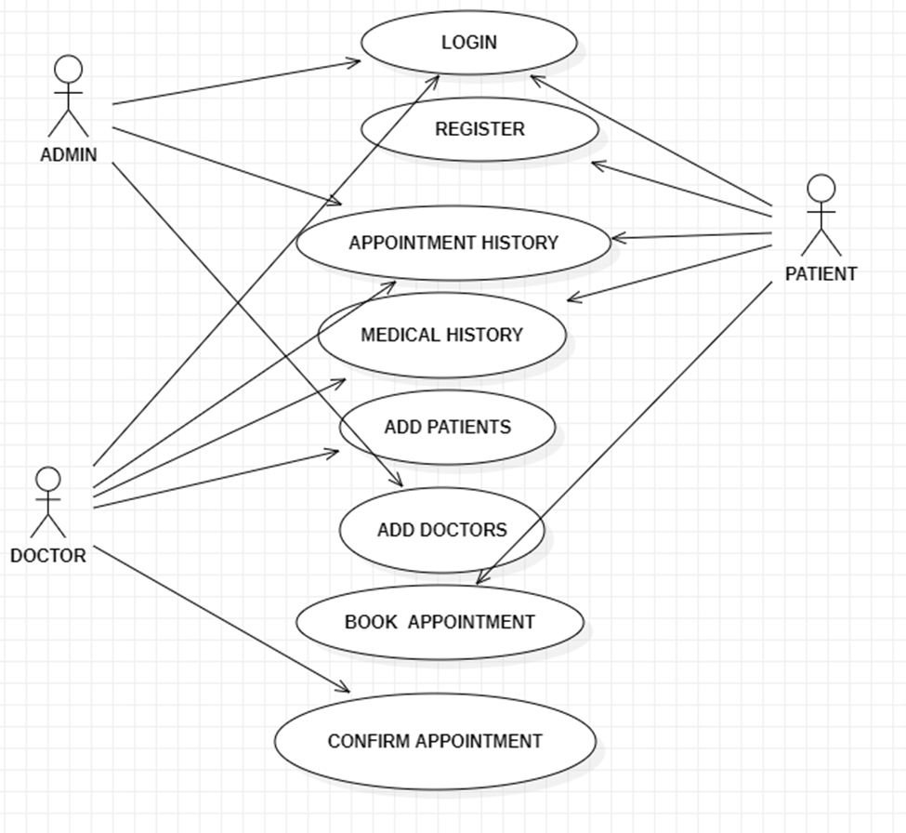
USE CASE DIAGRAM

Slide 14
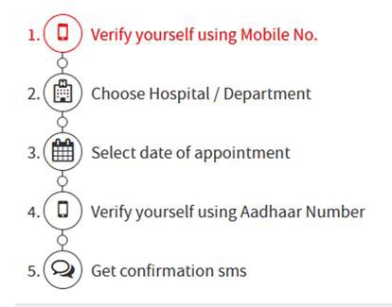
MODULE
STEPS
DIAGRAM
VERIFICATION
In this Process the Users may Create his Account by their Mobile Number.
CHOOSE HOSPITAL/DEPARTMENT
After login the user may choose the Hospital and AYUSH Departments.

Slide 15
MODULE
SELECT DATE FOR APPOINTMENT
Next the User select the date of the Appointment in the Date & Time Schedule
VERIFY USING AADHAR
After Fixing an Appointment the Users Aadhar Number may Verified by this Process.
GET CONFIRMATION SMS
User get Acknowledgement by the Confirmation Message (OTP)

Slide 16
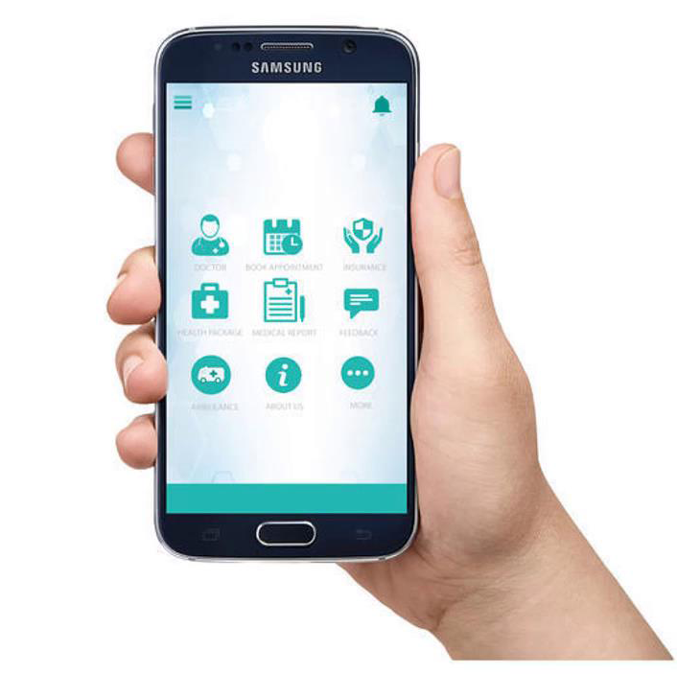
FUTURE SCOPE
Online appointment
General information about the hospital
Services available
Pathology reports view/download

Slide 17
CONCLUSION
The paper proposes an online patient appointment scheduling system using a mobile application in an AYUSH care environment.
The system uses an integrated health information system that enables communication among heterogeneous, autonomous, and distributed AYUSH information systems.
The prototype system demonstrates the feasibility of the proposed architecture.
Future work will focus on integrating new clinical applications into the system.
The mobile application must be easier to use for users and provide more advantages.The appointment time management must be reduced.

