Slide 1
Intro to Android and iOS
CS-328
Dick Steflik

Slide 2
The Players
Android – Open source mobile OS developed ny the Open Handset Alliance led by Google. Based on Linux 2.6 kernel
iOS – Apple’s proprietary mobile OS, iPhone, iPod Touch, iPad. Derived from OS X, very UNIX like
Symbian – acquired by Nokia 2008
Windows Phone 7 – Microsoft – Kin, discontinued 6 weeks after initial launch
Blackberry OS – RIM (Research in Motion), proprietary OS

Slide 3
The Smartphone Platform
With the iPhone being the first to the marketplace it sets the configuration of the Smartphone Platform
  3G/4G connectivity
  WiFi connectivity
  Bluetooth connectivity
  accelerometer w/compass
  ambient light sensor
  proximity sensor
  GPS
  gyroscope

Slide 4
What is Android
Android is an open source operating system, created by Google specifically for use on mobile devices (cell phones and tablets)
Linux based (2.6 kernel)
Can be programmed in C/C++ but most app development is done in Java (Java access to C Libraries via JNI (Java Native Interface))
Supports Bluetooth, Wi-Fi, and 3G and 4G networking

Slide 5
What is iOS
Apple’s mobile OS for phones (iPhone), tablets (iPad), handhelds (iPod),
based on BSD Unix
Application programming done in Objective C
Supports Bluetooth, Wi-Fi, and 3G and 4G networking

Slide 6
Bluetooth
Open wireless technology
  Developed by Ericsson (1994)
  Originally supposed to replace wired RS-232
  Short distance via low power, short distance radio
  Allows creation of personal area networks
    Mostly to connect wireless peripheral devices to a host computer (mice, headsets, microphones, keyboards…)
  Can also be used to communicate between two host computers wirelessly (replace serial cables)

Slide 7
Wi-Fi
Used to brand certified products that belong to a class of wireless local area network based on IEEE Standard 802.11
Currently there are 3 versions of 802.11 in common use:
  B, about 150 feet indoors, 300 ft outdoors
  G, 54 Mbits about 150 feet indoors, 300 ft outdoors
  N, 600 Mbits, about 1.5 miles in open air, uses MIMO (multiple input and output antennas)

Slide 8
3G ( 3rd Generation Network)
Must allow simultaneous use of speech and data servicesand provide peak data rate of 200 kbits/sec

Slide 9
4G
Provides a comprehensive and secure IP based solution for IP based telephony, ultra broadband internet, gaming services and streamed multimedia.
Peak data rate of 100 Mbit for high mobility devices and 1 Gbit for low mobility devices.

Slide 10
Commonly Used Packages
User interface controls and widgets
User interface layout
Secure networking and web browsing
Structured storage and relational databases (SQLite RDBMS)
2D and 3D Graphics SGL and OpenGL
Audio and visual media support
Access to optional hardware (GPS)

Slide 11
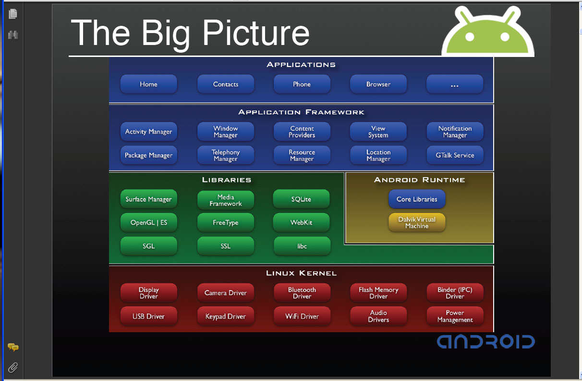
The Android Software Stack

Slide 12
Android Application Development
Android
SDK
Eclipse IDE
Android
Mobile
Device
Android
Emulator

Slide 13
iOS Application Development
iOS
SDK
XCODE IDE
iOS
Mobile
Device
iOS
Simulator

Slide 14
Android development
Java Source
Android Manifest
Generated Class
Java Compiler
.dex
File
Dalvik
VM
Resource XML
Android Libraries

Slide 15
iOS development
Xcode
Objective C Source
Interface Builder
.xib file
Objective C Compiler
.
Simulator or Device
Foundation Framework
Cocoa Libraries

