Slide 1

Power BI
Empower your business with Power BI, a powerful data visualization and business intelligence tool, helping you make informed decisions and drive success.

Slide 2

The Power of Power BI
1
Data Insights 📊
2
Real-Time Monitoring ⏰
3
Collaborative Analytics 👥
Unlock valuable insights from your data, allowing you to make data-driven decisions that propel your business forward.
Stay informed with live data updates, providing you with up-to-the-minute information on key metrics and performance.
Enable seamless collaboration and knowledge sharing across teams, fostering a data-driven culture within your organization.

Slide 3
Unleash the Features
Interactive Dashboards
Data Transformations
Advanced Analytics
Uncover hidden patterns, trends, and outliers with easy-to-use machine learning capabilities and data exploration tools.
Easily create visually stunning and interactive dashboards to monitor key performance indicators and track business goals.
Effortlessly shape and transform your data using Power Query, ensuring it's cleaned, structured, and ready for analysis.

Slide 4

Get Started Today
1
Connect to Data Sources
Import data from various sources including Excel, SQL databases, and cloud services to create a comprehensive data model.
2
Create Stunning Visuals
Drag and drop elements onto your canvas to build interactive visuals, such as charts, maps, and tables, without any coding.
3
Share and Collaborate
Publish your reports and dashboards to the Power BI service to securely share and collaborate with colleagues across devices.

Slide 5

Powerful Data Analysis and Visualization
Drill-Down Capabilities
Automated Reports
Natural Language Queries
Create scheduled and automated reports to keep key stakeholders informed without the hassle of manual data extraction and updates.
Navigate deep into your data hierarchy, exploring multiple levels of detail with a simple click or zoom.
Ask questions in plain, everyday language and let Power BI generate visualizations that accurately answer your queries.

Slide 6


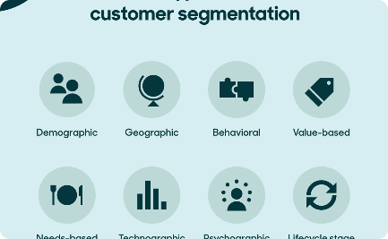
Power BI in Action
Revenue Growth Analysis
Supply Chain Optimization
Customer Segmentation
Segment customers based on demographics, behavior, and purchasing patterns to customize marketing strategies.
Visualize revenue growth trends over time, identify key drivers, and analyze the impact of marketing campaigns.
Monitor inventory levels, track supplier performance, and identify bottlenecks for efficient supply chain management.

Slide 7
Conclusion: Harness the Power of Power BI
1
Competitive Advantage
2
User-Friendly Interface
3
Continuous Innovation
Gain a competitive edge by leveraging Power BI's capabilities to transform data into actionable insights.
Enjoy a user-friendly interface that empowers both technical and non-technical users to analyze data effectively.
Stay ahead with regular updates, new features, and a vibrant community of Power BI enthusiasts.

