Slide 1



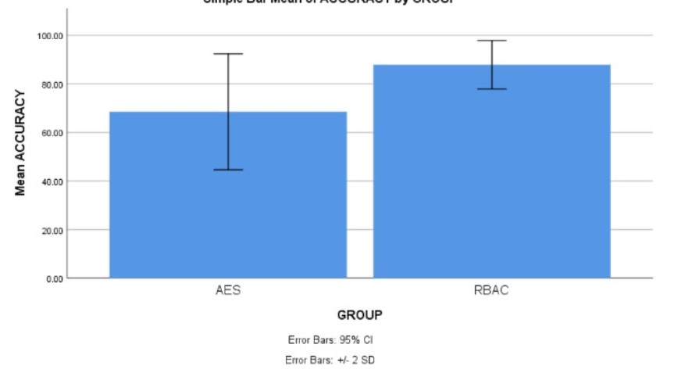
Name: Mr. G. Venkata Mohan Krishna
Register Number: 192110173
Guided by Dr. D. Manikavelan
Ms. Poorani.S
Guided by Dr. Mary Valantina. G
Enhancing Cloud Storage Security: A Comparative Study of Traceable Authentication Retrieval system with RBAC and AES Algorithm
Improving the accuracy in enhancing the cloud storage security is the major goal of this study. The aim of this study is to utilize Role Based Access Control Algorithms to improve the efficiency of enhancing cloud storage security using with improved accuracy.
This study embarks on a comparative journey to assess the strengths and weaknesses of RBAC and AES algorithms in the specific context of cloud storage security.
Concerns about the security of cloud storage have escalated due to the continuous growth in data volume and importance of stored in the cloud, leading to risks such as unauthorized access, data breaches, and privacy violations.
Through empirical testing and analysis, the study aims to demonstrate the advantages of the TAR system over existing security mechanisms and identify areas for further improvement.
The AES algorithm, renowned for its reliability and efficiency, plays a pivotal role in securing data both at rest and in transit.
INTRODUCTION
Fig.1 Cloud Services
MATERIALS AND METHODS
Connection Pooling-In high-traffic scenarios, constantly creating and closing connections can be inefficient.It manages a pool of pre-opened connections for reuse, improving performance.The client application uses the driver and connection string to establish a connection with the database server.
User Credentials are login credentials or account details, information that verify who you are when you access a computer program, website, or online service
Data Analysis-Involves gathering relevant data from various sources, ensuring its quality and accuracy.Raw data often contains errors
Modeling and analysis are two sides of the same coin in various fields, including computer science, engineering, research, and business. They work together to gain insights, solve problems, and make informed decisions
Database connectivity is to be established communication channel between a software application (client) and a database server that allows the application to access, manipulate, and stores the data
Evaluation of Accuracy in Enhancing Cloud Storage Security
Fig.2 Implementation of Traceable Authentication with RBAC, and AES for storing of User Credentials
RESULTS
Tab 1: Mean, Standard Deviation and Standard error mean with a accuracy rate comparison of Role Based Access Control and Advanced Encryption Standard
Tab 2:Significant Threshold value of accuracy comparison of Role Based Access Control and Advanced Encryption Standard
Algorithm | F | Sig. | t | df | Sig(2-Tailed) | Mean Diff | Std. Error Difference | Lower | Upper
Equal Variances Assumed | 6.413 | .016 | 6.687 | 38 | .000 | 19.35000 | 28.9353 | 13.49236 | 25.20764
Equal Variances Not Assumed |  |  | 6.687 | 25.493 | 0.000 | 19.35000 | 28.9353 | 13.39651 | 25.30349
Algorithm | N | Mean | Std. Deviation | Std. Error Mean
RBAC | 20 | 87.8500% | 5.00815 | 1.11986
AES | 20 | 68.5000% | 11.93182 | 2.66804
Fig.3 Statistical calculations for the Role Based Access Control and Advanced Encryption Standard.
DISCUSSION AND CONCLUSION
Based on T-test Statistical analysis, the significance value of p=0.038 (independent sample T - test p<0.05) is obtained and shows that there is a statistical significant difference between the group 1 and group 2.From the work , it is concluded that the RBAC algorithm attains the high accuracy comparing with other AES encryption.
Overall , the accuracy of the Role Based Access Control(RBAC) is 87.85% and it is better than the other algorithm. Advanced Encryption Standard(AES) is 78.25%.In the present work, Role Based Access Control(RBAC) is compared with Advanced Encryption Standard(AES) and it depicts that the proposed algorithm gives more accuracy when compared with the rest.It's important to note that this study compared Role Based Access Controlonly with Advanced Encryption Standard.
From the work , it is concluded that the Role Based Access Control algorithm attains the high accuracy when comparing with other Advanced Encryption Standard Algorithms in Enhancing Cloud Storage Security .Further research could explore how RBAC stacks up against other encryption algorithms and consider implementing.
Overall, this study aimed to improve cloud storage security by evaluating RBAC against AES. The results indicate that RBAC is a promising approach for achieving this goal. Future research can delve deeper into how RBAC interacts with other security measures to create an even more robust cloud storage security system.
BIBLIOGRAPHY
Daemen, Joan, and Vincent Rijmen. 2013. The Design of Rijndael: AES - The Advanced Encryption Standard. Springer Science & Business Media.
Li, Kuan-Ching, Qing Li, and Timothy K. Shih. 2014. Cloud Computing and Digital Media: Fundamentals, Techniques, and Applications. CRC Press.
Sheik, Al Tariq, Carsten Maple, Gregory Epiphaniou, and Mehrdad Dianati. 2023. “Securing Cloud-Assisted Connected and Autonomous Vehicles: An In-Depth Threat Analysis and Risk Assessment.” Sensors 24 (1).
Figueroa-Lorenzo, Santiago, Javier Añorga, and Saioa Arrizabalaga. 2019. “A Role-Based Access Control Model in Modbus SCADA Systems. A Centralized Model Approach.” Sensors 19 (20). https://doi.org/10.3390/s19204455.
Sheik, Al Tariq, Carsten Maple, Gregory Epiphaniou, and Mehrdad Dianati. 2023. “Securing Cloud-Assisted Connected and Autonomous Vehicles: An In-Depth Threat Analysis and Risk Assessment.” Sensors 24 (1). https://doi.org/10.3390/s24010241.

