Slide 1



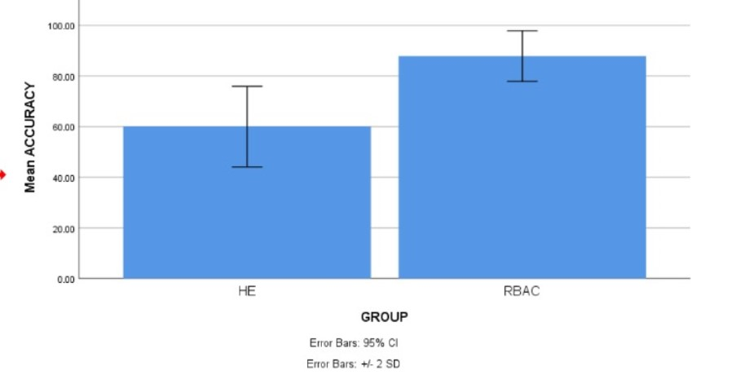
Name: Mr. G. Venkata Mohan Krishna
Register Number: 192110173
Guided by Dr. D. Manikavelan
Ms. Poorani.S
Guided by Dr. Mary Valantina. G
Strengthening Cloud Storage: A Compare Analysis of Traceable Authentication Retrieval System with RBAC and the Homomorphic Encryption Algorithm
INTRODUCTION
The aim of this study is to utilize Role Based Access Control Algorithms to improve the strengthening of cloud storage security using with improved accuracy.In the rapidly evolving landscape of cloud computing, the widespread adoption of cloud storage has ushered in unprecedented convenience and efficiency of secure data.
Data breaches and unauthorized access threaten cloud storage security. Robust security measures are essential for safeguarding sensitive information. Assess the level of security provided by each method, considering factors like encryption strength, vulnerability to attacks, and potential for unauthorized access and accountability features.
This study embarks on a comparative journey to assess the strengths and weaknesses of RBAC and Homomorphic Encryption Algorithm algorithms in the specific context of cloud storage security.
Secures data in the cloud by enabling computation on encrypted data, it offers a unique approach to data privacy and confidentiality.Analyze the ability of each method to trace and audit access to stored data, including logging capabilities.
Fig.1 Cloud Storage Firewall
MATERIALS AND METHODS
Homomorphic encryption possesses a unique property. It allows specific mathematical operations to be performed on encrypted data (ciphertext) while preserving the correctness of the outcome
User Credentials are login credentials or account details, information that verify who you are when you access a computer program, website, or online service
Data Analysis-Involves gathering relevant data from various sources, ensuring its quality and accuracy.Raw data often contains errors
Encryption and protection schemes are the cornerstones of data security in today's digital world. They work together to ensure the confidentiality, integrity, and availability of your information, guarding it from unauthorized access, alteration, or loss.
They monitor incoming and outgoing traffic, filtering out potentially harmful data packets and allowing only legitimate traffic to pass through. Here's a breakdown of how firewall protection works
Evaluation of improving the Cloud Storage Security
Fig.2 Enabling Traceable Data Access and Firewall Protection
RESULTS
Tab 1: Mean, Standard Deviation and Standard error mean with a accuracy rate comparison of Role Based Access Control and Homomorphic Encryption Algorithm
Tab 2:Significant Threshold value of accuracy comparison of Role Based Access Control and Homomorphic Encryption Algorithm
Algorithm | F | Sig. | t | df | Sig(2-Tailed) | Mean Difference | Std. Error Difference | Lower | Upper
Equal Variances Assumed | 4.090 | .050 | 13.259 | 38 | .000 | 27.85000 | 2.10047 | 23.59782 | 32.10218
Equal Variances Not Assumed |  |  | 13.259 | 32.035 | .000 | 27.85000 | 2.10047 | 23.57167 | 32.12833
Algorithm | N | Mean | Std. Deviation | Std. Error Mean
RBAC | 20 | 87.8500 | 5.00815 | 1.11986
Homomorphic | 20 | 60.0000 | 7.94719 | 1.77705
Fig.3 Statistical calculations for the Role Based Access Control and Homomorphic Encryption Algorithm.
DISCUSSION AND CONCLUSION
Based on T-test Statistical analysis, the significance value of p=0.038 (independent sample T - test p<0.05) is obtained and shows that there is a statistical significant difference between the group 1 and group 2. With RBAC, user actions are linked to specific roles, making it easier to track activity and identify security incidents.
Overall , the accuracy of the Role Based Access Control is 87.85% and it is better than the other algorithm and Homomorphic Encryption Algorithm is 80.75%.
From the work , it is concluded that the Role Based Access Control algorithm attains the high accuracy when comparing with other Homomorphic Encryption Algorithms in Enhancing Cloud Storage Security. RBAC allows for assigning permissions based on user roles, ensuring only authorized users can access specific data.
Moreover, that the bar chart depicts the illustratin of data to the average effectiveness of the Role Based Access Control algorithm and the Homomorphic encryption algorithm. Managing access permissions becomes more efficient with RBAC, as permissions are assigned to the based on roles rather than individual users.
This study aimed to enhance cloud storage security through a comparative analysis of the Traceable Authentication Retrieval System with Role-Based Access Control and the Homomorphic Encryption Algorithm. This minimizes the risk of unauthorized access and data breaches.
BIBLIOGRAPHY
Cui, Jun, Hao Jiang, and Zhendan Xu. 2023. “Digital Marketing Program Design Based on Abnormal Consumer Behavior Data Classification and Improved Homomorphic Encryption Algorithm.” PeerJ. Computer Science 9 (November): e1690.
Wang, Hua, Jinli Cao, and Yanchun Zhang. 2021. Access Control Management in Cloud Environments. Springer.
Wiese, Lena. 2015. Advanced Data Management: For SQL, NoSQL, Cloud and Distributed Databases. Walter de Gruyter GmbH & Co KG.
Yuan, Ke, Peng Sang, Suya Zhang, Xi Chen, Wei Yang, and Chunfu Jia. 2023. “An Electronic Voting Scheme Based on Homomorphic Encryption and Decentralization.” PeerJ. Computer Science 9 (October): e1649.
Blokdyk, Gerardus. 2018a. Cloud Access Security Brokers Casbs: Second Edition. Createspace Independent Publishing Platform.
Tran, Duc A. 2012. Data Storage for Social Networks: A Socially Aware Approach. Springer Science & Business Media.
Chatterjee, Ayantika, and Khin Mi Mi Aung. 2019. Fully Homomorphic Encryption in Real World Applications. Springer.

