Slide 1


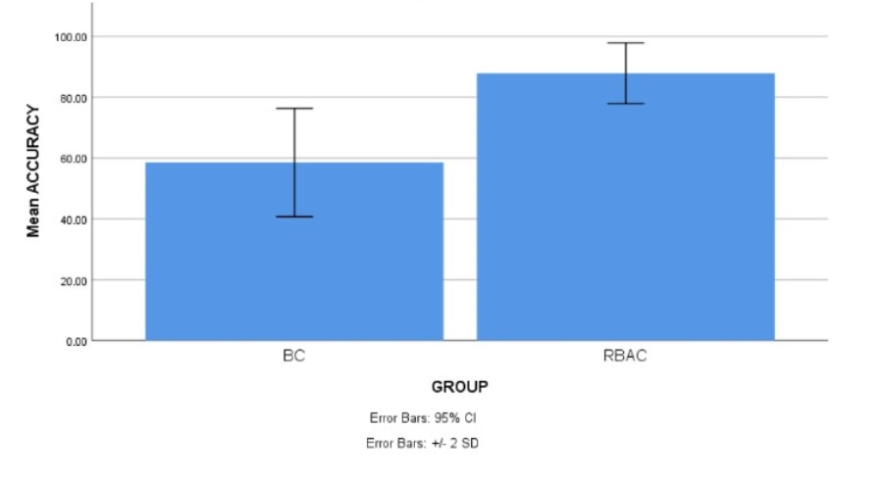
Name: Mr. G. Venkata Mohan Krishna
Register Number: 192110173
Guided by Dr. D. Manikavelan
Ms. Poorani.S
Guided by Dr. Mary Valantina. G
Strengthening Cloud Storage: A Compare Analysis of Traceable Authentication Retrieval System with RBAC and the BlockChain Algorithm
INTRODUCTION
The aim of this study is to utilize Role Based Access Control Algorithms to improve the strength of the cloud storage security using with improved accuracy.Cloud storage has become an integral part of modern data management systems, offering scalability, accessibility, and cost-effectiveness for storing vast amounts of data.
This study embarks on comparative journey to assess the strengths and weaknesses of RBAC and BlockChain algorithms in the specific context of cloud storage security.Innovative solutions are necessary to enhance data integrity and confidentiality, that requires the robust security mechanisms to address inherent risks.
Aims to strengthen security within cloud storage environments and to utilizes decentralized ledger technology to enhance data security and integrity.
This study delves into the intricacies of securing cloud storage through a comprehensive evaluation, focusing on a novel approach of the amalgamating Role-Based Access Control and Blockchain Algorithm.
Fig.1 Cloud Storage Security
MATERIALS AND METHODS
Data validation in a database is the process of ensuring that the information being entered or stored meets specific criteria. It's a crucial step that helps maintain data integrity, accuracy, and consistency within your database.
User Credentials are login credentials or account details, information that verify who you are when you access a computer program, website, or online service
Data Analysis-Involves gathering relevant data from various sources, ensuring its quality and accuracy.Raw data often contains errors
Verifying credentials is like checking IDs at a door. It confirms a user's identity (username, password, fingerprint) and access rights before granting entry to systems or information. This keeps unauthorized users out and protects sensitive data.
Protocol Analyzers are more sophisticated tools that go beyond capturing raw data. They decode the protocol information within packets, presenting it in a human-readable format for easier analysis.
Implementation of Accuracy in
Cloud Storage Security
Fig.2 Blockchain-Enabled Data Transaction Flow (Access/Modification) in the Cloud Storage Security
RESULTS
Tab 1: Mean, Standard Deviation and Standard error mean with a accuracy rate comparison of Role Based Access Control and BlockChain Algorithm.
Tab 2:Significant Threshold value of accuracy comparison of Role Based Access Control and BlockChain Algorithm.
Algorithm | N | Mean | Std. Deviation | Std. Error Mean
RBAC | 20 | 87.8985 | 5.07509 | 1.13483
BlockChain | 20 | 61.9320 | 12.23028 | 2.73477
Algorithm | F | Sig. | t | df | Sig(2-Tailed) | Mean Difference | Std.Error Difference | Lower | Upper
Equal Variances Assumed | 5.971 | .019 | 8.770 | 38 | .000 | 25.96650 | 2.96088 | 19.97251 | 31.969
Equal Variances Not Assumed |  |  | 8.770 | 25.355 | .000 | 25.96650 | 2.96088 | 19.87277 | 32.06023
Fig.3 Statistical calculations for the Role Based Access Control and BlockChain Algorithm.
DISCUSSION AND CONCLUSION
Based on T-test Statistical analysis, the significance value of p=0.038 (independent sample T - test p<0.05) is obtained and shows there is statistical significant difference between the group 1 and group 2.If p-value is less than 0.05, we can reject the null hypothesis and conclude that statistically significant difference exists between groups.
Overall , the accuracy of the Role Based Access Control(RBAC) is 87.85% and it is better than the other algorithm. Blockchain Algorithm - 81%.From the work ,it is concluded that Role Based Access Control algorithm attains the high accuracy when comparing with other Blockchain Algorithms in Enhancing Cloud Storage Security.
The statistical analysis supports the claim that the Traceable Authentication Retrieval System with its integration of a Blockchain Algorithm, is more effective in mitigating data breach incidents within cloud storage environments.Further research is needed to explore this effectiveness against real-world data breaches.
The study provides valuable insights, certain limitations merit consideration on more extensive and nuanced dataset could be enhance the model's predictive capabilities.
The statistical analysis supports the potentially of the integrated with a Blockchain Algorithm for mitigating data breach incidents within cloud storage environments.
BIBLIOGRAPHY
Aliyu, Ahmed Abubakar, and Jinshuo Liu. 2023. “Blockchain-Based Smart Farm Security Framework for the Internet of Things.” Sensors 23 (18).
Ananth Kumar, T., T. S. Arun Samuel, R. Dinesh Jackson Samuel, and M. Niranjana Murthy. 2022. Privacy and Security Challenges in Cloud Computing: A Holistic Approach. CRC Press.Nepal, Surya, and Mukaddim Pathan. 2013. Security, Privacy and Trust in Cloud Systems. Springer Science & Business Media.
Pescatore, Fred, Carmelo Prestano, and Malka Kichikova. 2022. “RBAC and Its Role with the Immune System.” Alternative Therapies in Health and Medicine 28 (1): 8–10.
Balamurugan, K. M., S. Rakesh Kumar, Abhishek Kumar, Vishal Kumar, and Sanjeevikumar Padmanaban. 2021. Blockchain Security in Cloud Computing. Springer Nature.
Mariano, Ermie, Jr, Da Young Lee, Seung Hyeon Yun, Juhyun Lee, Seung Yun Lee, and Sun Jin Hur. 2023. “Checkmeat: A Review on the Applicability of Conventional Meat Authentication Techniques to Cultured Meat.” Food Science of Animal Resources 43 (6): 1055–66. Pehcevski, Jovan. 2020. Security of Cloud-Based Systems. Arcler Press.
Cui, Zibin, Xiangdong Liu, Zehua Feng, and Zhengzong Huang. 2024. “Blockchain Adoption for Generic Drugs in the Medicine Supply Chain with Consumers’ Risk-Aversion: A Game-Theoretic Model Within Chinese Legal Framework.” Risk Management and Healthcare Policy 17 (January): 15–28.

