Slide 1


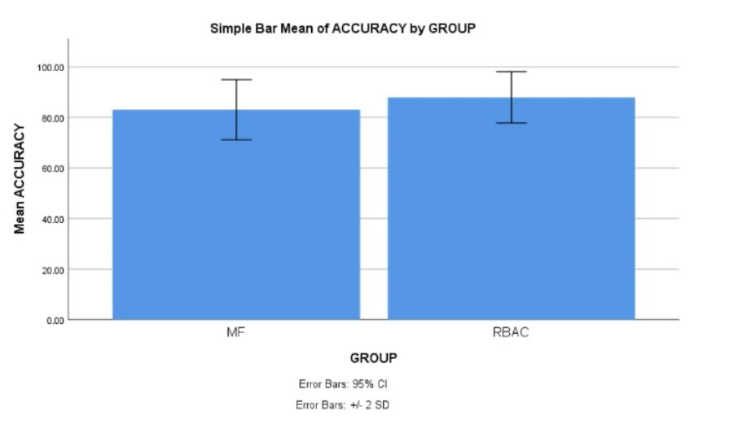
Name: Mr.G.Venkata Mohan Krishna
Register Number: 192110173
Guided by Dr. D. Manikavelan
Ms. Poorani.S
Guided by Dr. Mary Valantina. G
Exploring Cloud Storage Security Measures: A Comparative Study of Traceable Authentication Retrieval System with RBAC and Multi-factor Authentication Algorithm
The aim of this study is to utilize Role Based Access Control Algorithms to improve the strength of the cloud storage security using with improved accuracy.And adoption of cloud storage continues to soar, ensuring robust security measures is paramount to safeguarding sensitive data against unauthorized access and breaches.
This study embarks on a comparative journey to assess the strengths and weaknesses of RBAC and Multi-factor Authentication Algorithm in the specific context of cloud storage security.
Assigning specific roles to users and enforcing access privileges based on their roles, this approach aims to mitigate unauthorized access and ensure accountability.The Multi-factor Authentication Algorithm enhances security by requiring users to provide multiple forms of identification before accessing cloud-stored data.
In this research study , RBAC algorithm is compared with Multi-Factor Authentication algorithm to enhance accuracy and adoption of cloud storage safeguarding sensitive data against unauthorized access and breaches.
INTRODUCTION
Fig.1 Cloud Database
MATERIALS AND METHODS
Firewalls are a critical line of defense in our digital world, acting as security guards for your computer or network. They constantly monitor incoming and outgoing traffic, filtering out potentially harmful data packets and allowing only legitimate traffic to pass through. Firewalls continuously examine data packets, which are small bundles of information traveling across the network.
User Credentials are login credentials or account details, information that verify who you are when you access a computer program, website, or online service
Data Analysis-Involves gathering relevant data from various sources, ensuring its quality and accuracy.Raw data often contains errors
User provides username
and password.
TARS verifies the authenticity of the login attempt.The system prompts for an additional verification factor through MFA.
Data access control is a fundamental security principle that governs how users and systems access data within a computer system or network.
Evaluation of Accuracy in Cloud Storage Security
Fig.2 Focuses on the management aspect of user access and User Access Management of data access flow
RESULTS
Tab 1: Mean, Standard Deviation and Standard error mean with a accuracy rate comparison of Role Based Access Control and Multi-factor Authentication Algorithm
Tab 2:Significant Threshold value of accuracy comparison of Role Based Access Control and Multi-factor Authentication Algorithm
Algorithm | F | Sig. | t | df | Sig(2-Tailed) | Mean Difference | Std. Error Difference | Lower | Upper
Equal Variances Assumed | .290 | .593 | 2.804 | 38 | .008 | 4.89850 | 1.74671 | 1.36248 | 8.43452
Equal Variances Not Assumed |  |  | 2.804 | 37.100 | .008 | 4.89850 | 1.74671 | 1.35966 | 8.43734
Group | N | Mean(%) | Std Deviation | Std. Error
RBAC | 20 | 87.8985 | 5.07509 | 1.13483
Multi-factor | 20 | 83.0000 | 5.93828 | 1.32784
Fig. 3 Statistical calculations for the Role Based Access Control and Multi-factor Authentication Algorithm
DISCUSSION AND CONCLUSION
Based on T-test Statistical analysis, the significance value of p=0.038 (independent sample T - test p<0.05) is obtained and shows that there is a statistical significant difference between the group 1 and group 2. The p-value (0.038) is less than the commonly accepted threshold of 0.05 for statistical significance.
Overall , the accuracy of the Role Based Access Control(RBAC) is 87.85% and it is better than the other algorithm.Multi-factor Authentication Algorithm is 83.01%.
The study demonstrates the effectiveness of Role Based Access Control in providing a balanced solution that addresses concerns without compromising the user-friendliness.The study evaluates RBAC's performance in comparison to be proposed, shedding light on its strengths and potential limitations of cloud storage security.
From the work , it is concluded that the Role Based Access Control algorithm attains the high accuracy when comparing with other Multi-factor Authentication Algorithms in enhancing Cloud Storage Security.It the high accuracy of Role Based Access Controlsuggests it can be a strong foundation for cloud storage security by ensuring users only access authorized data. It addresses security concerns without making the system too difficult to use.
BIBLIOGRAPHY
Ahmad, Wan Muhamad Amir, Basaruddin Ahmad, Sarimah Abdullah, and Nor Azlida Aleng Mohamad. n.d. Statistical Analysis Using SPSS for Health Sciences (Penerbit USM). Penerbit USM.
Akbulut, Yaman, Abdulkadir Sengur, Yanhui Guo, and Florentin Smarandache. n.d. NS-K-NN: Neutrosophic Set-Based K-Nearest Neighbors Classiﬁer. Infinite Study. Ewing, Jordan, Thomas Oommen, Jobin Thomas, Anush Kasaragod, Richard Dobson, Colin Brooks, Paramsothy Jayakumar, Michael Cole, and Tulga Ersal. 2023. “Terrain Characterization via Machine vs. Deep Learning Using Remote Sensing.” Sensors 23 (12).
Öberg, Lena-Maria. 2007. Traceable Information Systems: Factors That Improve Traceability Between Information and Processes Over Time.
Pescatore, Fred, Carmelo Prestano, and Malka Kichikova. 2022. “RBAC and Its Role with the Immune System.” Alternative Therapies in Health and Medicine 28 (1): 8–10.
Fischer-Hellmann, Klaus-Peter. 2012. Information Flow Based Security Control Beyond RBAC: How to Enable Fine-Grained Security Policy Enforcement in Business Processes beyond Limitations of Role-Based Access Control (RBAC). Springer Science & Business Media.

